Slide 1

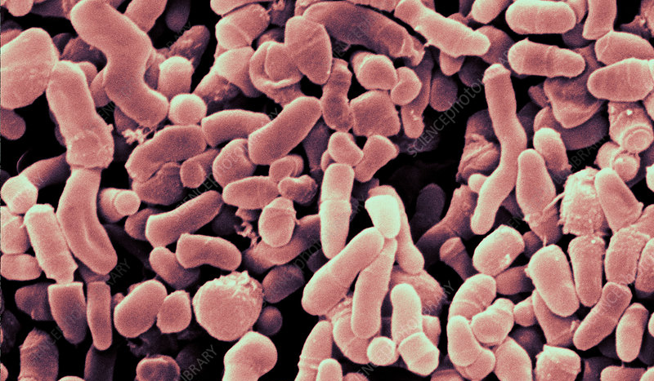
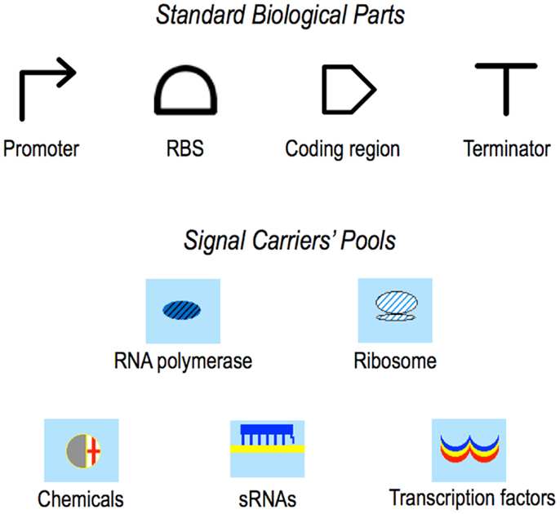






MICROBE MAKEOVER: REDUCING INFLAMMATION FROM HYDROLYSIS OF TRIGLYCERIDES
Elizabeth Hossack, Tia Makary, Camille Petit, Karin Schinkmann, Javin Oza
International School of Boston, Cambridge, MA, USA
Engineer S. epidermidis to secrete a peptide inhibitor that targets the lipase GehA, reducing inflammation and breakouts caused by P. acnes
Insert genetic circuits into E. coli, test inhibitor effectiveness using a pNPP assay, transfer the system to S. epidermidis
If the pNPP assay is successful, we will see a decrease in absorbance on the spectrophotometer
Result: the system will inhibit GehA → reduced sebum hydrolysis → lower inflammation and clearer skin
Propionibacterium acnes
Plasmid 1: Peptide Inhibitor Expression
Plasmid 2: GehA Lipase Production for Testing
Promoter (T7)
RBS
PelB Secretion Signal
Lipase Inhibitor Peptide
Terminator (T1)
Promoter (T7)
RBS
PelB Secretion Signal
GehA Lipase
His-Tag
Terminator (T1)

