Slide 1


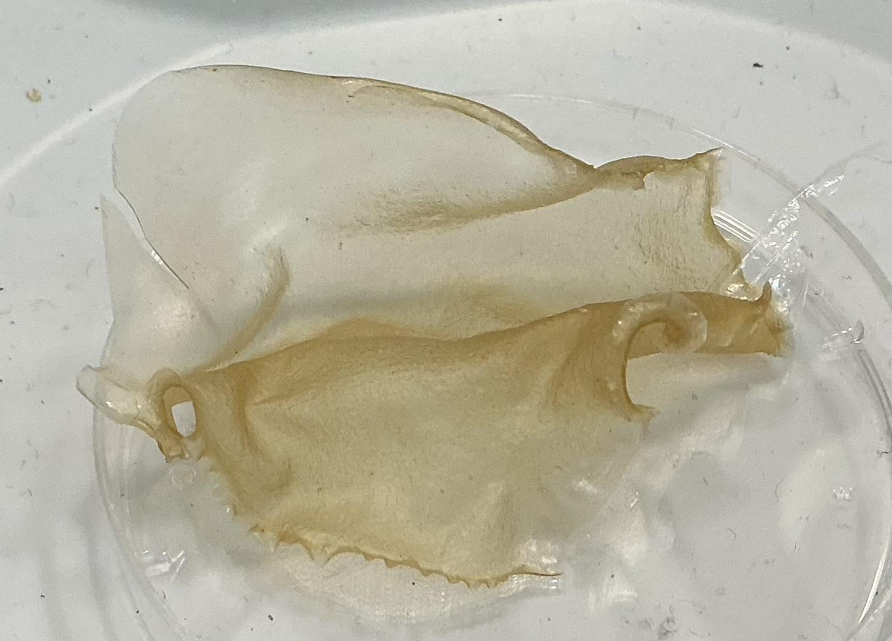
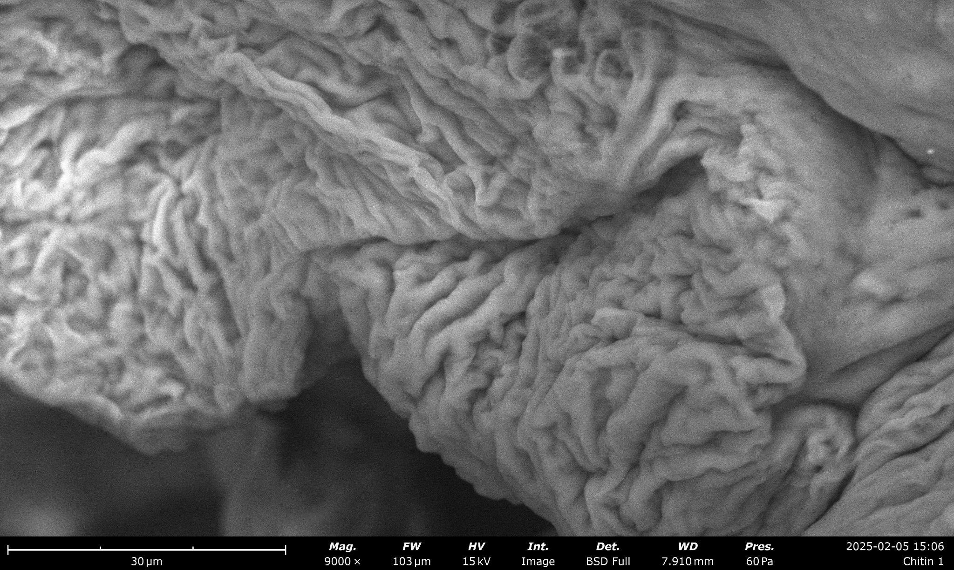
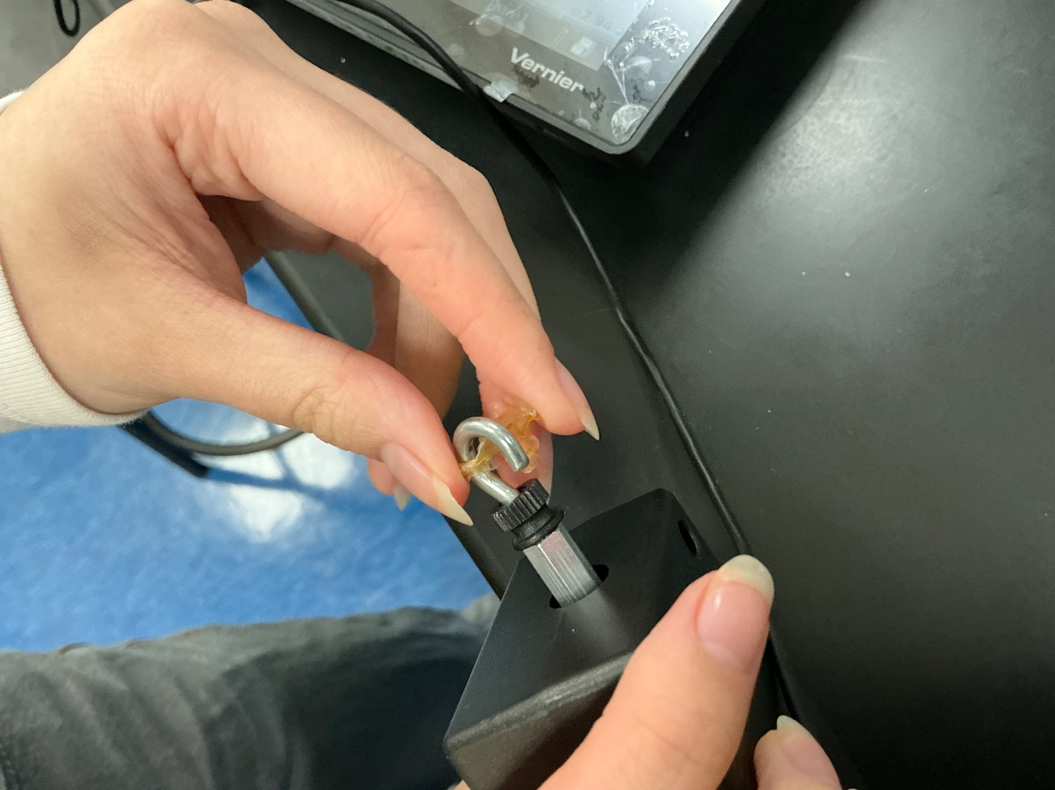
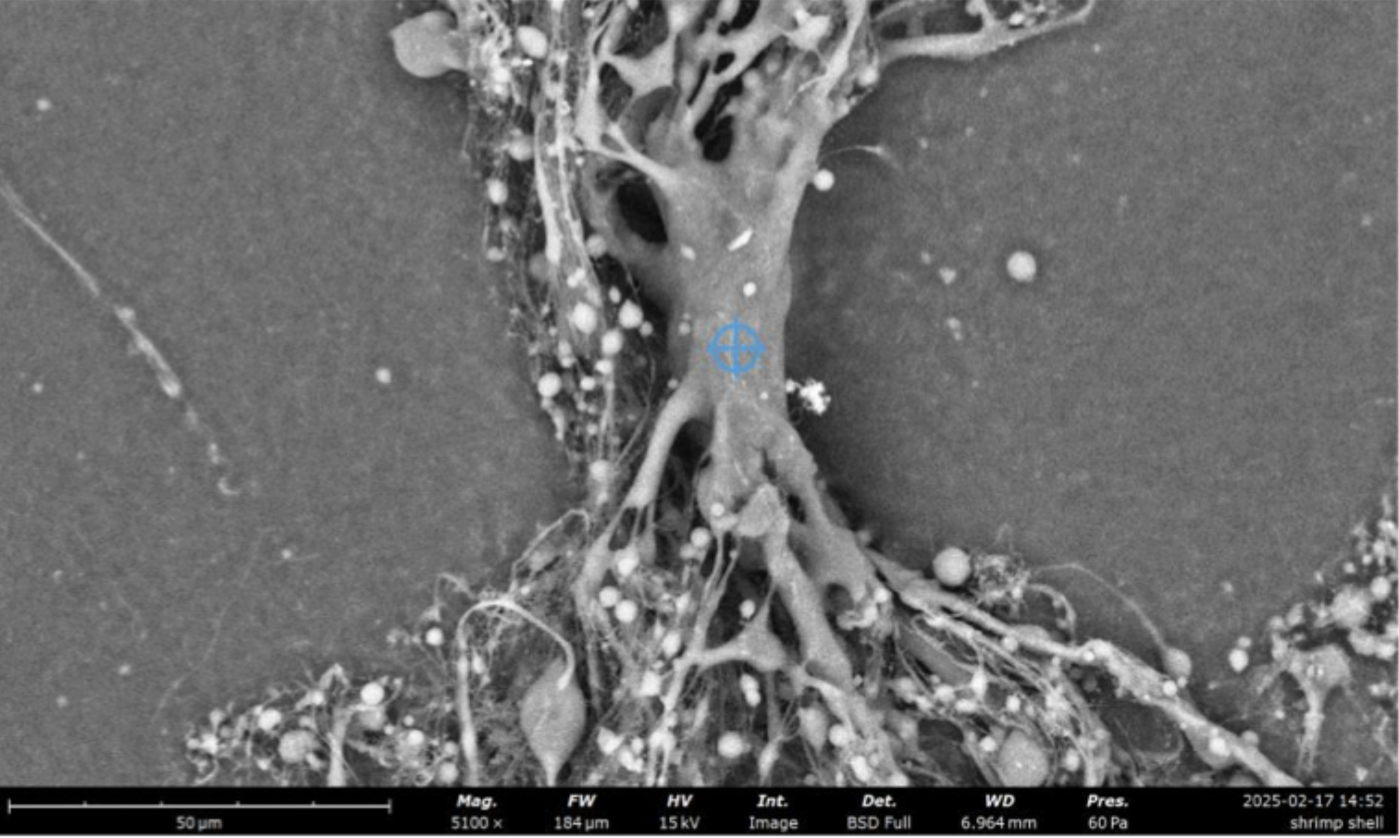
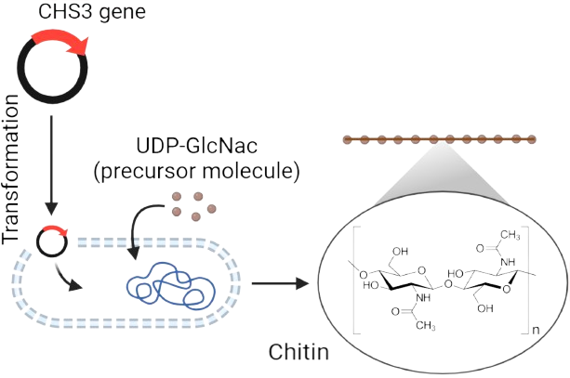
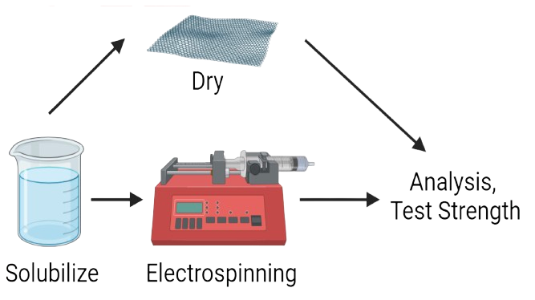






Fightin’ with Chitin
Mia Chen, Isabelle Lee, Audrey Loh, Megan Su, Caden Tan, Florence Wu, Dr. Hsu
Mentor: Ben French (Toledo)
Taipei American School, Taipei, Taiwan
OUR PROJECT
PRELIMINARY DATA
Problem: Kevlar in bulletproof vests is heavy and unbreathable
Solution: Create biosynthetic chitin from bacteria to replace Kevlar
Figure 1. Dried Chitosan Sheet
Figure 2. Dried Chitosan Sheet (SEM)
Figure 3. Tensile strength testing
Figure 4. Electrospun chitosan fibers (SEM)
EXPERIMENTAL PROCESS
Table 1. Tensile strength test data of a chitin strip
CHS3 gene
Trial # | Force (N)
1 | 24.30
2 | 47.16
3 | 57.89
4 | 48.58
5 | 40.68

