Slide 1


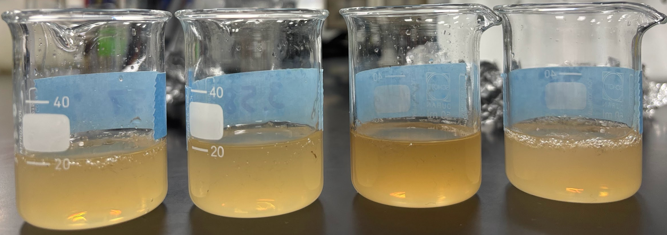
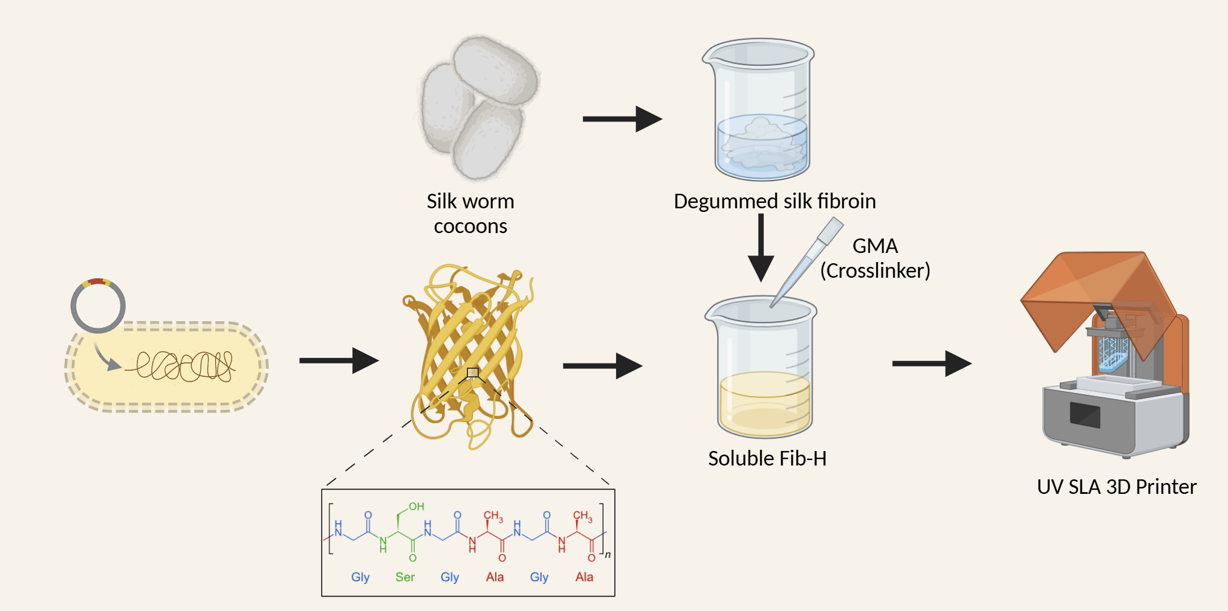
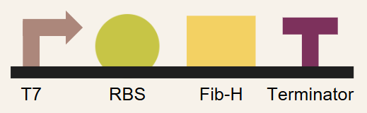
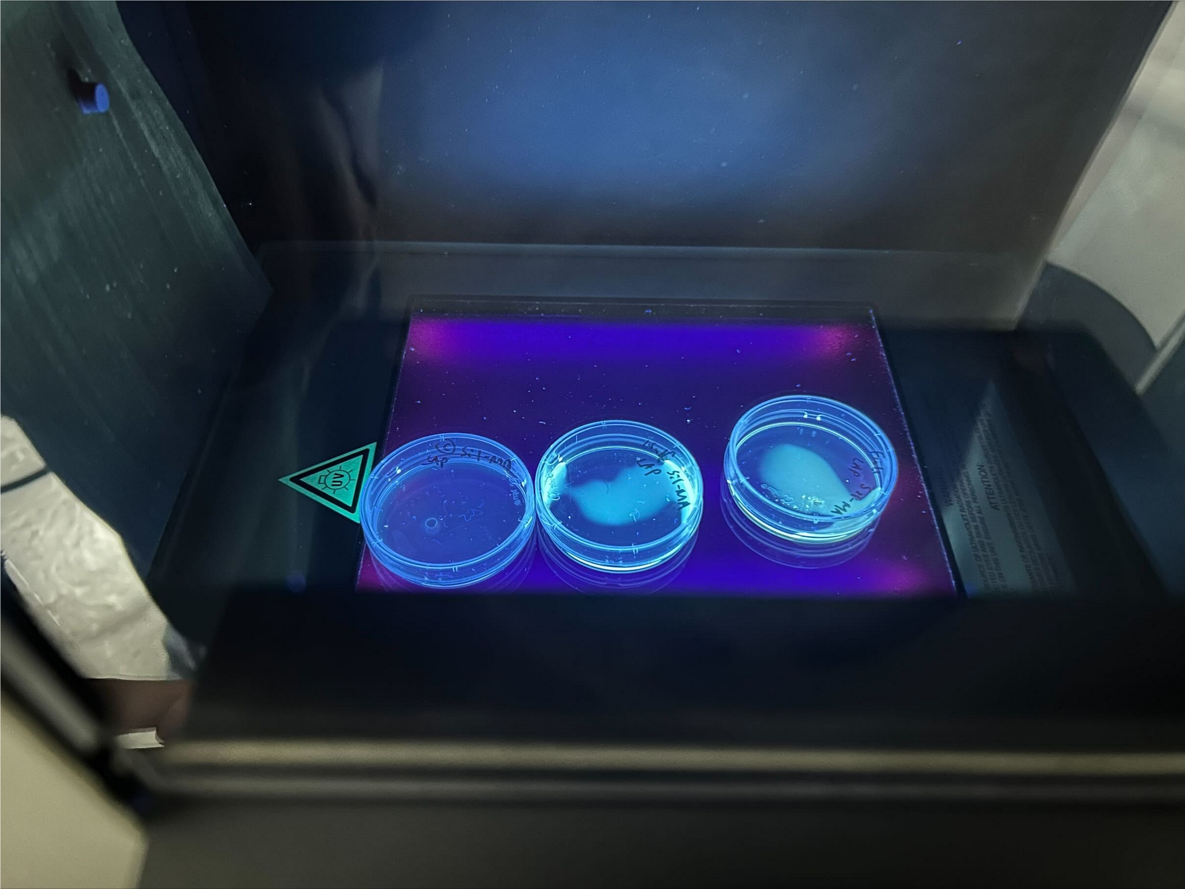






FibroGraft: Synthetic Silk Fibroin for Bone Graft
Angelina Kuo, Annie Chang, Cate Huang, Harriet Chi, Iris Yu, Jocelyn Weng, John Young, Lindsey Liaw, Ryan Chen, Sophie Yang, Dr. Hsu
Taipei American School, Taipei, Taiwan
Mentors: Dr. William Chen (University of South Dakota) & Amanda Ferrante (Northeastern)
Click here for audio
Problem: Bone grafts have a risk of rejection, carrying diseases, and poor integration in the body.
AIM: Combine synthetic biology and material engineering to develop a sustainable and effective silk-based bone graft to enhance bone regeneration.
Figure 2. Degummed and dissolved silk in LiBr
Figure 3. Successful UV photo-crosslinked silk fibroin
Figure 1. Project Flowchart
No LAP
~1-5 mgs
~6-10 mgs

