Slide 1

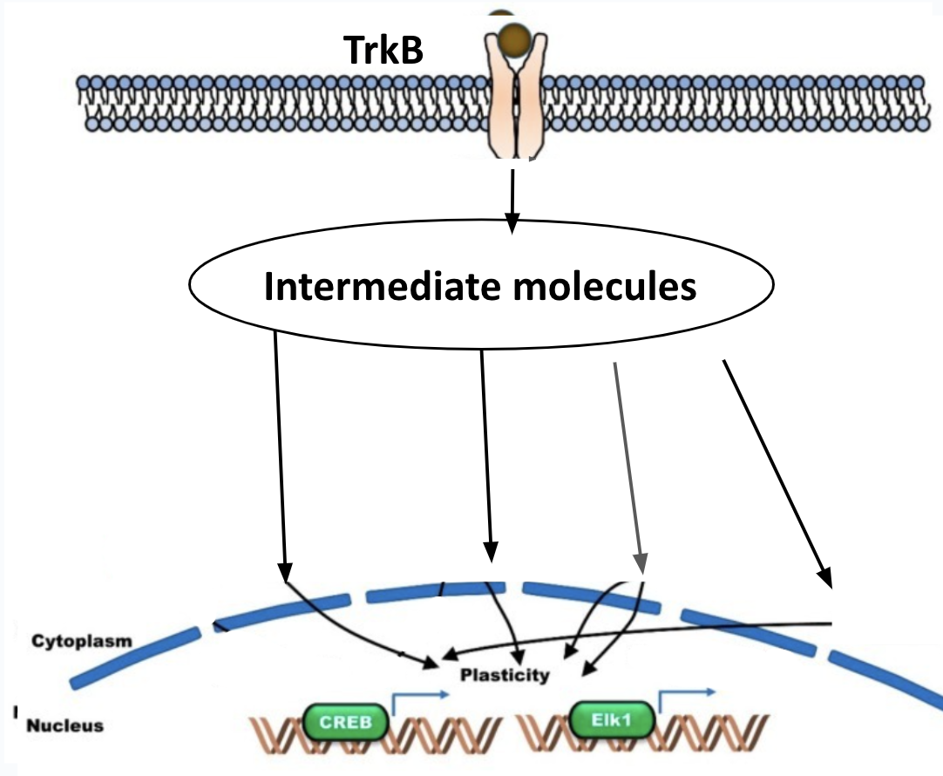
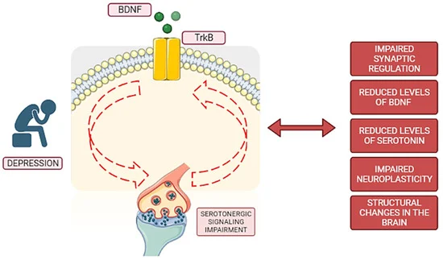







Accelerating Neuroplasticity in Antidepressants
Miley Arora, Serena Ma, Dr. Lindsey L’Ecuyer, Madi Garton (UCB)
Andover High School, Andover, MA, United States
Objective: Decrease the time it takes for patients with depression to see an improvement in their mood while taking antidepressants
We plan to engineer patients’ mesenchymal stem cells (MSCs) with BDNF to improve neuroplasticity
Limitation of access to real patients and testing treatment
We expect varied results in patients because of the diverse ways that depression manifests
BDNF-TrkB Pathway supporting neuroplasticity
Simplified BDNF and serotonin interaction. BDNF interacts with the TrkB receptor.

