Slide 1

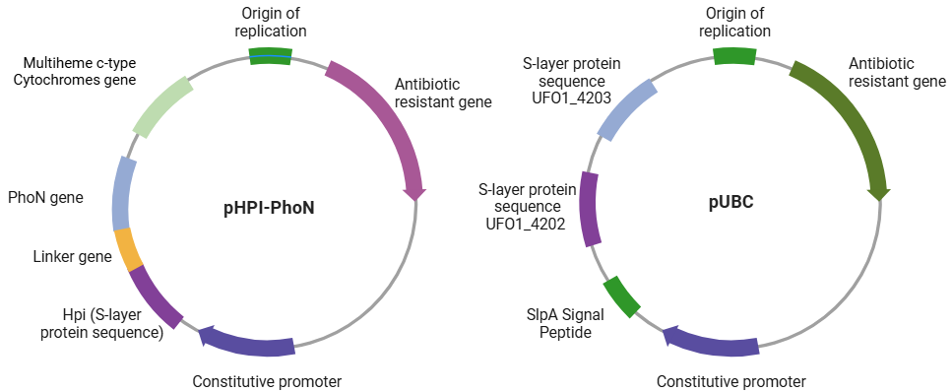
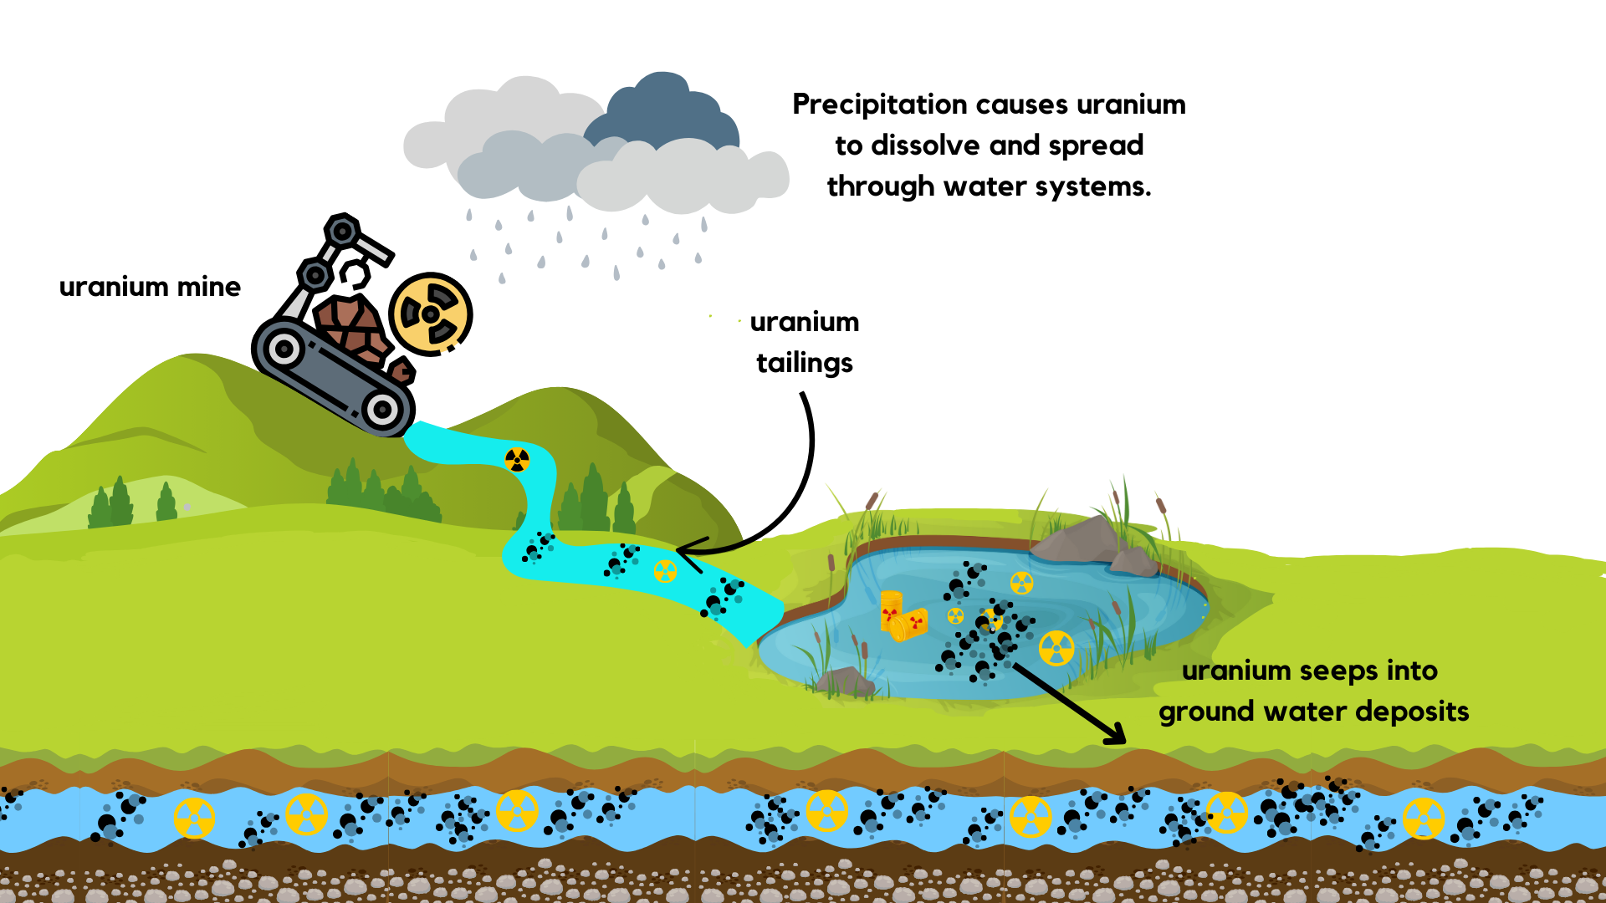
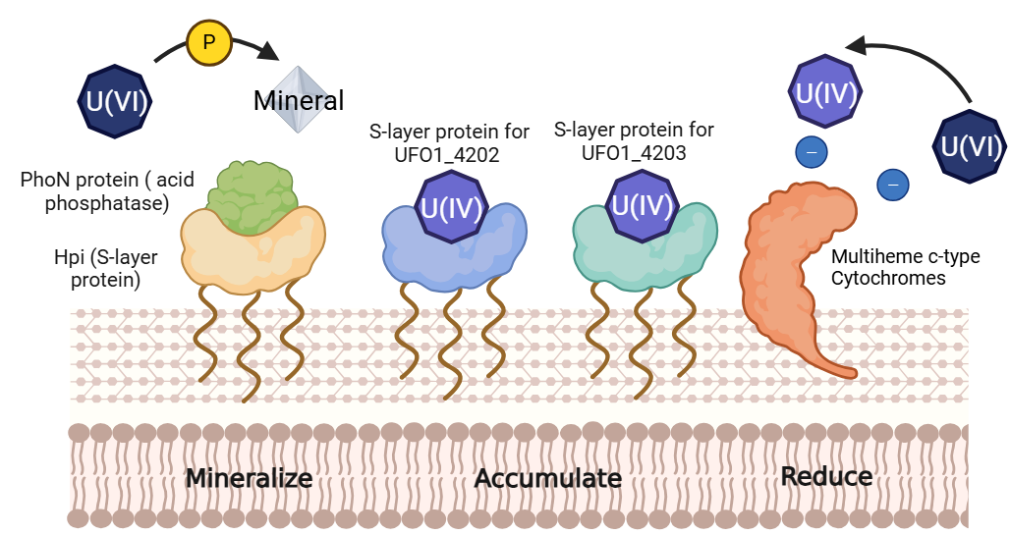






Remediation of Uranium via a Novel Deinococcus radiodurans Construct
Isabella Haslinger Johnson, Sofia Kovačević, Aparajita Shimpi, Lingzhen Wang, Wen Xiao, Dr. Beth Pethel, Dr. Jason Boock (Miami University)
Western Reserve Academy, Hudson, OH, USA
Objective
To engineer Deinococcus radiodurans as a versatile, cost-effective, and sustainable uranium remediation system by enhancing its ability to reduce, accumulate, and mineralize uranium in contaminated wastewater.
To introduce a fusion protein combining the S-layer protein with PhoN (acid phosphatase) for uranium precipitation, a multiheme c-type cytochromes to reduce U(VI) to U(IV), and uranium binding complex (UBC) from Pelosinus sp. strain UFO1 to immobilize uranium.

