Slide 1


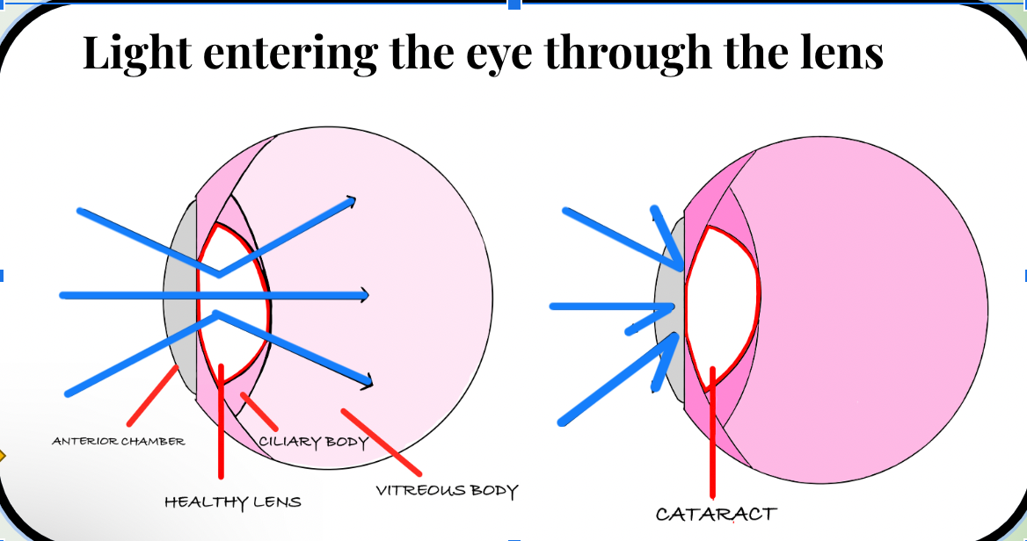
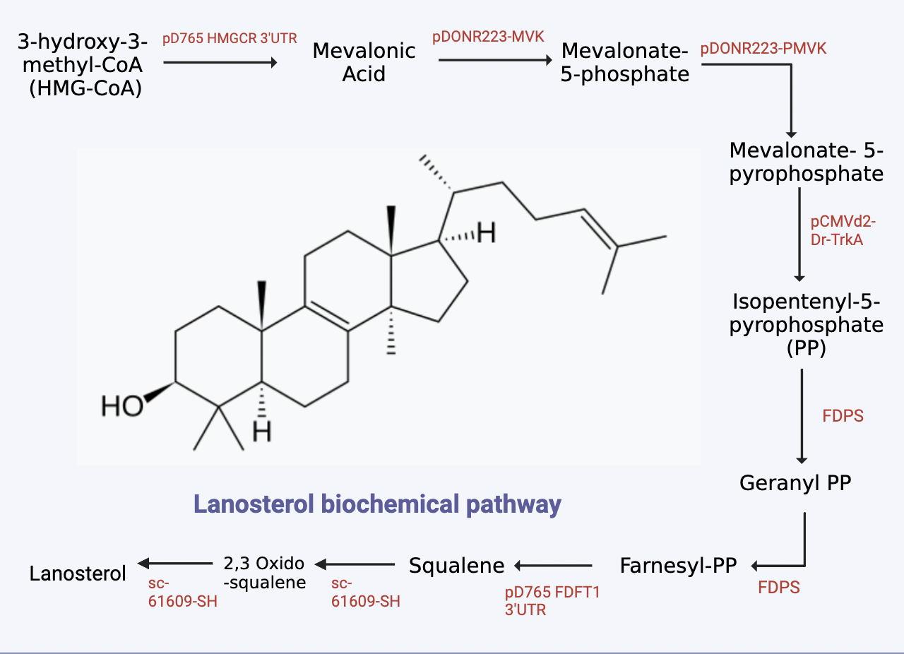





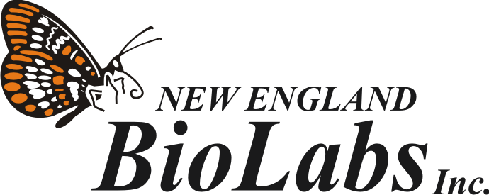

Innovative Enzyme-Based Yeast Therapy for Lifelong Cataract Prevention in Canines
Daryn Amos, Yunwoo Choi, Phalak Dhingra, Suzanna Gebhart, Dongyeon Kim, Xochi Nandi, Dr. Beth Pethel, Dr. Kissaou Tchedre (Austin Community College), Western Reserve Academy, Hudson, Ohio, United States
Problem: Cataracts are a common disease in dogs, causing vision impairment, extreme pain, and discomfort. Treatments including surgery – are effective but costly – $2,700 to $4,000 – making them inaccessible to most pet owners.
Solution: A preventative treatment utilizing a genetically modified yeast system that continuously aids lanosterol production throughout the animal's eyes after birth. Lanosterol, a naturally occurring tetracyclic triterpenoid in the eye, has shown great potential in reversing the aggregation of proteins within the eye and thus restoring lens transparency. We intend for this treatment to be administered at birth and would live in the eye to be able to produce lanosterol constantly.
Chemical Structure and Biochemical Pathway of Lanosterol
Notes:
Bold words on eye image, make bigger
Add genetic design to the slide

