Slide 1


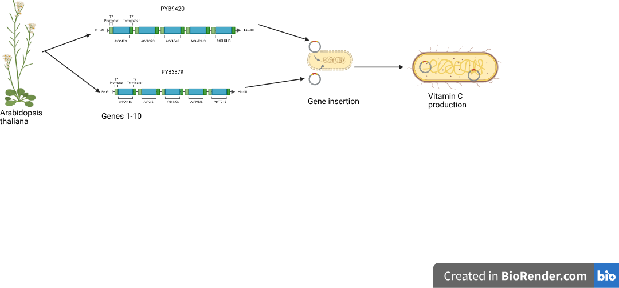
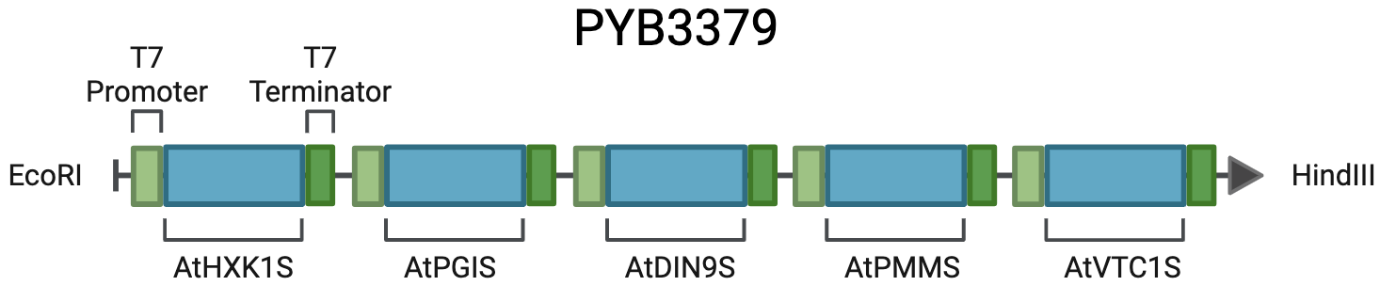
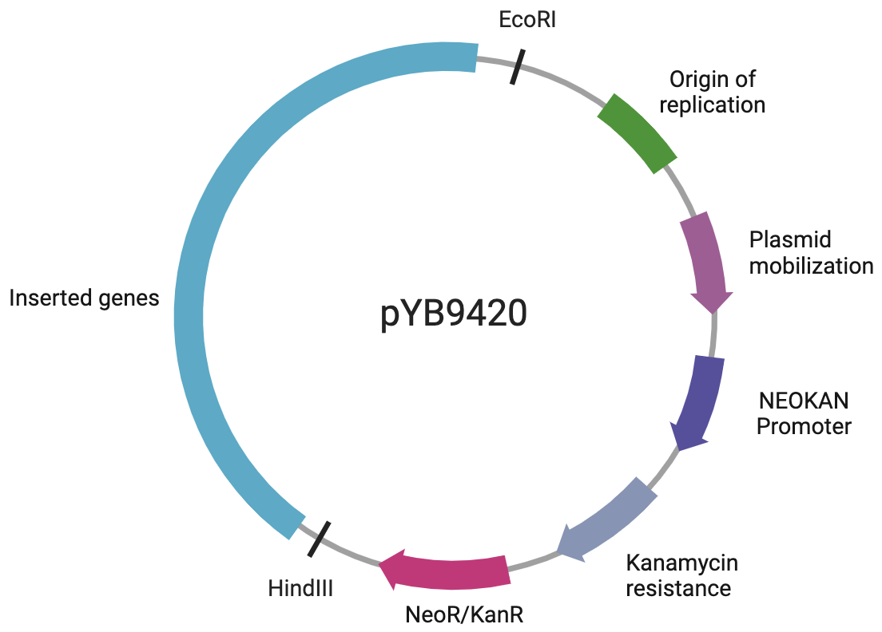
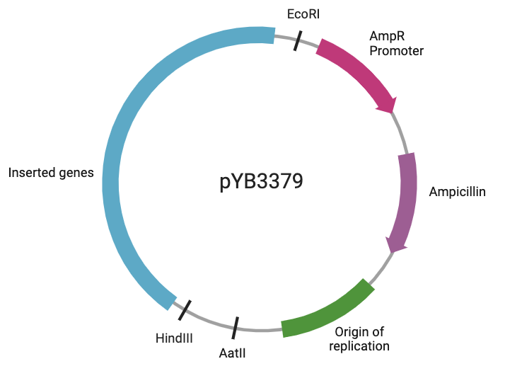
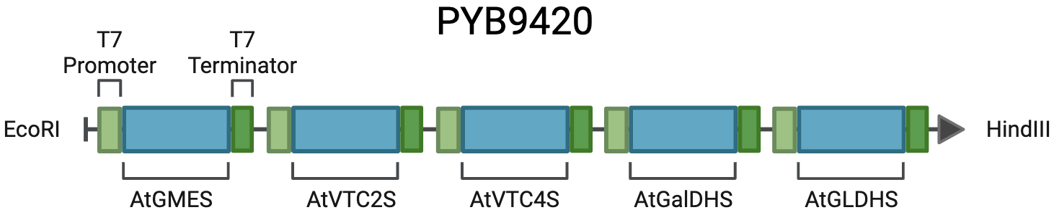






Biosynthetic Production of Vitamin C in Space
Blake Collier, Bob Fan, Haram Yoo, Dr. Pethel, Ming Hia (Boston University)
Western Reserve Academy, Hudson, Ohio, United States
Lengthening space exploration with the on demand production of vitamin C
Enhance protein production for radioresistant E. coli
Plasmid insertion & codon optimization
Fig.1: Vitamin C Production using E. coli
Fig. 2: Inserted genes
Fig. 3: Plasmid for A. thaliana gene insertion

