Slide 1

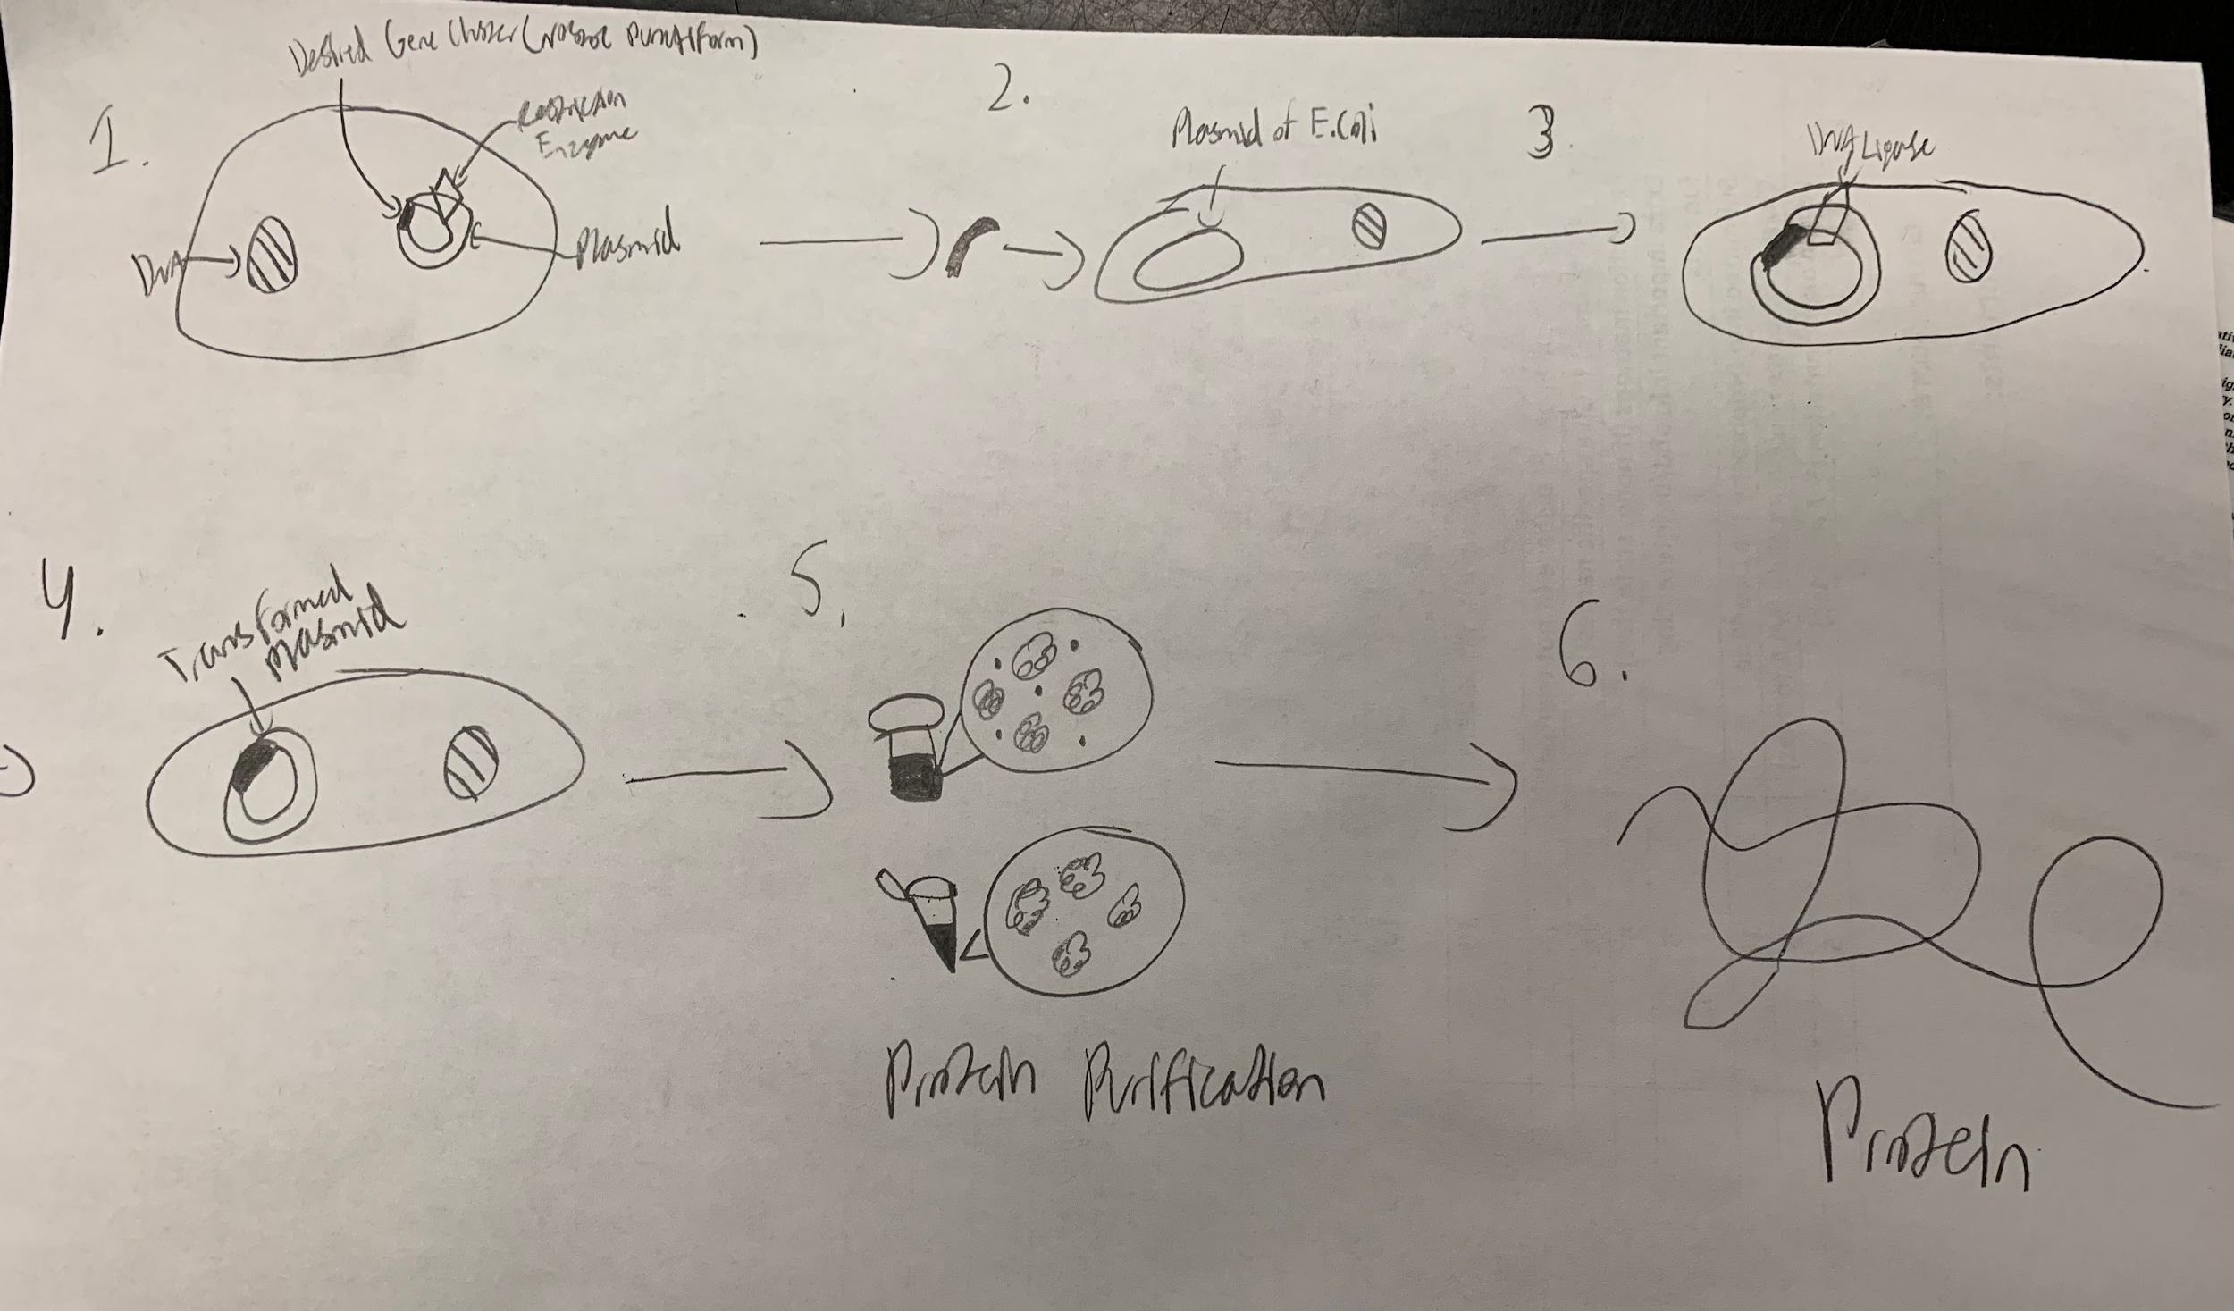






Genetic Engineering of E.Coli BL21(DE3) for Sustainable Shinorine-Based UV Protection
Eli Andry, Samved Gazzala, Hannah Hagen, Saranya Mekala, Aarav Patel, Vibhi Rathor, Prabha Sigamani, Mateusz Skoplak, Claire Wright, Yue Zhang, Stephen Nelson (Teacher), Rebecca C. Meyer, PhD (Mentor-MIT)
North Forsyth High School, Cumming, Georgia, USA
***Include a 1-minute audio file embedded in the slide***
Our objective is to find a use for natural UV protection in Shinorine for sunscreen. We plan to use Golden Gate or Gibson Assembly and induce the genes responsible with a T7 promoter for plasmid creation.
We expect to extract a useful bacterium that displays proper production of the Sinorine genes.
The Nostoc punctiforme will be inserted into a pET 18 vector in order to produce the AVA_3855 protein, producing shinorine which is a substance that can absorb UV rays.
We’d like to transform a sample of E.Coli BL21(DE3) with the Nostoc punctiforme, purify the AVA protein, and then have a sunscreen-like substance for use in facemasks.

