Slide 1

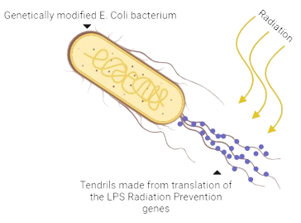
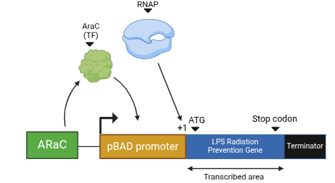






In this genetic circuit, we are using a pBAD operon system in which the araC protein works as a transcription factor in binding to the pBAD promoter to attract RNA polymerase. The pBAD promoter is commonly found in bacteria, especially in the segment of bacterial DNA known as the plasmid. Once RNAP binds to the transcription start site (+1), transcription of the LPS Radiation Gene begins. LPS, lipopolysaccharide, is the main gene type used in building radiation-capturing filaments. Once this gene is transcribed, translation can begin building the radiation prevention protein. We are using the bacterium e. coli as a chassis for our genetic circuit, as it works with this pBAD operon system. It is also a commonly used bacterium which is useful if you are trying to harvest large amounts of a protein.
Next-Gen Bioremediation: Regenerable LPS Vesicles for Uranium Sequestration
Hayim Sims¹, Amalya Fischer, Eliana Goldenholz, Rebecca Gold, Shlomo Vedol, Aaron Missaghi, Leah Kaplan, Shaindle Kaplan, Maria Lazebnik², Scott Gaines³ (Boston University)
Maimonides School, Brookline, Massachusetts, United States of America
Our study shows a novel, scalable way to reduce radiation through synthetic biology-based bioremediation. We leverage proteins in Geobacter, which produce a lipopolysaccharide (LPS) vesicle that traps and prevents uranium from damaging cells. Using Eschericschia coli (E. coli) and a pBAD inducible promoter system, we express genes from Geobacter in presence of Arabinose sugar, producing uranium-trapping vesicles sought.
Proteins will be purified and embedded in surfaces to test long-term stability in devices, gearing the development of technology for large-scale pollution remediation.

