Slide 1


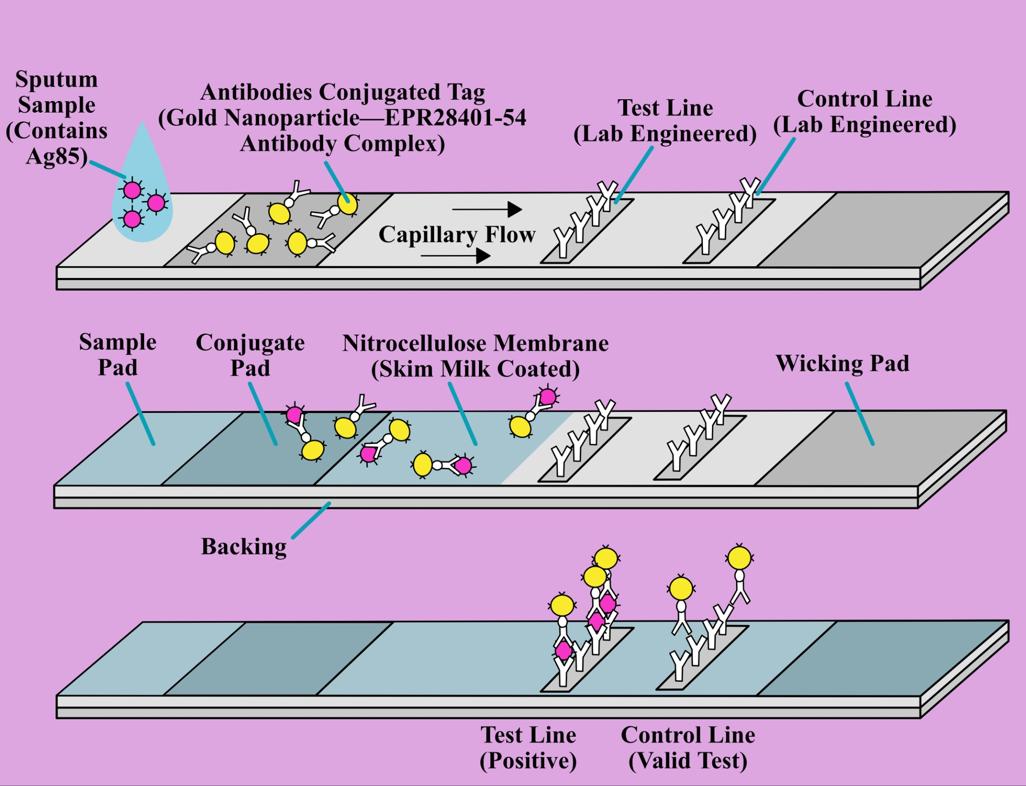









The Detection of Mycobacterium Tuberculosis Using a Modified Lateral Flow Assay
Ismail Allauddin, Chelsea Alonzo-Francis, Aarav Arora, Riya Gupta, Madison Lewis, Disha Maheshwari,
Victoria Semanduyeva, Anika Tapshalkar, Aarya Thakkar, Srihas Tumu, Mary Cartenuto, Dr. Peter Horanyi Ph.D. (UCB)
Denmark High School, Alpharetta, GA, USA
Questions
1. The objective of our project is to create a portable, affordable, and efficient test that identifies Mycobacterium tuberculosis, a pathogen that causes a devastating illness.
2. We plan on using a lateral flow assay to detect the presence of M. tuberculosis’s cell wall protein—Ag85—in sputum samples. If present, it will bind to a gold nanoparticle and antibody complex, then move across a test strip, creating a visible line.
3. We need a -80°C Ultra Low Temperature Freezer, nitrocellulose membranes, EPR28401-54 antibodies, and other essential materials. Currently, we lack these supplies, which prevents us from conducting experiments and testing our design.
4. We expect a clear positive result when M. tuberculosis is present, a functional control line, and all components working together. Our theoretical model suggests that with proper optimization, the test will be both sensitive and specific, enabling faster diagnosis and treatment, particularly in underserved regions.
Scientific Content
This diagram shows the different phases in which the antigen moves along the test strip. As the liquid moves through the membrane—driven by capillary flow—it transports the antigen through each phase, where it interacts with specific components that trigger reactions which play a role in determining if the test detects the presence of tuberculosis, ultimately producing a visible result that indicates a positive outcome.
Next Steps
→ Using ELISA to test the compatibility of the antibodies
with the Ag85 (antigen 85)
→ Assembling the components of the test together as a
prototype
→ Making negative and positive controls
→ Running the prototype by for each control to test
presence or lack of Ag85
→ Recording and analyzing results through data sets and
visual representations
Acknowledgements
We’d like to thank Dr. Peter Horanyi Ph.D. for the time he invested in our project. This team would also be incomplete without our ingenious mentor, Mrs. Mary Cartenuto.
Audio
References

