Slide 1

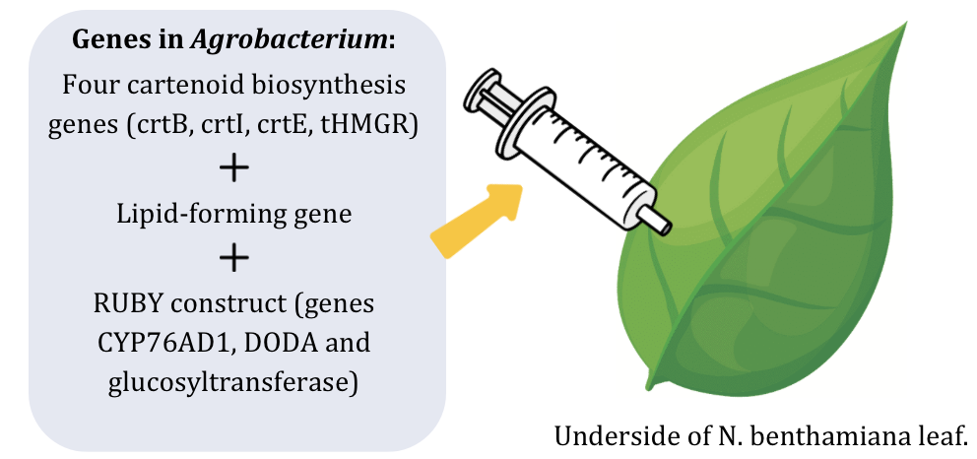







Combating Vitamin A Deficiency: Biofortification of Tobacco Leaves
Tanya Jay, Annabel Volpe, Frances Dunn, Charvi Talupuru, Esther Kim, Tee Jarukulvanich, Tasheen Kashem, Aarav Phadnis, Mr. Reginald Hobbs, Dr. Tianhu Sun (East Tennessee State University)
Lexington High School, Lexington, MA, USA
Using the model plant Nicotiana benthamiana, we aim to increase the stability of beta-carotene in the cytosol of the plant in order to improve the availability of vitamin A and combat the global deficiency.
Our project aims to introduce lipid droplets into the cytosol, while also expressing the key genes involved in carotenoid synthesis.
We hope that this will improve the stability of beta-carotene in the cytosol, leading to greater availability in the plant and thus more efficient conversion into vitamin A upon consumption.

