Slide 1



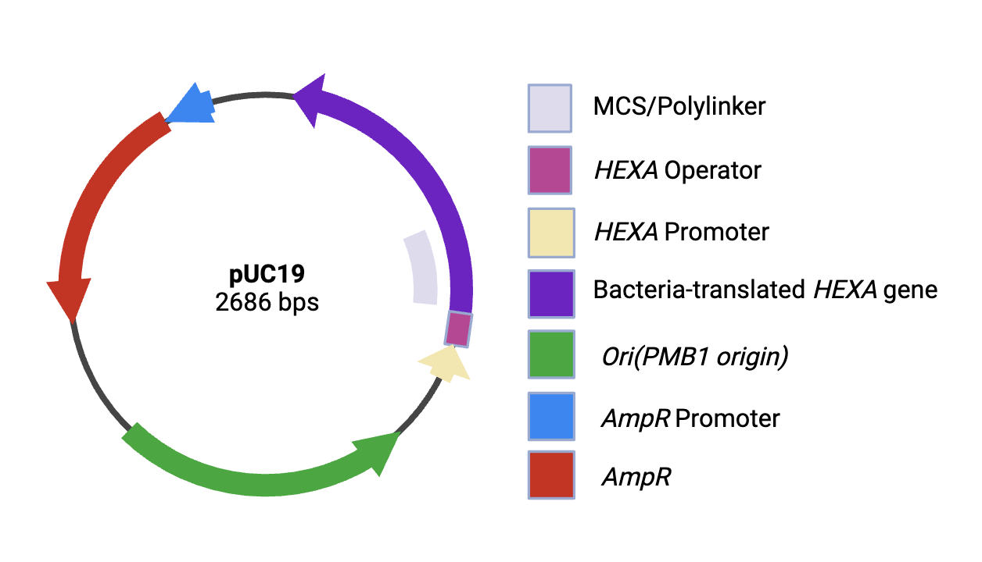








A Novel Synthetic Biology Approach for MPRA-Optimized Protein Cloning to Stop the Progression of Tay-Sachs Disease
Abhinav Dubba, Miya Nithin, Nila Prabhu, Abhinav Yamujala, Catherine Sharer, Alyssa Morrow(Ginkgo Bioworks)
Lambert High School, Suwanee, Georgia, United States
The objective of our project is to stop the progression of Tay-Sachs Disease through the extraction of cloned beta hexosaminidase-A from E.coli cells.
We intend on replacing the lac gene from the plasmid pUC19 with HEXA in order to overproduce the alpha subunit of β-HexA.
Additionally, we plan on determining protein production by using sodium dodecyl-sulfate polyacrylamide gel electrophoresis and a Western blot
Finally, we will use MPRA arrays to optimize the amount of protein produced and evaluate the presence of off-target effects to be able to mitigate them.
Some of our next steps include testing our solution in mammalian cells and evaluating various delivery techniques including a nasal spray and spinal injection.
Overview
Schematic
Experiment
Step 1: Translate HEXA into an RNA-compatible sequence
Step 2: Insert it into pUC19 and clone it
Step 3: Determine protein expression using SDS-page gel electrophoresis
Step 4: Use MPRA arrays to assess off-target effects.
Step 5: Mass produce proteins and insert it into a nasal spray

