Slide 1


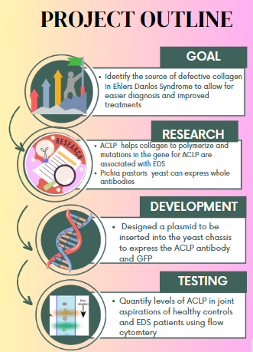
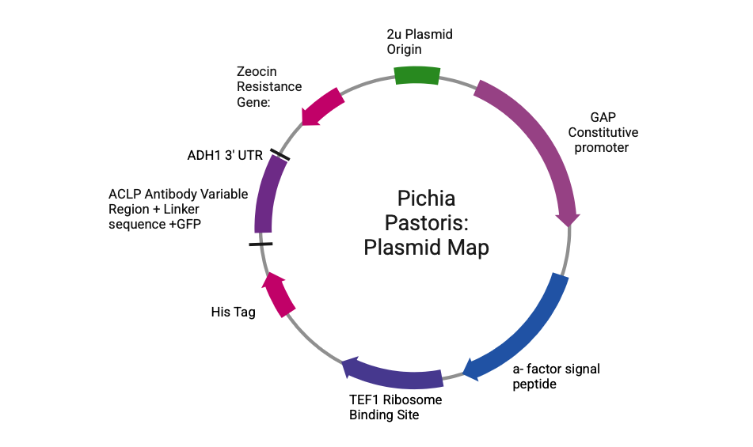
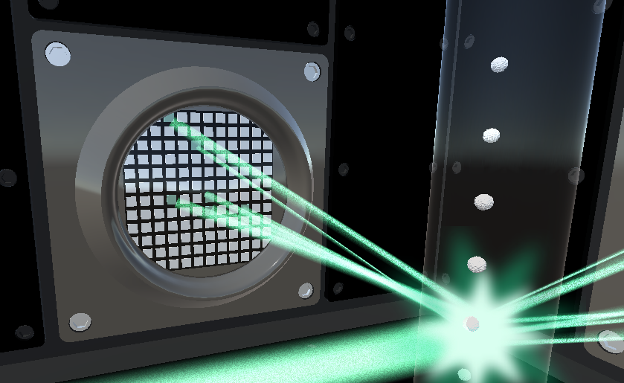
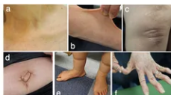







“Diagnostic GeneYeast”: A Biosensor for EDS
Katherine Dalphin, Cecilia Geyer, Vasiliki Gioldasis, and Ariana Ortega,
Team Leader: Mary Johnston, Mentors: Michael Sheets, Susana Donkor
Haverhill High School, Haverhill, Massachusetts, USA
Expected Results: Flow cytometry enables quantification of the amount of the antibody present. We expect there will be more ACLP in healthy patients (left) vs EDS patients (right)

