Slide 1


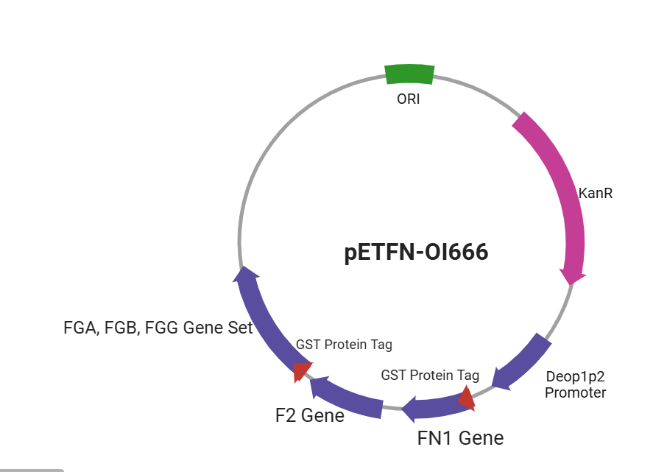
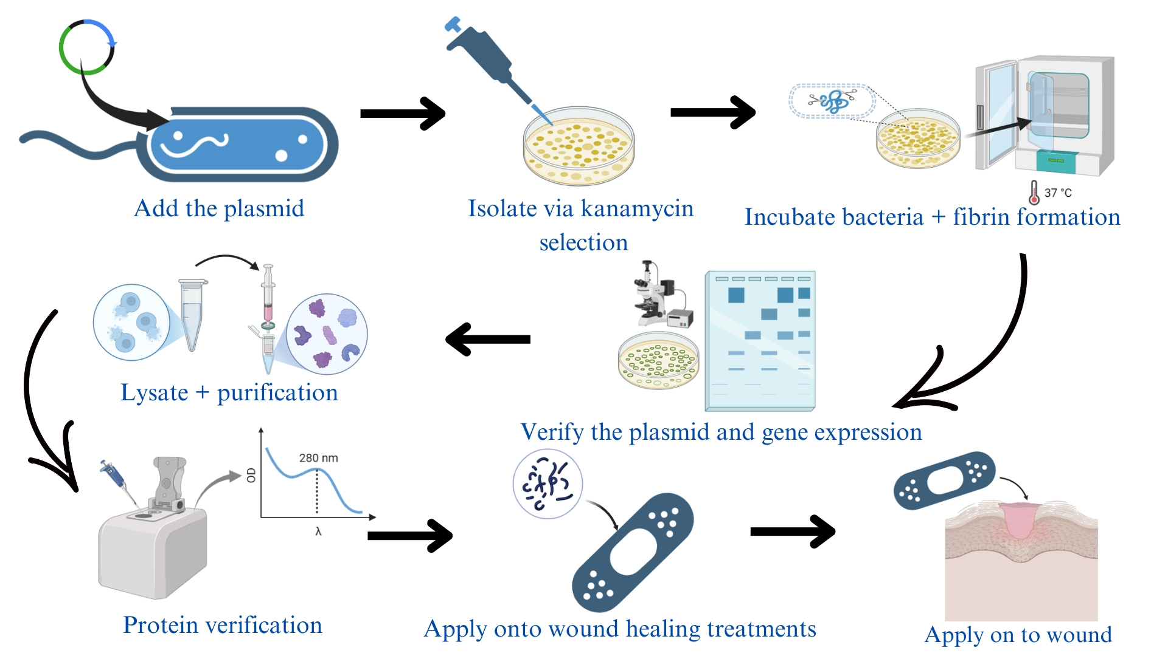
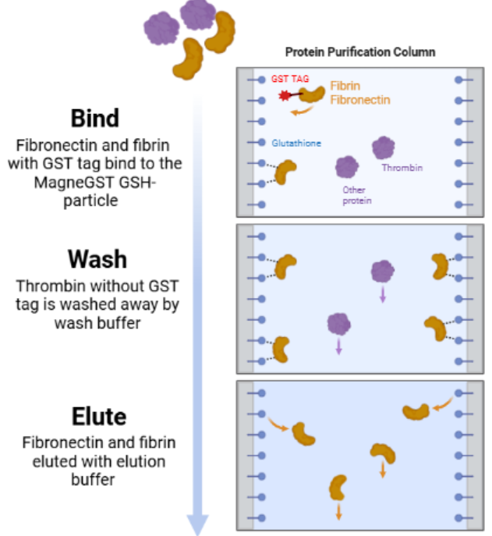






Wound Healing Enhancement Using Recombinant Extracellular Matrix Proteins Produced by Escherichia coli
Zhongchen Cai, Chun Chan, Ruiwen Wang, Xinyu You, Dr. Beth Pethel, Joe Switzer (MIT)
Western Reserve Academy, Hudson, OH, USA
Our project aims to improve open wound healing for patients by simultaneously producing fibronectin and fibrinogen via Escherichia coli for wound application.
Our plan involves transforming the plasmid pETFN-OI666 into the E. coli strain BL21, constructing a bacterial strain that produces fibronectin, fibrinogen, and thrombin in vitro.

