Slide 1


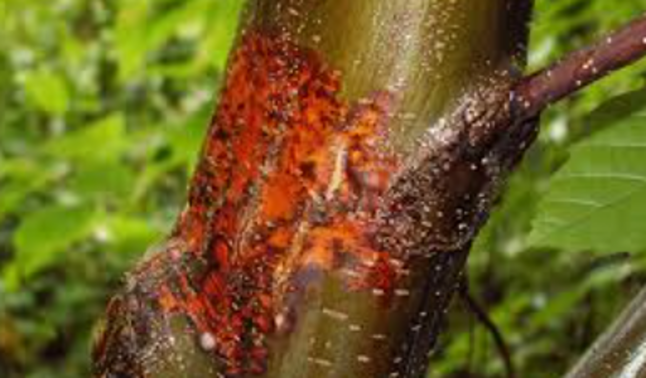
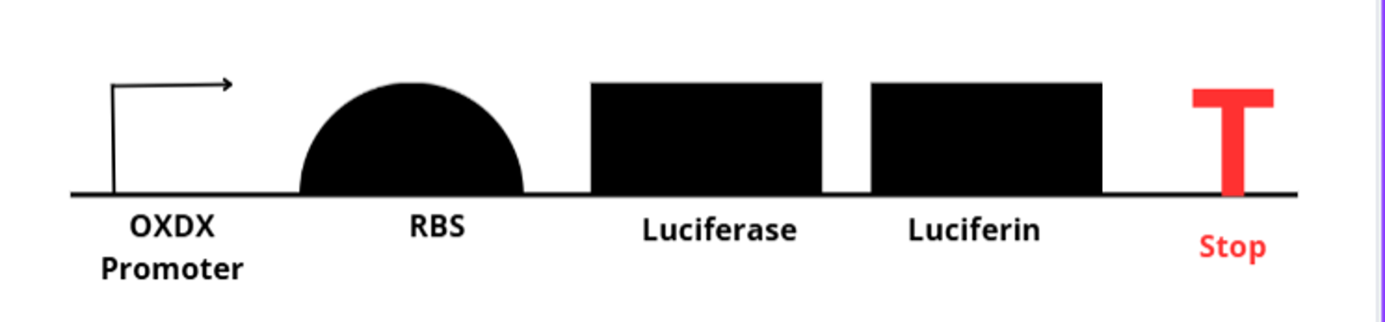







Project BioGlow: Early Detection of Chestnut Blight
Brylee Jones, Jude Athey, Abe Athey, Hallee Kipp, Dylan Klepper, Vincent Klug, Eric Thomas, Natalie Baker, Joey Dodson, and Teacher Amanda Dunham
Mentors Dr. Kelley Doering and Amanda Ferrante
DB EXCEL, Kingsport, TN, Sullivan
Our project aims to transform Pseudomonas fluorescens strain with a plasmid that produces bioluminescence in response to oxalic acid, enabling early detection of Cryphonectria parasitica infections in American chestnut trees before visible symptoms appear visible symptoms appear.

