Slide 1


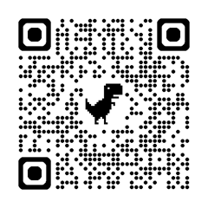
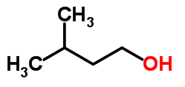
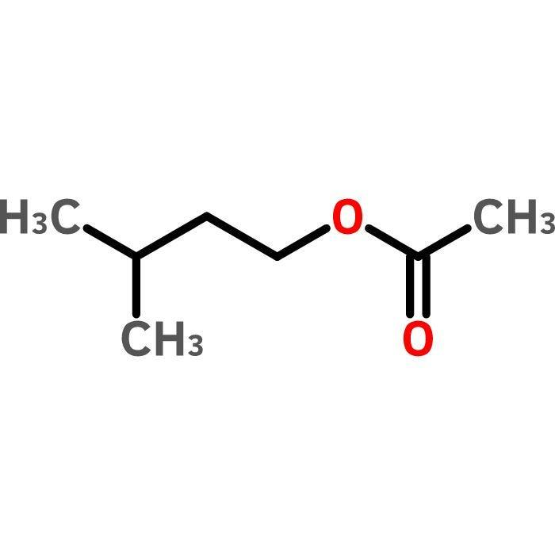
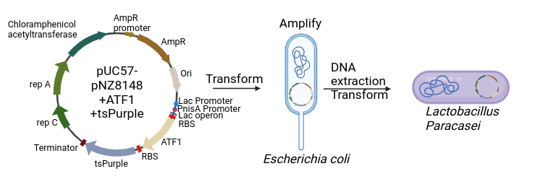
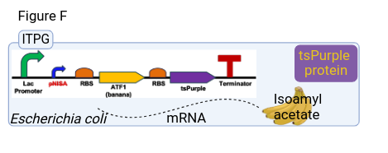
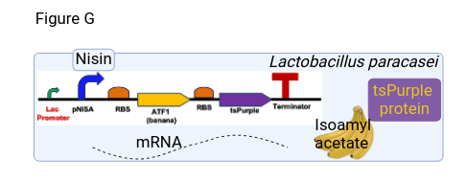






Lightning Talk
Enriched Flavoured Yogurt
Mahabubul Hasan Sowrav, Yamileth Manzano-Ortiz, Margarita Mendiola-Santoyo, Warren Oliver, Lisbet Ortiz Arreaga, ​Ana M White Teacher Leader, Mary Lerner Mentor (UCB)​, Cross Keys HS, Atlanta, GA, USA
Our objective is to express a natural banana flavor in yogurt using synthetic biology techniques.
We will insert our target genes, ATF1(banana smell) and tspurple (selective marker) into a shuttle vector
Vector will be transformed and amplified in E.coli before transformed in Lactobacillus paracasei.
Our expected result is smooth yogurt that produces it's our flavors.
ATF1 Gene
RBS
ATF1 Gene
Promoter
Isoamyl alcohol
Isoamyl acetate
+
AATase
Project Design

