Slide 1


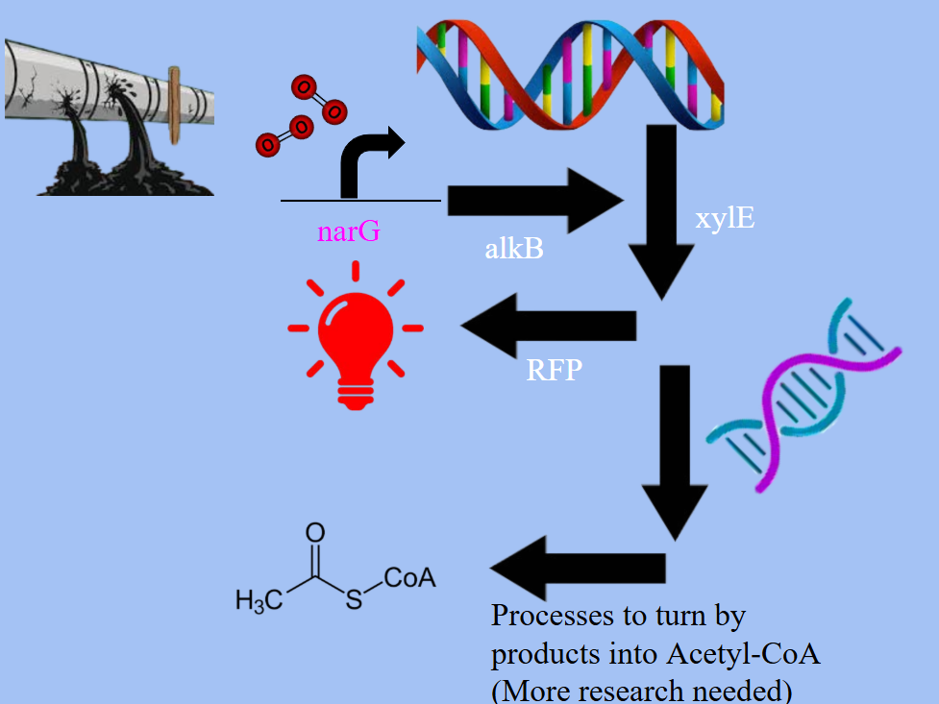
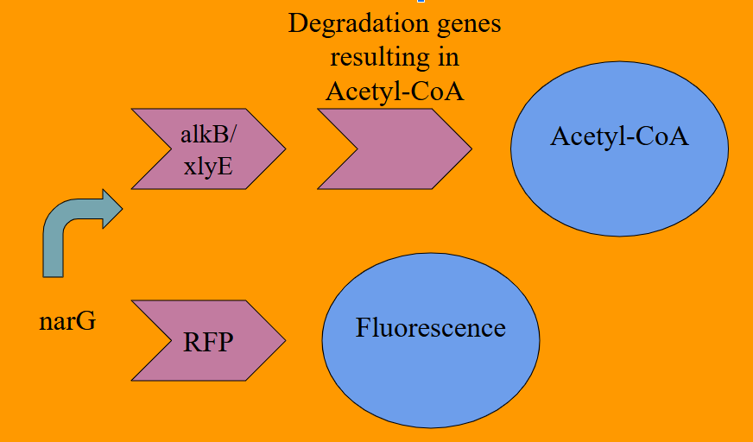
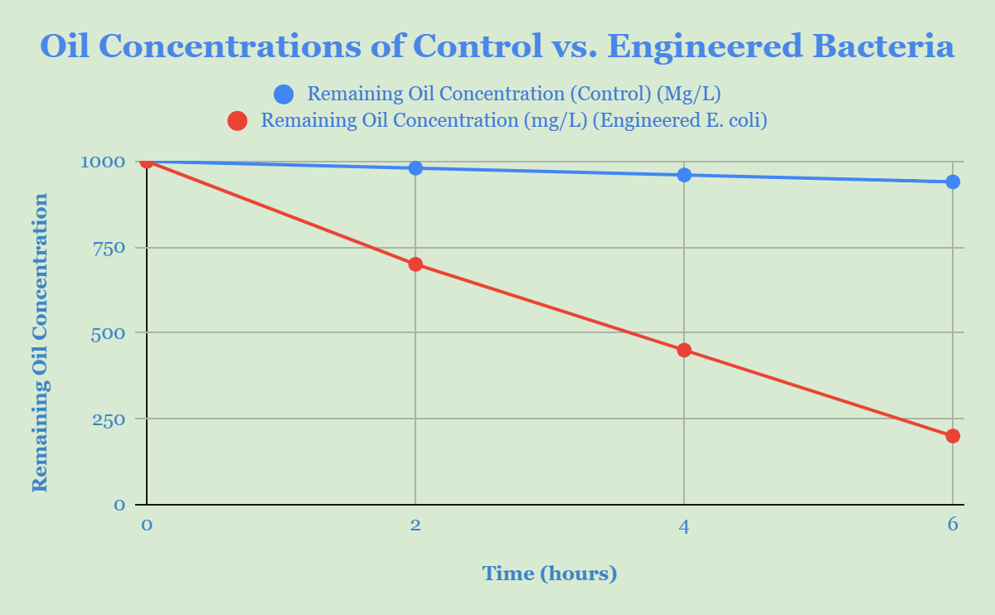
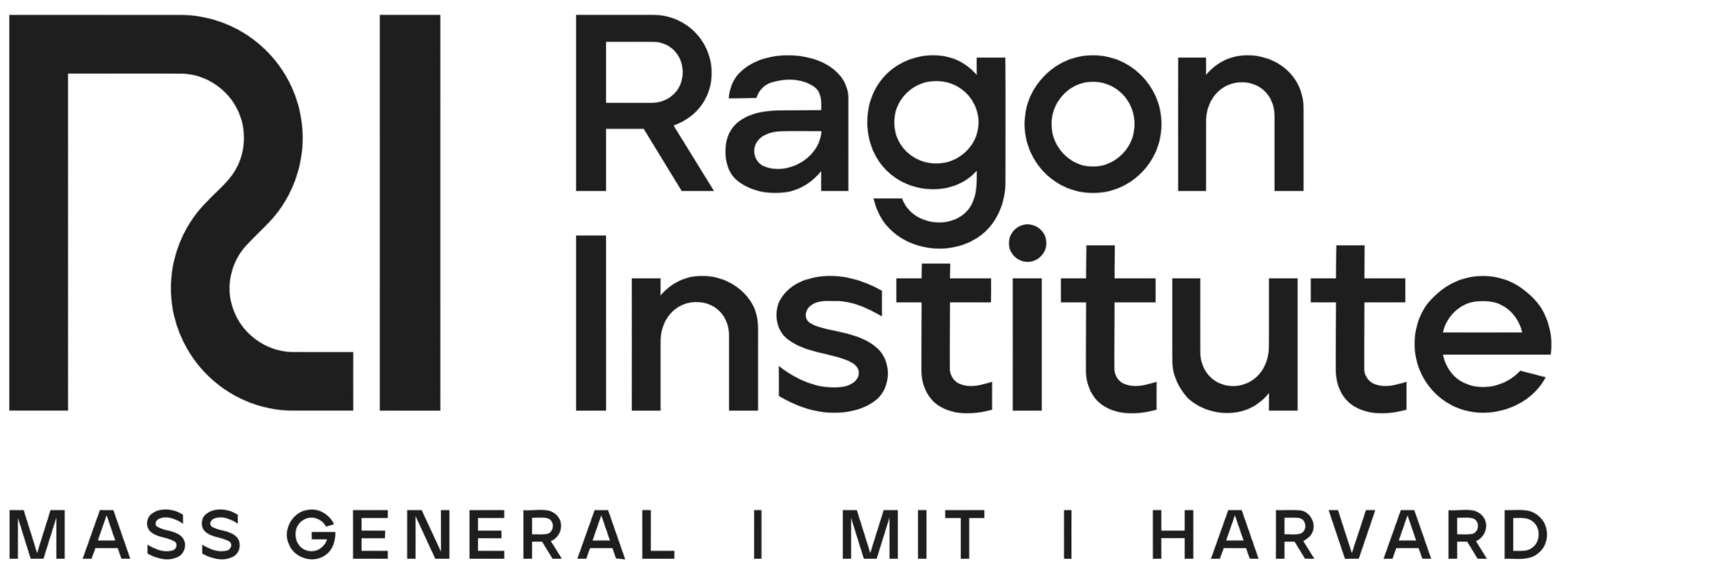





EcoSpill
Neel Bhosale, Vansh Singh, Siya Gupta, Mrs. Ambika Bhosale. Dr. Yuval Dorfan, John P. Stevens High School, Edison, NJ
Our project aimed to reduce the impact oil pipe leakages in middle eastern countries
We plan to not only detect the oil spill, but to actively degrade it using proteins in synthetically engineered bacteria
We expect the strand of E.Coli to fully break down the hydrocarbons in the oil and turn them into Acetyl-CoA, which is helpful to the environment. We also expect the bacteria to produce fluorescence, so engineers can detect the location of the spill and quickly repair it for minimal impact.

