Slide 1


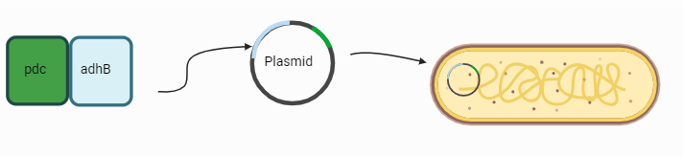
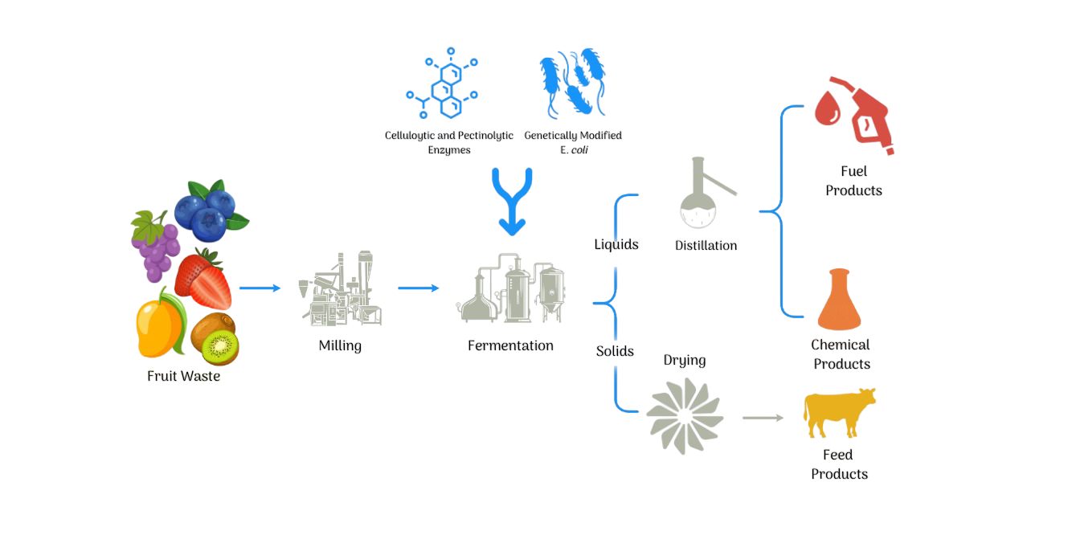
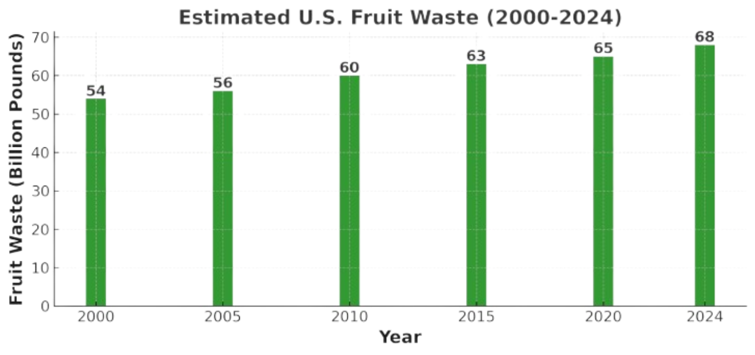






Renewable Energy: Repurposing Fruit Waste to Biofuel using Engineered Escherichia coli
Ajai Bubra, Brenna Pethel, Emma van Ginkel, Dr. Beth Pethel, Gitanshu Bhatia (LanzaTech)
Western Reserve Academy, Hudson, Ohio, USA
Objective and Design
Genetic Modification: designing E. coli with genes of pdc (pyruvate decarboxylase) and adhB (alcohol dehydrogenase) enzymes from Zymomonas mobilis to enhance ethanol yield.
Sustainable Fuel Production: ferment fruit waste using genetically modified E. coli to produce ethanol efficiently.
Greenhouse Gas Reduction: decrease the methane emissions released through fruit waste decomposition by repurposing the fruit waste for biofuel production.

