Slide 1


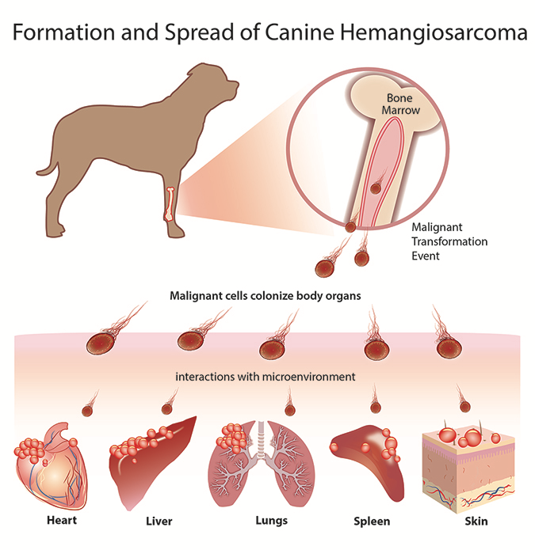
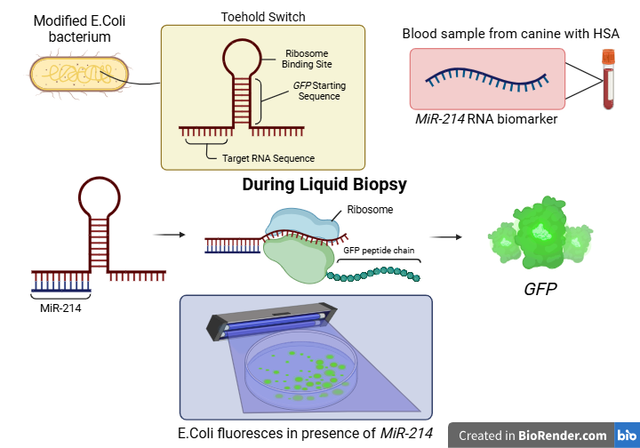






Liquid Biopsy 2.0: E.coli Bacteria Fluorescence-Based Detection of Canine Hemangiosarcoma
Abigail Sanchez-Chavez, Chloe Martin, Zion Jatta, Temitayo Fakunle, Kayony Pierre, Bria Washington, Abigail Ejoga, Andres Gonzalez, Victoria Vazquez, Dr. Tiffany Jones, Dr. Grace Vezeau (CATALOG)
South Cobb High School, Austell, GA, US
Background & Objective
Liquid biopsies often struggle in detecting certain cancer types and are prone to false-negatives, especially in early-stage canine cancers.
Genetically engineer E. coli bacteria to fluoresce in the presence of MiR-214, a biomarker associated with hemangiosarcoma (HSA) - an aggressive and rapidly progressing cancer common in canines.
Fig.1 (left) : Visual aid demonstrating Hemangiosarcoma in canines and its detrimental impact on vital organs.
Method & Expected Results
Presented as a “Diagnostic Kit”
Engineered E. Coli bacteria are designed with a toehold switch mechanism that activates a green fluorescence (GFP) upon detection of miR-214.
If miR-214 is present, the bacteria will produce a visible fluorescent signal (GFP) indicating early detection of HSA and possible cancer progression.
Fig.2 (right): Diagram demonstrating our mechanism; E.coli bacteria fluorescence-based detection of
miR-214 biomarker.

