Slide 1


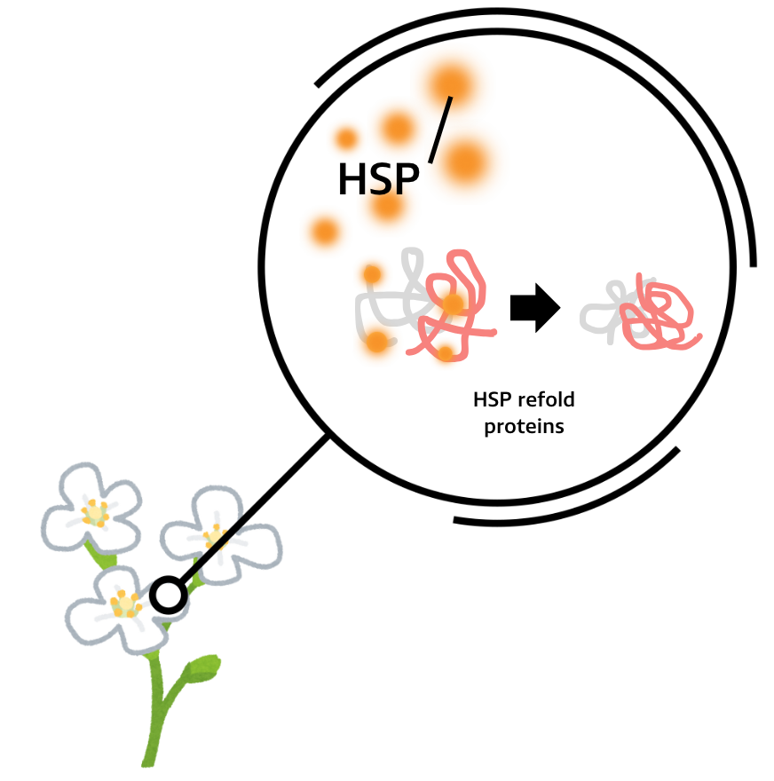
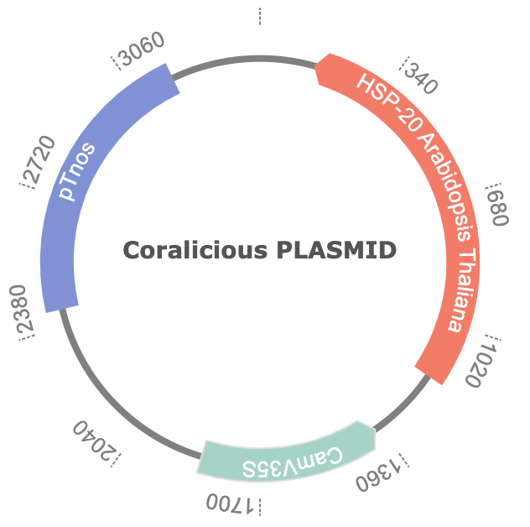
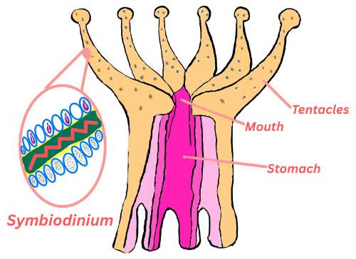






Coral Reef Resilience to Climate Change: Utilizing Arabidopsis thaliana HSPs to Improve Symbiodinium Thermal Tolerance
Regina Rubiano, Tucker Marshall, Hayden Walmsley, Dr. Beth Pethel, Dr. Leah Davis (NOAA)
Western Reserve Academy, Hudson, Ohio, United States of America
To incorporate HSP20 to Symbiodinium, we are targeting its chloroplast genome using a biolistic (gene gun) transformation method.
Our project aims to enhance coral heat tolerance heat shock proteins (HSPs) from Arabidopsis thaliana into Symbiodinium.
We anticipate improved thermal tolerance in Symbiodinium, reducing coral bleaching during heat stress.
Our system uses the Cauliflower Mosaic Virus 35S (CaMV35S) promoter, a constitutive promoter that ensures continuous expression of HSP20.
This allows for stable and high-level gene expression in Symbiodinium, independent of temperature fluctuations.

