Slide 1



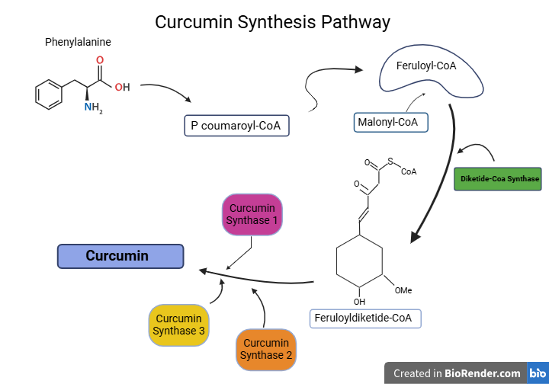
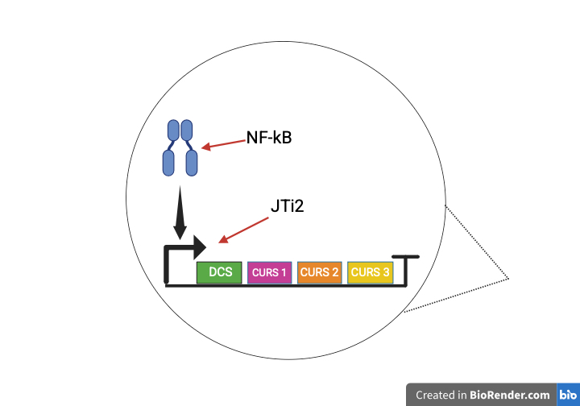
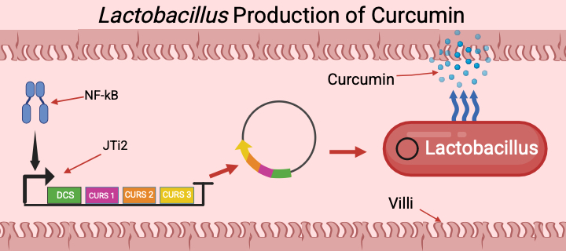






Utilizing Engineered Curcumin for Targeted Suppression of Inflammation in Rheumatoid Arthritis
Gavin Gall, Ben Grant, Adrian Alfirevic, Kaden Haslinger, Abbi Bernhardt, Dr. Beth Pethel, Dr. SitaRam Meena (UCB)
Western Reserve Academy, Hudson, Ohio, United States
The objective of our project is to create a long term, cost effective, immunomodulator for Rheumatoid Arthritis.
Our design will release curcumin in response to NF-kB to reduce inflammation.
Healthy Joint
Rheumatoid Arthritis
Curcumin Synthesis Pathway
Lactobacillus Production of Curcumin

