Slide 1

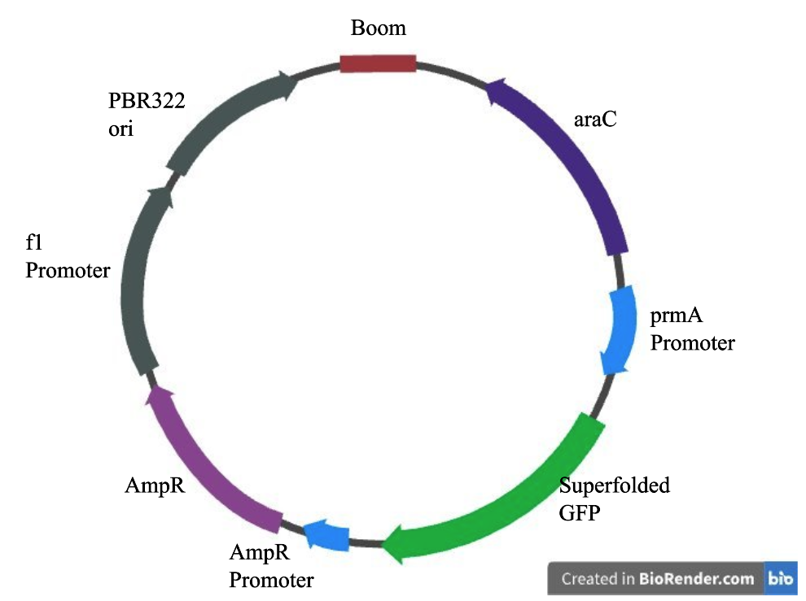

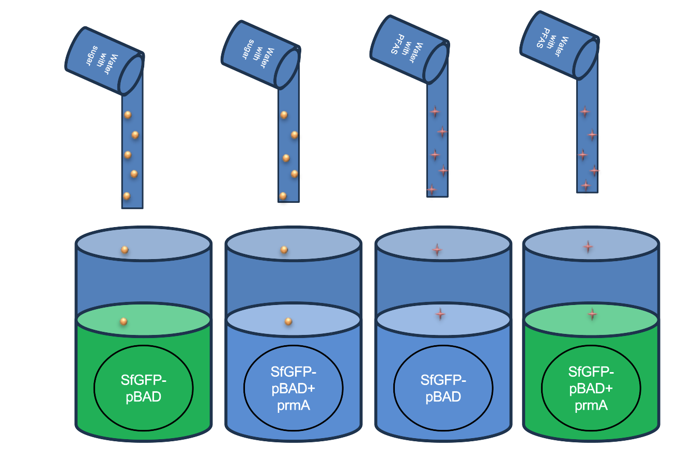






Removal of PFAS in Water
Juan Mendoza, Ana White Teacher Leader, Michale sheets (Sunflower Therapeutics)
Cross Keys High School, Atlanta, Georgia, United States of America
Problem: PFAS also known as forever chemicals is a type of microplastic found in our environment and have adverse health effects.
Objective: Eliminate PFAS from the water supply.
SfGFP-pBAD + prmA
BBC LT_ Gold Team_
Cross Keys_2025
PFAS
Under prmA promoter
GFP
DeHa 1 & 2
Arabinose
Under the pBAD promoter
Kill switch gene (rhaS)

