Slide 1

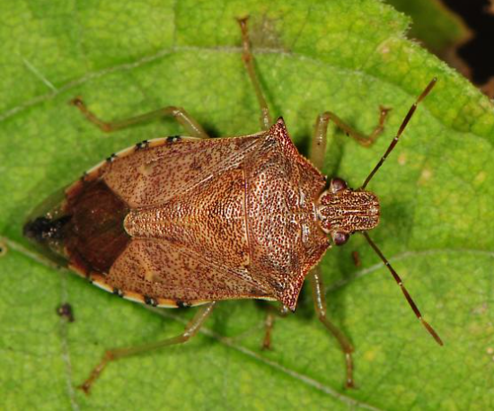
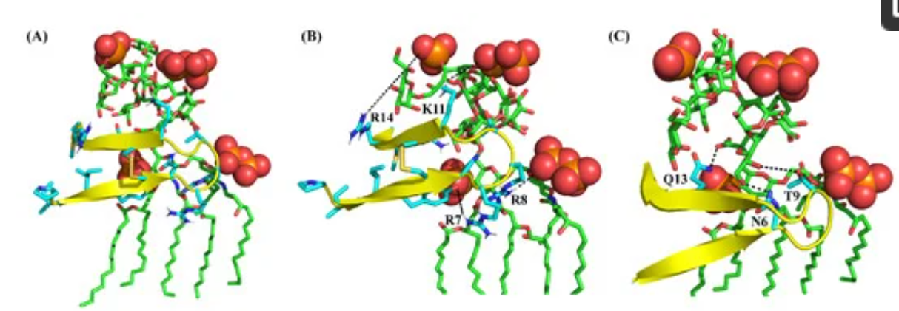
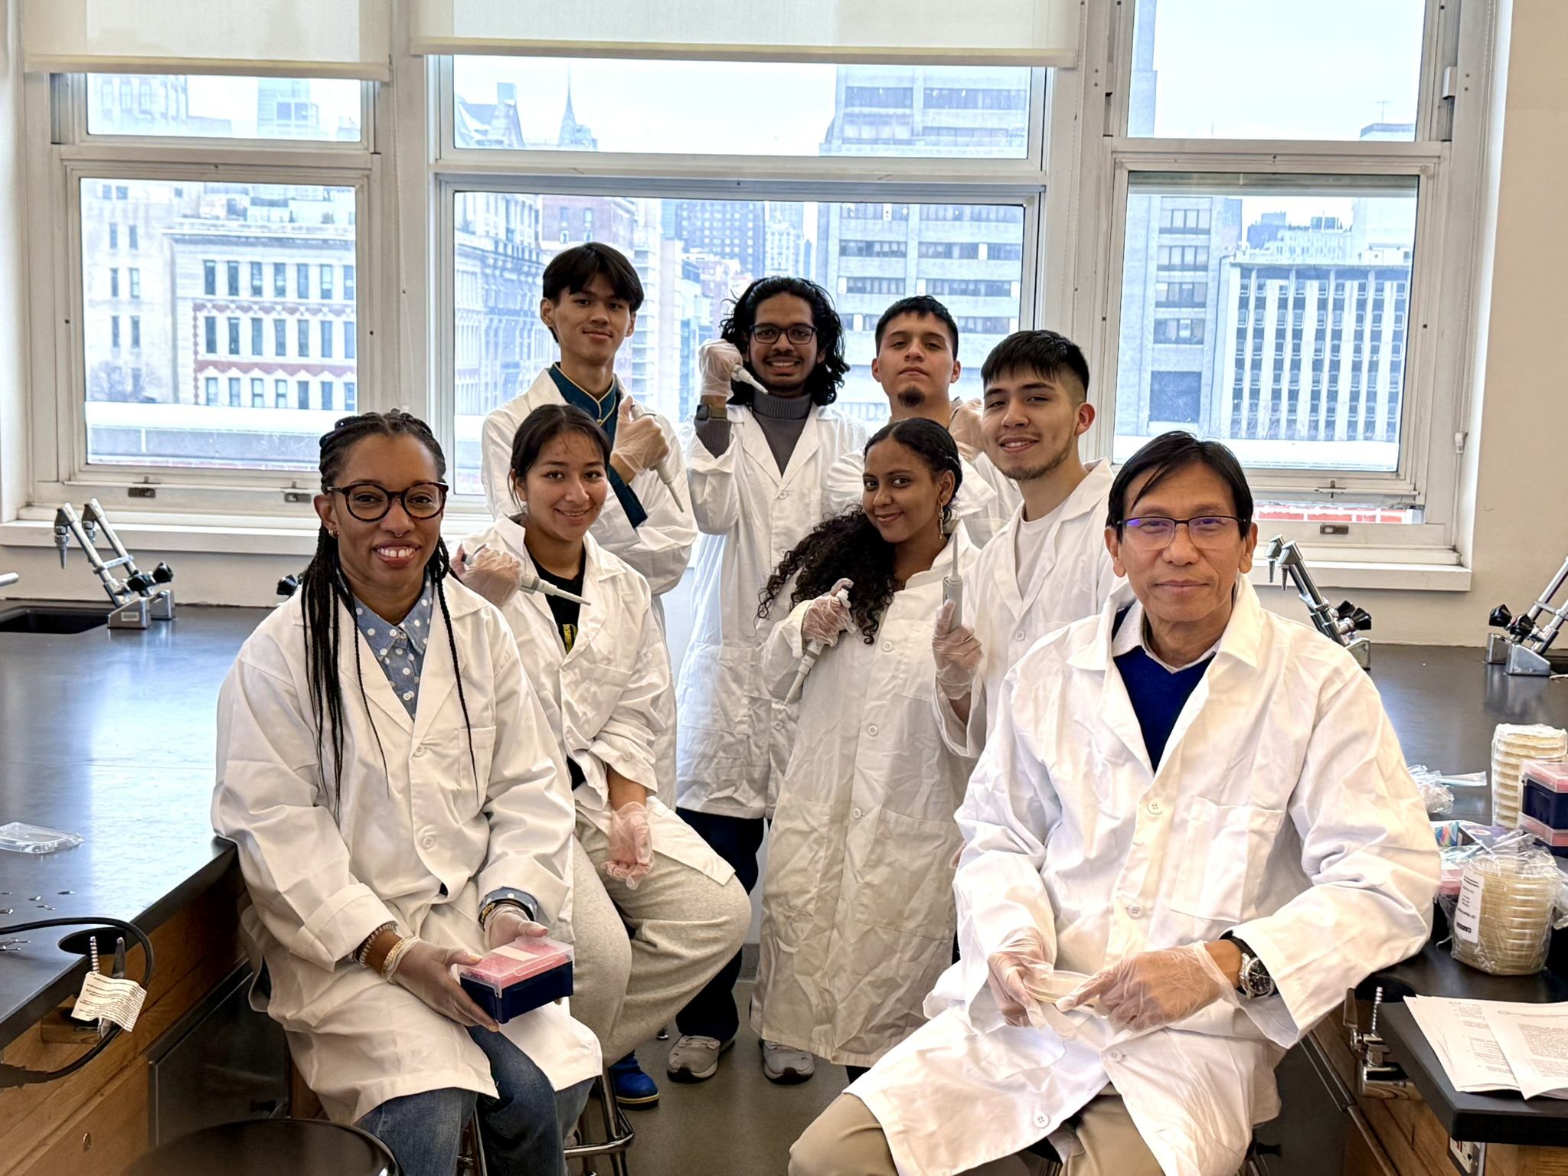
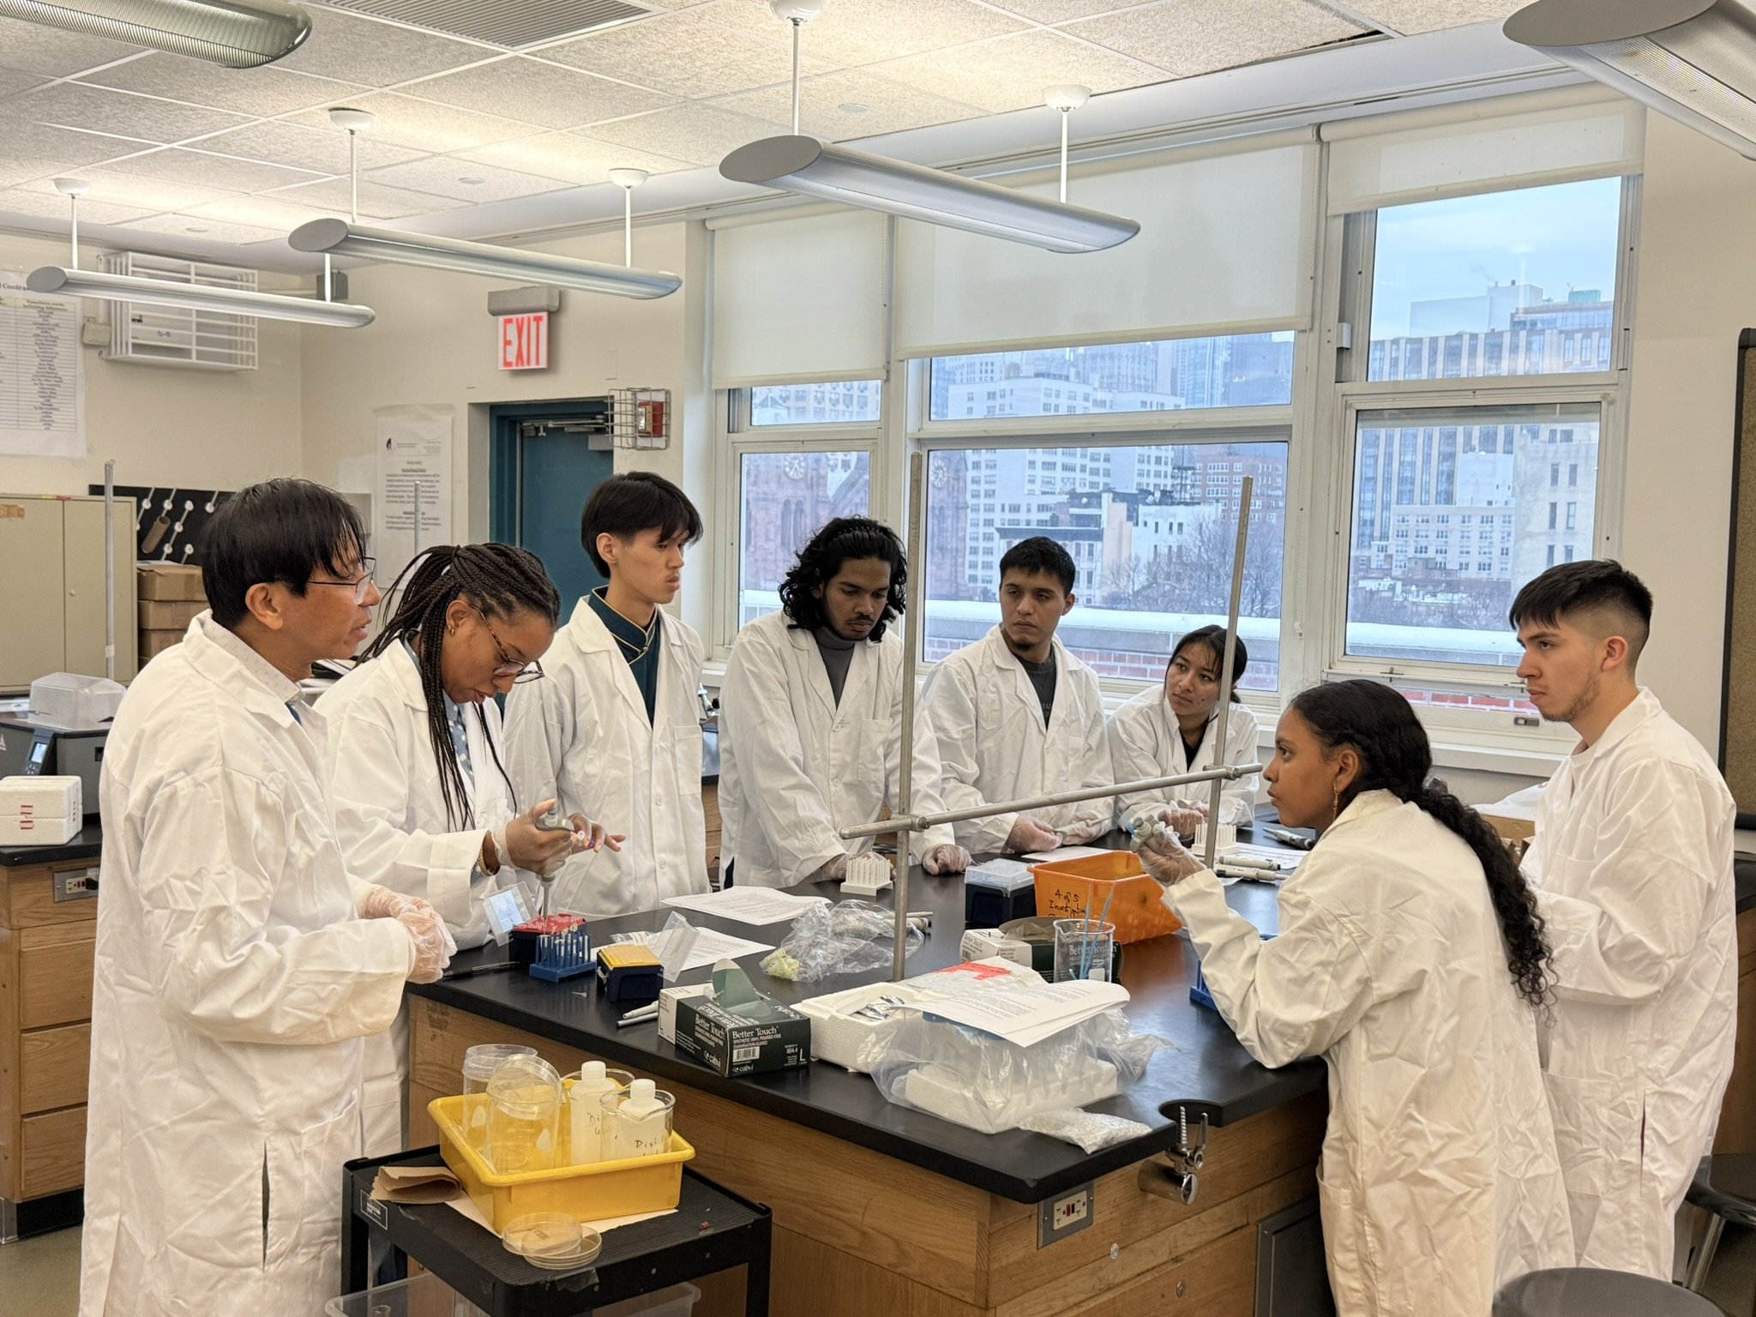

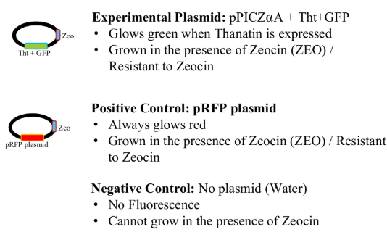
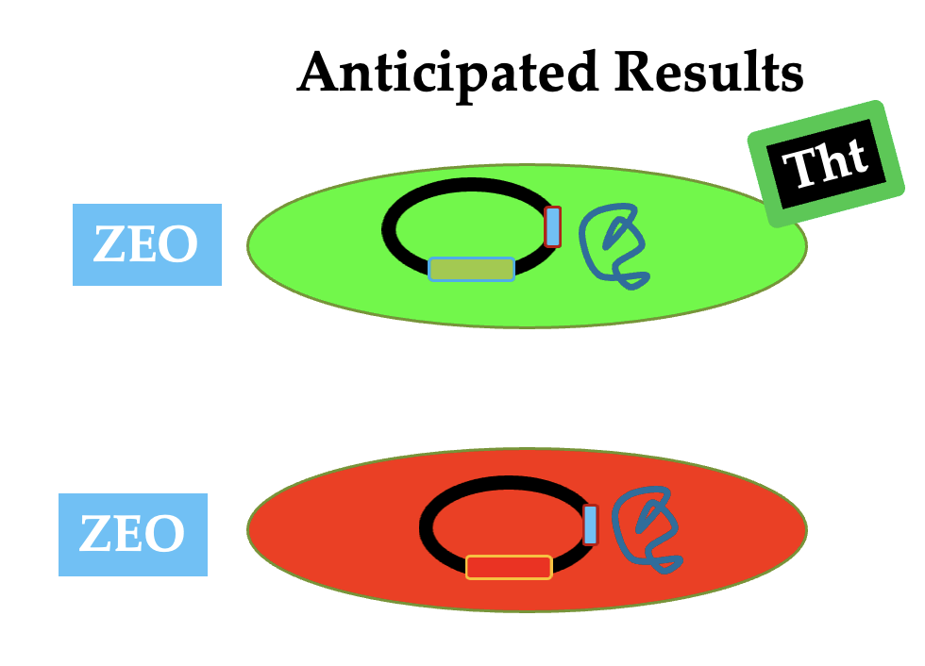
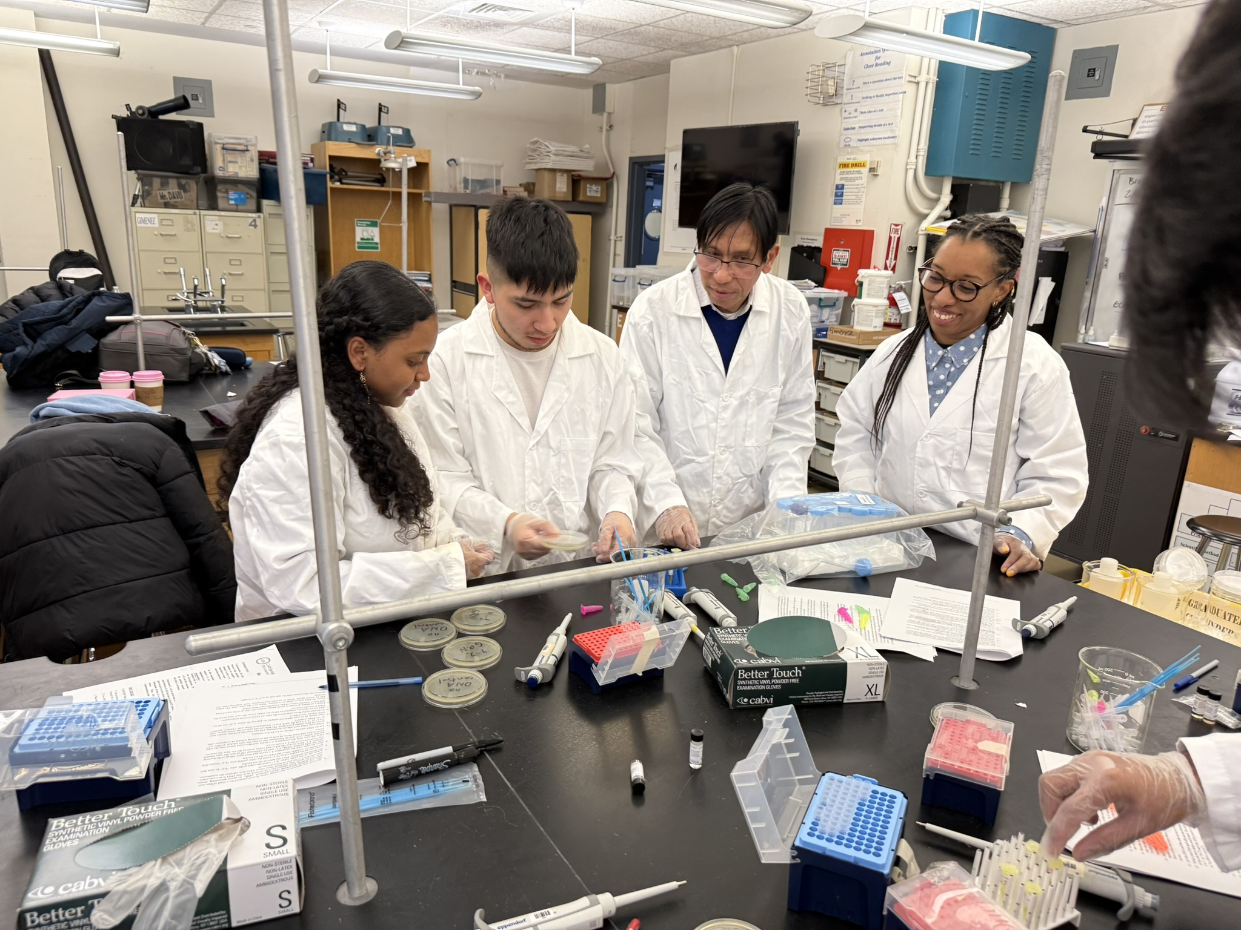
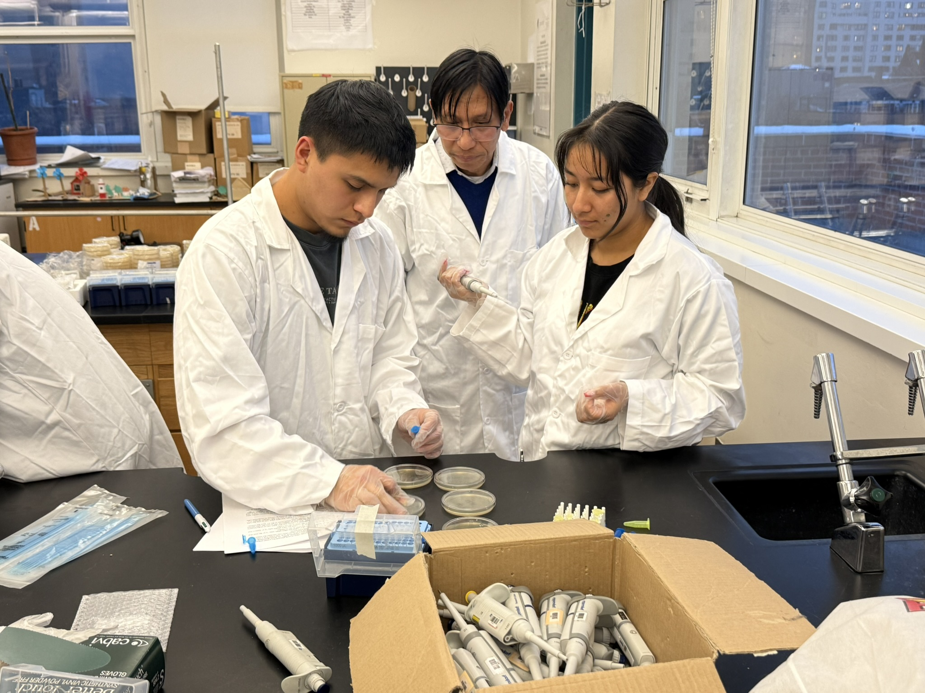
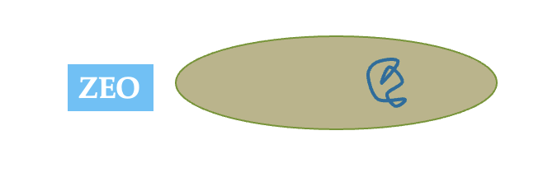
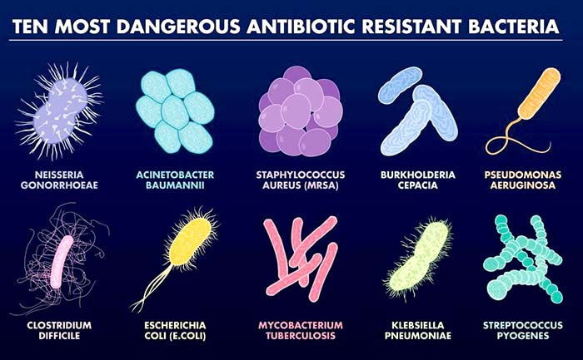
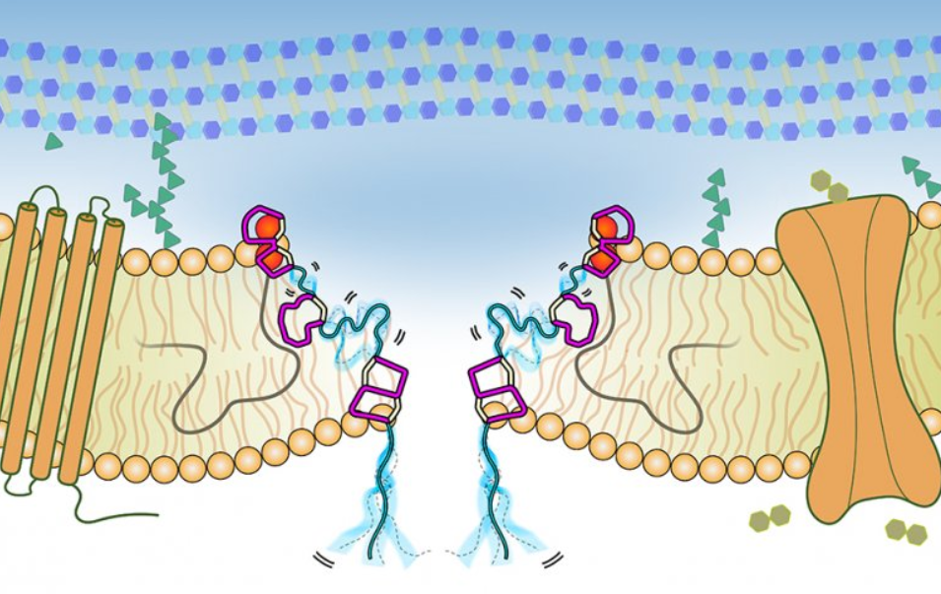
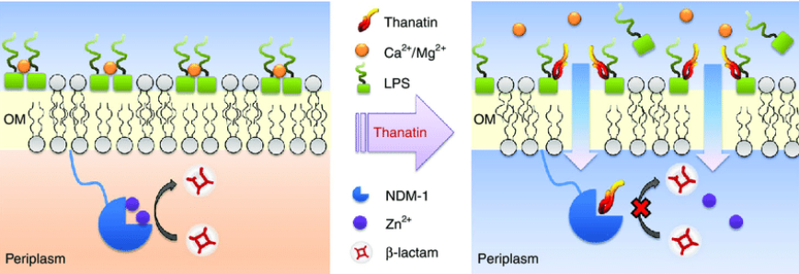






Engineering yeast to produce multi-drug resistance- antimicrobial agent Thanatin.
Team Members: Ashton Allie, Brandon Arauco, Jennifer Chica, Diego Guizado, Michel Pena and FNU Thundup Tashi
Team Leader: Alfred Lwin Mentor: Racquel Kim Sherwood, PhD
Manhattan Comprehensive Night & Day High School, New York City, NY, USA
The rapid increase of antibiotic-resistant bacteria poses serious global health concerns. Doctors struggle to treat multi-drug-resistant bacterial infections, which can be caused by dangerous pathogens like Carbapenem-resistant Acinetobacter baumannii, Methicillin-resistant Staphylococcus aureus (MRSA), Vancomycin-resistant Enterococcus Sp. (VRE), Carbapenem-resistant Pseudomonas aeruginosa, and multi-drug-resistant Mycobacterium tuberculosis (MDR-TB). Each year, these pathogens are responsible for millions of deaths globally. Today, there is an urgent need for the development of new antibiotic agents to combat multi-drug-resistant pathogens. Unfortunately, creating effective antibiotics has been time-consuming and costly. A promising antimicrobial peptide called “Thanatin," produced by the insect called spined soldier bug (Podisus maculiventris), has been proven to have a wide range of antimicrobial activity. Thanatin accomplishes this by binding to LPS in the bacterial cell wall, inhibiting its biosynthesis, and permeabilizing bacterial cell membranes. The combination of these activities can kill many types of bacterial pathogens. For our project, we aim to engineer yeast Pichia pastoris to produce Thanatin for treating multi-drug-resistant bacteria. We intend to use P. pastoris as our chassis because it is widely used in bioengineering and can efficiently and cost-effectively produce large amounts of recombinant Thanatin. To accomplish this, we will clone the DNA sequences that encode the Thanatin-GFP fusion peptide into yeast expression vector pGAP4_r, marked by Zeo for selection. This construct will then be transformed into P. pastoris. Next, we will use a fluorescence microscope to visualize the green fluorescent protein (GFP) that is part of the Thanatin-GFP fusion peptide to confirm protein production. To test Thanatin's antimicrobial properties, we will purify it and perform MIC testing to determine its ability to kill pathogenic and MDR bacteria.
Spined Soldier Bug
(Podisus maculiventris)
Stage 1: Engineering P. pastoris
Dead
Stage 2: Testing Thanatin Antimicrobial Activity by MIC assay
In the minimum inhibitory concentration (MIC) assay, S. Aureus will be spread evenly onto LB plates to create a lawn. Purified Protein RFP will serve as a positive control for protein expression, while Thanatin-GFP, produced by a control plasmid, will be spotted onto the plates where S. Aureus has been applied. The plates will be incubated at 37°F for 12 hours. To assess the bactericidal activity, we will measure the diameter of the clear, zone of inhibition (ZOI) surrounding the spots of purified Thanatin-GFP on the plates.
References
Bioengineering the Antimicrobial Activity of Yeast by Recombinant Thanatin Production. Pipiya, S. O., Kudzhaev, A. M., Mirzoeva, N. Z., Mokrushina, Y. A., Ziganshin, R. H., Komlev, A. S., Petrova, P. E., Smirnov, I. V., Gabibov, A. G., Shamova, O. V., & Terekhov, S. S. (2023). Bioengineering the Antimicrobial Activity of Yeast by Recombinant Thanatin Production. Antibiotics, 12(12), 1719. https://doi.org/10.3390/antibiotics12121719
Production of recombinant thanatin in watery rice seeds that lack and accumulation of storage starch and proteins. Tomohiro Imamuraa, Ken-Taro Sekineb, Tetsuro Yamashitac, Hiroaki Kusanoa, Hiroaki Shimadaa
Thanatin: A Promising Antimicrobial Peptide Targeting the Achilles’ Heel of Multidrug-Resistant Bacteria. Qianhui Liu 1,2,†, Qian Wu 1,2,†, Tianming Xu 1,2, Pradeep K. Malakar 1,2, Yongheng Zhu 1,2, Jing Liu 1,2, Yong Zhao 1,2,* and Zhaohuan Zhang 1,2,*
Antimicrobial peptide thanatin fused endolysin PA90 (Tha‑PA90) for the control of Acinetobacter baumannii infection in mouse model. Jeonghyun Lim1, Heejoon Myung1,2, Daejin Lim3* and Miryoung Song1*
Synthetic biology era: Improving antibiotic’s world. Silvia Guzmán-Trampe , Corina D. Ceapa , Monserrat Manzo-Ruiz , Sergio Sánchez
Acknowledgements
Our MCNDHS BioBuilder Team very much would like to thank Dr. Natalie Kuldell and Chloe Franklin for their advice and support. We are immensely grateful to our mentor, Racquel Kim Sherwood, for her mentoring throughout the project. Our profound thanks to Ms. Margaret Aylward and Mr. Roberts and the CYD team, and our heartfelt thanks to our principal Ms. Erickson, assistant principals, Ms. Ventrella, Ms. Nam, Ms. King, Mr. Matura, and all the faculty for their support.
Conventional antibiotic effect on bacteria cell membrane
Anticipated Results
ZOI
Thanatin AMP effect on cell membrane
Positive Control
RFP
Experimental Group
Thanatin-GFP

