Slide 1

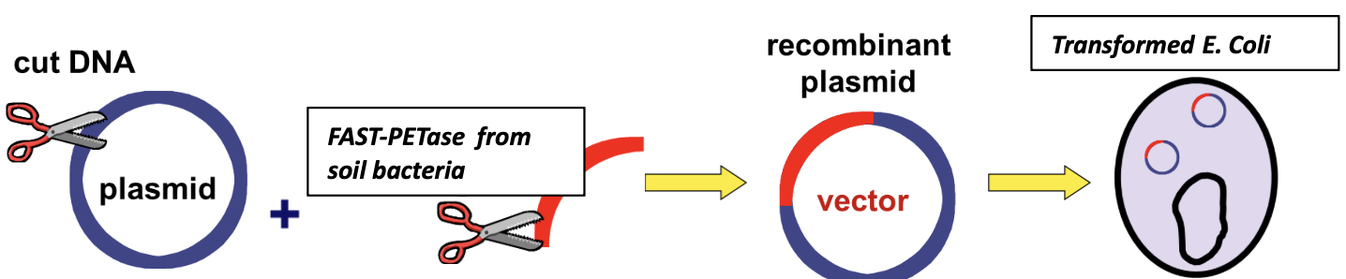
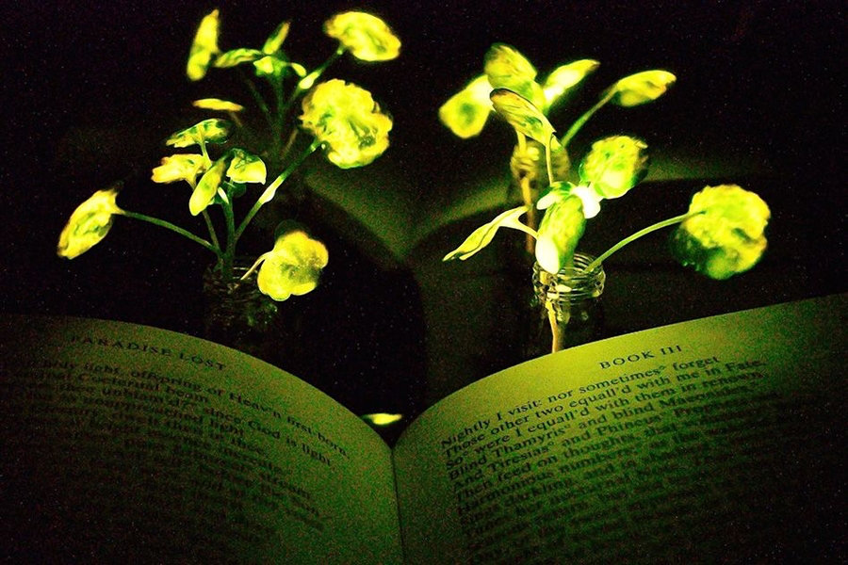






Producing a Electricity-free Sustainable Light Source Using Bioengineered Escherichia coli
Katherine Duanmu, Zubin Abraham, Carina Clark, Madelyn Downing, Alvin Dzoung, Jomana Elghamrawy, Abigail Nunes, Keelan Peterson, Jamarquis Sann, Ian Walters, Dr. Enhua Wang (Advisor), Dr. John Kisiday from the University of Wyoming (Mentor)
Academy of Notre Dame, Tyngsboro, Massachusetts, USA
Our objective is to create a continuous and sustainable light emission source without the need for external electricity supply offering a sustainable and environmentally friendly solution to light generation.
Neonothopanus nambi is a brown fungus, which emits brown colors in the day but a bright green in the dark. In the fungus, one key group of genes are responsible for the bioluminescence of the fungus. One of them is Luciferase gene (nnluz) encoding luciferase, an enzymes controls the fungal bioluminescence cycle, and can glow when inserted into the luciferase gene into bacteria.
Bacterial Strain: E. coli (laboratory strain)
Gene of Interest: Luciferase gene from Neonothopanus nambi (nnluz)
Plasmid Vector: Recombinant plasmid with luciferase gene and necessary regulatory elements
Transformation Method: Heat shock or electroporation to introduce the gene into E. coli
Team Content
Advisor: Dr. Enhua Wang
Team Captain: Katherine Duanmu
Members: Zubin Abraham, Carina Clark, Madelyn Downing, Alvin Dzoung, Jomana Elghamrawy, Abigail Nunes, Keelan Peterson, Jamarquis Sann, Ian Walters,
Future work:
Incorporate engineering work to design a device with self-emitting light bacteria to work as an sustainable light source.
Transfer other bioluminescence genes (eg: nnhisps: The hispidin synthase gene and nnh3h: The hispidin-3-hydroxylase gene) from Neonothopanus nambi to create different E.coli strains and select the high expression level bacteria strains.
Electricity prices in the United States have been rising due to increasing fossil fuel costs and the need for power grid improvements. Moreover, many remote and underdeveloped regions, particularly in developing countries, lack consistent access to electricity, making sustainable light sources essential for daily life. One promising natural alternative is bioluminescence, a phenomenon in which living organisms produce light through biochemical reactions.
References and acknowledgements
https://ista.ac.at/en/news/scientists-discovered-a-set-of-enzymes-to-create-glowing-organisms/
https://my.clevelandclinic.org/health/diseases/16638-e-coli-infection
We’d like to thank our mentor Dr. John Kisiday from the University of Wyoming for meeting with our team to discuss more about the engineering industry. Thank you!

