Slide 1


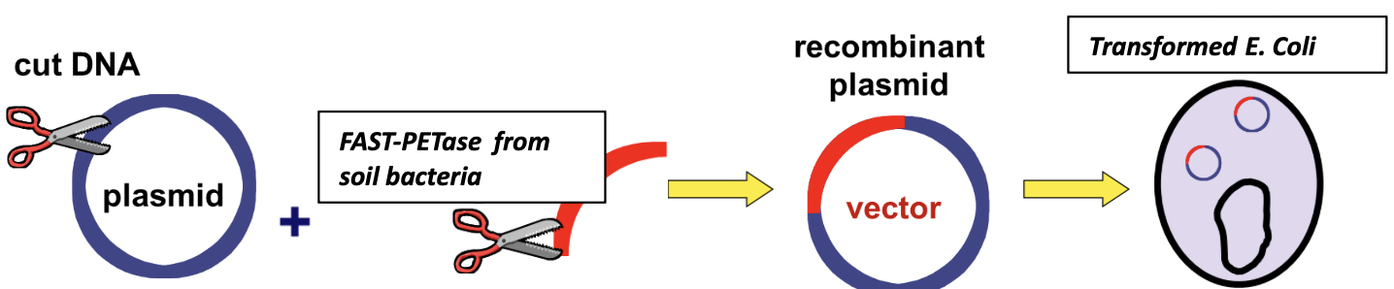
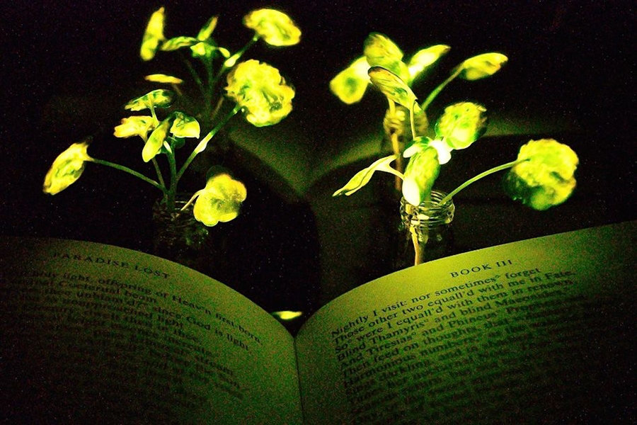
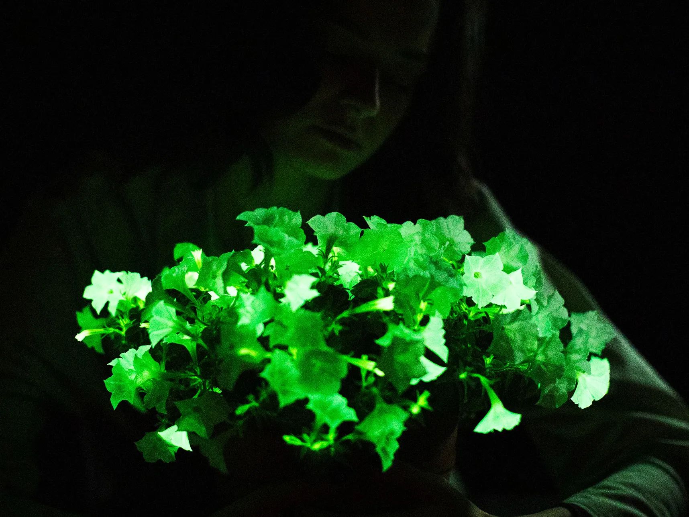






Producing a Electricity-free Sustainable Light Source Using Bioengineering Escherichia Coli
Katherine Duanmu, Zubin Abraham, Carina Clark, Madelyn Downing, Alvin Dzoung, Jomana Elghamrawy, Abigail Nunes, Keelan Peterson, Jamarquis Sann, Ian Walters, Dr. Enhua Wang
Academy of Notre Dame, Tyngsboro, Massachusetts, USA
Our objective is to create a continuous and sustainable light emission source without the need for external electricity supply offering a sustainable and environmentally friendly solution to light generation.
Neonothopanus nambi is a brown fungus, which emits brown colors in the day but a bright green in the dark. In the fungus, one key group of genes are responsible for the bioluminescence of the fungus. One gene is Luciferase gene (nnluz) encoding luciferase, an enzyme that controls the fungal bioluminescence cycle, and can glow when inserted into the luciferase gene into bacteria
Bacterial Strain: E. coli (laboratory strain)
Gene of Interest: Luciferase gene from Neonothopanus nambi (nnluz)
Plasmid Vector: Recombinant plasmid with luciferase gene and necessary regulatory elements
Transformation Method: Heat shock or electroporation to introduce the gene into E. coli

