Slide 1

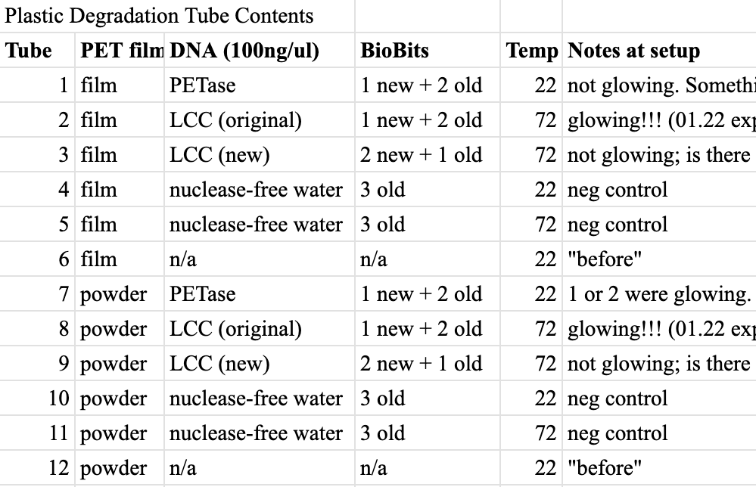
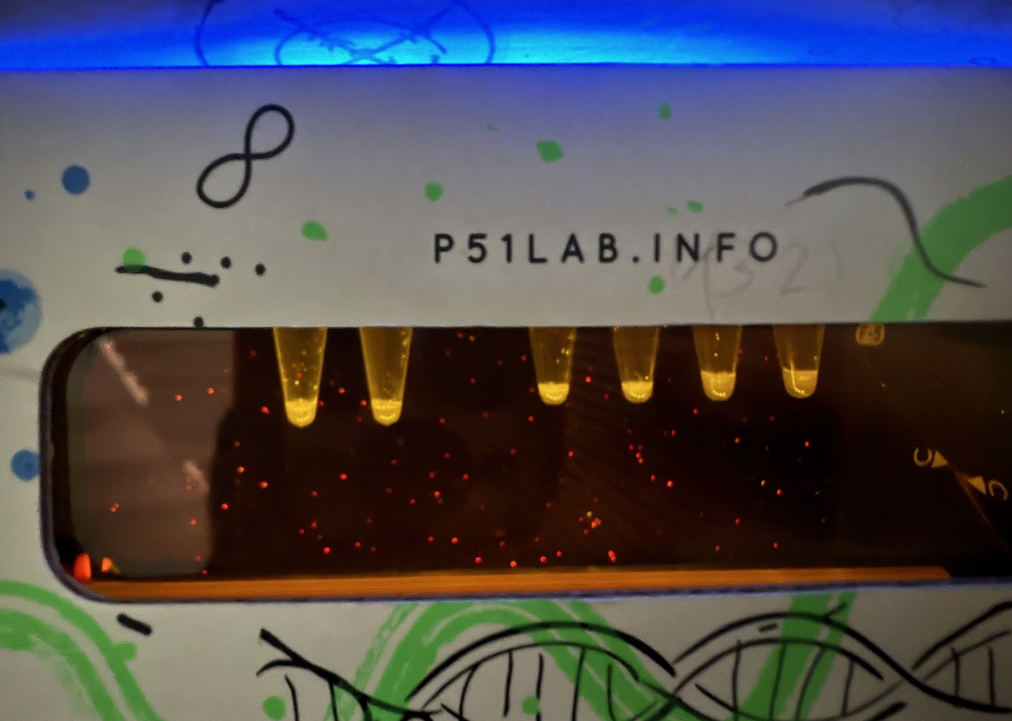
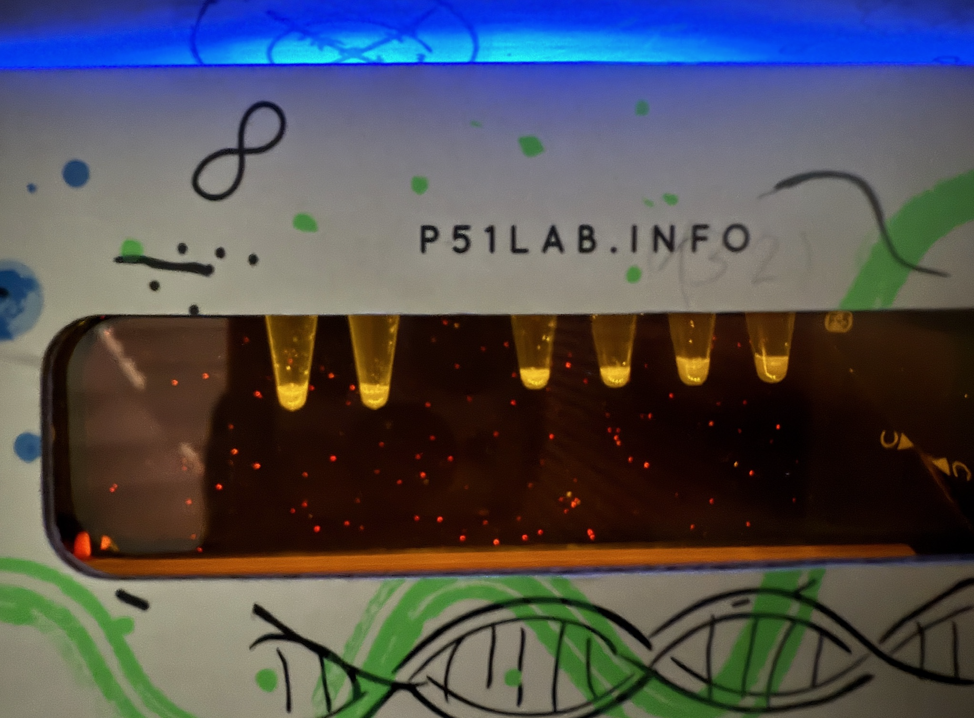
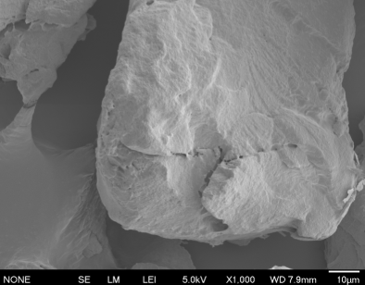
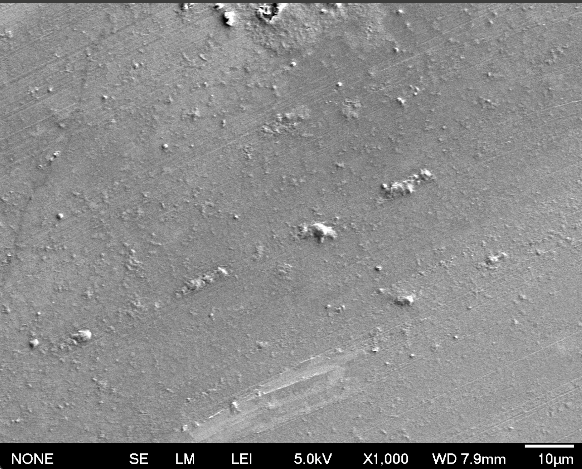
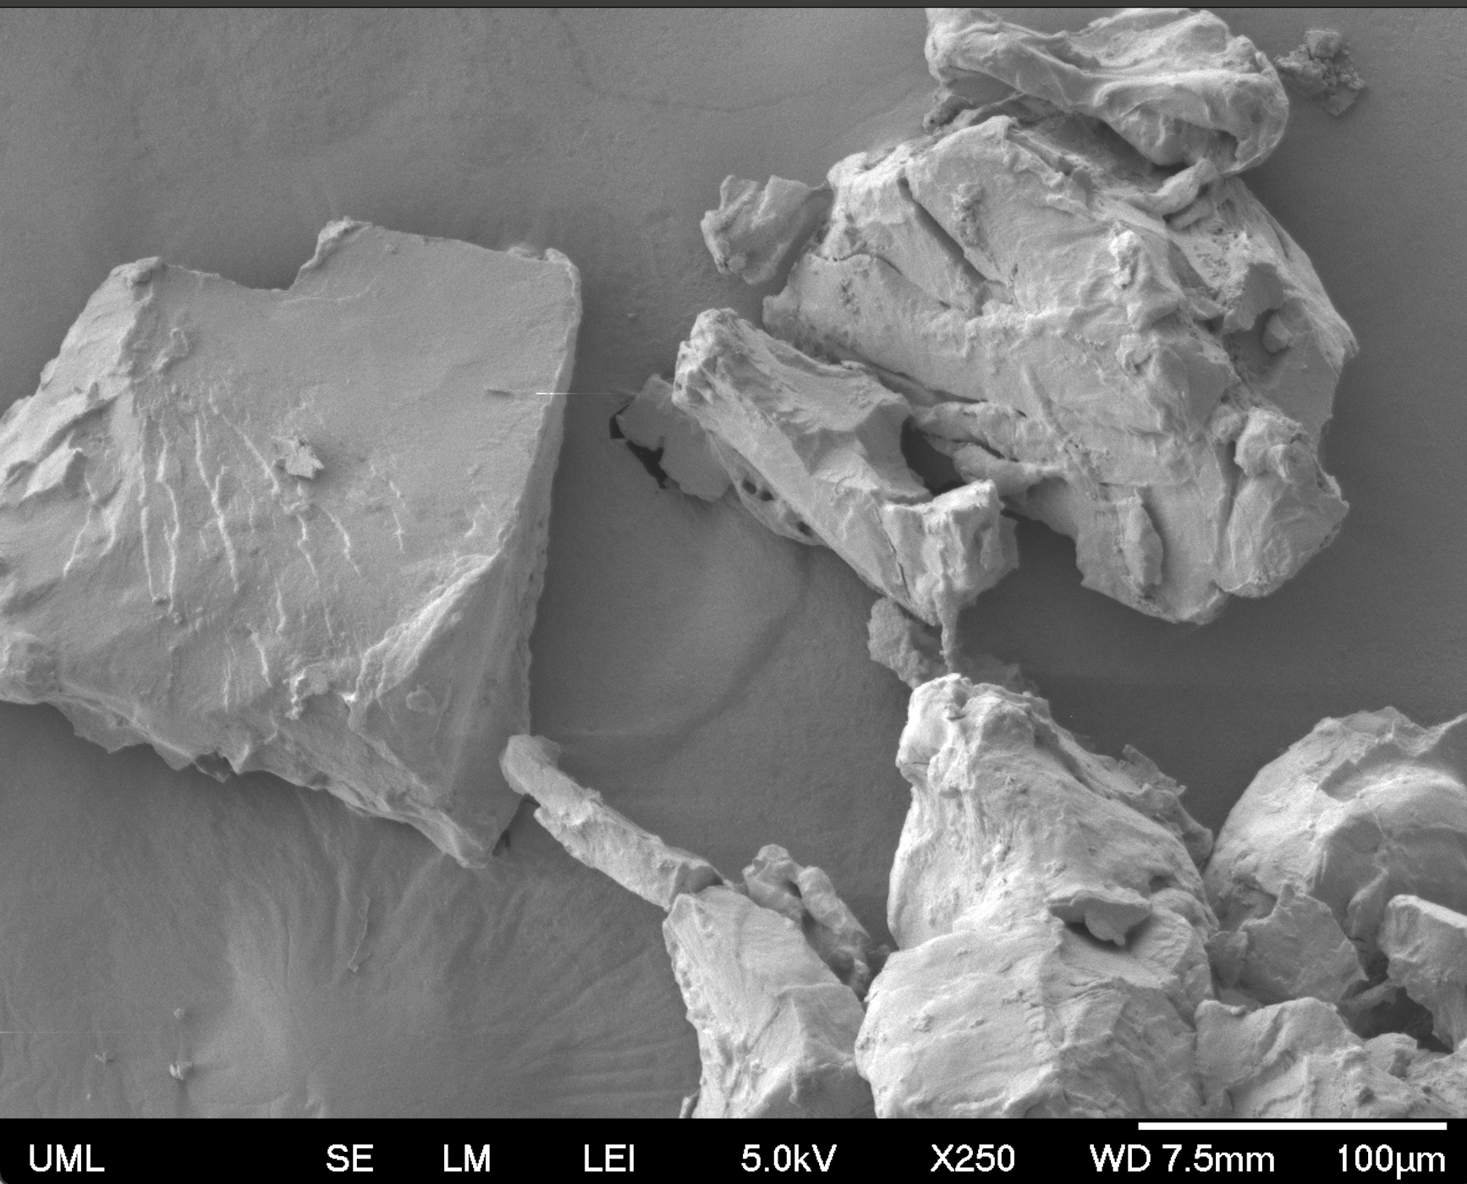
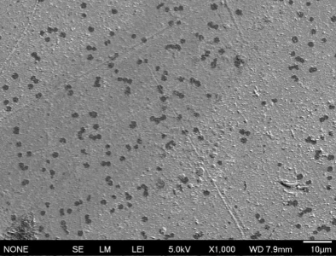
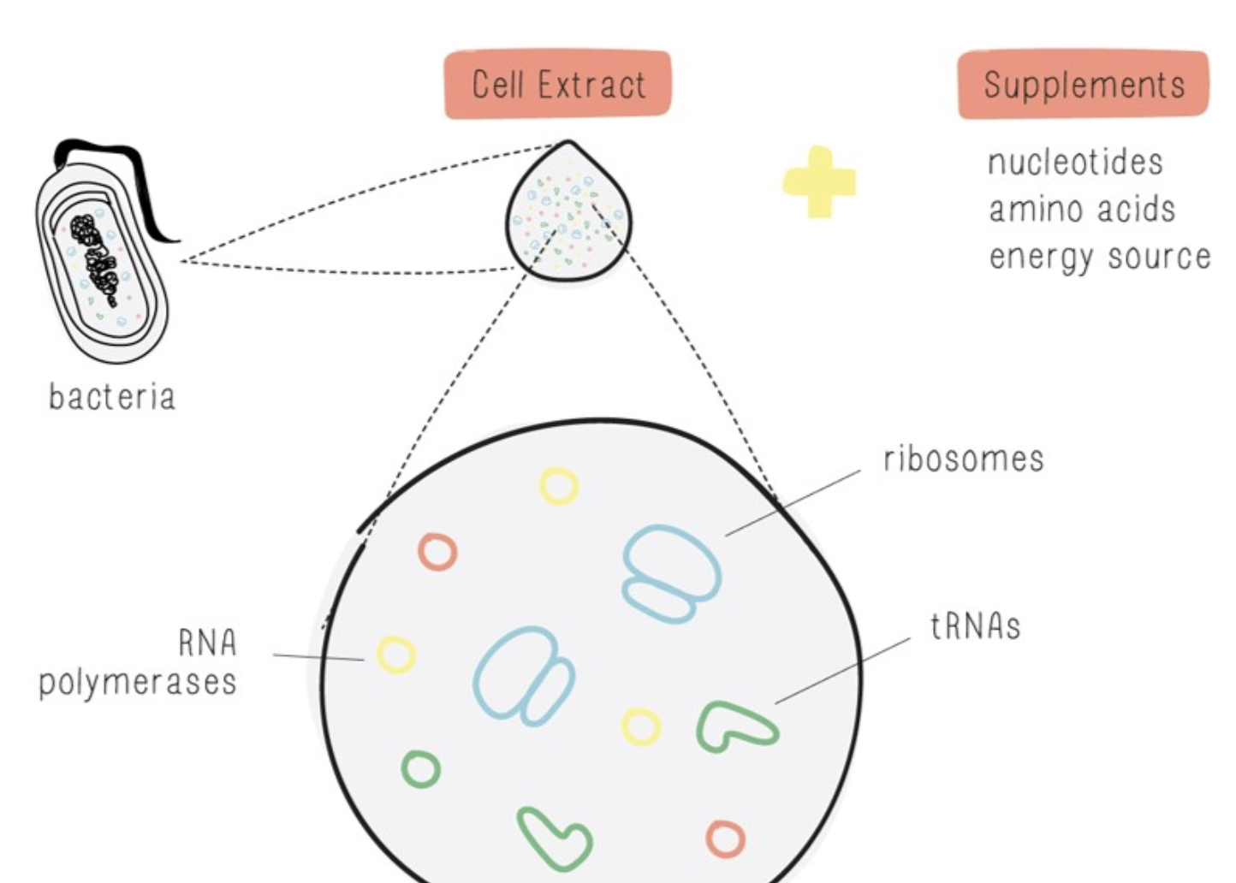






Bottles Be Gone
Siri Jayaprakash, Ella Hu, Sanjith Kalpat, Keerthi Shome, Tommy Kruecker-Green,
Dr. Lindsey L’Ecuyer (teacher), Nathan Crook and Tianyu Li (mentors, NCSU)
Andover High School, Andover, Massachusetts, USA
Objective:
Utilizing plastic degrading enzymes like LCC and PETase to break PET down into harmless organic compounds
PETase
Biobits:
LCC
Problems:
ImageJ can not correctly isolate plastic particles from the background creating difficulties to analyze the roundness of the particles.
72° reactions dried out before reaching 5 day mark
Notes:
What is the objective of your project?
(optional) What techniques did you use or plan to use?
(optional) What technical needs do you have? What are the limitations of your tools?
(Optional) What results do you have or expect?

