Slide 1


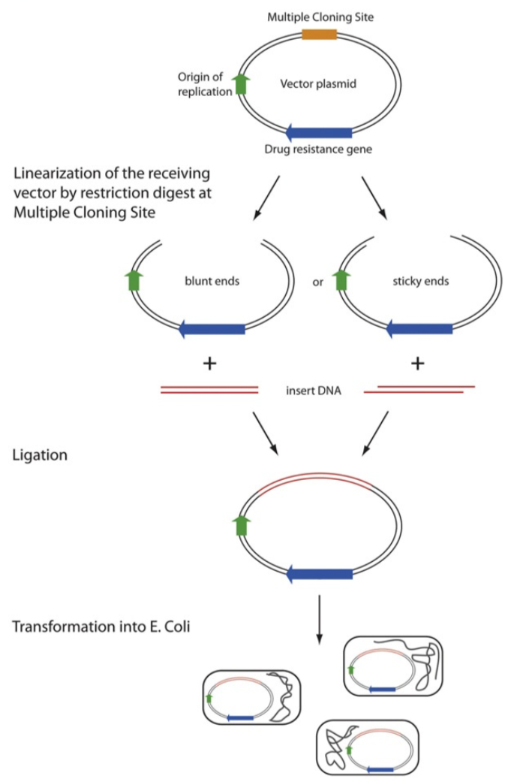
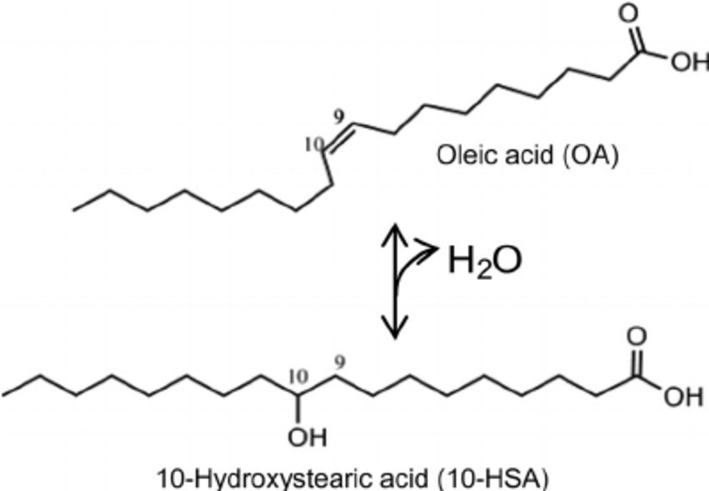
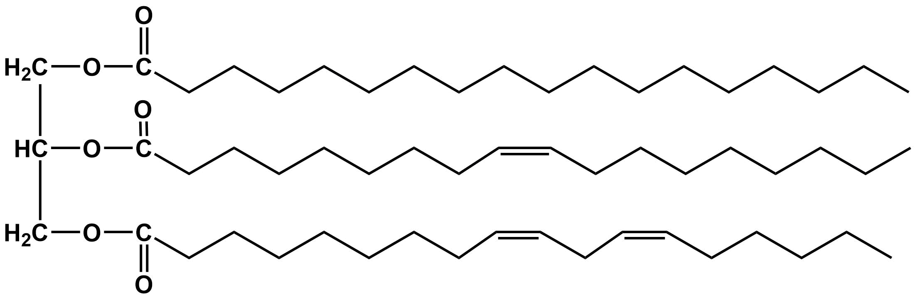
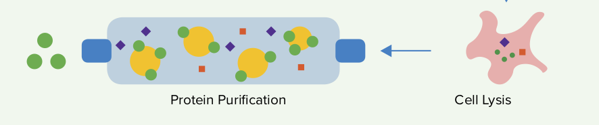
Removing Lipid Stains on Fabrics Using Oleate Hydratase
Arvin H edayat, Anna Lian, Shraddha Lulla, Aurik Mah, Megan Malur,
Neil Malur, William Middlezong, Ellie Tillman-Schwartz, Jessy Wang, Jessie Yuan
Weston High School, Weston, MA
Introduction & Project Details
Experiments We Did &/or Planned
Objective: Develop an enzyme based process that can degrade laundry stains more effectively and sustainably than current cleaning agents.
About our design: We planned to add a hydroxyl functional group to increase solubility as it increases the polarity of the substance.
Laundry & Enzymes: Enzymes are commonly used in many laundry detergents due to their ability to break down specific molecules. Proteases, amylases, lipases, and cellulases are all examples of typical detergent enzymes. We focused on finding a way to make lipid stains more soluble in water so that they could be easily rinsed out. Oleic acid is a common natural fatty acid found in vegetable oils present in foods like pizza, stir fry and soups.
Experiment details / plans
We intended to use Escherichia coli to create oleate hydratase enzymes to degrade oleic acid. We planned to use transformation to insert a plasmid with a gene that encodes for oleate hydratase from Elizabethkingia meningoseptica.
In the image below, oleate hydratase reacts with the substrate, forming a product with an additional hydroxyl group. Since hydroxyl groups increase solubility as a consequence of their polarity, we predict that the fat molecule would dissolve more easily.
Diagram of a lipid
oleic acid

Slide 2
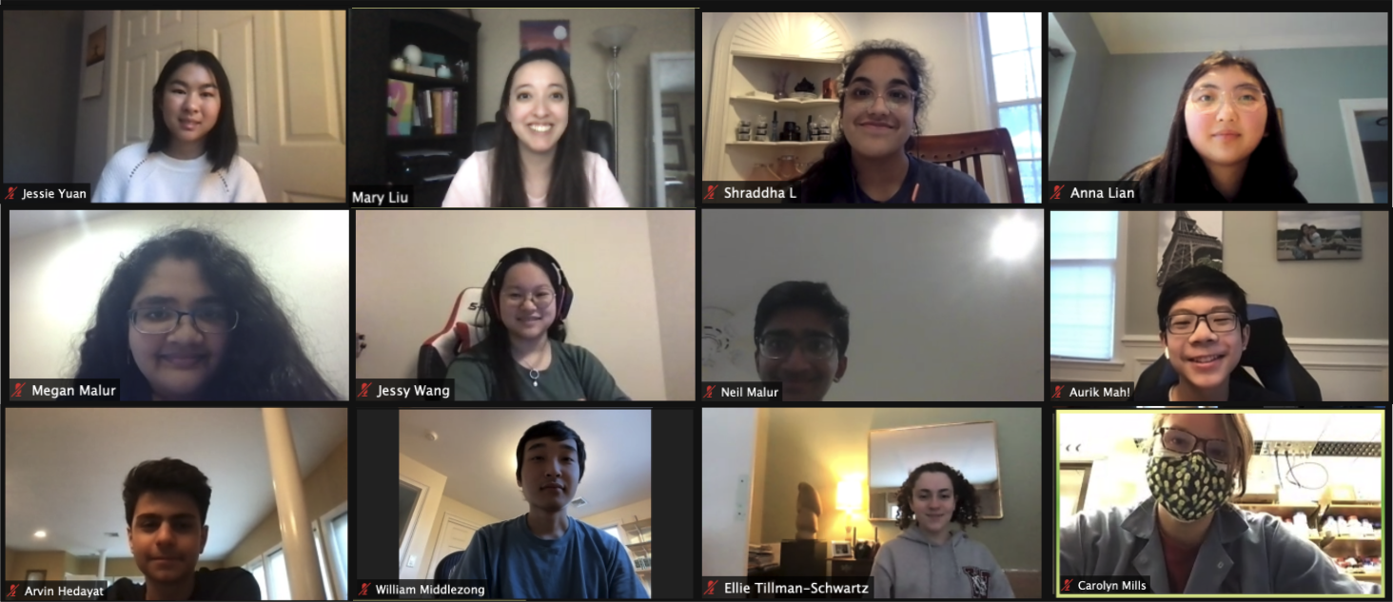
Project Title
Participating Students (first and last names)
School Name, Location
Removing Lipid Stains on Fabrics Using Oleate Hydratase
Arvin H edayat, Anna Lian, Shraddha Lulla, Aurik Mah, Megan Malur,
Neil Malur, William Middlezong, Ellie Tillman-Schwartz, Jessy Wang, Jessie Yuan
Weston High School, Weston, MA
Challenge for Next Year’s Team
About This Year’s Team
Continue to find enzymes suitable for the experiment
Determine best way to purify enzymes without changing effectiveness
Identify other types of common stains and the corresponding enzymes that may be able to degrade them
If your team doesn’t continue the project next year, but it was picked up by another school’s team, what experiment would you want them to do? (Be specific so they can actually try it!)
  Determine how long it takes hydratase to be effective: Conduct an experiment where purified hydratase is used on a fabric stain, like oil. Control for the amount of hydratase, the stain composition, type of fabric, and length of time on the fabric. Pretreat the fabric with enzyme to determine whether hydratase removes the stain more efficiently in combination with detergents.
  The effectiveness of the enzyme can be measured by stain reduction. For example this could be measured by using a hydrophobic dye to better measure the radius of the stain.
  Another question to be investigated: How does making oleic acid more soluble affect the whole stain?
We meet each week to continue our research and experimental plan. We have students from a variety of grades from 9-12.
References & Acknowledgements
We would like to thank:
Dr. Carolyn Mills (mentor)
Ms. Liu
Image Citations
https://blog.addgene.org/plasmids-101-what-is-a-plasmid
https://jb.asm.org/content/191/15/5010
https://blog.addgene.org/plasmids-101-protein-expression

