Slide 1


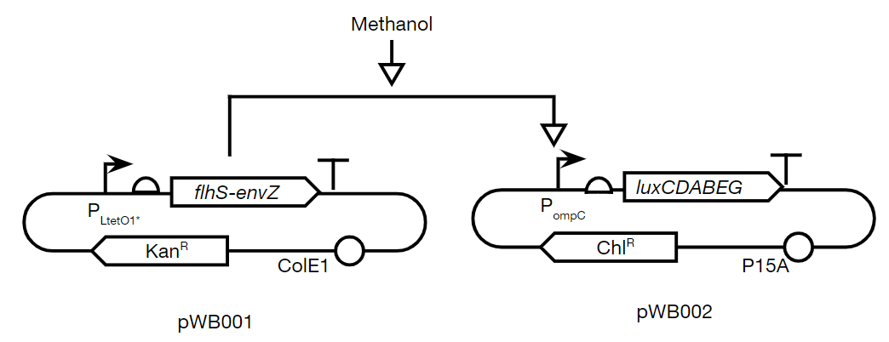
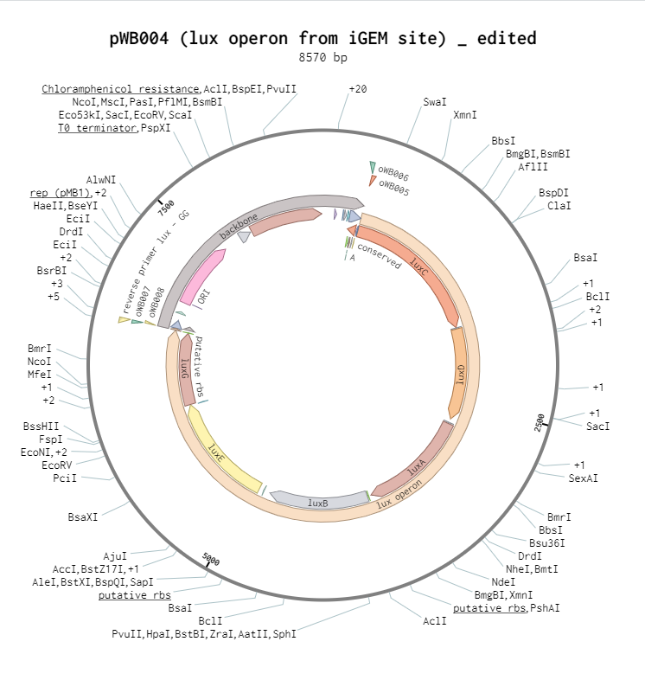
Cow Farts: the Sequel
Westborough High School BioBuilders
Westborough High School, Westborough MA
Introduction & Project Details
Experiments We Did &/or Planned
Methane production from farmed cows is a major contributor to emissions. We decided to build a biosensor to detect methanol since it is part of the methane consumption pathway.
Our goal was to use Escherichia coli as a chassis (which uses the lux operon to glow in the presence of methanol).
We used a chimeric histidine kinase (CHK) to promote a phosphorylation cascade that induces luxCDABEG expression
Genetic Circuit Diagram -- methanol sensing leads to EnvZ activating OmpR inducing ompC promoter, turning on lux operon and bioluminescence
No tests or experiments have been run yet, but these are the plans:
> Design of a negative control where no results are expected:
(no pathway, no CHK or RR, no cascade, no bioluminescence)
> Design positive control to check for bioluminescence efficacy:
(always-on RR, always-on ompC, should be always-on biolum.)
> Physically build our plasmids to determine if our design works!
(entire pathway, CHK+RR, methanol-triggered cascade & biolum.)
We used Benchling to design plasmids and primers to assemble using Golden Gate cloning.

Slide 2
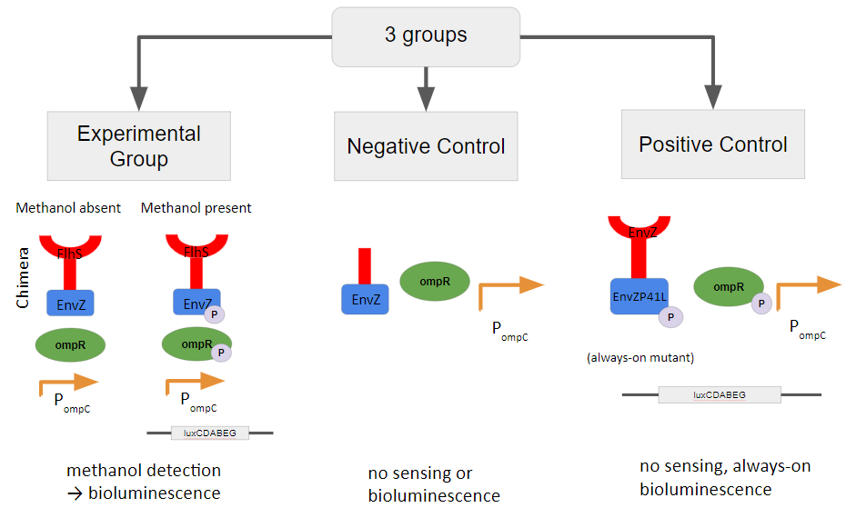
Cow Farts: the Sequel
Westborough High School BioBuilders
Westborough High School, Westborough MA
Challenge for Next Year’s Team
About This Year’s Team
> To build plasmids pWB001, pWB002
> To design and build the positive and negative control plasmids
> To test our Biosensor plasmid!
(and redesign if necessary)
This is year 2 for us. We had several returning members and several new members. We operated completely virtually this year, meeting several times each month. Our amazing mentor, Dr. Josh Atkinson, taught us how to use Benchling to design our plasmids/primers and introduced us to Golden Gate Cloning.
Our team leader, Viggy Vanchinathan set up all of the BioBuilder teams on Slack to streamline communications.
We were awarded a Westborough Education Foundation grant which funded our registration the the Project Development Studio this year.
Experimental Design
References & Acknowledgements
Thank you to our mentor, Dr. Josh Atkinson at the University of Southern California
References
Selvamani et al. Biotechnology and Bioprocess Engineering (2017) 22: 225-230
Foo et al. Prog Biophys Mol Biol. (2015) 118(3): 119–129.
Tokyo-NoKoGen - iGEM 2012

