Slide 1


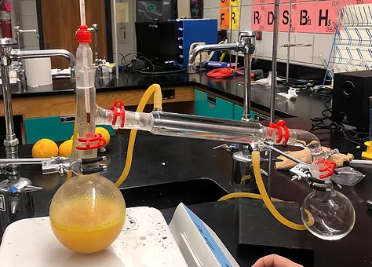
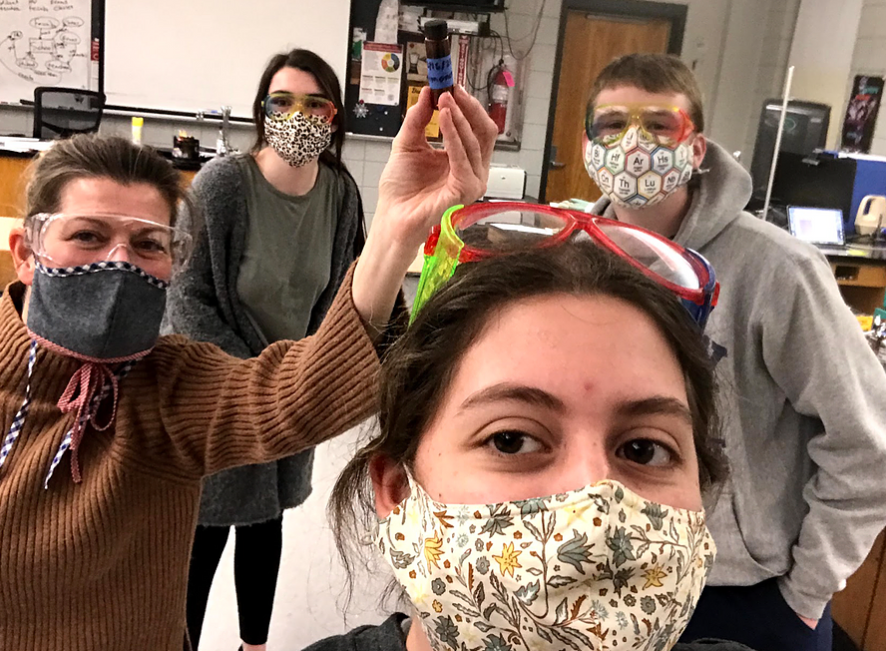
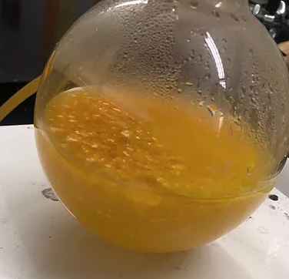
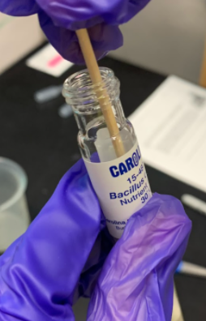
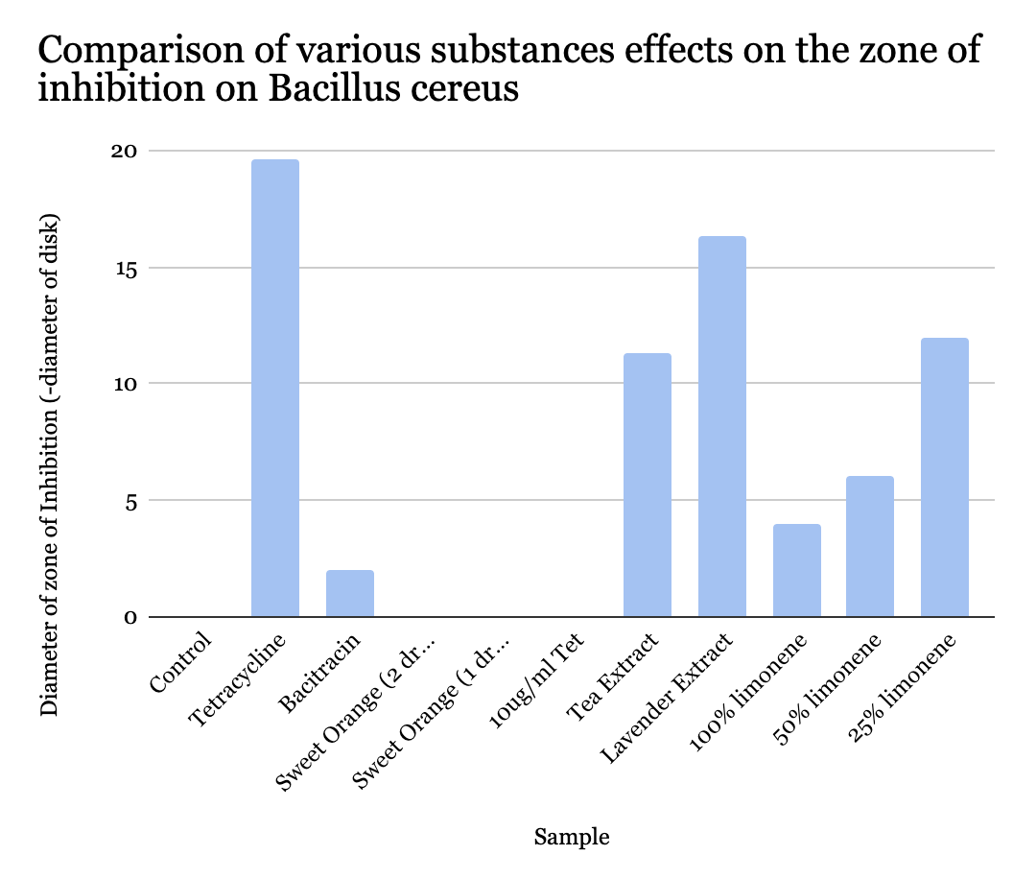
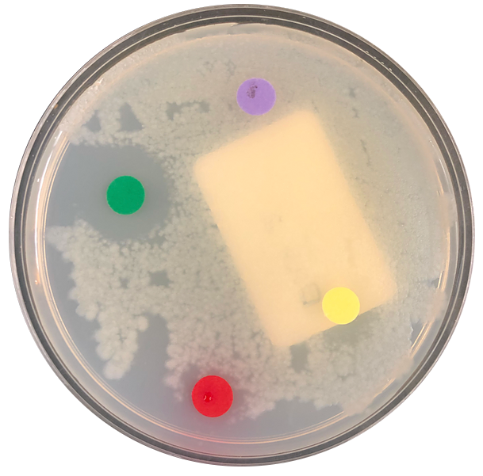
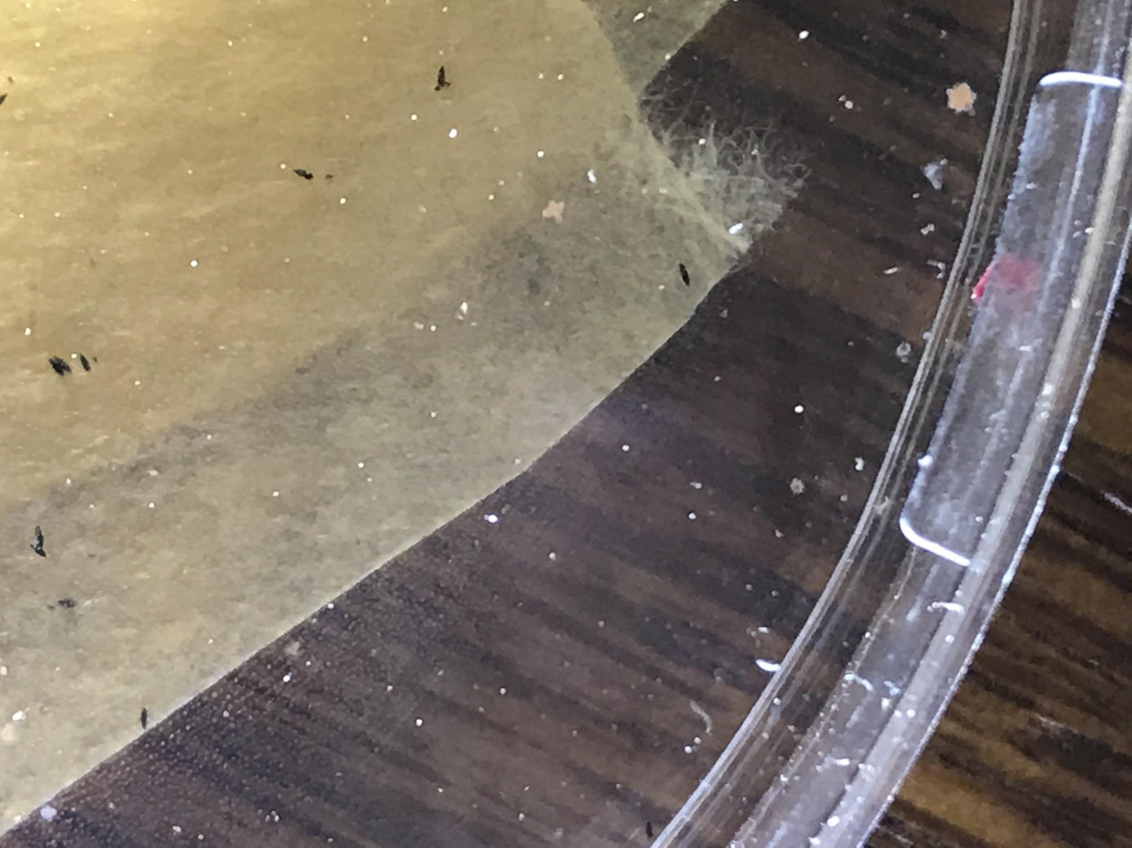
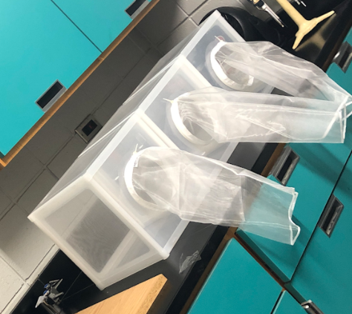
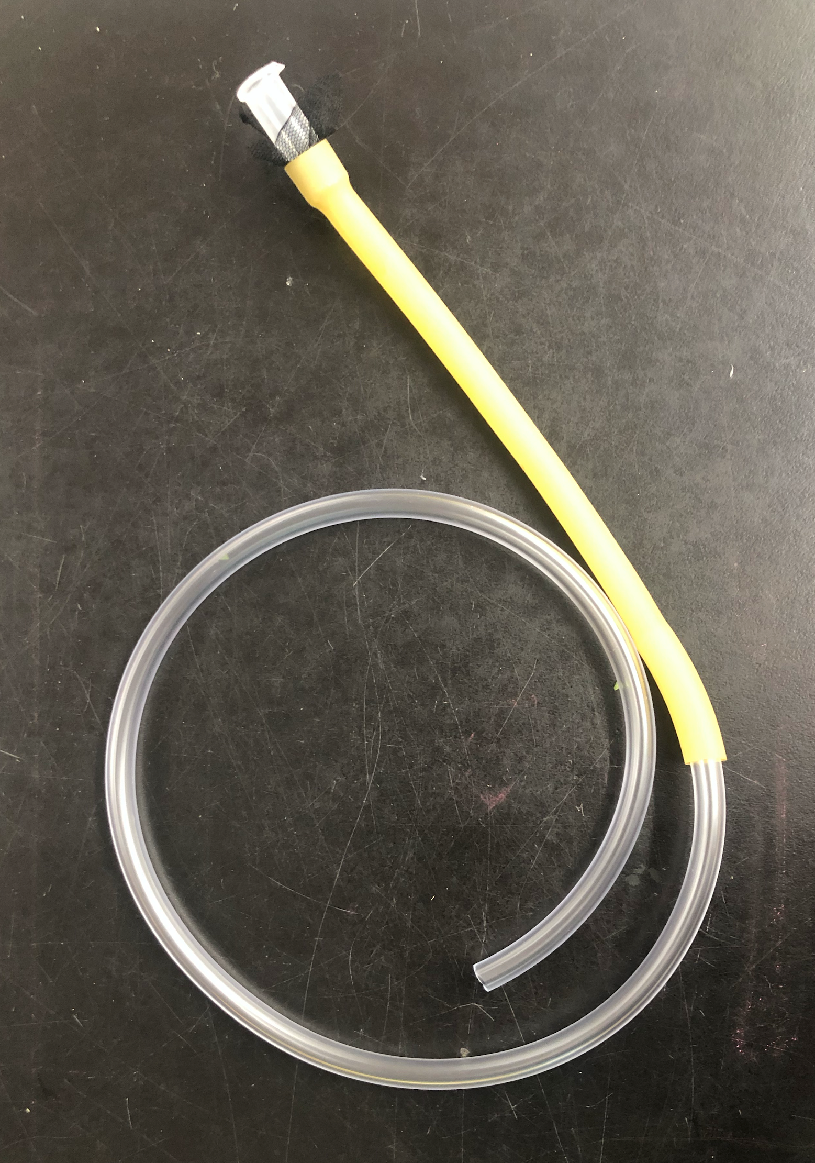
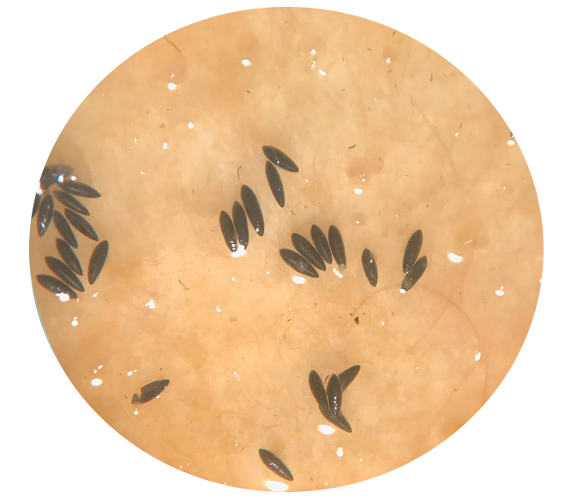
AliveSCENT
M. Aldulaimy, E. Angelo, T. Clare, Y. Collins, G. Cote, E. Fugazzotto, A. Jasim, S. Lundberg, A. Murrant-Johnson, M. Patel, S. Puma, C. Riley
Tyngsborough High School, Tyngsborough, MA
Introduction & Project Details
Experiments We Did
As vectors for disease transmission, mosquitoes are responsible for over 700,000 deaths each year. Currently, there are many methods to repel mosquitoes including DEET, citronella candles, and bug zappers. Last year, AliveSCENT, a biologically-inspired mosquito deterrent that utilizes the native methylerythritol 4-phosphate (MEP) pathway of Escherichia coli for the production of limonene was proposed as a possible solution to this public health problem (BioTreks, 2020).
However, before bacteria can be re-engineered to produce limonene, its effectiveness as a natural insect repellent among live mosquitoes must first be evaluated. In preparation for this, a successful breeding colony must first be established. Eggs from the Aedes albopictus (Westminster College) provided by Dr. Joseph Wagman and Dr. Diana Ortiz will be hatched, larvae will be reared to adulthood, and adults will be transferred to permanent Bug Dorms. Since female mosquitoes are responsible for biting, they will be isolated from the population during live mosquito tests.
Limonene is a monoterpene with a citrus scent that has the potential to repel insects (BioTreks, 2020). Orange peel extract typically contains 90-95% limonene. Earlier this year, limonene was extracted from orange peels using steam distillation. The purpose of this is to use this naturally occurring limonene, and observe its effects on live mosquitoes. A mosquito nursery has been built to make this possible, and although there have been issues hatching any mosquitoes, a small number have hatched and there are plans to begin a new colony for testing this Spring. Our mosquitoes are disease-free and will be contained properly to prevent escape.
Utilizing the bacteria kit provided by BioBuilder, an experiment was conducted to test the effectiveness of different concentrations of limonene as an antibacterial agent. Other essential oils were also tested and it was found that lavender was more effective than the lowest concentration of limonene, thus prompting the research of alternative variables for possible further experimentation next season.
The plasmid design has been changed from last season to include two devices. Device A as shown in the Lightning Talk, is designed with a constitutive promoter, and a geranyl pyrophosphate synthase translational unit that will be assembled into a red fluorescent protein-encoding vector. Device B is designed with a stationary phase promoter and a limonene synthase translational unit that will be assembled into a red fluorescent protein-encoding vector. As of now, the team is looking at plasmid pGL403 from the Addgene plasmid library for inspiration because it contains both GPPS and LIMS which are necessary for limonene production.
Experiment 1. Extraction of limonene from orange peels by distillation
Experiment 2. Tested zone of inhibition of Bacillus cereus using essential oils
Experiment 3. Assembled Mosquito Nursery Video of Mosquitoes
Experiment 4. The Effects of Limonene Concentration on Mosquito Behavior
Planned for Spring 2021

Slide 2
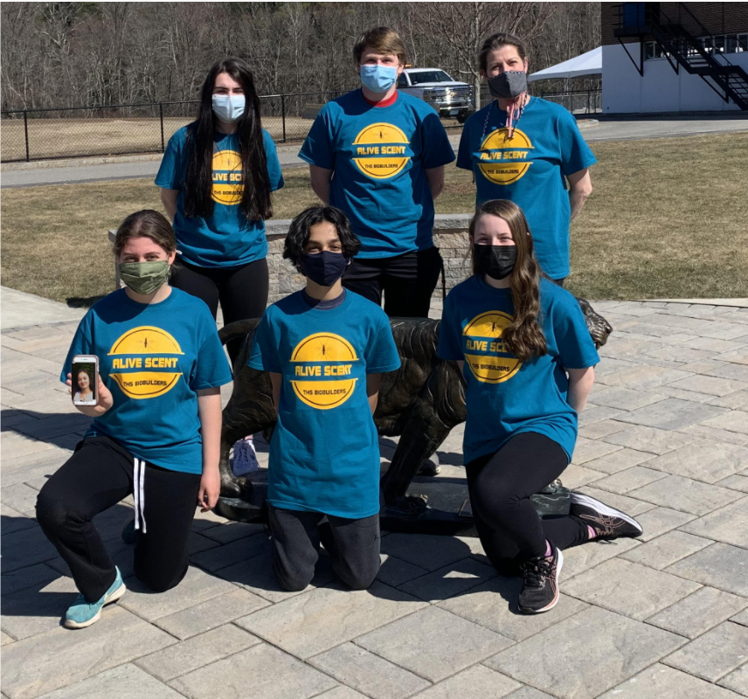
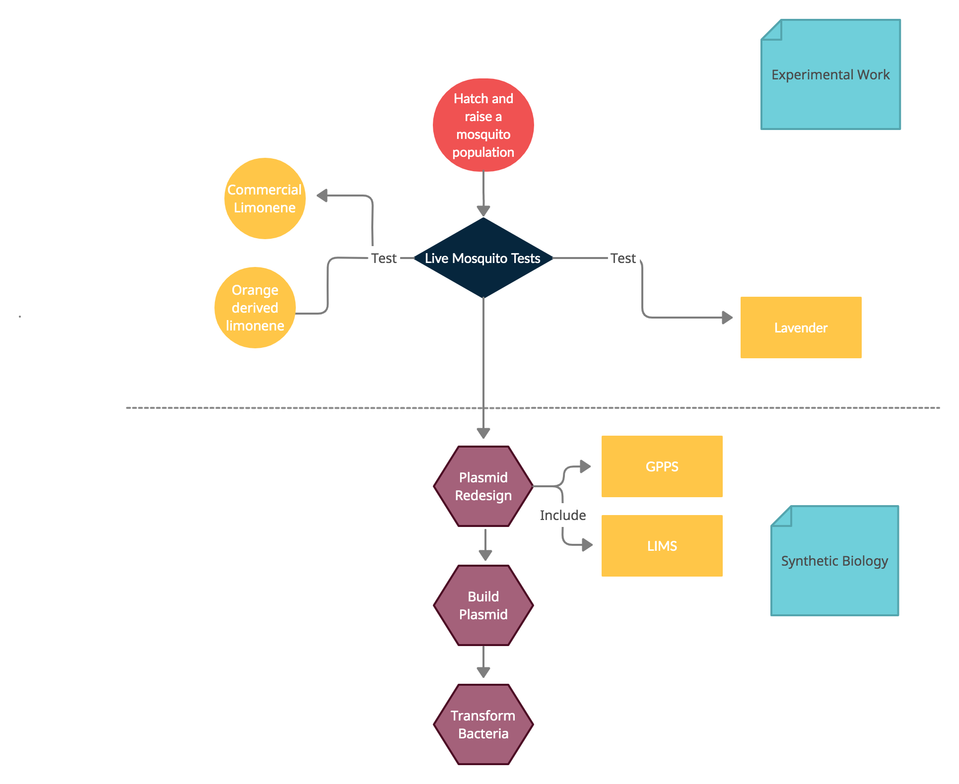
AliveSCENT
M. Aldulaimy, E. Angelo, T. Clare, Y. Collins, G. Cote, E. Fugazzotto, A. Jasim, S. Lundberg, A.
Murrant-Johnson, M. Patel, S. Puma, C. Riley
Tyngsborough High School, Tyngsborough, MA
Challenge for Next Year’s Team
About This Year’s Team
Season 2021-2022:
The 2021 Tyngsborough BioBuilder Team consists of current juniors and sophomores who are interested in a career in biology and technology. Although this year has been a tough year because of the pandemic, we have been able to come together and share our interests in biology. The Tyngsborough BioBuilderClub meets every Wednesday to collaborate. Whether members were joining remotely or in-person, we were able to make sufficient progress towards meeting our goals for the season. Our most memorable season highlights include meeting with Dr. Wagman to learn more about Aedes and performing experiments as a team in-person. We have practiced designing and testing experimental protocols, learned how to troubleshoot the handling of live materials, and successfully extracted limonene from oranges, but we are most proud of our first-class Mosquito Nursery!
References & Acknowledgements
Jervis, A. J., Carbonell, P., Vinaixa, M., Dunstan, M. S., Hollywood, K. A., Robinson, C. J., Rattray, N. J. W., Yan, C., Swainston, N., Currin, A., Sung, R., Toogood, H., Taylor, S., Faulon, J.-L., Breitling, R., Takano, E., & Scrutton, N. S. (2018). Machine Learning of Designed Translational Control Allows Predictive Pathway Optimization in Escherichia coli. ACS Synthetic Biology, 8(1), 127–136. https://doi.org/10.1021/acssynbio.8b00398
Ladania MS. Citrus fruit: biology, technology and evaluation [Internet]. Elsevier Inc; 2008. Chapter 6, Fruit biochemistry; [cited 2020 Apr]. Available from: www.sciencedirect.com/topics/agricultural-and-biological-sciences/lemon-peels
Machine learning of designed translational control allows predictive pathway optimisation in Escherichia coli. Jervis AJ, Carbonell P, Vinaixa M, Dunstan MS, Hollywood KA, Robinson CJ, Rattray NJW, Yan C, Swainston N, Currin A, Sung R, Toogood HS, Taylor S, Faulon JL, Breitling R, Takano E, Scrutton NS. ACS Synth Biol. 2018 Dec 18. doi: 10.1021/acssynbio.8b00398. 10.1021/acssynbio.8b00398 PubMed 30563328
“Orange Peels.” Orange Peels - an Overview | ScienceDirect Topics, www.sciencedirect.com/topics/agricultural-and-biological-sciences/orange-peels.
“pGL403 (Plasmid #119953).” Addgene, www.addgene.org/119953/.
TheRedNile. “How to Extract Limonene from Orange Peels.” YouTube, YouTube, 12 Mar. 2015, www.youtube.com/watch?v=o4CBXkfVHDc&feature=emb_title.
Thermo Fisher Scientific. MSDS limonene safety data sheet [Internet]. Waltham (MA): Thermo Fisher Scientific; 2010 Oct 22 [revised 2018 Jan 19; cited 2020 Apr]. Available from:https://www.fishersci.com/store/msds?part Number=AC203731000 product Description=%28-%29-LIMONENE+92%25+100ML&vendorId=VN00032119&countryCode=US&language=en
Tyngsborough BioBuilderClub (2020). AliveSCENT: A method for engineering E. coli to produce limonene as a natural mosquito repellent. Https://Biotreks.Org/E202007/. https://biotreks.org/e202007/
Wagman JM, Achee NL, Grieco JP (2015) Insensitivity to the Spatial Repellent Action of Transfluthrin in Aedes aegypti: A Heritable Trait Associated with Decreased Insecticide Susceptibility. PLoS Negl Trop Dis 9(4): e0003726. doi:10.1371/journal.pntd.0003726
The THS BioBuilderClub would like to extend our thanks to Michael Sheets from the Dunlop Lab at Boston University for being a patient and thoughtful mentor and for donating his time and contributing to our bacteria growth data by conducting alternate antimicrobial inquiry investigations with different essential oils. Our team would also like to extend a heartfelt thanks to Dr. Natalie Kuldell for creating a platform where students can practice real science with help from real scientists. We would also like to thank Dr. Joseph Wagman, for providing Aedes albopictus eggs and his advice and expertise throughout this process as well as Dr. Diana Ortiz from whom the colony originated. A special thanks to Rebekah Ravgiala, for guiding our team through this whole process and spending numerous hours after school with us.

