Slide 1

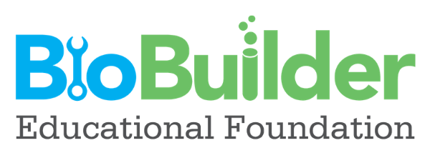
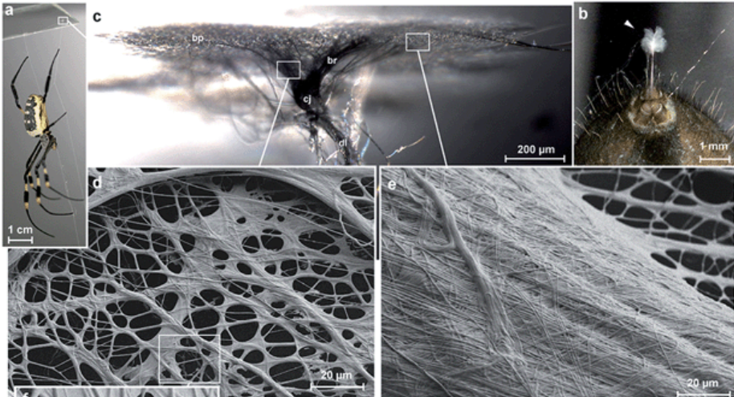
Spider-Silk-Producing Yeast for Wound Healing
Corinne Drabenstott, Alexa Tascher, Sophia Hopper, Tul Cherukuri, and Monica Chen
Green Hope High School and Ravenscroft High School, North Carolina
Project Summary
Chassis
Design
We designed a yeast that can detect a wound and create a bandage for it made of spider silk.
The yeast Saccharomyces cerevisiae was an ideal chassis for many reasons. First, it can be easily transformed, allowing for deletion or addition of new genes for protein production. Secondly, it is better than bacteria at producing large proteins like the spider silk proteins in great quantities. Lastly, the Y55 strain was chosen because it has been identified as avirulent, unlike other strains that have been known to cause infection in humans.
Plasmid
Yeast cells
Background
Promoter Components
Spider silk is a highly sought after biomaterial due to its many desirable characteristics such as biodegradability, self-assembly, elasticity, and strength (it is said to be stronger than steel!) As a result, scientists have found many applications of spider silk including bullet-proof vests,
surgical sutures, and artificial ligaments.
Our project focuses on how spider silk can be used for wound healing applications. Using synthetic biology, artificial spider silk can be created without having to harvest the silk from real spiders.
PySp1 DEFB103B
AhpCp2D1 (ROS activation):
ROS (reactive oxygen species) have a crucial role in wound healing; they stop blood flow (hemostasis), recruit different types of white blood cells (including monocytes and neutrophils), and aid tissue repair (including endothelial cell division, blood vessel reformation, collagen formation, etc.). Therefore, they are prevalent at wounds and can be used to identify the location of a wound site. This promoter is controlled by the OxyR transcription factor which is activated by the presence of ROS.
ANB1 promoter (oxygen/alkalinity sensing):
A wound microenvironment can be characterized by a lack of oxygen, associated with slowed or no healing and a risk of infection, or a healthy amount of oxygen, associated with a normal rate of healing. The yeast ANB1 promoter would suppress the silk-producing gene under aerobic (sufficient oxygen) conditions and allow the silk producing gene to be expressed under anaerobic (insufficient oxygen) conditions, so that silk is only produced when the microenvironment is such that the wound cannot heal effectively on its own.
AOX1 promoter: This promoter makes sure the silk is excreted by the yeast, so it doesn't fatally build up inside.
CACG motif: This motif, found in the promoters for the silk genes of many spider species, enhances the expression of PySp1.
Modified Promoter: ANB1, AhpCp2D1, AOX1, CACG motif
Pyriform Spider Silk
Since each spider makes many different kinds of silk, each a different protein, we decided to use the Argiope argenta pyriform silk. Pyriform silk is used to attach webs to substrates and catch victims. This is the sticky silk which can attach securely to low energy surfaces like skin. This will ensure that the bandage attaches to the skin well. Other benefits of pyriform silk include extreme strength with little material necessary, biodegradability, self assembly (electrostatic interactions), and its cement-like properties! It is liquid for a second and then forms an immovable monobloc, like stitches. This is expressed by the PySp1 gene.
Antimicrobial Properties
The DEFB103B gene can be used to enhance the abilities of the spider silk bandage by allowing the silk to have antimicrobial properties. This gene codes for hBD-3 (human beta-defensin 103B) which has been found to have anti-inflammatory properties; it also attracts macrophages to the site of the injury. Then, the hBD3 induces the secretion of the cytokine IL-17, which is normally secreted by Th17 and γδ lymphocytes in human skin. IL-17 induces the activity of AMP (antimicrobial peptides) genes that inhibit the growth of bacteria and other microbes.
from: Spider's super-glue: thread anchors are composite adhesives with synergistic hierarchical organization; Jonas O. Wolff, Ingo Grawe, Marina Wirth, André Karstedt and Stanislav N. Gorb; Soft Matter, 2015, 11, 2394-2403

Slide 2
Spider-Silk-Producing Yeast for Wound Healing
Corinne Drabenstott, Alexa Tascher, Sophia Hopper, Tul Cherukuri, and Monica Chen
Green Hope High School and Ravenscroft High School, North Carolina
Challenge for Next Year’s Team
About This Year’s Team
Ensure that the yeast chassis is safe to put on wounds.
It is possible that the extreme repeat homogenization in PySp1 could make it hard to manufacture. If this happens we could look at mixing in other silk proteins.
Create a BioBrick with the PySp1 gene.
Another possible antimicrobial method to consider: the BioBrick BBa_K2018010 (codes for Laterosporulin, a bacteriocin).
Test different promoters to see which one is the most effective or how best to combine the functions of different promoters into one.
We are a joint-high school team from Green Hope High School and Ravenscroft High School in North Carolina. This team was started by Corinne Drabenstott and Alexa Tascher who met through the Young Women in Bio Ambassadors program. Tul Cherukuri and Sophia Hopper joined the team from Ravenscroft and Monica Chen from Green Hope.
References & Acknowledgements
I Grew Real Spider Silk Using Yeast
Spider's super-glue: thread anchors are composite adhesives with synergistic hierarchical organization
Complete gene sequence of spider attachment silk protein (PySp1) reveals novel linker regions and extreme repeat homogenization
Antimicrobial peptides and wound healing
Yeast-Based Synthetic Biology Platform for Antimicrobial Peptide Production
Pathogenicity of Saccharomyces cerevisiae in Complement Factor Five-Deficient Mice
(PDF) Reactive oxygen species (ROS) and wound healing: The functional role of ROS and emerging ROS-modulating technologies for augmentation of the healing process
Thanks to our wonderful mentor Dr. Patricia Silveyra!

