Slide 1

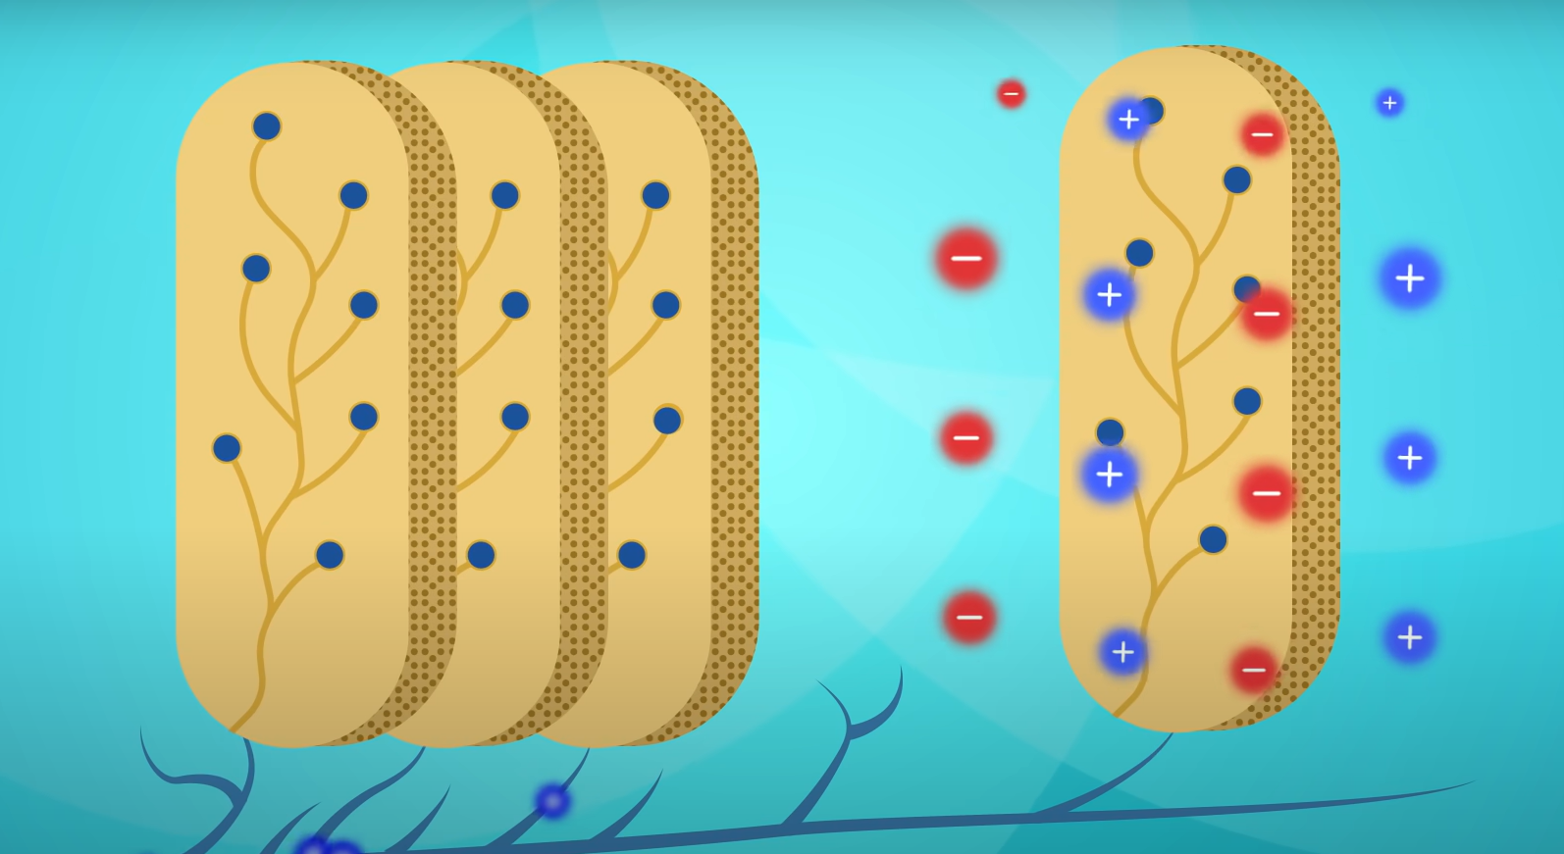
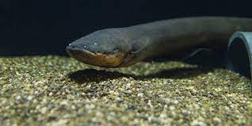






Generating Electricity from Biological Sources
Jacob Sardinha,Tyler Karp, Christopher Kim, Mr. Stewart Pierson
The Rivers School, Weston, MA
Abstract
Our group started out by thinking about harnessing electricity in living organisms and putting it to use, for example for running a prosthetic limb. We investigated how current flows in nerves, and later how electric eels generate electricity. We researched the differences in the genes in electric organs in eels verses genes in smooth muscle tissue, the idea being to isolate the electricity-generating genes and possibly implant them in cells in order to create electricity-generating cells. Though we did not conduct any experiments, we have a number of ideas we can pursue going forward.
Science Content
Our team looked at the electrocytes, cells that generate electricity in the electric organ, in electric eels and other electrical fish as a natural source of electrical energy. We wanted to identify how these cells are able to generate large amounts of usable electricity. After becoming familiar with the processes in electrocytes that generate electric fields, we then researched the genetics of these cells. We looked at several studies on electrocytes in electric eels and other electrical fish and identified several genes that differ between the electrocytes and skeletal muscle cells (and other muscle cells) including:
mef2- a transcription factor than interacts with Ca2+ pathways
Several genes responsible for Na+/K+-ATPase subunits and ion channels including scn4aa
hox10a, hox11a, hox12a, hox13a - regulatory machinery genes
We also looked to design a device to utilize the electricity generated by cells. The challenge with this part would be to ensure the cells generated electricity simultaneously, To do this, we studied a formal experiment which worked on mimicking the methods of electrolytes using artificial gels.
Team Content
This is the 2nd year of the Rivers BioBuilder team. Our team consists of 1 returning member, Jacob Sardinia, and 2 new members, Tyler Karp and Christopher Kim. We also have Mr. Stewart Pierson as our returning advisor, and Dr. Kate Schneider is our Biobuilder mentor.
Next steps:
Next, we want to run experiments to identify the specific genes and pathways that allow electrocytes to generate electricity. To do this, we would genetically remove different combinations of genes from electrocytes and measure the cells ability to generate electricity in order to determine which/ what combination is essential to generate electricity Once identified, we want to design a cell that uses and amplifies these genes to generate electricity, as well as a device which utilizes these cells the energy generated by these cells.
Introduction/Background
We wanted to find a way to generate energy without the use of fossil fuels that harm the environment. We knew that electricity is generated from the movement of ions, and we also knew that cells can move ions, so we wanted to create electricity from cells. We then looked into some animals that can already generate electrical fields, such as eels, and we wanted to mimic them in order to modify existing cells to produce electricity. We also wanted to use this electricity to power devices such as prosthetics.
References and acknowledgements
(Traeger, L.L., Volkening, J.D., Moffett, H. et al. Unique patterns of transcript and miRNA expression in the South American strong voltage electric eel (Electrophorus electricus). BMC Genomics 16, 243 (2015). https://doi.org/10.1186/s12864-015-1288-8 )
Jason R. Gallant, Carl D. Hopkins, David L. Deitcher; Differential expression of genes and proteins between electric organ and skeletal muscle in the mormyrid electric fish Brienomyrus brachyistius. J Exp Biol 15 July 2012; 215 (14): 2479–2494. doi: https://doi.org/10.1242/jeb.063222
"How the Electric Eel Got His Zap." Physics Today, 27 Jun. 2014, physicstoday.scitation.org/do/10.1063/PT.5.010271/full/. Accessed 1 Mar. 2023.
We’d like to thank our Biobuilder mentor, Dr. Kate Schneider, for meeting with and assisting us throughout this project. We would also like the thank our faculty advisor Mr. Pierson for all of his help over the last few months.

