Slide 1

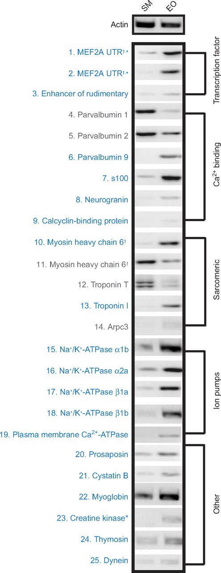
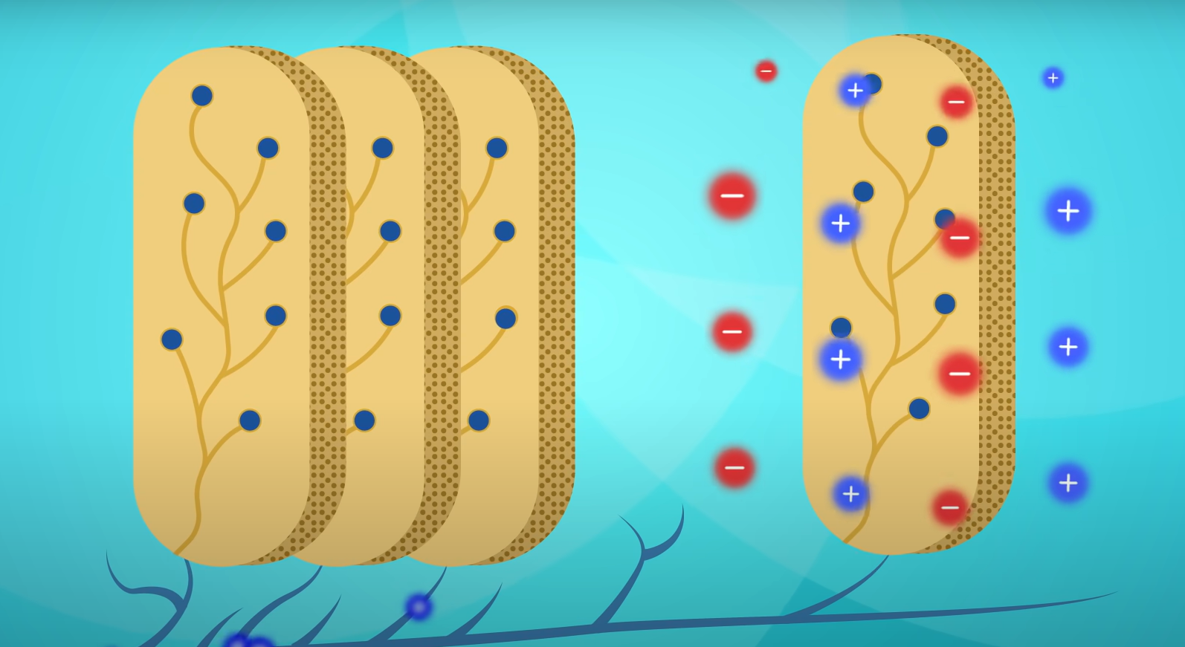
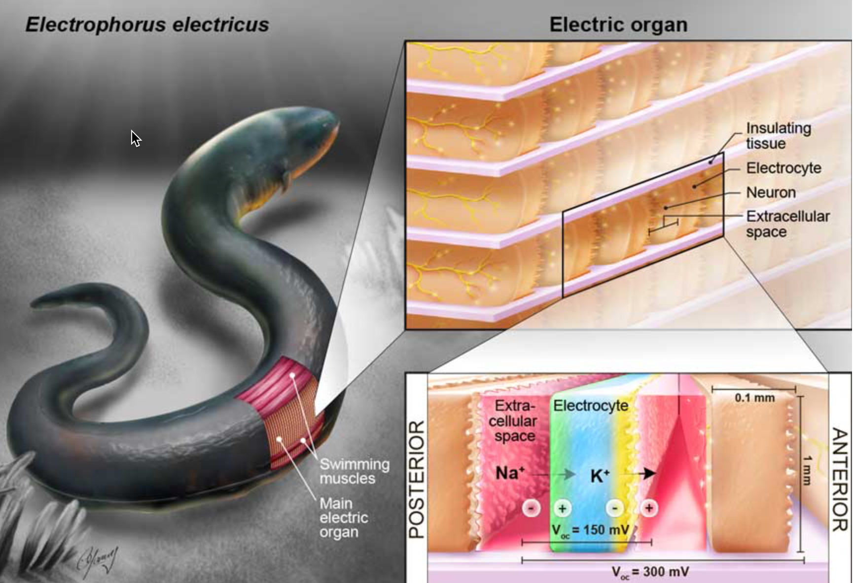
Generating Electricity from Biological Sources
Jacob Sardinha,Tyler Karp, Christopher Kim, Mr. Stewart Pierson
The Rivers School, Weston, MA
Objective: Generate electricity using designed cells
Researched how electrocytes generate electricity in electric eels and other electric fish
Identified potential genes responsible for generation of electricity in electrocytes
Our next Step would be to remove these genes from the electrocytes and test the cells’ ability to generate electricity to determine which genes produce the phenotype to generate electricity
Jason R. Gallant, Carl D. Hopkins, David L. Deitcher; Differential expression of genes and proteins between electric organ and skeletal muscle in the mormyrid electric fish Brienomyrus brachyistius. J Exp Biol 15 July 2012; 215 (14): 2479–2494. doi: https://doi.org/10.1242/jeb.063222

