Slide 1
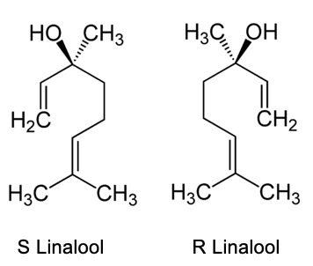
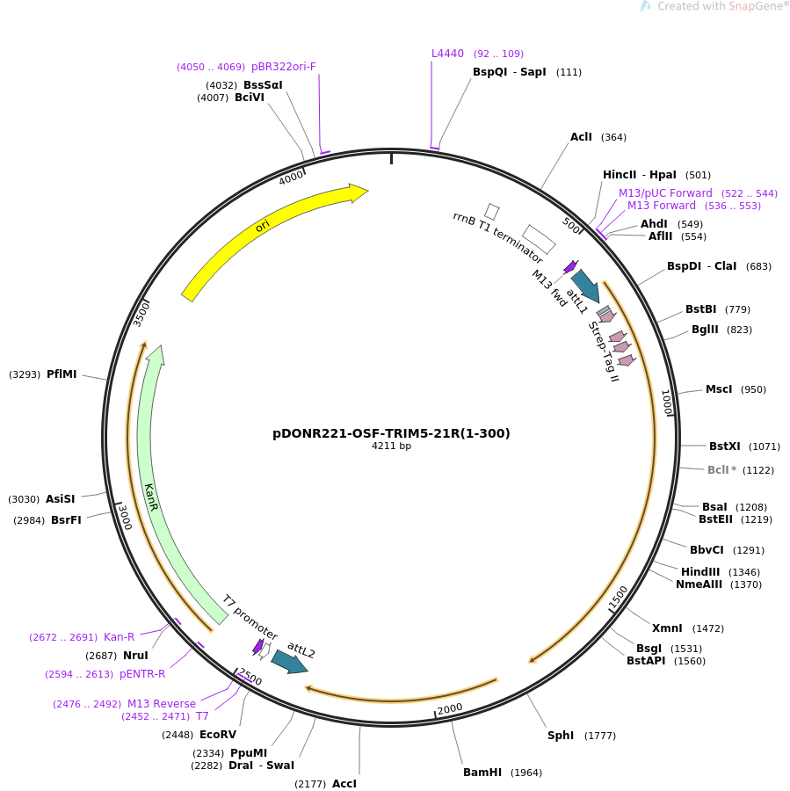
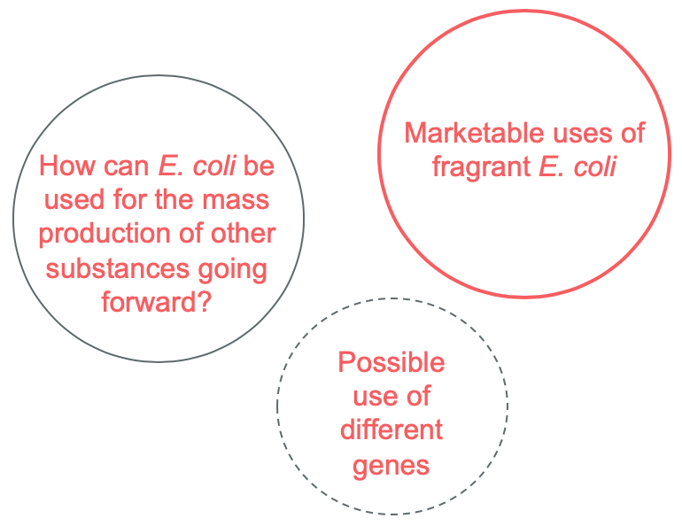

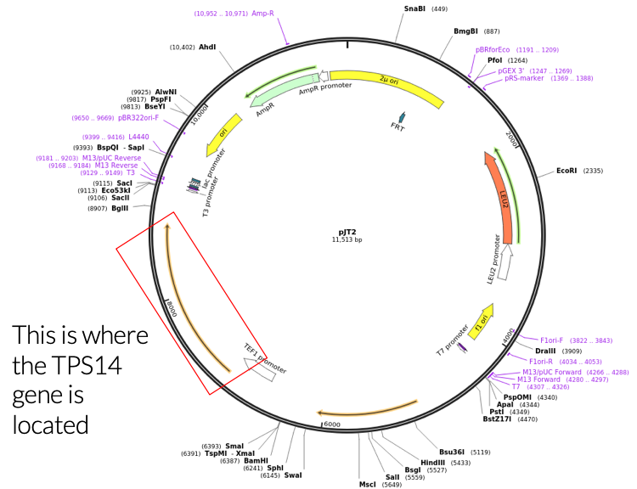

Genetically Modifying E. Coli to Produce S-Linalool Synthase
Emily Bucari, Madeline Morgan, Parsa Masomi, Lucas Tian
Westwood High School
Goal
PCR and Primers
Applications
Going Forward
To be able to produce S-Linalool in large quantities using E. coli.
Use PCR to isolate and amplify the TPS14 gene, as well as attach the restriction site sequence for EcoRV during PCR
Restriction site:
5’...GATATC...3’
Primers:
Forward: taagcagatatctttaattacaaaatggctacc
Reverse: tgcttagatatcctcactattataaagatgtgt
Enables this fragrant alcohol to be more accessible.
Mass production
  For companies
  For wider variety of uses
Stress relieving scent
Alternative to candles that pose a fire hazard and are banned in certain buildings such as dormitories.
Next Steps:
  Purchase of materials
  Construction of system
How can we explore a larger variety of scents?
Wider/more profitable industrial applications?
Limitations?
Background
Linalool is a terpene alcohol found naturally in many flowers.
It has been found to have a pleasant scent that has even been correlated with reducing stress.
Special Thanks To
Identifying the Gene and Plasmid
Inserting the TPS14 gene
Dr. Miller
Mrs. Pilger
Matt Tuttle
First, we identified the gene TPS14, which codes for linalool synthase, an enzyme that catalyzes the chemical reaction to produce linalool.
We then identified the plasmid pJT2, which encompasses the TPS14 gene.
We will insert TPS14 into the pDONR221-OSF-TRIM5-21R(1-300)
We will use the EcoRV restriction site to cut the E. coli plasmid
Discussion
Notes:
Single sided poster!

