Slide 1
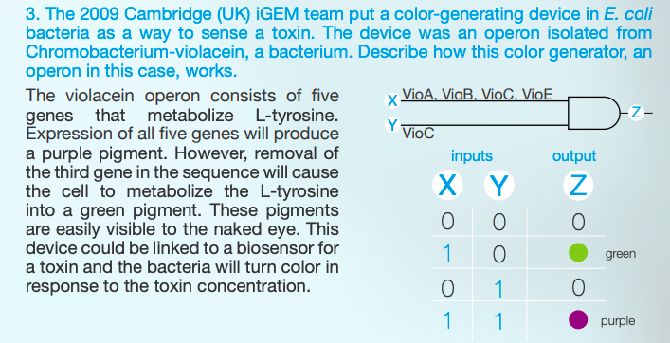
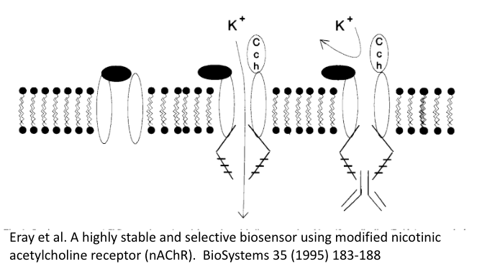
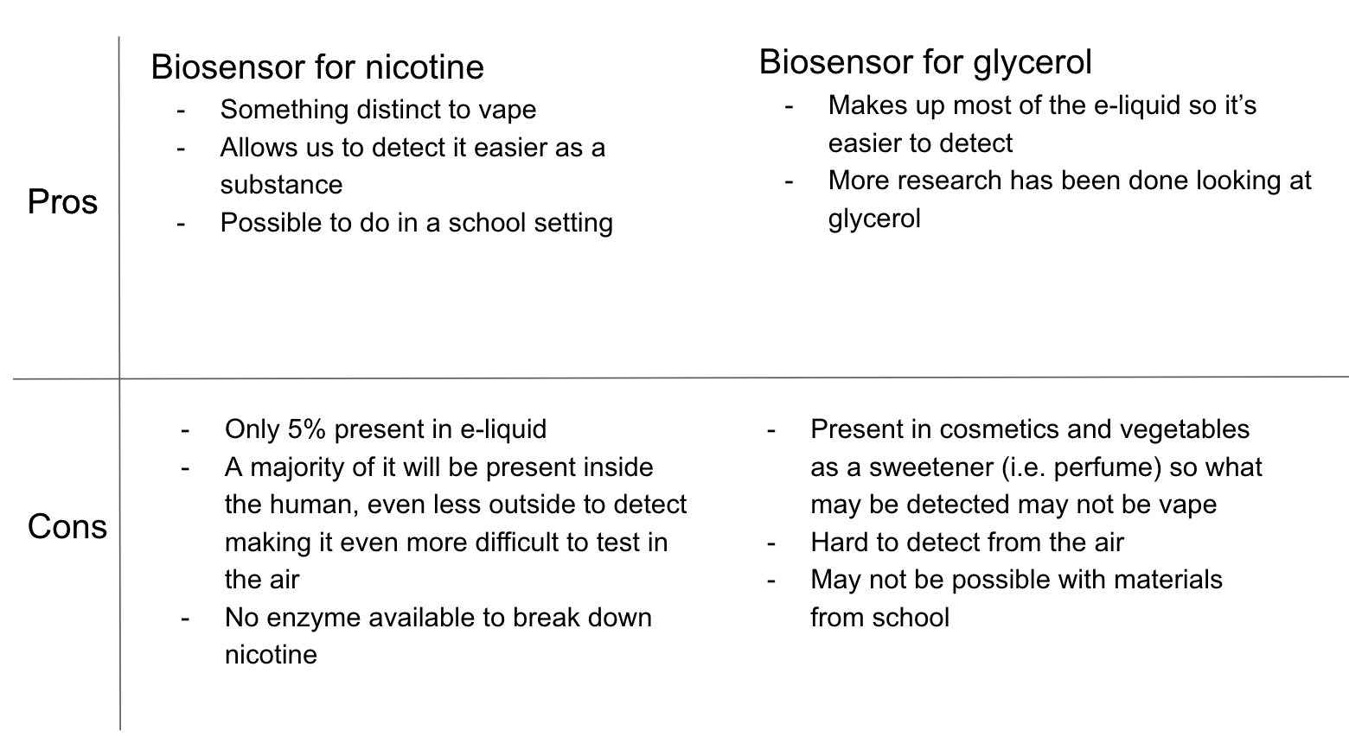
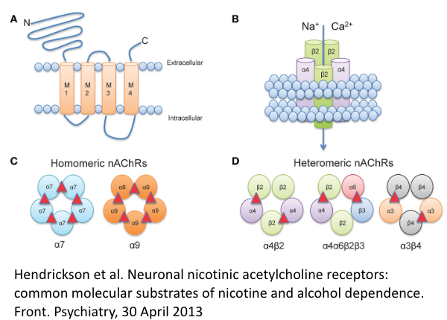

Detecting Vape Through Biosensing and Receptors Present in Humans
By Sophie DiPietro, Katie Huang, Anna Lian, Shraddha Lulla, Megan Malur, Neil Malur, Ashley McCoy & Jessie Yuan (Weston High School)
PAST COLOR BASED BIOSENSOR:
INTRODUCTION:
USING RESTRICTION ENZYMES TO CREATE RECOMBINANT PLASMID
As vaping becomes more prevalent amongst teenagers in the United States, the dangers of vaping have become more clear. Within schools, teens often vape in bathrooms and other private areas of the building, but the inability to place cameras in these areas keeps the school from having actual evidence of the behavior
The purpose of this research is to try and discover a Biosensor system which could use on of the ingredients in the Vape to induce an operon system which would trigger a response.
The operon response would ideally be a visible response, such as luminesce or color change.
In order to create the transformed fluorescent bacteria, a recombinant plasmid must be created including the necessary gene regions conducive to a functioning bacteria. This includes the nicotine/vegetable glycine operon, ampR, pBAD, ori, and the gene of interest (RFP). It is also important to include a gene sequence, similar to ara-C, that binds to the promoter to cause transcription. In order to assemble these pieces, restriction digest must take place. The restriction enzymes need to be tailored to the specific gene sequences to ensure they cut at the intended points and include all necessary nucleotides in the segments. Restriction enzymes that produce ”sticky ends” are preferred for their overhang of nucleotides that ensure proper attachment during the ligase stage. For example, the BamHI & HindIII are restriction enzymes were used in the similar pARA-R restriction digest that instead, included ara-C. Once the fragments are cut, they can be combined to create a recombinant plasmid using the enzyme ligase. Gel electrophoresis can be used to confirm that transformed plasmids of the proper base pair length were created.
EXAMPLES OF RECEPTORS:
METHODS:
NEXT STEPS:
The three main ingredients in vape products are nicotine, vegetable glycerin, and propylene glycol. Propylene glycol is contained in a large variety of products, so our methods would focus mainly on the detection of nicotine or vegetable glycerin. While vegetable glycerin makes up a larger percent of the vape product at 60%, it is also in a larger variety of products. Nicotine makes up a smaller percentage of the product, but is not in as many non-vape related products as vegetable glycerin, and therefore could make for a better ligand. For this reason, the biosensing system could be most effective if it is used for the detection of nicotine. The focus of our research at this point is to attempt to either find or create a biosensing system that uses nicotine to induce the system and some sort of physical response. The use of model organisms like e-coli would work for a proof of concept, but other bacteria with more air detection abilities would have to be used in a final product.
Identify the DNA sequences
Utilize CRISPR to modify operon triggered by nicotine

