Slide 1

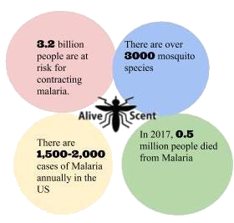
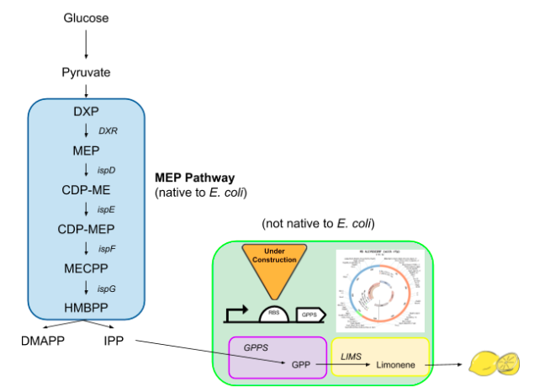

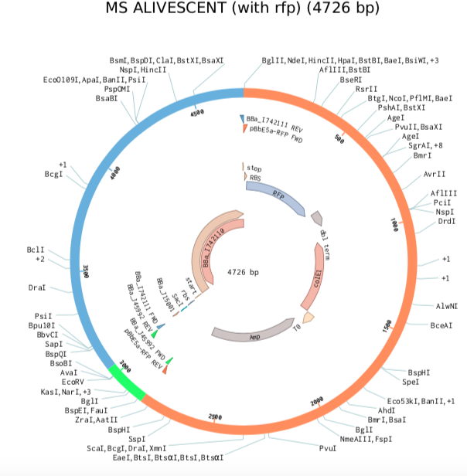
AliveScent™
Background
Abstract
Did you know?
The Idea
The mosquito is responsible for thousands of deaths each year, making it one of the most dangerous animals on the planet. There are over 3,000 species of mosquitoes. About 175 species are found in the US and they can live in almost any environment except in extreme cold. Mosquito bites can cause fatal illnesses including Malaria and Eastern Equine Encephalitis (EEE). The most common methods for preventing mosquito bites, and therefore disease transmission, is by using DEET-containing products, citronella candles, and bug zappers. Unfortunately, DEET-containing products can cause skin and eye irritation, citronella candles may lead to fires, and bug zappers not only require electricity but make for a messy cleanup. AliveSCENT is a biologically-inspired alternative that relies on the native methylerythritol 4-phosphate (MEP) pathway of Escherichia coli in the production of limonene as a natural, odor-releasing mosquito repellent for commercial use. Limonene is an aromatic compound that makes up a large portion of most citrus scents including lemons and is a safer alternative to the sprays, flames, and insect mess. The smell of the compound itself is reportedly similar to that of citrus and turpentine. This product will attempt to reduce the incidence of Malaria and EEE. This system will be constructed through plasmid design, assembly, and integration, followed by verification of limonene product using gas chromatography, odor detection by wafting, and testing as an effective repellent using a mosquito choice chamber. Here, work towards plasmid assembly will be shown. This phase will require the assembly of a stationary phase promoter, with a ribosome binding site and limonene synthase translational unit into a red fluorescent protein-encoding vector. In preparation for plasmid assembly, the translational unit was transformed into NEB 5-alpha Competent E. coli, with mixed results.
The mosquito is the deadliest animal
Mosquitoes can be repelled by certain scents because the strong odor interferes with their senses and makes it difficult to locate food..
Reprogram NEB 5-alpha Competent E. coli to generate limonene, commonly found in the rind of
When a mosquito bites a person with malaria, some blood contaminated with parasites is taken in. These will mix with the mosquito’s saliva. The saliva enters a person’s bloodstream when they are bitten by the mosquito This causes them to contract the illness
Pictured left is an enlarged image of our plasmid.
Notes:
Single sided poster!

Slide 2

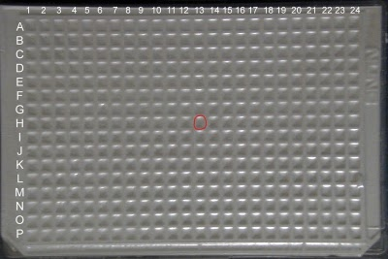
AliveScent™
Procedure
Procedure. Bacterial transformation of BBa_I742111
A. Prepare part
1. Place NEB 5-alpha Competent E. coli* (NEB #C29871) on ice to thaw.
2. Access Registry of Biological Parts to determine location of the part of interest in the iGEM part distribution kit. Distribution kit 2018 (well 3I) and 2019 (well 18H) contain BBa_I742111 (RBS + LIMS).
3. Use figure 1 from the Registry of Biological Parts pictured below to locate well 3I (2018) and well 18H (2019).
4. Puncture the aluminum foil covered well with a pipet tip and inject 10 μl of sterile water. Resuspend the plasmid by pipetting up and down. Plasmids are treated with cresol red for visible confirmation.
C. Prepare plates
1. Label the bottom of 5 LB plates: LB/50 μl chlor; LB/100 μl chlor; LB/chlor/LOW; LB/chlor/HIGH; and LB/chlor/NK.
2. Perform a 1:10 dilution of a 34mg/ml chloramphenicol stock solution and transfer 50 μl to the plate labeled LB/50 μl chlor.
3. Use a sterile spreader to evenly coat the surface of the LB plate. Let dry with cover slightly off plate.
4. Transfer 25 μl of NEB 5-alpha Competent E. coli* to the plate labeled LB/50μl chlor. Use a sterile spreader to evenly coat the surface of the plate.
5. Transfer 100 μl of the 1:10 dilution of a 34mg/ml chloramphenicol stock solution to the plate labeled LB/100 μl chlor
6. Use a sterile spreader to evenly coat the surface of the LB plate. Let dry with cover slightly off plate.
7. Transfer 25 μl of NEB 5-alpha Competent E. coli* to the plate labeled LB/100 μl chlor. Use a sterile spreader to evenly coat the surface of the plate.
8. Perform a 1:500 dilution of a 34mg/ml chloramphenicol stock solution.
9. Transfer 100 μl of the 1:500 dilution of a 34mg/ml chloramphenicol stock solution to the plate labeled LB/chlor/LOW.
10. Use a sterile spreader to evenly coat the surface of the LB plate. Let dry with cover slightly off plate.
11. Transfer 50 μl of NEB 5-alpha Competent E. coli* to the plate labeled LB/chlor/LOW. Use a sterile spreader to evenly coat the surface of the plate.
12. Transfer 100 μl of the 1:500 dilution of a 34mg/ml chloramphenicol stock solution to the plate labeled LB/chlor/HIGH.
13. Use a sterile spreader to evenly coat the surface of the LB plate. Let dry with cover slightly off plate.
14. Spin the NEB 5-alpha Competent E. coli* in a microcentrifuge tube for 2 minutes. Discard the supernatant and resuspend the pellet of cells by gently pipetting up and down.
15. Transfer 50 μl of re-suspended NEB 5-alpha Competent E. coli* to the plate labeled LB/chlor/HIGH. Use a sterile spreader to evenly coat the surface of the plate.
16. Transfer 25 μl of undiluted 34mg/ml chloramphenicol to the plate labeled LB/chlor/NK.
17. Use a sterile spreader to evenly coat the surface of the LB plate. Let dry with cover slightly off plate.
18. Transfer 2μl of re-suspended NEB 5-alpha Competent E. coli* to the plate labeled LB/chlor/NK. Use a sterile spreader to evenly coat the surface of the plate.
19. Incubate overnight at 37ºC agar side up.
B. Prepare competent cells
1. Pipet 50 μl of cells into a microfuge tube on ice.
2. Add 4 μl of BBa_I742111 to the tube and flicked to mix. Do not vortex.
3. Allow cells to incubate with DNA on ice for 30 minutes.
4. Heat shock the tube at 42ºC for exactly 30 seconds and return to ice for an additional 5 minutes.
6. Add 950 μl of room temperature LB broth to the tube.
7. Incubate the tube at 37ºC for 60 minutes on a roller. This outgrowth step allows the bacteria time to manufacture the antibiotic resistance proteins encoded in the plasmid backbone so that they will be able to grow once plated on the antibiotic containing agar plate. This step is not critical for ampicillin resistance but is much more important for other antibiotic resistances including chloramphenicol.
8. After 60-minute incubation period to ensure that cells get adequate food, invert the tube to mix and streak plates as described below.
Figure 1.
Notes:
Single sided poster!

Slide 3
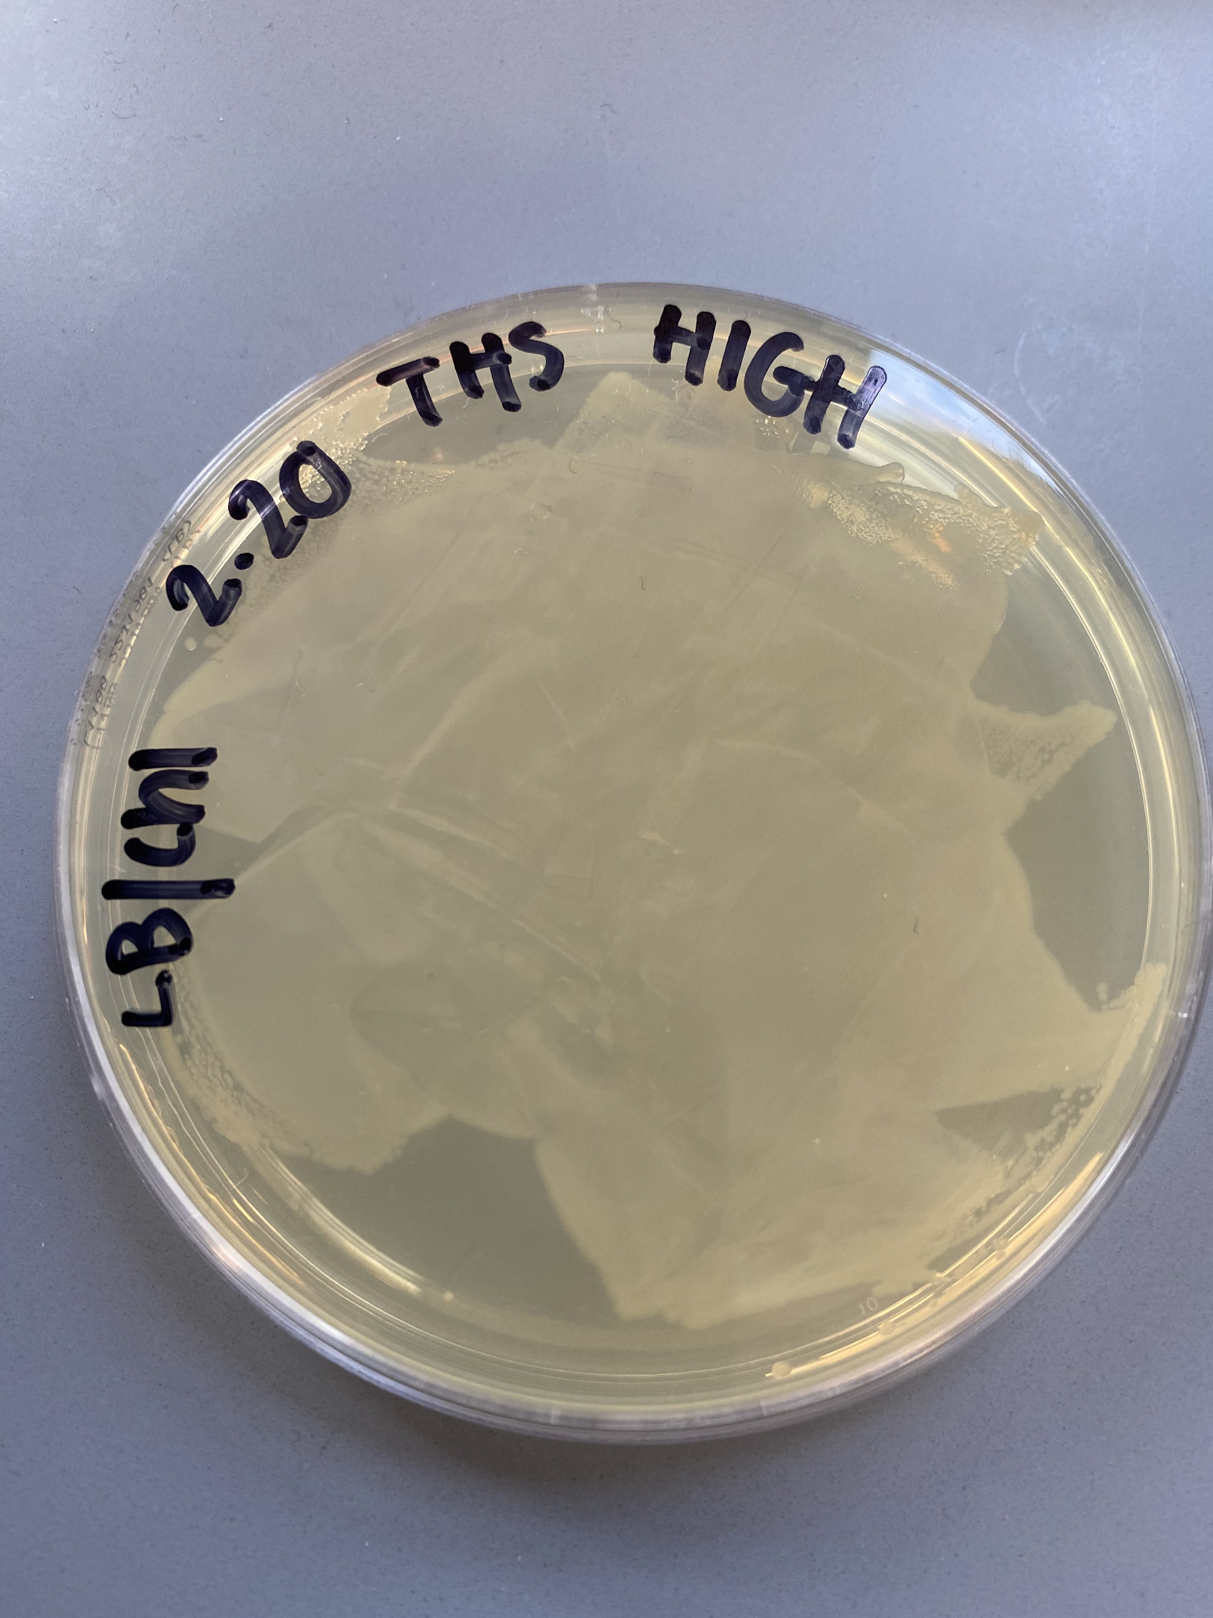
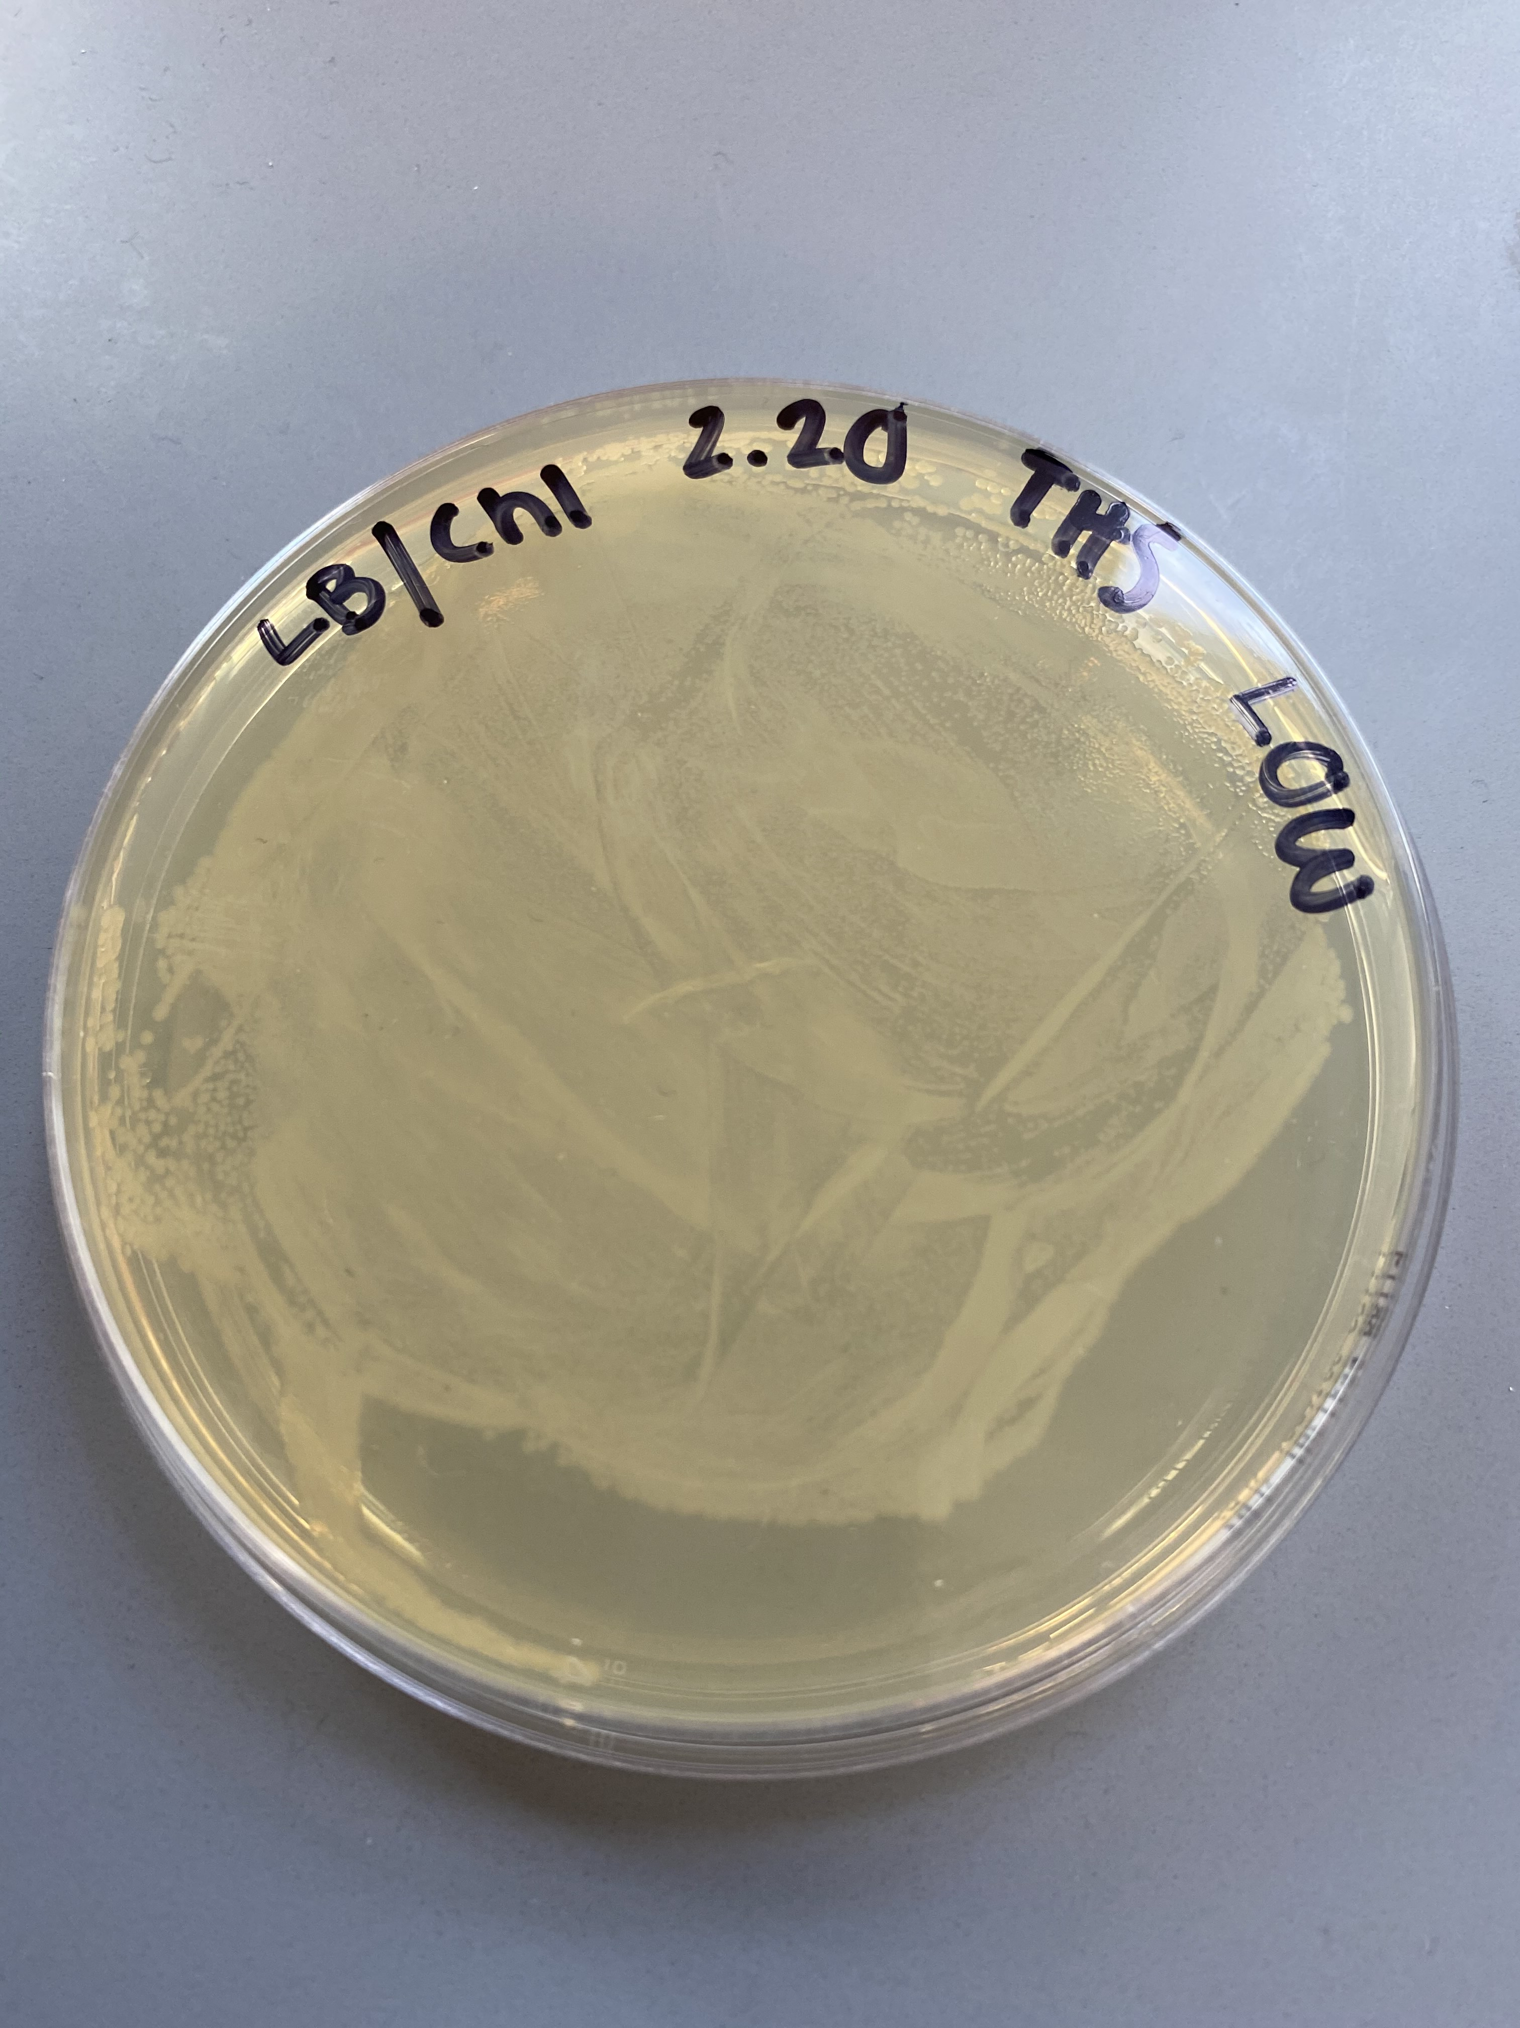
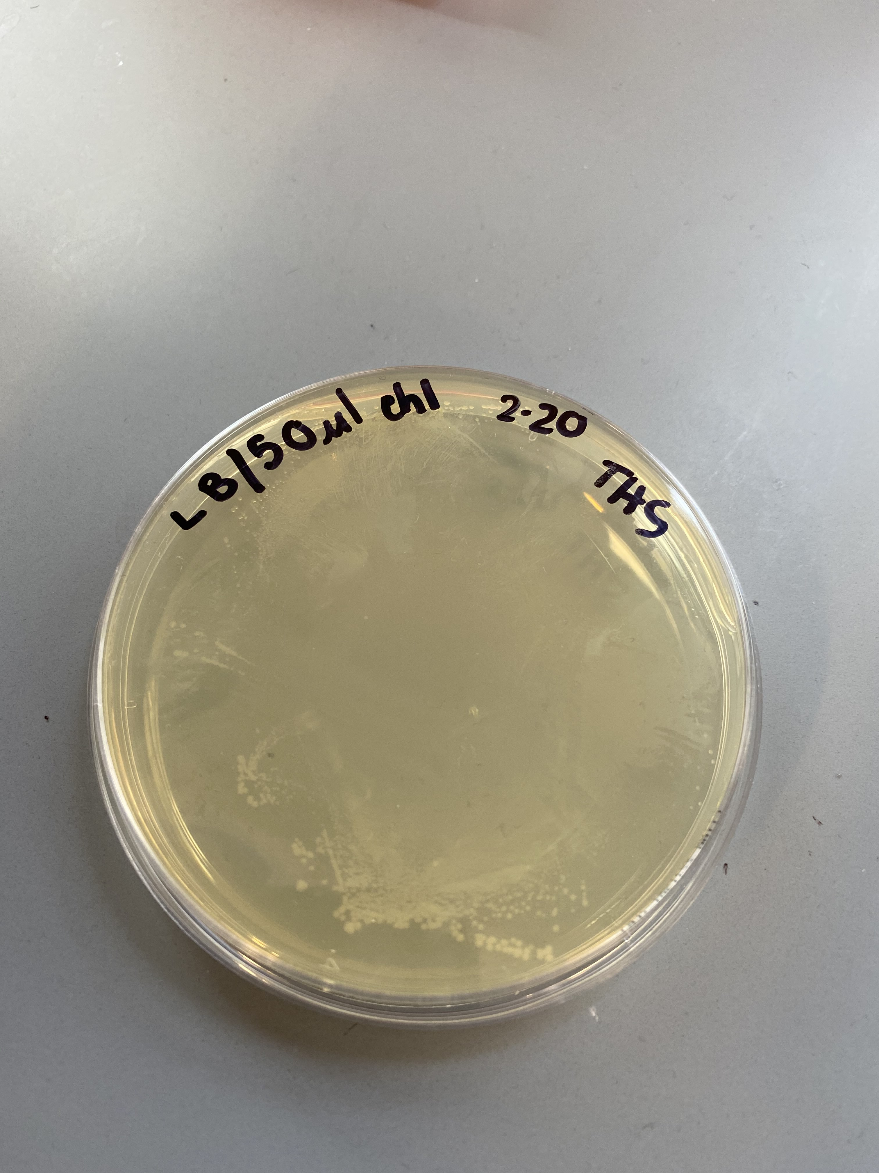
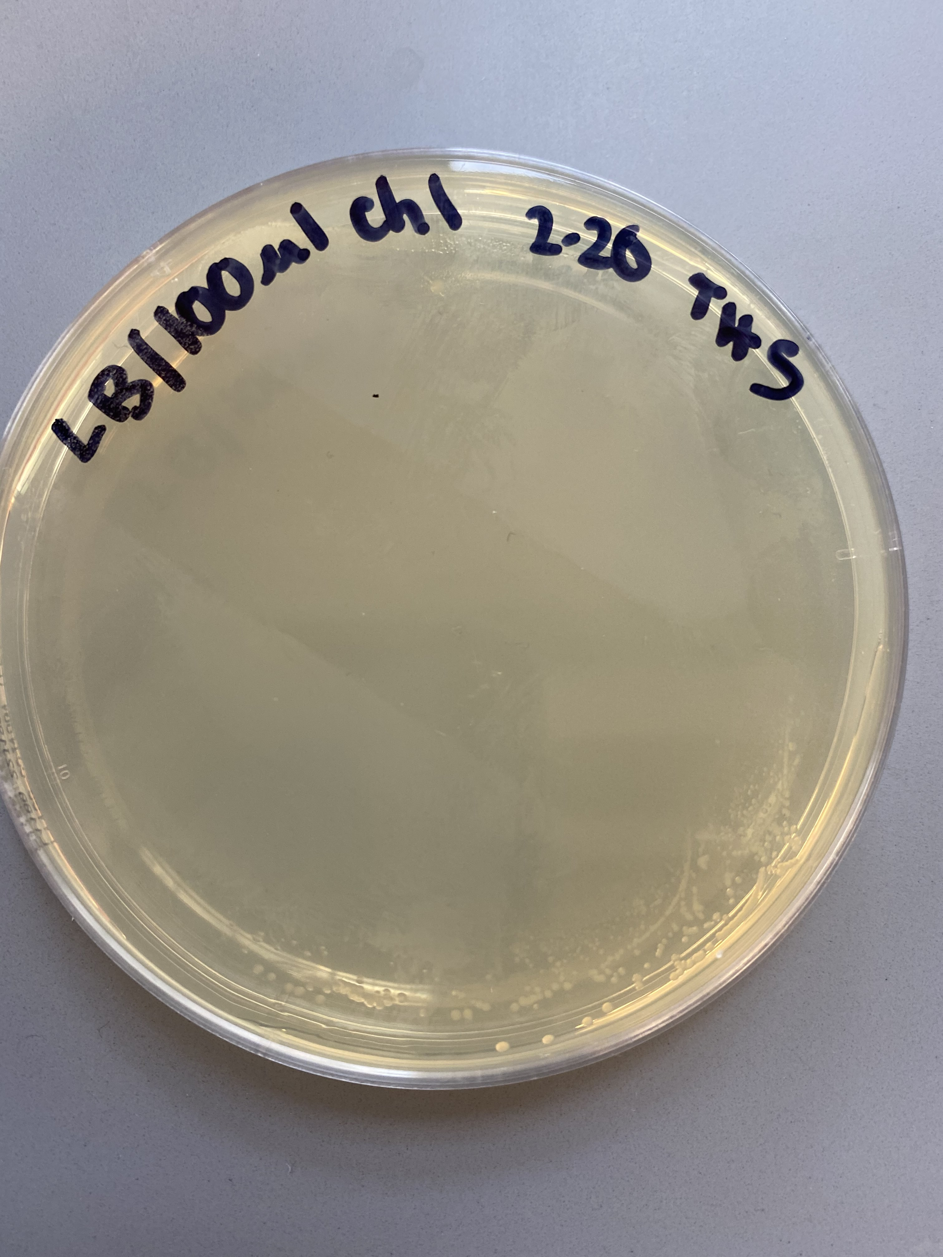
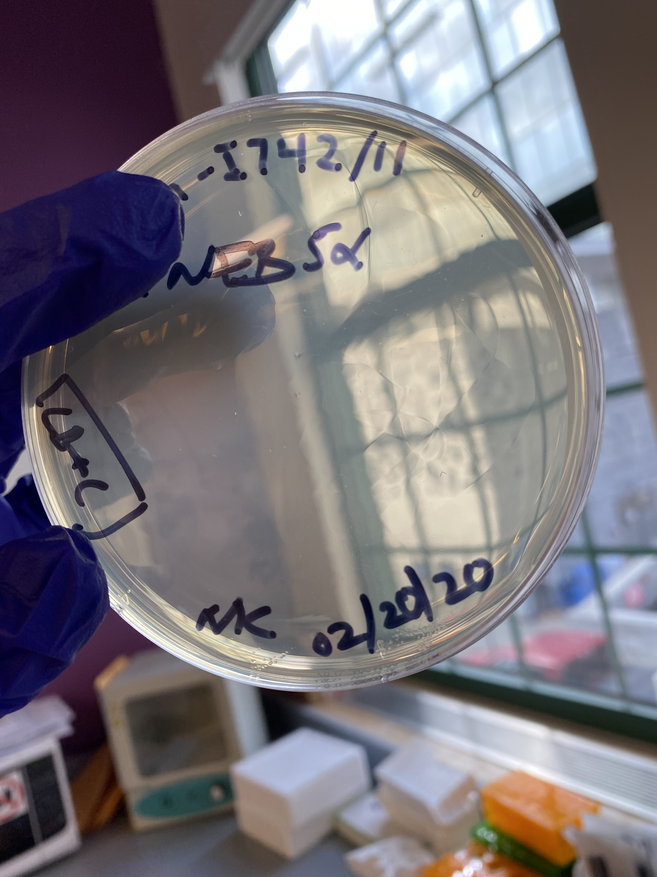
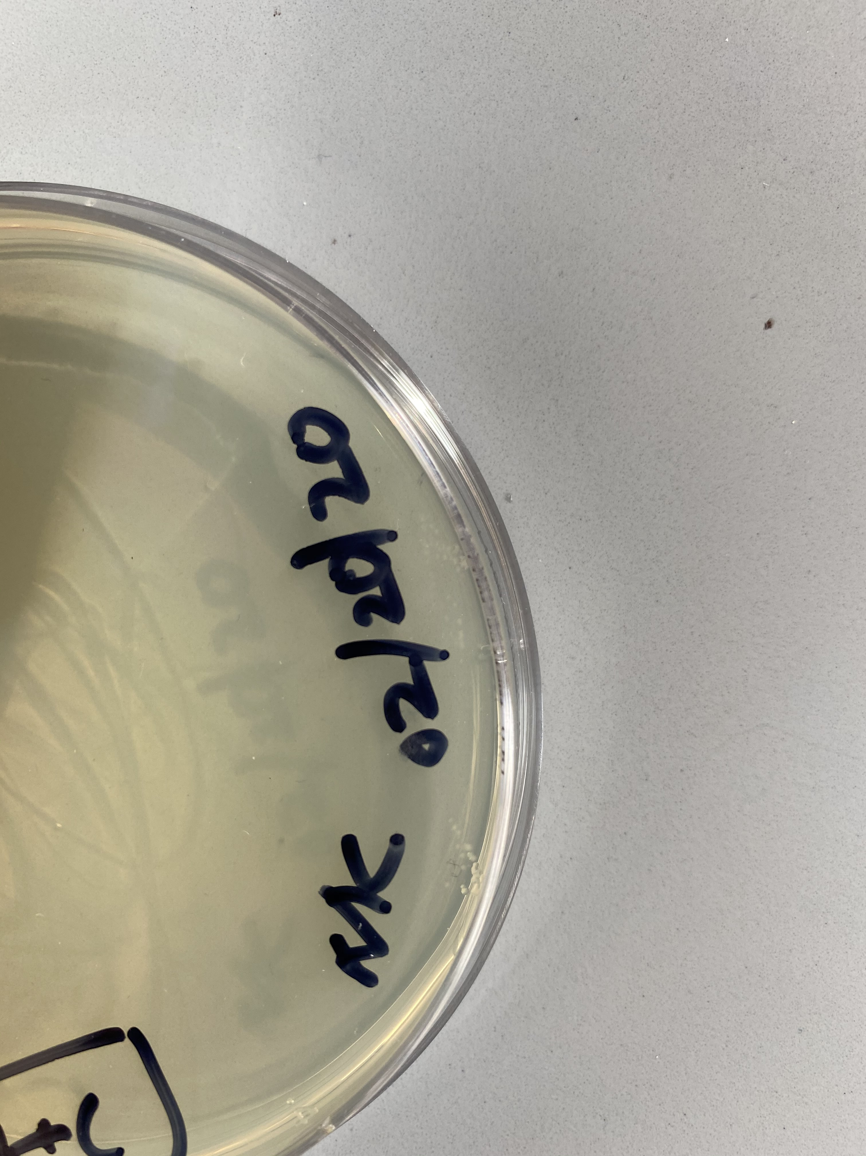
AliveScent™
Results
Results
Results for 100 μl of the 1:500 dilution of a 34mg/ml chloramphenicol stock solution and 50 μl of re-suspended NEB 5-alpha Competent E. coli* for a “high” concentration of plated competent cells.
Results for 100 μl of the 1:500 dilution of a 34mg/ml chloramphenicol stock solution and 50 μl of NEB 5-alpha Competent E. coli* for a “low” concentration of plated non-centrifuged competent cells​.
Results for 50 μl of the 1:10 dilution of a 34mg/ml chloramphenicol stock solution and 25 μl of NEB 5-alpha Competent E. coli*.
Results for 100 μl of the 1:10 dilution of a 34mg/ml chloramphenicol stock solution and 25 μl of NEB 5-alpha Competent E. coli*.
Results for 25 μl of undiluted 34mg/ml chloramphenicol stock solution and 2 μl of re-suspended NEB 5-alpha Competent E. coli*
Closeup of results for 25 μl of undiluted 34mg/ml chloramphenicol stock solution and 2 μl of re-suspended NEB 5-alpha Competent E. coli*
Notes:
Single sided poster!

Slide 4
AliveScent™
Conclusion
Conclusion
References
The purpose of this project is to design a genetic program that produces the aliphatic hydrocarbon, and major component of the oil of citrus fruit peels, limonene as a novel mosquito repellent. To accomplish this, the THS-BBC has designed a genetic system that uses a stationary phase promoter to drive the expression of limonene synthase, the enzyme necessary to convert geranyl diphosphate (GPP) into limonene only when E. coli have reached stationary phase of growth. At a parts level, and with the use of Benchling as a design platform, the final construct will use the OsmY stationary phase promoter (BBa_45992) to drive the expression of limonene synthase (BBa_I742111).
It has not escaped our attention, that in order for limonene to be expressed, the precursor compound isopentenyl diphosphate (IPP) generated from the native methylerythritol phosphate (MEP) pathway of E. coli will require geranyl diphosphate synthase (GPPS) not naturally produced by E. coli, but necessary for limonene synthesis. Given this constraint, a second plasmid containing the coding sequence for GPPS will be required.
To date, the THS-BBC has transformed NEB5-alpha competent E. coli (NEB#C29871) with limonene synthase (BBa_I742111) with mixed results. After a 24-hour incubation period cells plated on a 1:500 dilution of chloramphenicol stock showed a lawn of growth. Similar results were observed for cells grown in a 1:10 dilution of the chloramphenicol stock solution. Chloramphenicol was intended to be the selective mechanism for identifying successful transformants. Because the concentration of chloramphenicol was too low coupled with a cell concentration that was too high, it was difficult to ascertain which cells had been successfully transformed. To account for this complication, an additional plate was prepared using 25μl of undiluted chloramphenicol stock solution plated with 2μl of cells. After a 24-hour incubation period there was no visible growth with the exception of colonies at the periphery. Given that the LB plate was superficially treated with chloramphenicol and may not have reached the plate edges, we are hesitant to conclude that the few colonies growing at this location are successful transformants.
To achieve our goal of reprogramming E. coli to express limonene synthase will first require a successful transformation of the BBa_I742111 (LIMS) part. Once we have confirmed that BBa_I742111 has been taken up, successful transformants will be grown up in a liquid culture and the part will be purified. The pBbE5a-RFP vector along with LIMS will be amplified using polymerase chain reaction (pcr). The pcr products will be confirmed using gel electrophoresis and purified for final assembly. Gibson assembly will be employed to ligate OsmY, LIMS, and the pBbE5a-RFP vector into our final AliveSCENT product to be transformed into NEB 5-alpha Competent E. coli cells. Confirmation of AliveSCENT will be accomplished by gas chromatography, odor detection by wafting, and testing as an effective repellent using a mosquito choice chamber. Future experimentation involves the construction and subsequent transformation of E.coli with a second plasmid containing GPPS required to close the MEP pathway for limonene production. Successfully transformed cells will be extracted for limonene production by lysis followed by gas chromatography. Evaluation of limonene effectiveness as a mosquito repellent will be accomplished by using a choice chamber to compare mosquito response to limonene extract vs limonene extract from lemon peels.
Centers for Disease Control and Prevention. (2020, February 12). Frequently Asked Questions About Malaria. CDC. https://www.cdc.gov/malaria/about/faqs.html
Jeon, Y.C., Nguyen, A.D., & Lee, E.Y. (2019, October 24). Bioproduction of Isoprenoids and Other Secondary Metabolites Using Methanotrophic Bacteria as an Alternative Microbial Cell Factory Option: Current Stage and Future Aspects. MDPI. https://www.mdpi.com/2073-4344/9/11/883/htm
Qidwai, T., Jamal, F., Khan, M.Y., & Sharma, B. (2014, April 23). Exploring Drug Targets in Isoprenoid Biosynthetic Pathway for Plasmodium falciparum. NCBI.https://www.ncbi.nlm.nih.gov/pmc/articles/PMC4017727/
Vedaste, T. (2018). Let’s Understand the Disease of Malaria. Tantine. https://www.tantine.rw/article/Dusobanukirwe-Indwara-ya-Malariya
World Health Organization. (2017). Global Health Observatory (GHO) data: Number of Malaria Deaths. World Health Organization. https://www.who.int/gho/malaria/epidemic/deaths/en/
Yang, J., & Guo, L. (2014, November 18). Biosynthesis of β-carotene in engineered E. coli using the MEP and MVA pathways. NCBI. https://www.ncbi.nlm.nih.gov/pmc/articles/PMC4239400/
Yang, J., Xian, M., Su, S., Zhao, G., Nie, Q., Jiang, X., Zheng, Y., & Lui, W. (2012, April 27). Enhancing Production of Bio-Isoprene Using Hybrid MVA Pathway and Isoprene Synthase in E. coli. PLOS ONE. https://journals.plos.org/plosone/article?id=10.1371/journal.pone.0033509
Acknowledgements
The THS-BBC would like to extend our thanks to Integrated DNA Technologies for their generous donation of BBa_J45992, Mr. Michael Sheets for donating the pBbE5a-RFP vector for our assembly and for being a patient and thoughtful mentor, and Dr. Natalie Kuldell for donating part BBa_I742111, and more importantly for her tireless efforts at building a community of synthusiasts!
Notes:
Single sided poster!

