Slide 1

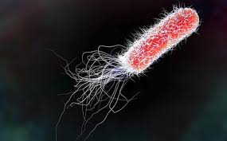

Abstract:
Manipulating the growth rate and production of enzymes in Ideonella sakaiensis
Chris Lee, Audrey Gandakusuma, Crystalia Evelyn Liaw, Sherry Lee, K. Dio Lalas, Mr.Hayden ,
Figures & Graphs:
Slide/poster size is 40.97x23.04 (16:9 aspect ratio)
Minimum font: 28pt (this may seem large, but at this poster size it’s not)
Recommended font Types: Calibri, Arial, Times New Roman
This is only a template. All content may be modified, except for slide dimensions
If you are creating your e-poster on a PC, please make sure to save your formulas as an image and embed it into your presentation or they will change on our Macs.
Include and image or a graph for visual appeal. If you have more than one, they will be viewable in the center when this section is selected.
Don’t exceed past this point.
ABSTRACT
Polyethylene Terephthalate (PET) is a serious threat to the environment, it releases a large amount of carbon dioxide and requires a prolonged period of time to decompose. Luckily a new scientific discovery has been made about a bacteria known as Ideonella Sakaiensis, a plastic-eating bacteria. Polyethylene Terephthalate (PET) is made out of Ethylene glycerol and terrathetac acid with the help of polymerization it forms PET. This is when Ideonella Sakaiensis becomes helpful, the bacteria is able to convert Polyethylene Terephthalate into monomeric mono-2-hydroxyethyl terephthalate (MHET). Then it would break down MHET into ethylene glycol and and terephthalic acid.
The bacteria will then produce energy that could be used, however the process of Ideonella sakaienis dividing and producing energy takes a long period of time so if we are able to increase the growth rate of the bacteria, the more energy we are able to collect. That is when we use microbuell fuel cells. If we are able to collect the bacteria’s energy with microbuel fuel cells then this would be a more safer and effective method.
Introduction:
Results:
Keep it short and sweet.
More explanation and images/graphs/videos will be viewable in the center when this section is selected.
Around 3-4 bullet points.
Keep it short and sweet.
More explanation and images/graphs/videos will be viewable in the center when this section is selected.
Around 3-4 bullet points.
Methods:
Step-by-step explanation
More explanation and images/graphs/videos will be viewable in the center when this section is selected.
As many bullet points as needed, but keep it around 5-6 (fit within this side of the page.
Conclusions:
Keep it short and sweet.
More explanation and images/graphs/videos will be viewable in the center when this section is selected.
Around 3-4 bullet points.
References:
Font for this can be relatively small (around 18pt).
Can give a general thanks or contact information.
The larger reference list can be viewable in the middle with the section is selected.
Click Section Headings to View Additional Content
Notes:
https://drive.google.com/file/d/1dZ1o08QPuV-vaVWeiKyuXwquUkr9b5gq/view?ts=5e6279e9

Slide 2
Abstract:
Manipulating the growth rate and production of enzymes in Ideonella sakaiensis
Chris Lee, Audrey Gandakusuma, Crystalia Evelyn Liaw, Sherry Lee, K. Dio Lalas, Mr.Hayden ,
Figures & Graphs:
Slide/poster size is 40.97x23.04 (16:9 aspect ratio)
Minimum font: 28pt (this may seem large, but at this poster size it’s not)
Recommended font Types: Calibri, Arial, Times New Roman
This is only a template. All content may be modified, except for slide dimensions
If you are creating your e-poster on a PC, please make sure to save your formulas as an image and embed it into your presentation or they will change on our Macs.
Include and image or a graph for visual appeal. If you have more than one, they will be viewable in the center when this section is selected.
Don’t exceed past this point.
What is Ideonella Sakaiensis?
Is a bacterium of the Ideonella genus and the Comamonadaceae family, capable of breaking down and consuming plastic poly(ethylene terephthalate) (PET) as the sole source of carbon and energy. These polymers are broken through the process of hydrolysis through the use of enzymes, an enzyme located in the living cell would find a polymer or compound where in this case it is a called a substrate which would bring it into its active site, if it's the right "fit" it would link into the enzyme and water would come in, performing the process of hydrolysis and cut the substrate into free monomers or free molecules.
What is a microbial fuel cell?
This is a bio-electrochemical device that uses bacteria and mimics the bacterial interactions occurring in nature to move an electric current. MFCs can be divided into two broad categories: mediated and non-mediated. Microbial Fuel cells may also be classified into two, Microbe, meaning a microorganism, in particular a bacterium that causes disease or fermentation and electrogenic bacteria, meaning species that can pass electrons to extracellular electron acceptors and have the ability to be used in devices such as bioelectrochemical systems (BES). This cycle is aerobic in the sense that it requires oxygen.
Introduction:
Results:
Keep it short and sweet.
More explanation and images/graphs/videos will be viewable in the center when this section is selected.
Around 3-4 bullet points.
Keep it short and sweet.
More explanation and images/graphs/videos will be viewable in the center when this section is selected.
Around 3-4 bullet points.
Methods:
Step-by-step explanation
More explanation and images/graphs/videos will be viewable in the center when this section is selected.
As many bullet points as needed, but keep it around 5-6 (fit within this side of the page.
Conclusions:
Keep it short and sweet.
More explanation and images/graphs/videos will be viewable in the center when this section is selected.
Around 3-4 bullet points.
What is the problem?
Plastic pollution has been a global issue and Polyethylene Terephthalate (PET) is one of the most common types of plastic used in day-to-day products such as soda bottles, water bottles and peanut butter jars. When plastics break down, they become microplastics and their decomposition rate can take as long as 1,000 years, leading to a buildup of these in the ocean and land. Plastic releases a toxic chemical called bisphenol A when they decompose, especially in the ocean, disrupting the hormonal systems of animals.
On the other hand, electricity used in households is usually sourced from fossil fuels and the burning of these fuels results in pollution. Most first-world countries generate approximately 12,000 kW/h per year. Conversely, poorer areas in other countries do not have access to electricity (less than 20% of the whole country) such as Tanzania, Niger, Liberia, and many others.
References:
Font for this can be relatively small (around 18pt).
Can give a general thanks or contact information.
The larger reference list can be viewable in the middle with the section is selected.
Click Section Headings to View Additional Content

Slide 3
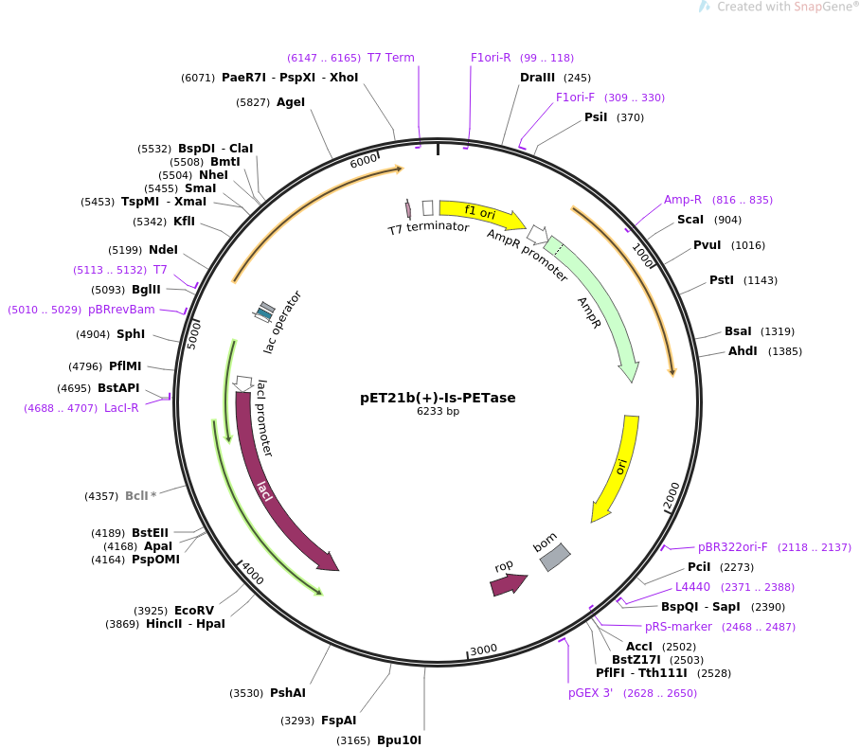

Abstract:
Manipulating the growth rate and production of enzymes in Ideonella sakaiensis
Chris Lee, Audrey Gandakusuma, Crystalia Evelyn Liaw, Sherry Lee, K. Dio Lalas, Mr.Hayden ,
Figures & Graphs:
Slide/poster size is 40.97x23.04 (16:9 aspect ratio)
Minimum font: 28pt (this may seem large, but at this poster size it’s not)
Recommended font Types: Calibri, Arial, Times New Roman
This is only a template. All content may be modified, except for slide dimensions
If you are creating your e-poster on a PC, please make sure to save your formulas as an image and embed it into your presentation or they will change on our Macs.
Include and image or a graph for visual appeal. If you have more than one, they will be viewable in the center when this section is selected.
Don’t exceed past this point.
METHODS
Solutions:
Changing the surrounding temperature or chemical surrounding
The bacterium grows at 5.5 to 9.0 pH (optimally 7 to 7.5) and 15–42 ° C (optimally 30–37 ° C) temperature. It has been scientifically proven that increassing the temperature’s surrounding will increase the process of bacteria and since Ideonella sakaiensis takes a long period of time to divide and disintegrate Polyethylene Terephthalate (PET) and monomeric mono-2-hydroxyethyl terephthalate (MHET) but at the same time decreasing the pH, decreasing the pH level could increase the process because the bacteria itself is known for its acidic featurers.
Increasing the oxygen carrying capacity (Vitreoscilla hemoglobin (VHb))
Since Ideonella sakaiensis is aerobic (The mechanism by which pyruvic acid is broken down and NADH is used to make a large quantity of ATP the part of the respiration throughout the presence of oxygen) then increasing the respiration process could possibly increase the process of disintegrate Polyethylene Terephthalate (PET) and monomeric mono-2-hydroxyethyl terephthalate (MHET) .
Since the breakdown is done by enzymes, increasing the production of enzymes would also be effective. By that we could increase the number of genes inside the plasmids
Introduction:
Results:
Keep it short and sweet.
More explanation and images/graphs/videos will be viewable in the center when this section is selected.
Around 3-4 bullet points.
Keep it short and sweet.
More explanation and images/graphs/videos will be viewable in the center when this section is selected.
Around 3-4 bullet points.
Methods:
Step-by-step explanation
More explanation and images/graphs/videos will be viewable in the center when this section is selected.
As many bullet points as needed, but keep it around 5-6 (fit within this side of the page.
Conclusions:
Keep it short and sweet.
More explanation and images/graphs/videos will be viewable in the center when this section is selected.
Around 3-4 bullet points.
References:
Font for this can be relatively small (around 18pt).
Can give a general thanks or contact information.
The larger reference list can be viewable in the middle with the section is selected.

Slide 4
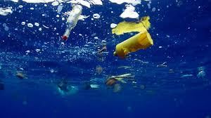
Abstract:
Manipulating the growth rate and production of enzymes in Ideonella sakaiensis
Chris Lee, Audrey Gandakusuma, Crystalia Evelyn Liaw, Sherry Lee, K. Dio Lalas, Mr.Hayden ,
Figures & Graphs:
Slide/poster size is 40.97x23.04 (16:9 aspect ratio)
Minimum font: 28pt (this may seem large, but at this poster size it’s not)
Recommended font Types: Calibri, Arial, Times New Roman
This is only a template. All content may be modified, except for slide dimensions
If you are creating your e-poster on a PC, please make sure to save your formulas as an image and embed it into your presentation or they will change on our Macs.
Include and image or a graph for visual appeal. If you have more than one, they will be viewable in the center when this section is selected.
Don’t exceed past this point.
CONCLUSIONS
In conclusion, ideonella sakaiensis is a underrated bacteria and should be paid more attention. Since it is able to give numerous of benefits for the environment. Increasing the process of disintegrating Terephthalate (PET) and monomeric mono-2-hydroxyethyl terephthalate (MHET) would surely be beneficial because it would solve on the world’s problem which is overuse of plastic and at the same time collecting energy from the bacteria, we would be able collect electricity in a more safer and environmentally friendly method.
Introduction:
Results:
Keep it short and sweet.
More explanation and images/graphs/videos will be viewable in the center when this section is selected.
Around 3-4 bullet points.
Keep it short and sweet.
More explanation and images/graphs/videos will be viewable in the center when this section is selected.
Around 3-4 bullet points.
Methods:
Step-by-step explanation
More explanation and images/graphs/videos will be viewable in the center when this section is selected.
As many bullet points as needed, but keep it around 5-6 (fit within this side of the page.
Conclusions:
Keep it short and sweet.
More explanation and images/graphs/videos will be viewable in the center when this section is selected.
Around 3-4 bullet points.
Acknowledgments
By involvement in the BioBuilderClub, an after-school program sponsored by the BioBuilder Educational Foundation, this idea was realized. BioBuilderClub recruits high school teams around the world to combine engineering methods and science know-how to use synthetic biology to design / build / test out their own project ideas.
References:
Font for this can be relatively small (around 18pt).
Can give a general thanks or contact information.
The larger reference list can be viewable in the middle with the section is selected.
Click Section Headings to View Additional Content
Notes:
Disintegrate

