Slide 1


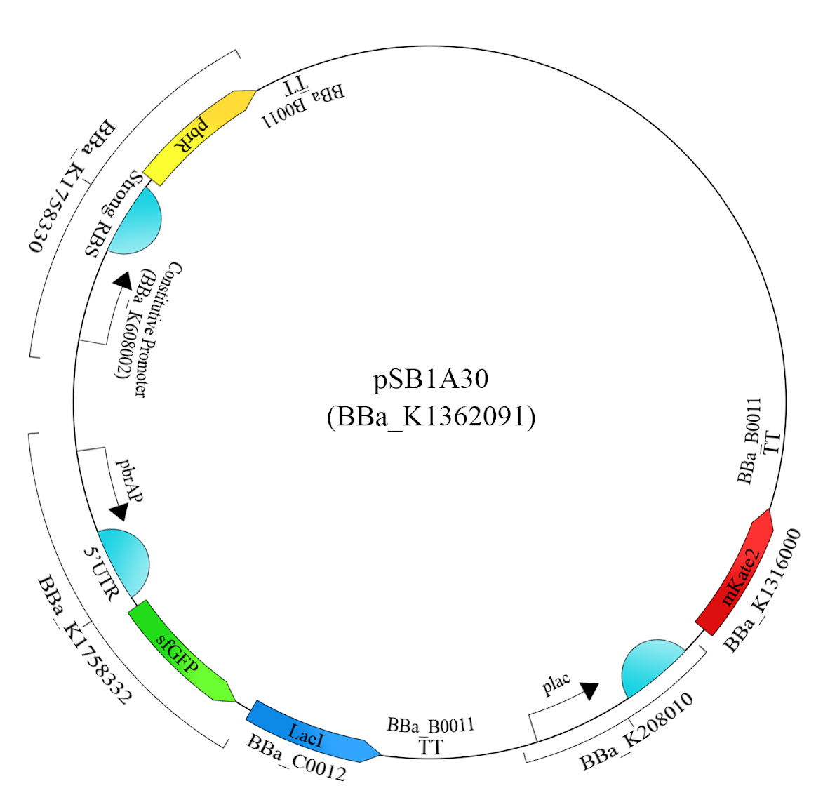

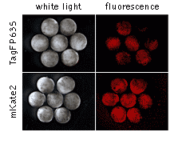
Detecting Lead Using Fluorescent Proteins
William Bradford, Ella Dailey, Brianne Lefanowicz, and Hendrik Younger
Background
For many homes built before 1978, lead paint was commonly used, especially between 1940–1959 (69% of homes) and before 1940 (87% of homes) (Environmental Protection Agency, 2019). After the ban of lead paint use in 1978, many new products have arisen to combat this threat, including chemical-based indicators and lead treatment paints. One of the worst threats from lead paint is when it is sanded or removed, as lead dust gets into the air. It would be expensive to buy a treatment paint and apply it only to tear down the wall. What if there were a way to bind the lead so toxic dust is no longer an issue?
According to a study by the International Agency for Research on Cancer (IARC) on inorganic and organic lead compounds, there is a process called phytoextraction in which some plants can draw in lead through their roots. The distribution of lead throughout the plant becomes more even when a chelate (usually EDTA) binds to the lead and prevents it from being toxic (IARC, 1970). This process could be used in conjunction with transformed E.coli to help prevent lead poisoning. Transformed E.coli could be used to mitigate the threat of lead through a procedure that introduces several new pieces of DNA into the bacteria, and in combination with an EDTA solution, could help reduce the risks of dealing with lead paint.
BioBricks
BBa_K1758330 - Part of a lead-sensing promoter system
BBa_K1758331 - Part of a lead-sensing promoter system
BBa_K1758332 - Part of the lead promoter system (includes expression of GFP)
BBa_C0012 - LacI
BBa_K208010 - The Lac Operon promoter and RBS
BBa_K1316000 - mKate2 (red fluorescent protein)
BBa_B0011 - a bidirectional terminator (used three times)
BBa_K1362091 - a high-copy backbone carrying Amp resistance
Procedure
First, a plasmid with three added genes will be transformed into E.coli cells. The first gene will produce lead-sensing proteins. If lead is present, the proteins will bind to the second gene’s promoter, causing it to produce GFP and LacI proportionally to the amount of lead in the cell. The third gene will be repressed using LacI. It will produce mKate2, a red fluorescent protein, which will signal a lack of lead. Secondly, a solution will be prepared to neutralize the negative effects of the lead. The solution will contain Ethylenediaminetetraacetic acid (EDTA), which bonds with metal ions and eliminates their functionalities within most biological cells.
Figure 1. Shows the fluorescent properties of mKate2 (“mKate2”, n.d.)
Third, the transformed E. Coli will be added to the eppendorf tubes. To apply these two solutions, the painted surface would be sampled in multiple locations. The samples would then be tested using the previously prepared eppendorf tubes. If lead is present, the E.coli will begin to glow green. Next, the EDTA solution is added, which will begin to bond to the lead in the paint. Over time, this will decrease the amount of lead present. Once there is no longer any glow, the E.coli solution should be partially reapplied to check that there is no more lead. After all of the lead has been bound to EDTA, the affected walls should be safer to demolish.
Plasmid Design
Environmental Protection Agency. (2019). Protect Your Family from Exposures to Lead. Retrieved from, https://www.epa.gov/lead/protect-your-family-exposures-lead
IARC Working Group on the Evaluation of Carcinogenic Risk to Humans. (1970, January 1). Inorganic And Organic Lead Compounds. Retrieved from https://www.ncbi.nlm.nih.gov/books/NBK321296/.
Part:BBa_C0012. Retrieved from, http://parts.igem.org/Part:BBa_C0012
Part:BBa_K1316000. Retrieved from, http://parts.igem.org/Part:BBa_K1316000
Part:BBa_K1758330. Retrieved from, http://parts.igem.org/Part:BBa_K1758330
Part:BBa_K1758331. Retrieved from, http://parts.igem.org/Part:BBa_K1758331
Part:BBa_K1758332. Retrieved from, http://parts.igem.org/Part:BBa_K1758332
Part:BBa_ R0010. Retrieved from, http://parts.igem.org/Part:BBa_R0010
mKate2. (n.d.). Retrieved March 5, 2020, from https://evrogen.com/products/mKate2/mKate2_Detailed_description.shtml
References

