Slide 1
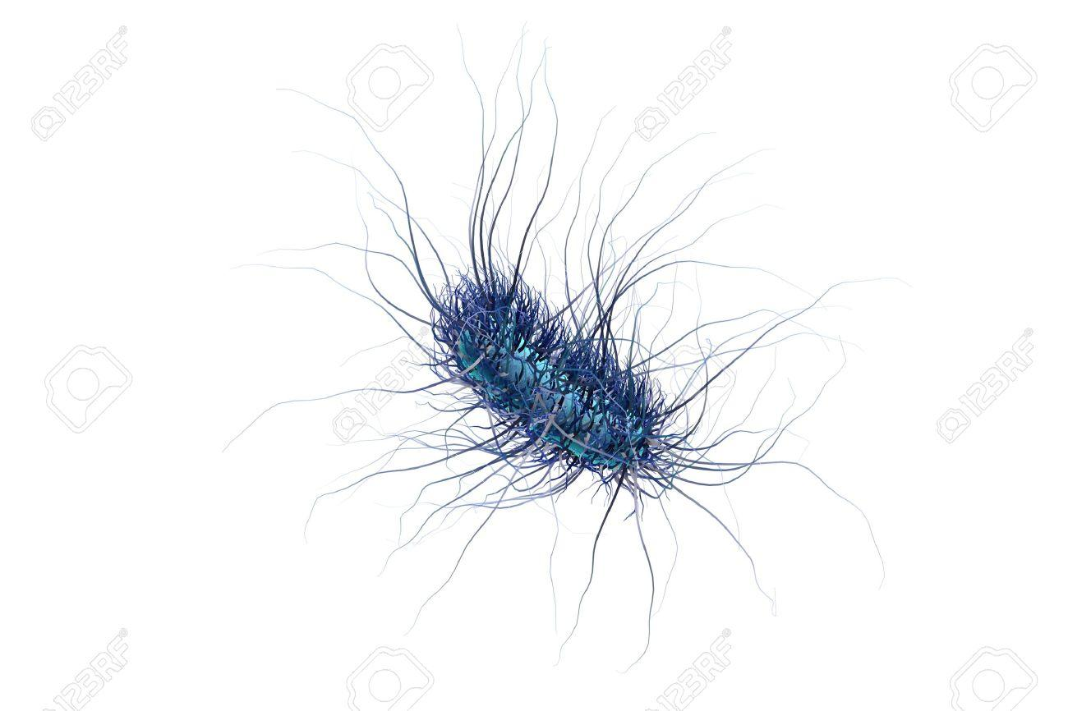

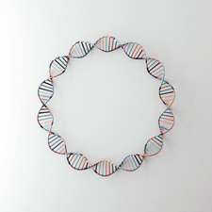
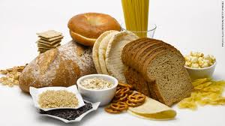
BioBuilderClub
Gluten Degradation Pill for Gluten Intolerance
Natalia Trounce, Shawn Vinogradsky, Lauren Binder, Sara Matsumoto
Palo Alto High School & Carlmont High School
Gluten is the common name for a group of complex proteins from all grains in the Triticeae grass family, which are found in many foods especially those made with grains such as wheat, barley, and rye. There are four conditions associated with negative reactions caused by gluten consumption, that affect 5-10% of the global population: celiac disease, wheat allergies, gluten sensitivity, and gluten intolerance.
In this project, we will use E.Coli as a microbial host to produce the PEP 2RA3 microbial enzyme, a newly discovered, stable tool which breaks down gliandins, one of two main protein groups which make up gluten. These enzymes will be used in a pill which we hope will act similarly to a lactase pill for people with lactose intolerance, in that it will help affected individuals safely ingest foods containing gluten.

Slide 2

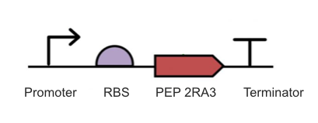
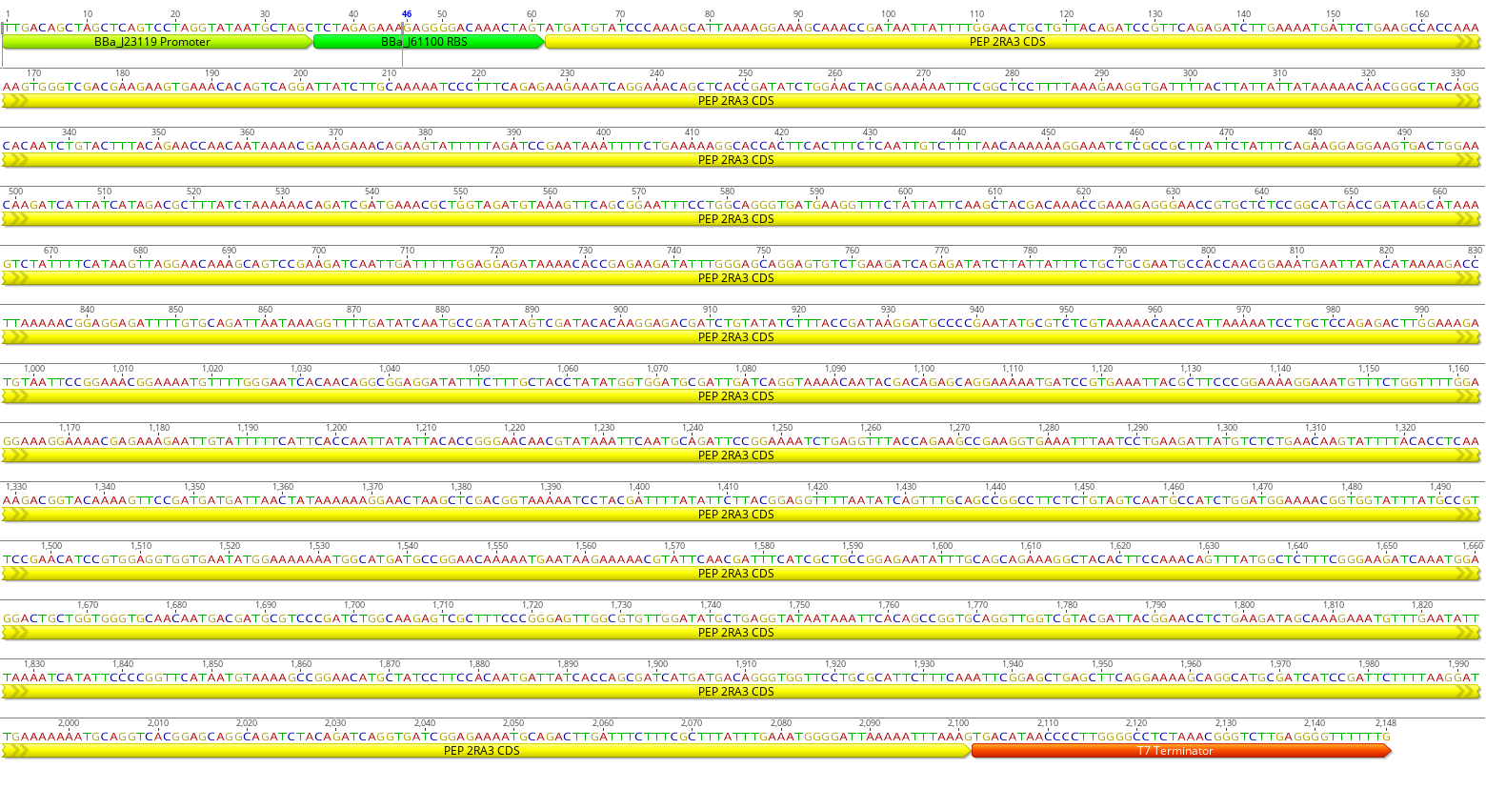
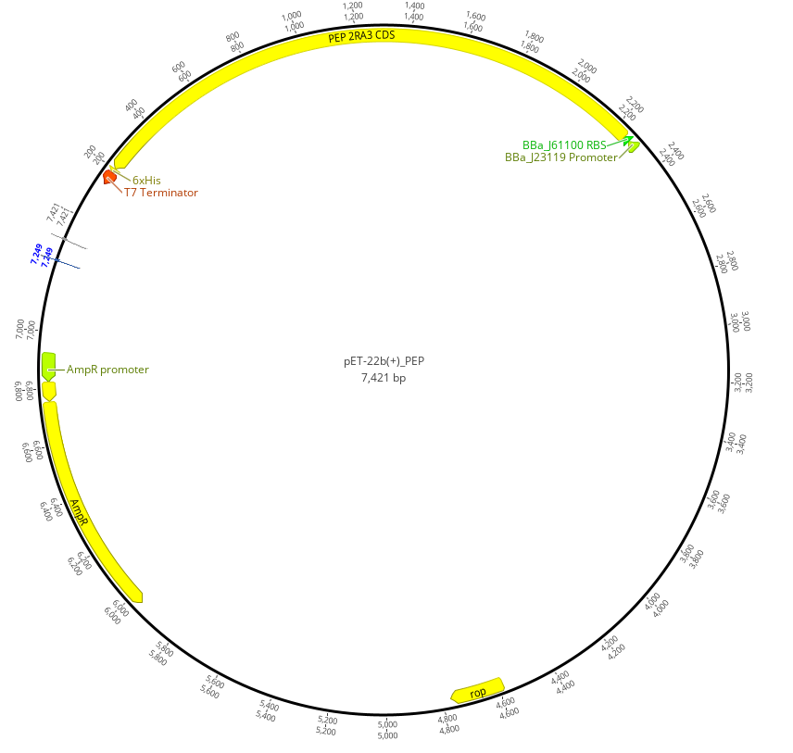
BioBuilderClub
Gluten Degradation Pill for Gluten Intolerance
Natalia Trounce, Shawn Vinogradsky, Lauren Binder, Sara Matsumoto
Palo Alto High School & Carlmont High School
We created a basic DNA construct (bottom right), consisting of a promoter (start) sequence, a ribosome binding site (RBS), the enzyme coding sequence (CDS) for the PEP 2RA3, and a terminator- we used the T7 terminator sequence. The terminator and promoter were both chosen from the iGEM parts registry. To convert the construct into a plasmid (bottom left), we modified the ends of the restriction sites and put them together with ligase. To produce the enzyme, we would transform this plasmid into E.coli, and place the E.coli inside a pill to be taken orally.

Slide 3
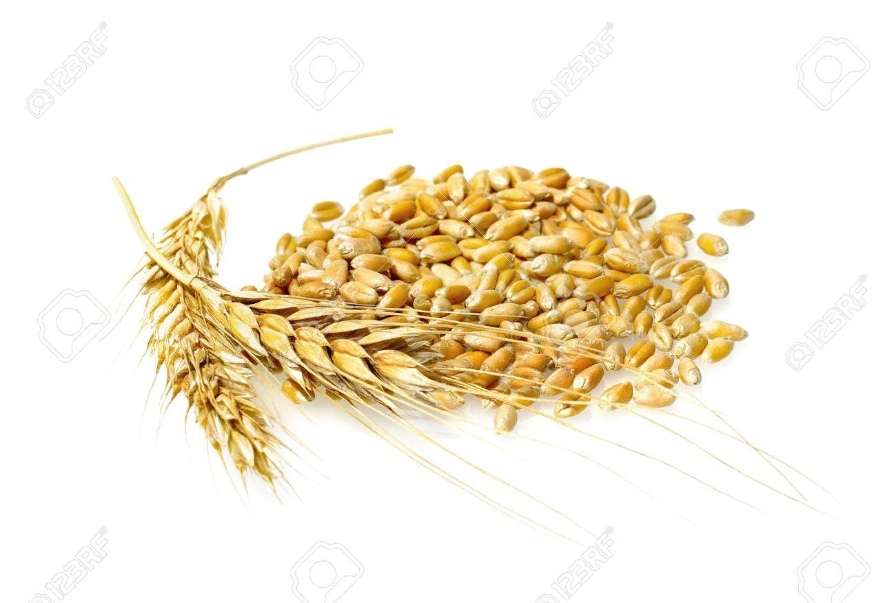
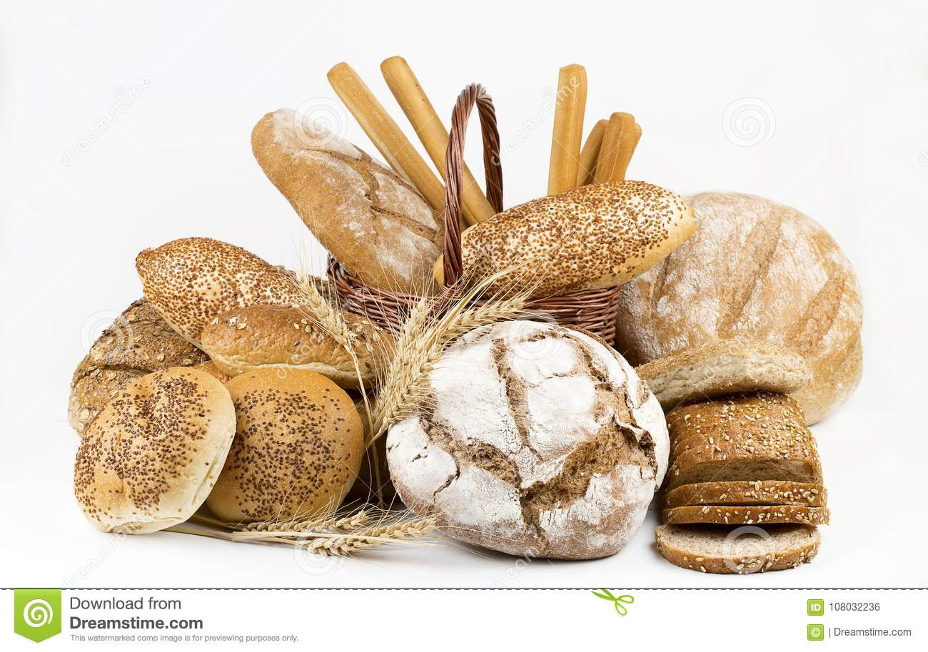
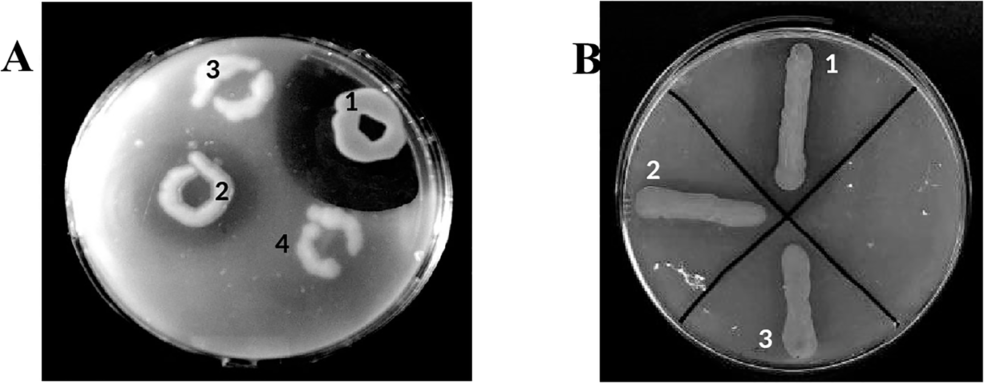
BioBuilderClub
Gluten Degradation Pill for Gluten Intolerance
Natalia Trounce, Shawn Vinogradsky, Lauren Binder, Sara Matsumoto
Palo Alto High School & Carlmont High School
Our solution does not have to be perfect to help people. Even if there are small particles of gluten remaining after degradation, this idea may be beneficial because it allows people to enjoy the taste, smell, and texture of the authentic, gluten-containing foods, not their gluten-free counterparts, with fewer of the debilitating symptoms that they would otherwise face.
One way to test our design would be to see if E. Coli can efficiently secrete the enzyme and whether the enzyme degrades gluten, which can be measured with petri plates containing gliandin. We could also purify the enzyme from E. Coli without secretion, and test the efficiency in-vitro without E. Coli, just the enzyme.

