Slide 1


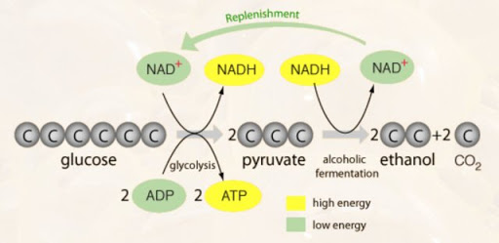
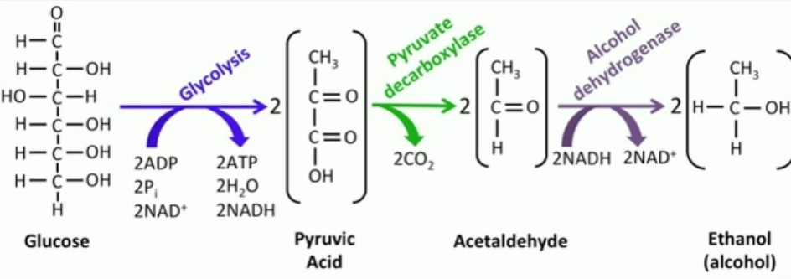
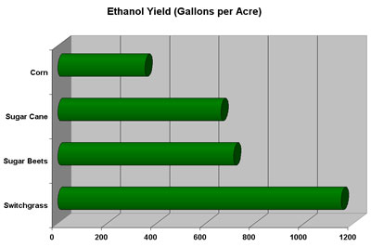
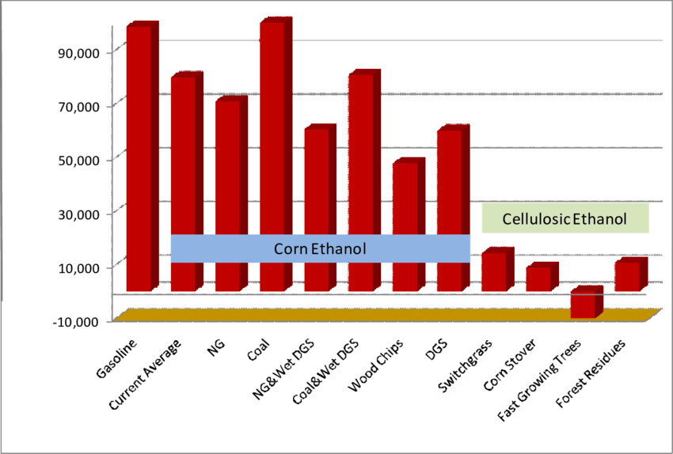
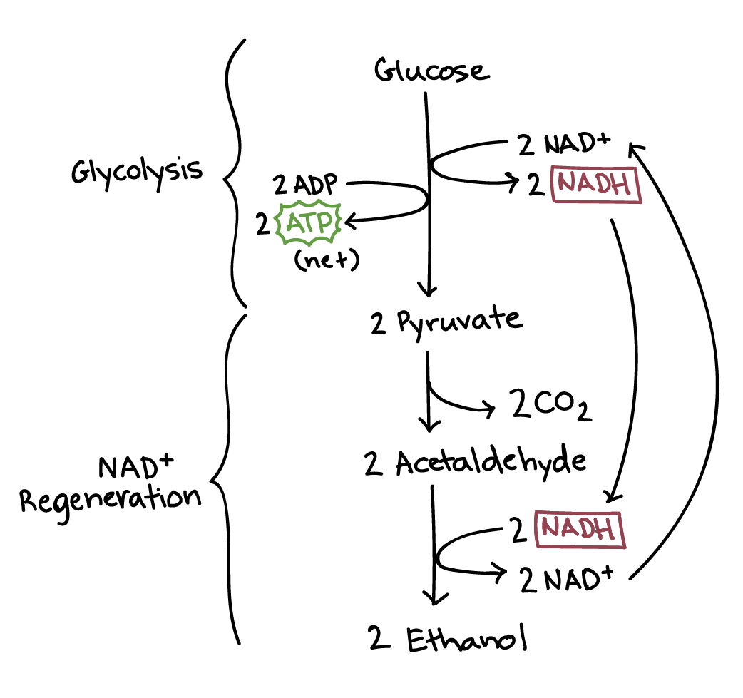
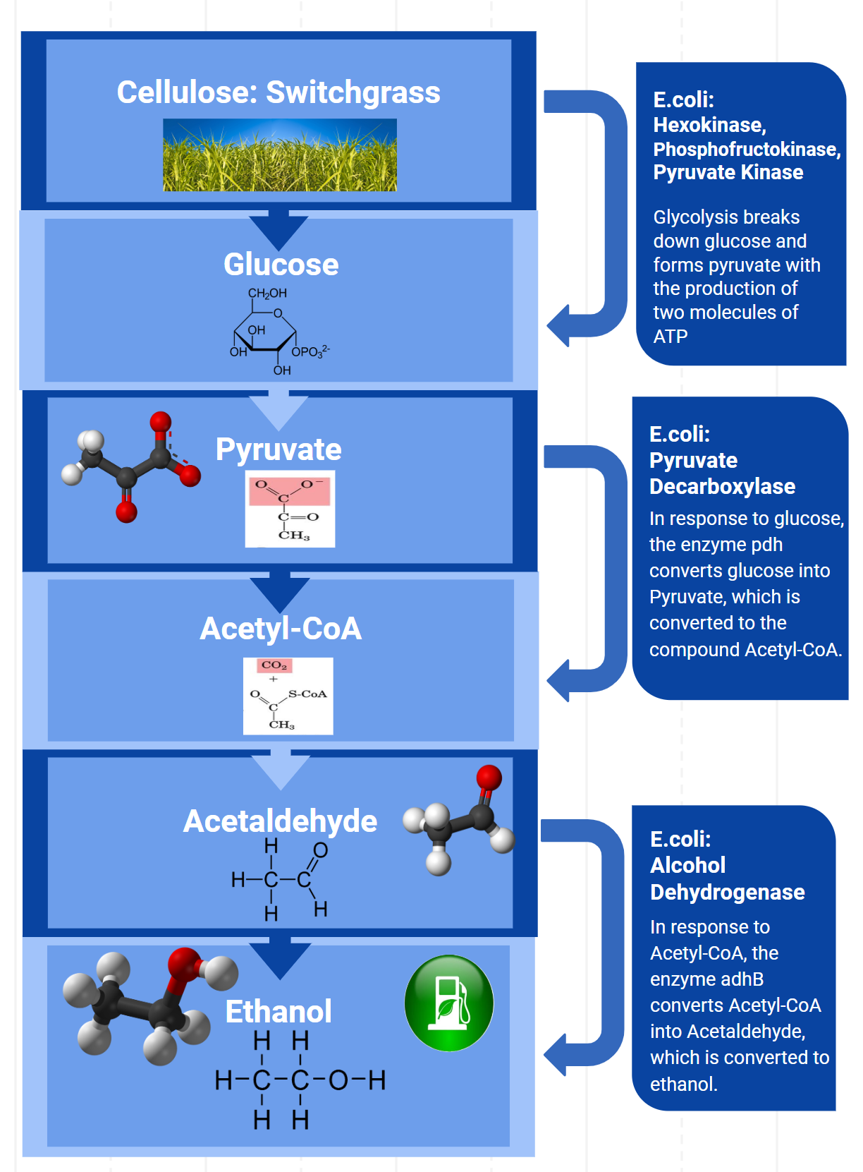
Sustainable Switchgrass
Evelyn Vu, Vicki Yang, Philip Shraybman, Kaitlyn Ramesh, Phoebe Shubin, Sasha Feygin, Amelia Lee, Edward Flanagan,
Austin Packard, Kate Paik, Kaitlyn Wong, Arnon Kuzmin, Andrew Atallah, Albert Wang, Jennifer Regrut
Needham High School
Introduction
Results
Results (Continued)
Conclusions
Production and usage of biofuel is an environmentally-friendly alternative to fossil fuels
Switchgrass is a prodigious producer of cellulose, producing higher biofuel yields than food crops
Bacteria can convert cellulose to ethanol through glycolysis and ethanol fermentation
Bacteria with the DNA that creates the enzymes from these processes are inserted into an E.coli bacteria that will convert cellulose into ethanol
Ethanol Fermentation:
Steps:
Step (1): a carboxyl group is removed from pyruvate and released in as carbon dioxide, producing a two-carbon molecule called acetaldehyde
Step (2): NADH passes its electrons to acetaldehyde, regenerating NAD⁺ and forming ethanol
Enzymes:
Pyruvate Decarboxylase: turns pyruvate into acetaldehyde and CO2
Alcohol Dehydrogenase II (adhB gene): turns acetaldehyde and a ubiquinone into ethanol
Alcohol Dehydrogenase (NAD+ dependent): turns acetaldehyde and a uniquinone into ethanol and NADH
(1) Zymomona Mobilis
Steps: turns pyruvate into ethanol and CO2
Beneficial Traits: high-ethanol productivity, high alcohol tolerance, broad pH range
Processes:
Entner-Doudoroff Pathway: metabolic pathway that starts with glucose and catabolizes it into pyruvate
Homoethanol pathway: metabolizes pyruvate to ethanol (pdc, adh)
Genes/Enzymes:
Pyruvate Decarboxylase
Alcohol Dehydrogenase II (adhB gene)
(2) (Geo)Bacillus Stearothermophilus
Steps: turns acetaldehyde into ethanol
Beneficial Traits: high growth rate, high ethanol production from glucose
Genes/Enzymes:
Alcohol Dehydrogenase (NAD+ dependent)
(3) Zymobacter Palmae
Steps: turns pyruvic acid into ethanol
Beneficial Traits: high-ethanol productivity, high alcohol tolerance, broad pH range
Genes/Enzymes:
Pyruvate Decarboxylase
Alcohol dehydrogenase II (adhB gene)
(4) Clostridium Thermocellum
Beneficial Traits: rapidly ferments cellulose, produces ethanol at a high yield
Processes:
Glycolysis
Genes/Enzymes:
Pyruvate Decarboxylase
Alcohol Dehydrogenase II (adhB gene)
Problem: Ethanol Fermentation produces CO₂ as by-product
Less combustion emission in production process
Replacing production of CO₂ in combustion rxns > CO₂ produced through ethanol production
Negligible CO₂ emission: we don’t need to deal with it
Overall: Production of CO2 in this bacteria will pale in comparison to the CO₂ produced by a car/plane/other vehicle that uses traditional fuels)
Methods
Glycolysis: Cellulose from switchgrass converted to glucose, which is converted into a pyruvate
Ethanol Fermentation: converts glucose into ethanol
References & Acknowledgements
Thanks to Needham High School and Ms. Regrut for giving us the opportunity to pursue this research.
Reference 1:Akinosho, Hannah, et al. “The Emergence of Clostridium Thermocellum as a High Utility Candidate for Consolidated Bioprocessing Applications.” Frontiers in Chemistry, vol. 2, 2014, doi:10.3389/fchem.2014.00066.
Reference 2: Tian, Liang, et al. “Enhanced Ethanol Formation by Clostridium Thermocellum via Pyruvate Decarboxylase.” Microbial Cell Factories, vol. 16, no. 1, 2017, doi:10.1186/s12934-017-0783-9.
Reference 3: Zarubin, Bobby. “Cellulosic Ethanol: Environmentally Friendly, But Costly.” Cellulosic Ethanol: Environmentally Friendly, But Costly, 16 Nov. 2014, large.stanford.edu/courses/2014/ph240/zarubin1/.
Notes:
Single sided poster!
LOGO??? CONCLUSIONS??? PLASMID? EXPERIMENT

