Slide 1

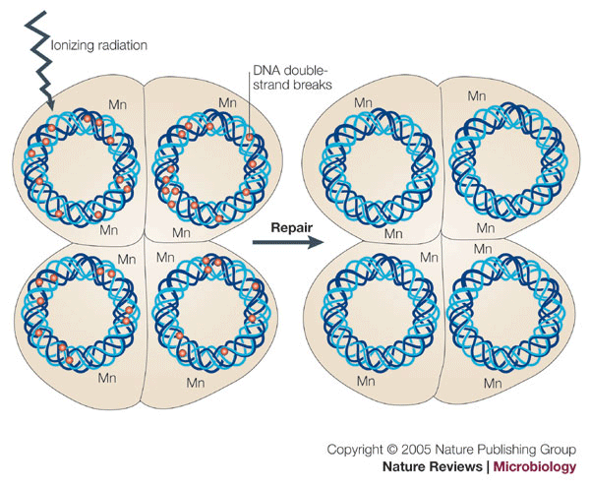
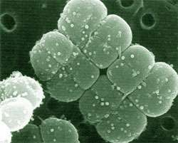
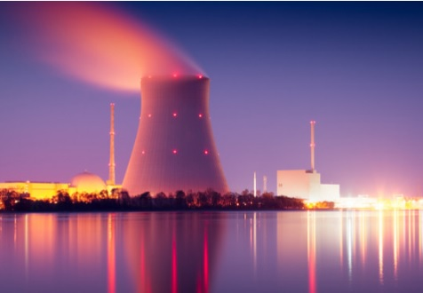
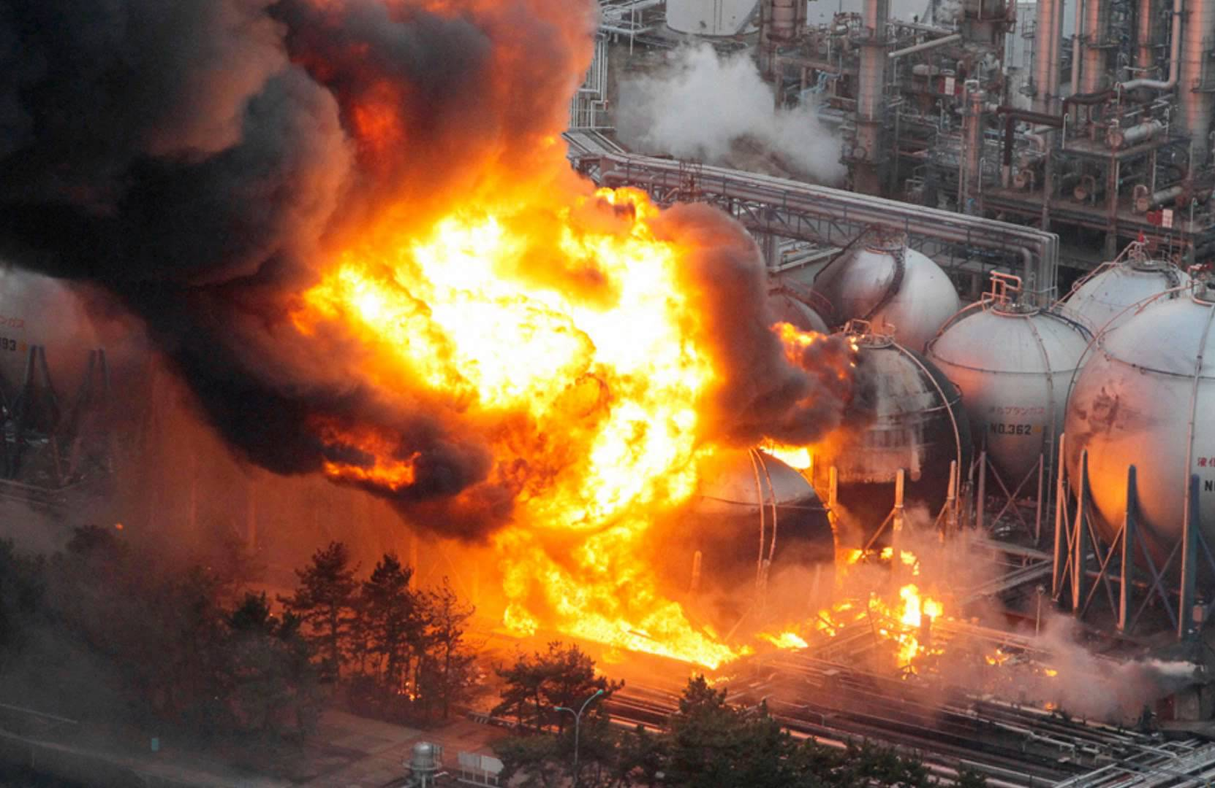
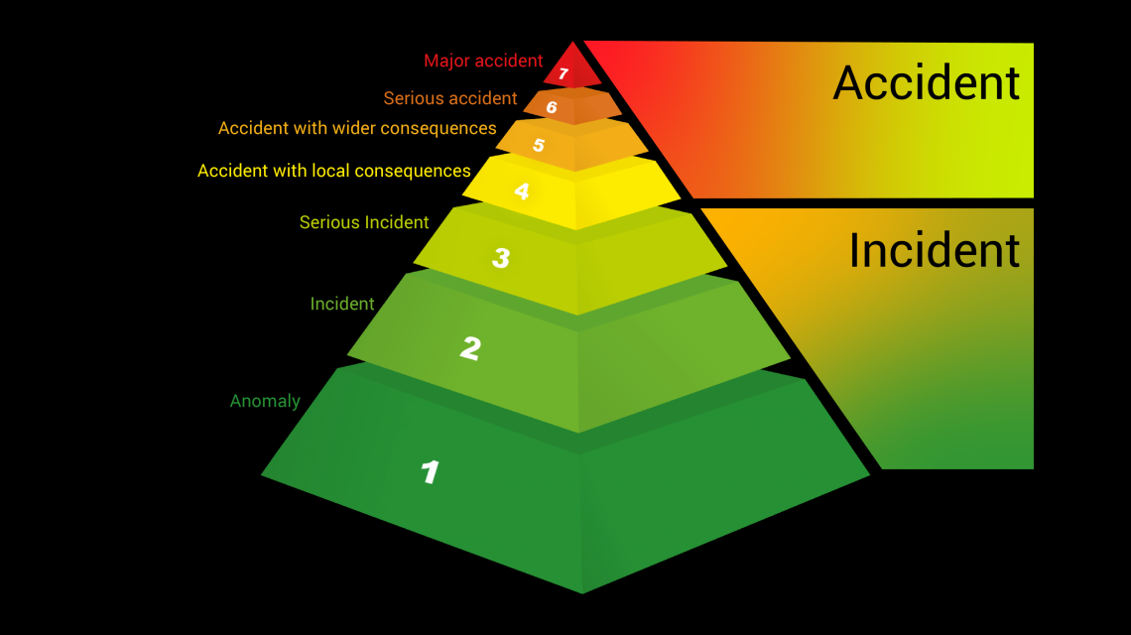
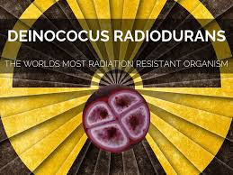
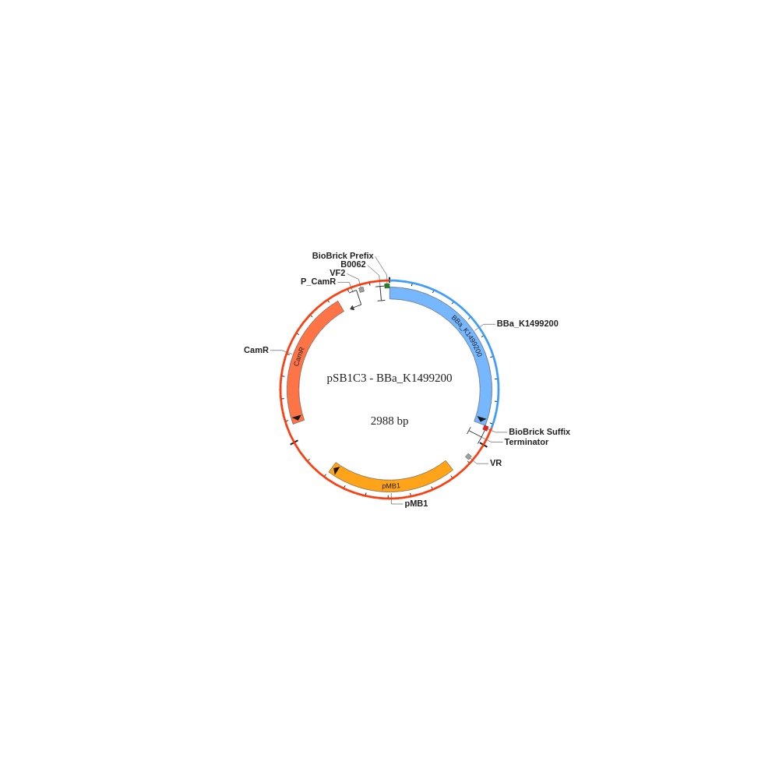

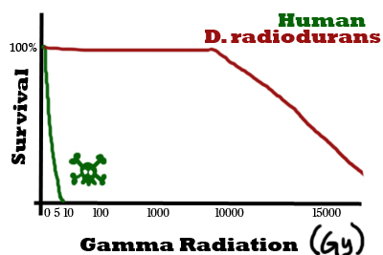
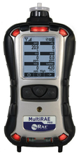
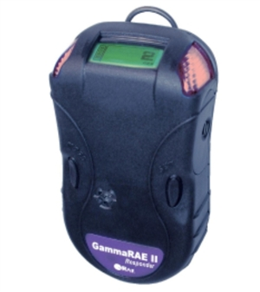
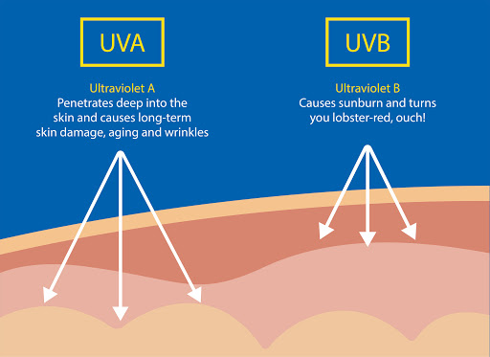
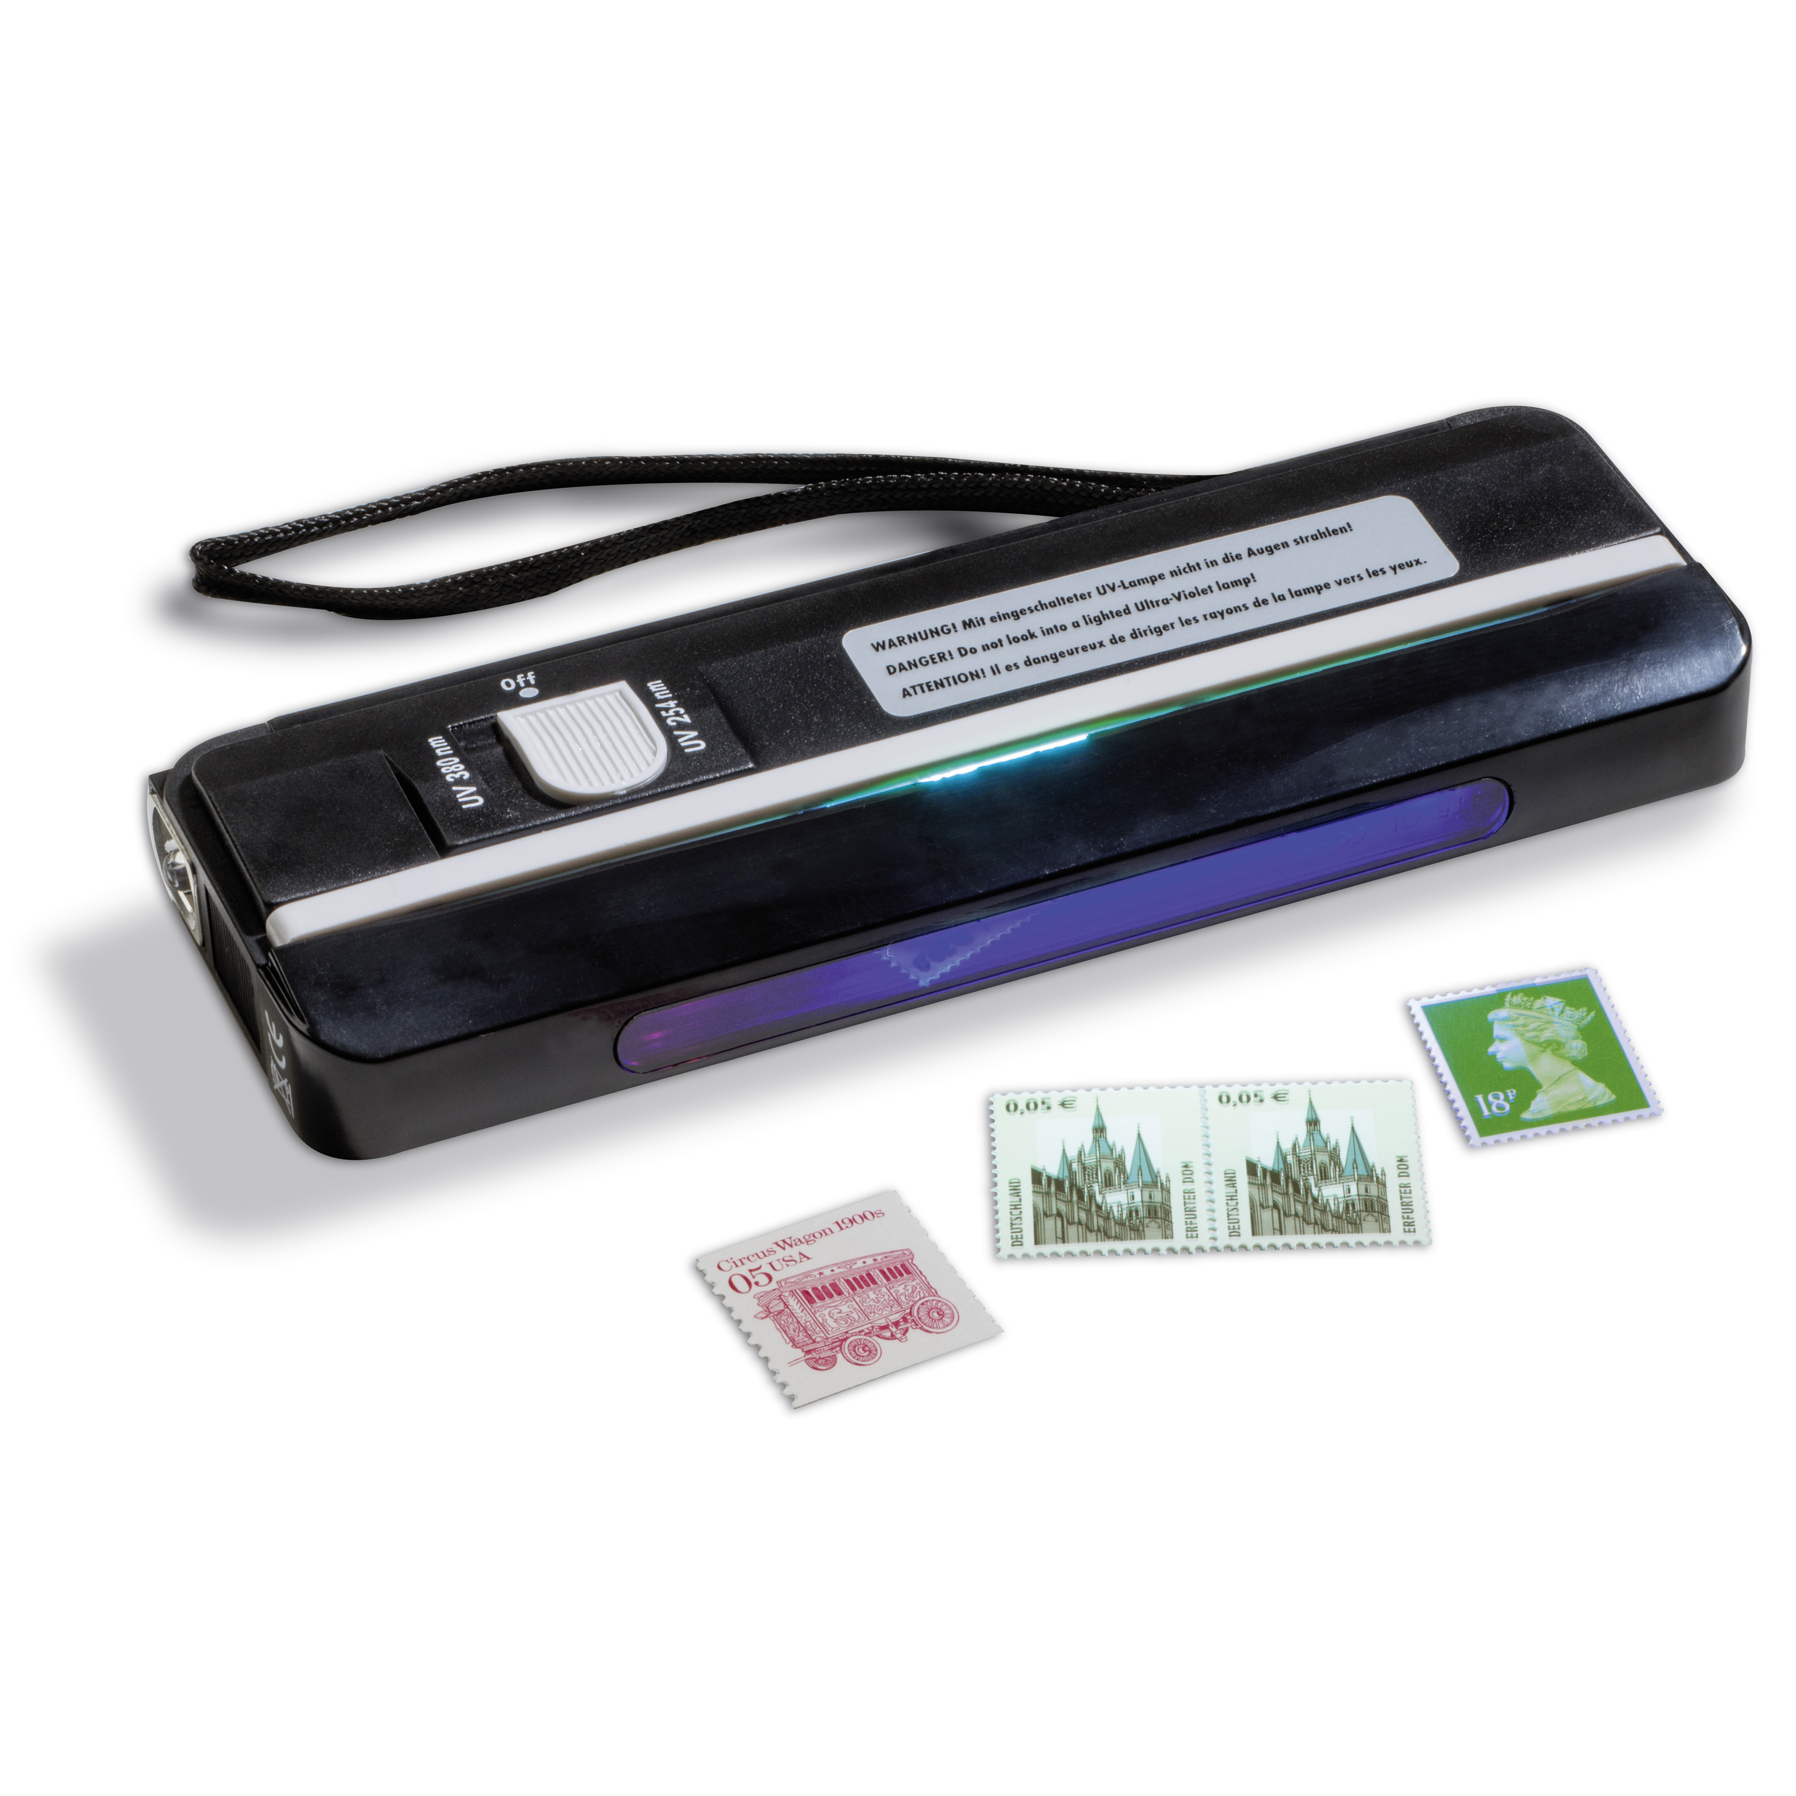
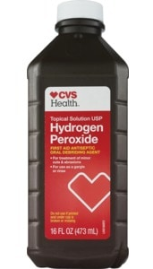
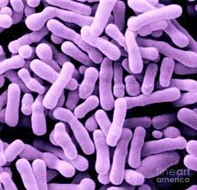
Designing A Bio-senor with A Bio-reporter to Detect Radioactivity in the Environment
Team members: Ziling Chen, Yang Chen, Naseem Amari, and Dmitry Sklyarov
Team Leader: Alfred Aung Lwin ; Mentor: Racquel Sherwood
Abstract
Nuclear accidents and incidents due to natural disasters (i.e. earthquakes) or human error are of global concern. When they happen, the radiation released poses serious risk to human health and the environment.
As of today more than 100 of these nuclear incidents have occurred. The most well-known cases are: Fukushima Daichi nuclear disaster (2011), Chernobyl (1986) and Three Mile Island (1979). Exposure to radiation from these accidents resulted in: skin burns, acute radiation syndrome, shock, cancer and death.
Unfortunately, the majority of these accidents and incidents are the result of human error. Yet, despite significant safety improvements, there is still a possibility that another nuclear accident will happen.
Today, we rely on radiation detectors to inform us of unexpected increases in radiation levels. However, these instruments are expensive and can be unavailable or are inefficient at monitoring environmental radiation.
Our Research Goal:
Use synthetic biology to develop a whole celled biosensor and reporter that can detect ionizing radiation in the environment and show the presence of radiation doses.
Rationale
D. radiodurans is considered the worlds toughest bacteria. It is a polyextremophile capable of surviving:
Lethal doses of radiation in humans (over 12,000 Gys)
Cold
Dehydration
Vacuum
Acidic conditions
We plan to use genes required for Deinococcus radiodurans radiation resistance to engineer a radiation resistant biosensor and reporter in an E.coli chassis.
Research Plan
Phase I: Develop a radiation resistant chassis
  We inserted DNA damage repair gene, uvsE, to protect the E.coli chassis from DNA damage during radiation exposure.
Phase II: Design a whole celled biosensor and reporter
  We designed a plasmid that encodes parts that can sense radiation (RecA Promoter), tolerate radiation (uvsE) and fluoresces in the presence of radiation (GFP).
Phase I:
Develop a radiation resistant chassis - Materials and methods
Transformation: We transformed NEB 10-Beta Competent E. coli cells using the “High Efficiency Transformation” protocol and plated transformants on LB + Chloramphenicol plates. Cells were incubated overnight and stored in the refrigerator.
  Experimental plasmid: Encodes uvsE (D. radiodurans UV DNA damage endonuclease, Bba_K1499200).
  Control plasmid: Encodes RFP (Red Fluorescent Protein, BBa_J04450).
Radiation Tolerance Assay: We performed 2 DNA damage tolerance assays as a way to asses survival due to DNA damaging agents (i.e.. Radiation exposure).
We do not have access to an ionizing radiation source. Instead, we used UV-A light, UV-B light and Hydrogen Peroxide as DNA damaging agents. At the end of our tests we plan to asses survival rates of our experimental chassis (expressing uvsE) and our control chassis (expressing RFP)

Slide 2
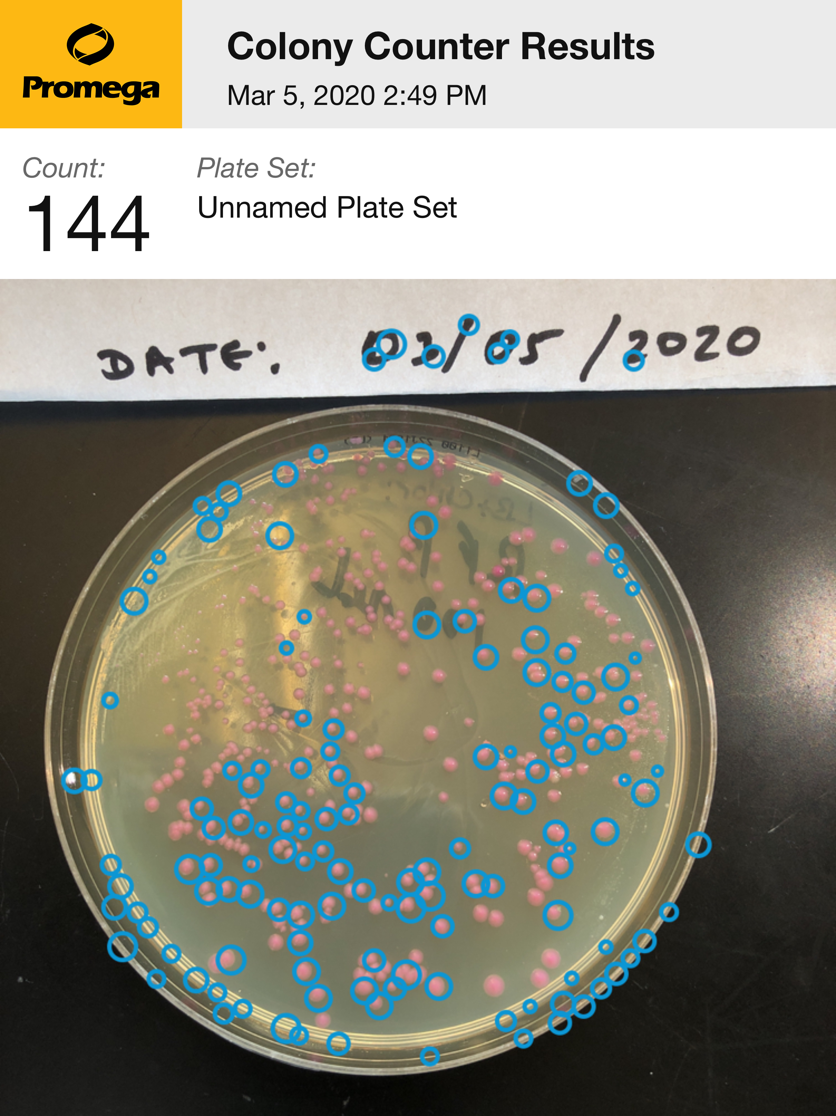
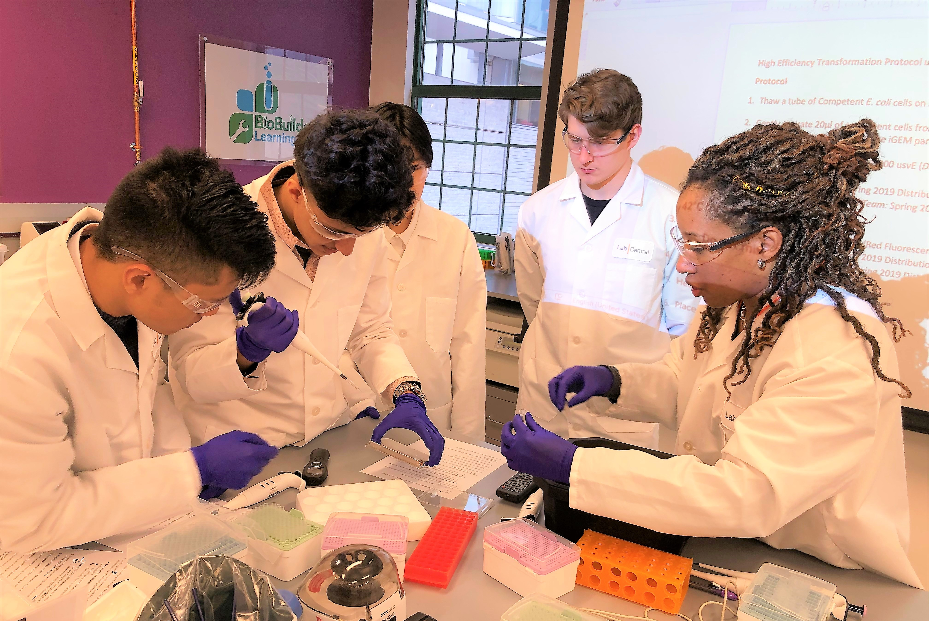
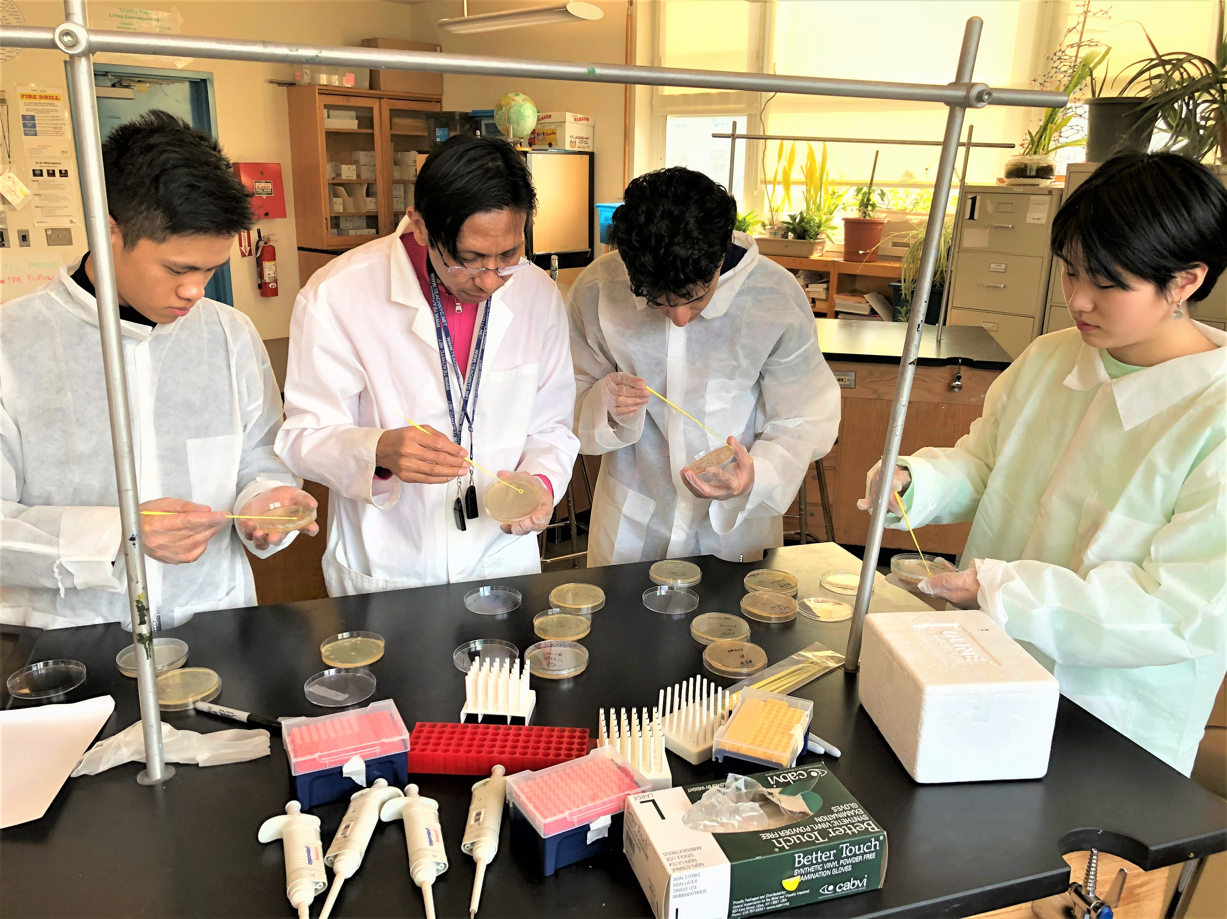
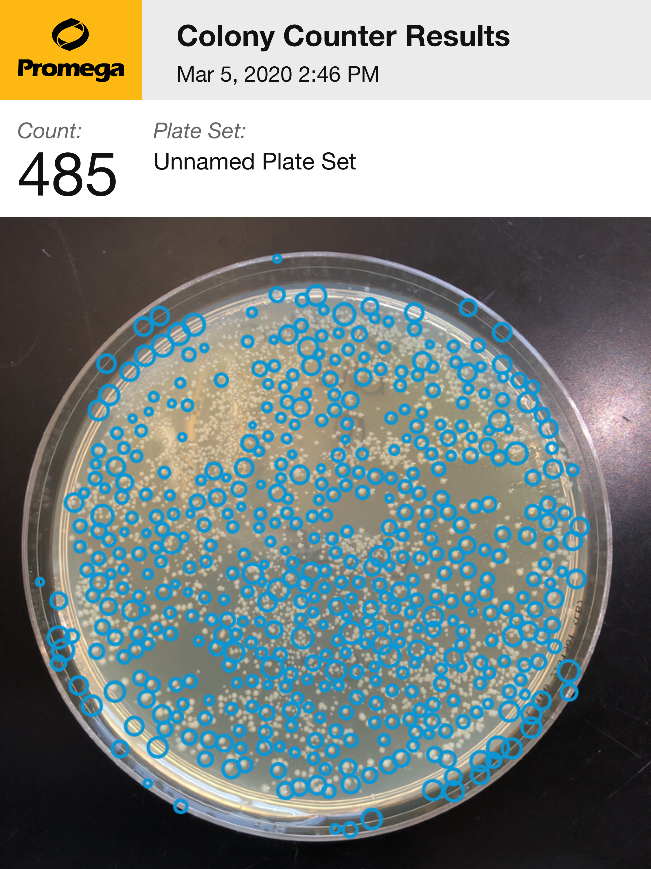
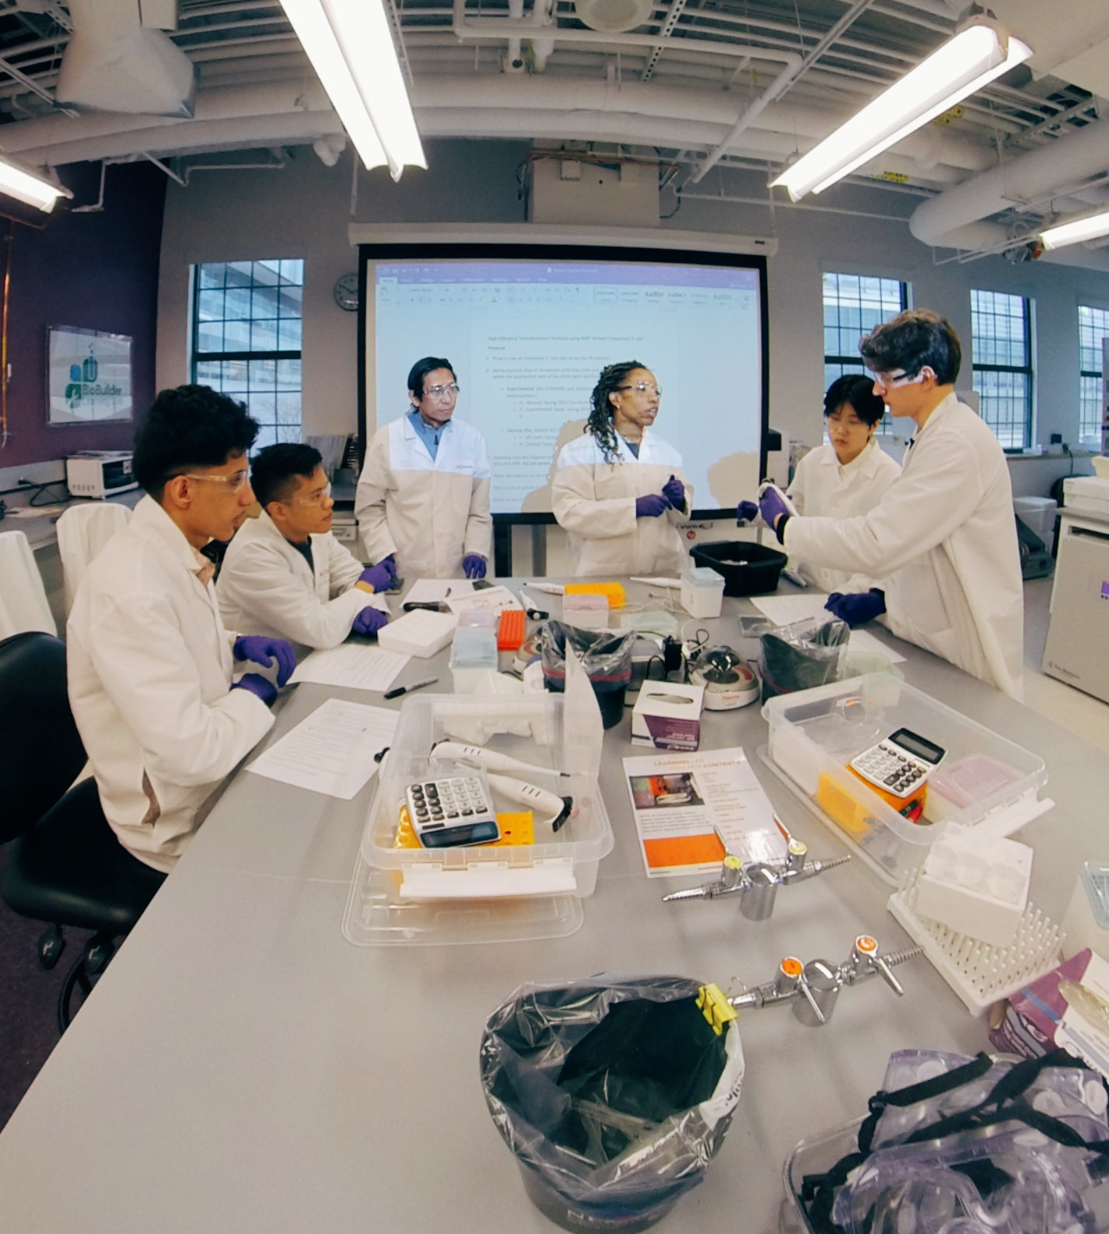
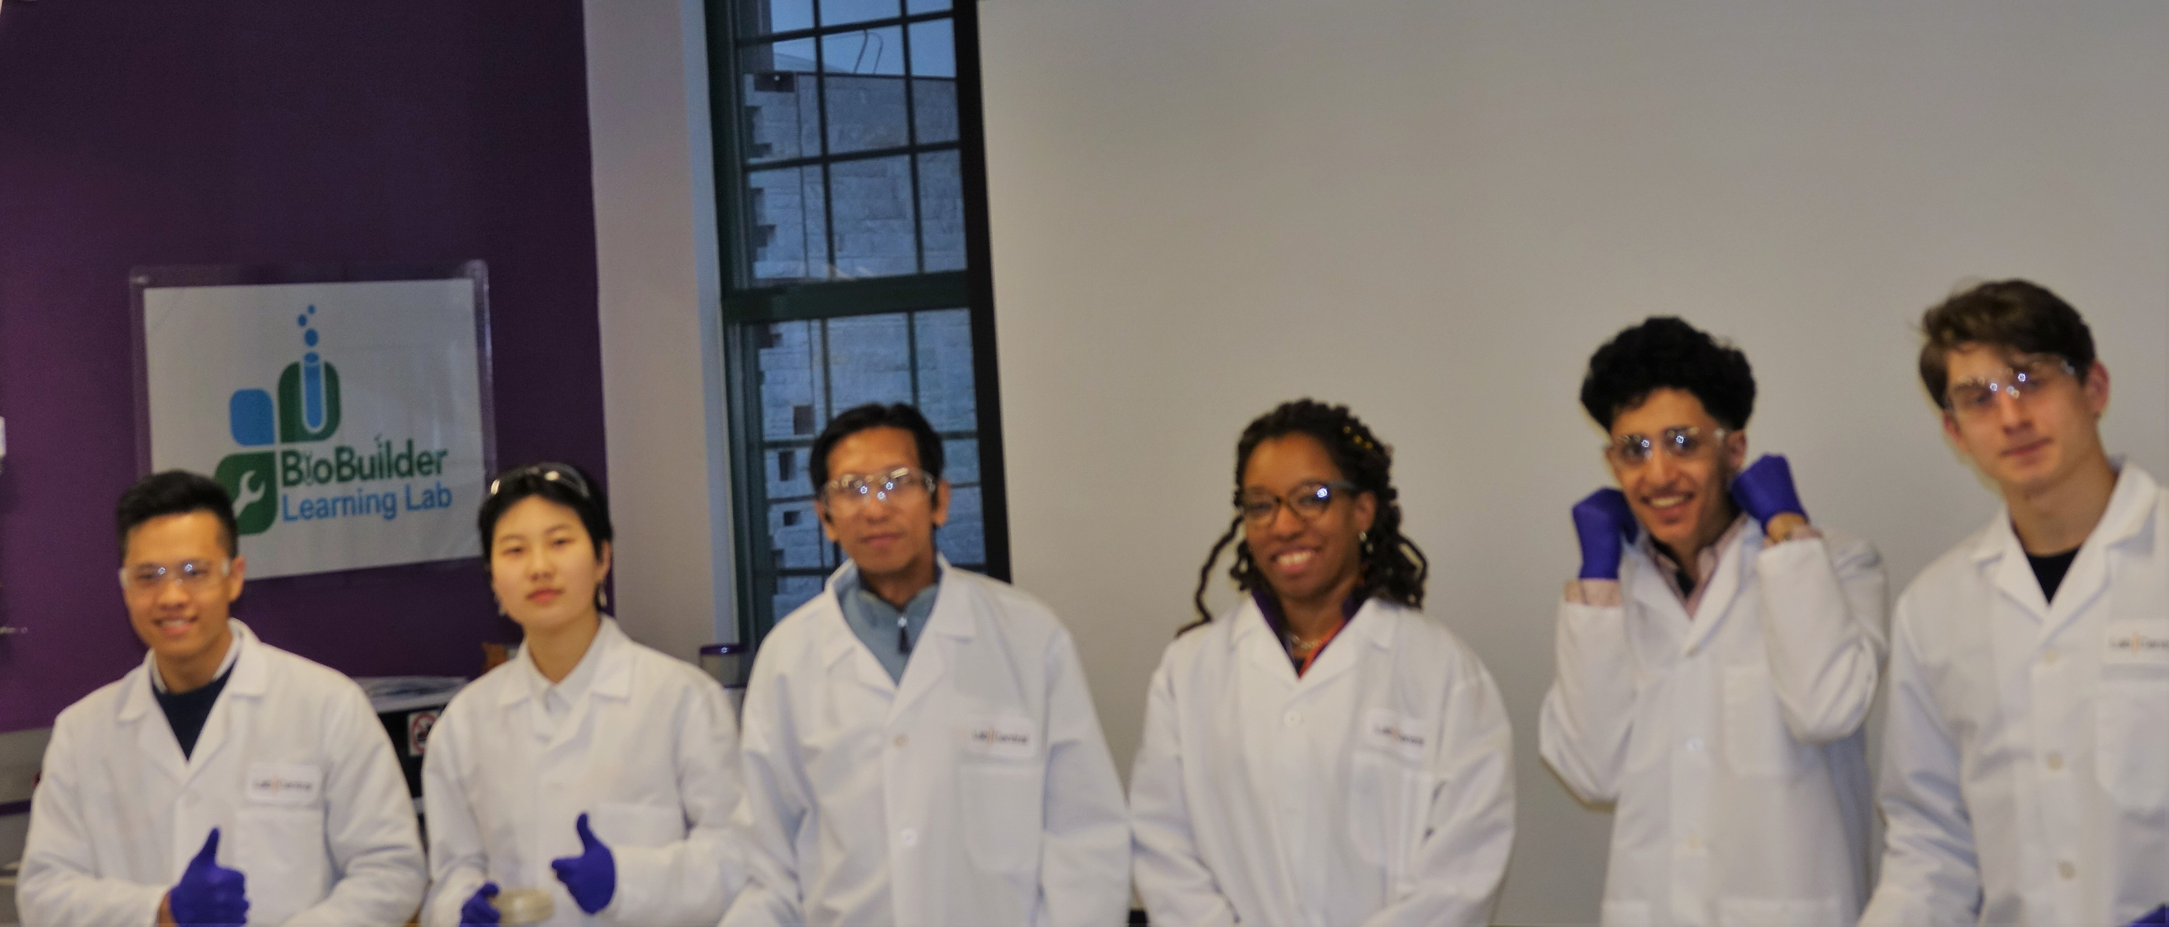
Designing A Bio-senor with A Bio-reporter to Detect Radioactivity in the Environment
Team members: Ziling Chen, Yang Chen, Naseem Amari, and Dmitry Sklyarov
Team Leader: Alfred Aung Lwin ; Mentor: Racquel Sherwood
Results: TBD – Data unavailable at time of publication
Radiation Tolerance using UV A-380 nm or UVB-240 nm lamps
Phase II:
Design a whole celled biosensor and reporter
Chassis: Radiation resistant chassis expressing uvsE, (Phase I).
Parts for Bioreporter + Biosensor:
  Radiation Biosensor: recA promoter from D. radiodurans is activated in the presence of radiation.
  Radiation Resistance: D. radiodurans uvsE (BBa-k1499200) for DNA damage repair.
  Radiation Bioreporter: Green Fluorescent Protein derived from jellyfish Aequeora victoria wild-type GFP (BBa_E0040)
  RBS: Ribosome Binding Site (BBa_B0035)
Chassis | Type of UV exposure | Duration of exposure | Colonies before exposure | Colonies after exposure | Survival rate
10-beta + RFP | UVA-380nm | 5 minutes | 219
10-beta + uvsE | UVA-380nm | 5 minutes | 258
10-beta + RFP | UVA-380nm | 10 minutes | 288
10-beta + uvsE | UVB-380nm | 10 minutes | 459
10-beta + RFP | UVB-240nm | 5 minutes | 241
10-beta + uvsE | UVB-240nm | 5 minutes | 485
10-beta + RFP | UVB-240nm | 10 minutes | 144
10-beta + uvsE | UVB-240nm | 10 minutes | 181
RecA Promoter
Terminator
References:
Engineering Deinococcus radiodurans into biosensor to monitor radioactivity and genotoxicity in environment
G GuanJun, F Lu, L HuiMing, H YueJin - Chinese Science Bulletin, 2008 – Springer
Battista, J. R., A. M. Earl, and M. J. Park. 1999. Why is Deinococcus radiodurans so resistant to ionizing radiation? Trends Microbiol. 7:362-365.
Krisko, A., & Radman, M. (2013). Biology of extreme radiation resistance: the way of Deinococcus radiodurans. Cold Spring Harbor perspectives in biology, 5(7), a012765. doi:10.1101/cshperspect.a012765
Kuldell Natalie, Bernstein Rachel, Ingram Karen, M. Hart Kathryn AC. Biobuilder: Synthetic Biology in the lab. Sebastopol, CA (USA): O’ Reilly Media, Inc.; 2015.
Lockhart JS, DeVeaux LC (2013) The Essential Role of the Deinococcus radiodurans ssb Gene in Cell Survival and Radiation Tolerance. PLoS ONE 8(8): e71651.
Ruder, Kate.2004. A Fight about the Toughest Microbe on Earth.
Slade D, Radman M. 2011. Oxidative stress resistance in Deinococcus radiodurans. Microbiol Mol Biol Rev 75: 133–191.
iGEM Registry of standard Biological Parts
iGEM Osaka 2011.
WHO ( World Health Organization), 2016 April. Ionizing radiation, health effects and protective measures.
To Be Determined . . .
RBS
uvsE
RBS
GFP
Radiation Biosensor
Radiation Resistance
Radiation Bioreporter
Conclusion and Future Directions
Optimize and complete the radiation tolerance testing assay to determine if uvsE protects our chassis from DNA damage.
Build and optimize our radiosensor and reporter by testing alternate parts and chasses:
  Optimize DNA damage tolerance: Test D. radiodurans uvsE Vs RecA
  Radiosensor options: Test strength of radiation responsive promotors
  Chassis options: Current vs MG1655-CB1000 (This E.coli strain that has evolved an increased level of radiation resistance.
DNA Damage Tolerance 3% Hydrogen Peroxide
Cells + pDNA | Hydrogen Peroxide Concen. | Duration of exposure | Colonies before exposure | Colonies after exposure | Survival rate
10-beta + RFP | 3% | 24 hrs.
10-beta + uvsE | 3% | 24 hrs.
10-beta + RFP | 3% | 24 hrs.
10-beta + uvsE | 3% | 24 hrs.
10-beta + RFP | 3% | 24 hrs.
10-beta + uvsE | 3% | 24 hrs.
10-beta + RFP | 3% | 24 hrs.
10-beta + uvsE | 3% | 24 hrs.
To Be Determined . . .
Acknowledgements: Our MCNDHS BioBuilder Team would like to extend our heartfelt thanks to Dr. Natalie Kuldell, and Carla Boon for their advice and support given to us during the project. We also would like to offer our special thanks to our amazing mentor Dr. Racquel Kim Wood for her constant advice and support to us all along. We also very much would like to thank our Principal Michael Toise, Asst. Principal (Science) Mark Testa and other faculty for their avid support. We are grateful to Ms. Margaret Aylward, and CDI staffs for their generous support. We are truly thankful to our science teacher and team leader, Alfred A. Lwin for his leadership, guidance, support and encouragement during our Bio Builder project.

