Slide 1
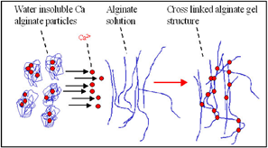
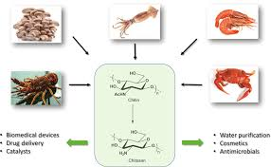
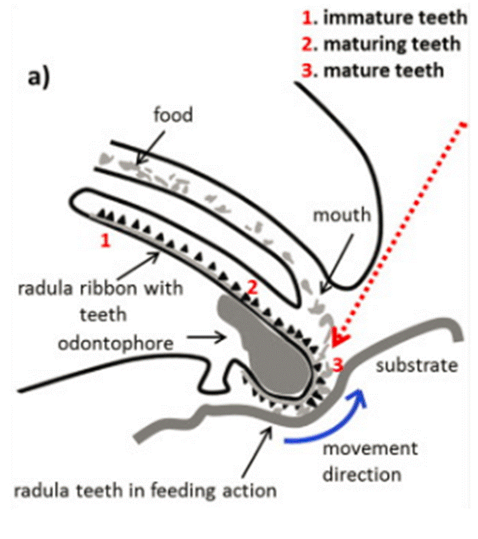
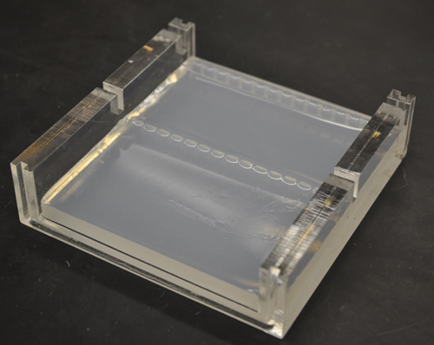
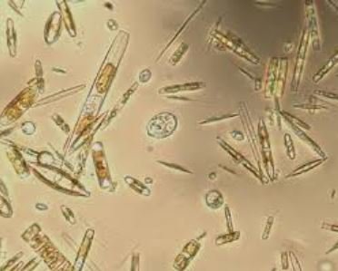
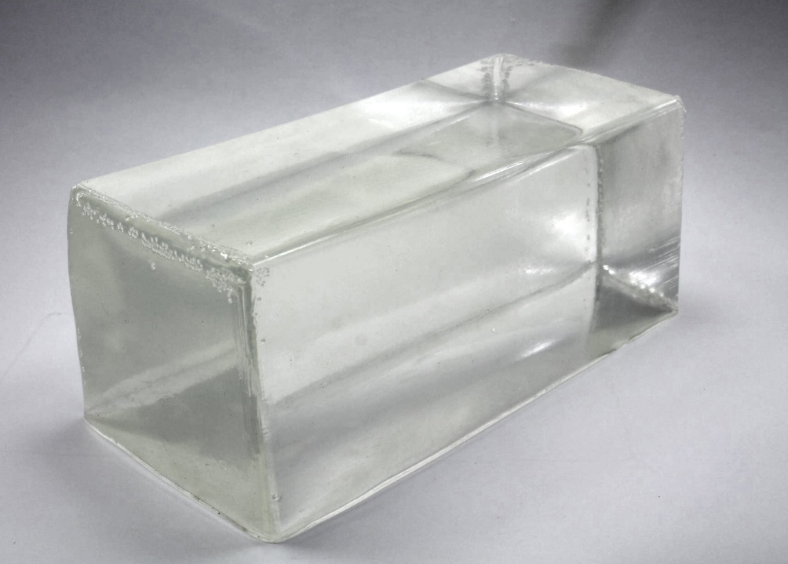
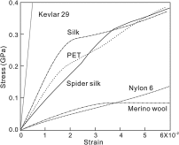
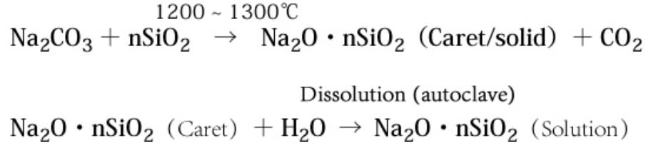
A Comparison of Agents:
The Development of Novel Biocompatible Materials for Strength, Durability, Conductivity, Elasticity, and Visibility
Srinitya Allam, Rosa Bouchery, Eirian Crocker, Ria Hosuru, Richard Kim, Valerie Lau,Terrance Luangrath, Rohebot Mengesha, Elena Novak, Skylar Ondrejko, Hannah Park, Wamia Said, Meron Tadesse, Irene Torosyan, Jessica Truong, Riley Turbak, Jack Cantarella, Elizabeth Romano, P.I.
The Governor’s School at Innovation Park - Prince William County Schools & George Mason University
Methods- Expression & Function:
Select natural agent comparison for strength, durability, flexibility, conductivity, visibility and conductivity
Is there a gene/protein/polymer sequence known?
What are the agent’s current uses that can be enhanced?
Alginate, Collagen, Lignin, Chitin, Limpet teeth, Agarose, Silica, Gelatin, Cellulose, Spider Silk
An overview of the products that may be secreted through synthetic biology approaches and/or chemically synthesized ex vivo.
Spider silk, Lignin, Chitin, Cellulose, Limpet Teeth, Polyvinyl Alcohol, Ceramic Fibers
Choice of products that be generated and used in conjunction for novel materials that retain one or more the following themes:
  Strength, Durability, Conductivity, Elasticity, and Visibility
A Comparison of Agents:
Alginate
Collagen
Lignin
Chitin
Limpet Teeth
Produced by brown seaweed and Pseudomonas and Azotobacter bacteria(Massengale et. al., 2000)
Polysaccarhide of mannuronic and guluronic acid that cross links with divalent metal ions to create a gel with pores
Longer guluronic acid chain creates a stiffer gel(Lee & Mooney, 2012)
Low toxcitity, affinity for water with a cross linkage pattern that mimicks the extra cellular matrix(Burdick & Stevens, 2005)
Collagen is responsible for skin elasticity and consists of great tensile strength. (W. H. Freeman and Company, 2000)
Basic function: to help tissues withstand stretching. (Lodish, H, 1970)
Its fundamental unit consists of a (300-nm) and (1.5-nm diameter) long protein, each chain consisting of 1050 amino acids. (W. H. Freeman and Company, 2000)
Lignin is a complex polymer present in all cell walls
The lignin monomers, called monolignols, are the non-methoxylated p-coumaryl alcohol, the monomethoxylated coniferyl alcohol and the dimethoxylated sinapyl alcohol.
It is covalently linked to hemicellulose and cellulose
It has numerous applications like it being a strength aid, polymer for hydrogels, and being a source for carbon fibers
One of the most abundant polysaccharides in nature” (Badwan et al.,2015).
Produced by a shellfish and wings of insects and cell walls of yeast, mushrooms, and other fungi (Rajendran et al, 2016)
High Strength in chitan form
Chitosan (deacetylated chitin), a more biocompatible derivative of chitin. (Badwan et al., 2015).
Application: cosmetics, packing materials, binding to common water pollutants. (Gopakumar et al., 2019).
Biocompatability: Not well studied, however, the goethite crystals surrounded by silicon matrix would most likely create a highly biocompatible material.
Polymer: Chitin / Goethite crystal polymer, the Chitin has gaps shaped in such a way that the crystals grow and strengthen the biopolymer. (Weirner et al. 2011)
Exact biomineralization pathways are currently unknown.
Stronger than diamond (3-6.5 giga pascals. (Barber et al. 2015)
A Comparison of Agents:
Select natural agent comparison for strength, durability, flexibility, conductivity, visibility and conductivity
Is there a gene/protein/polymer sequence known?
What are the agent’s current uses that can be enhanced?
PLA, HLA, PGA, Ceramic, CNT, PA, PC, Diamond, GO, R-L, PV
Optimization:
Match each theme with a secretable product, and choose whether this needs to be embedded into a matrix for support
Generate multiple polymers using pre-made plasmids rather than generating a completely new vector backbone
Combine polymers to create a new biocompatible materials combine 1+ of the desired output through evaluation using control:
  Strength
  Durability
  Conductivity
  Elasticity
  Visibility (Color, Iridescence, Light Dispersion)
Assess financial feasibility for commercial growth
Minimize waste products to streamline secreted product harvesting,
Assess biocompatibility and eco-friendliness of product generate and waste generated.
Test secreted output for ideal performance
  Protein Isolation and Purification
Methods- Vector & Model Species:
Initial comparison for the vectors for synthetic biology approaches and model species for expression
  Spider silk
  Lignin
  Chitin
  Cellulose
Andersen, T.,2015
Silica
Sayed.S, (2017)
Spider Silk
Agarose
Gelatin
Cellulose
The type of interest is dragline silk made for supporting structure of the web.
It is made purest by spiders, but it can also be made by E. coli and silkworms through DNA recombination (Caracciolo, Ahlgren, & Goetz, 2019).
It has a strength rating of 1.1 gigapascals (GPa), toughness factor of 180 megajoules/meter, and can increase its length by 27% (Wood-Black, 2018).
Spider silk produces no toxic or inflammatory response and is degradable.
It is used in body armor, drug delivery, tendon repair, and dressings.
Proteins made by MaSp 1 and 2 genes which are known (Ayoub et al., 2007).
Agarose is a polysaccharide that is generally extracted from red seaweed and is a linear polymer made up of repeating units of agarobiose. (Roberts & Martens, 2016)
Chemical, thermal, and physical stability.
It is used as the medium for electrophoretic separation PCR (Bio-Rad, 2020)
Silica can also be produced by many diatoms through biogenic means. in 2013, scientists found that silica can regulate iron levels of oceanic ecosystems. (Nelson)
We could find ways to target other substances from water using the silica structure produced and manipulated by diatoms.
Rather than taking an ecological route, we could apply this concept to a novel method for water purification as heavy metals are abundant in water.
Gelatin is an organic substance made up of the protein collagen powder harvested from the bones of farm animals through a streamlined process of hydrolysis (Peta, 2010)
Ballistic gel has high durability and flexibility with a high tolerance of heavy impact from small ballistics, but its structural integrity is less than suitable due to its malleable nature (Mann, R., 2019)
Ballistic gel would not be a go to choice material wise as its melting point is only 105 degrees Fahrenheit which can be easily reached during especially hot summers (Mann, R., 2019)
Carbohydrate polymer produced by plants and some bacteria
Made by cellulose synthase outside the plant cell wall
Bacterial cellulose (BC) purer than plant-made because not mixed with other molecules in the cell wall (Du et al., 2018).
BC's nanofiber-like structure contributes to its high water holding and retention capabilities, transparency, high porosity and tensile strength, biocompatibility and biodegradability (Du et al., 2018).
Used in textiles, tires, paper, separation membranes, antibacterial wound dressing, temporary artificial skin, and wound healing scaffolds (Gullo et al., 2019).
Methods- Vector & Model Species
Initial comparison for the vectors for synthetic biology approaches and model species for expression
  Limpet Teeth
  Polyvinyl alcohol
  Ceramic Fibers
References:
Media and content resources listed alphabetically
Lee et al. 2012
Peta, 2010
Ko & Wan, 2018

Slide 2
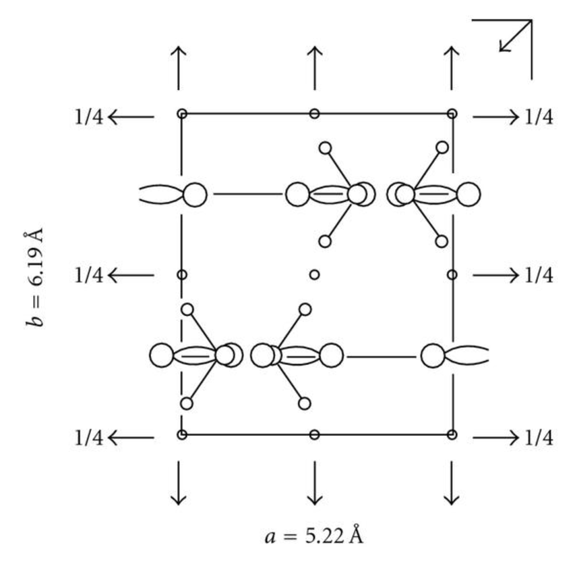
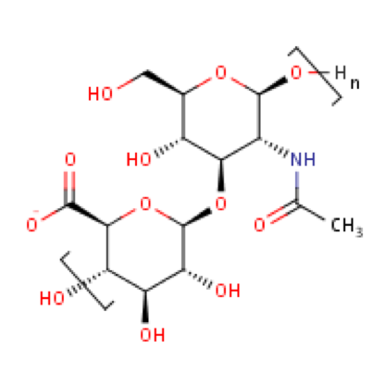
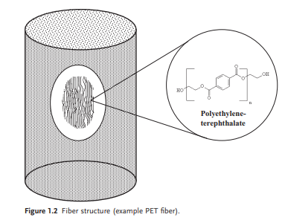
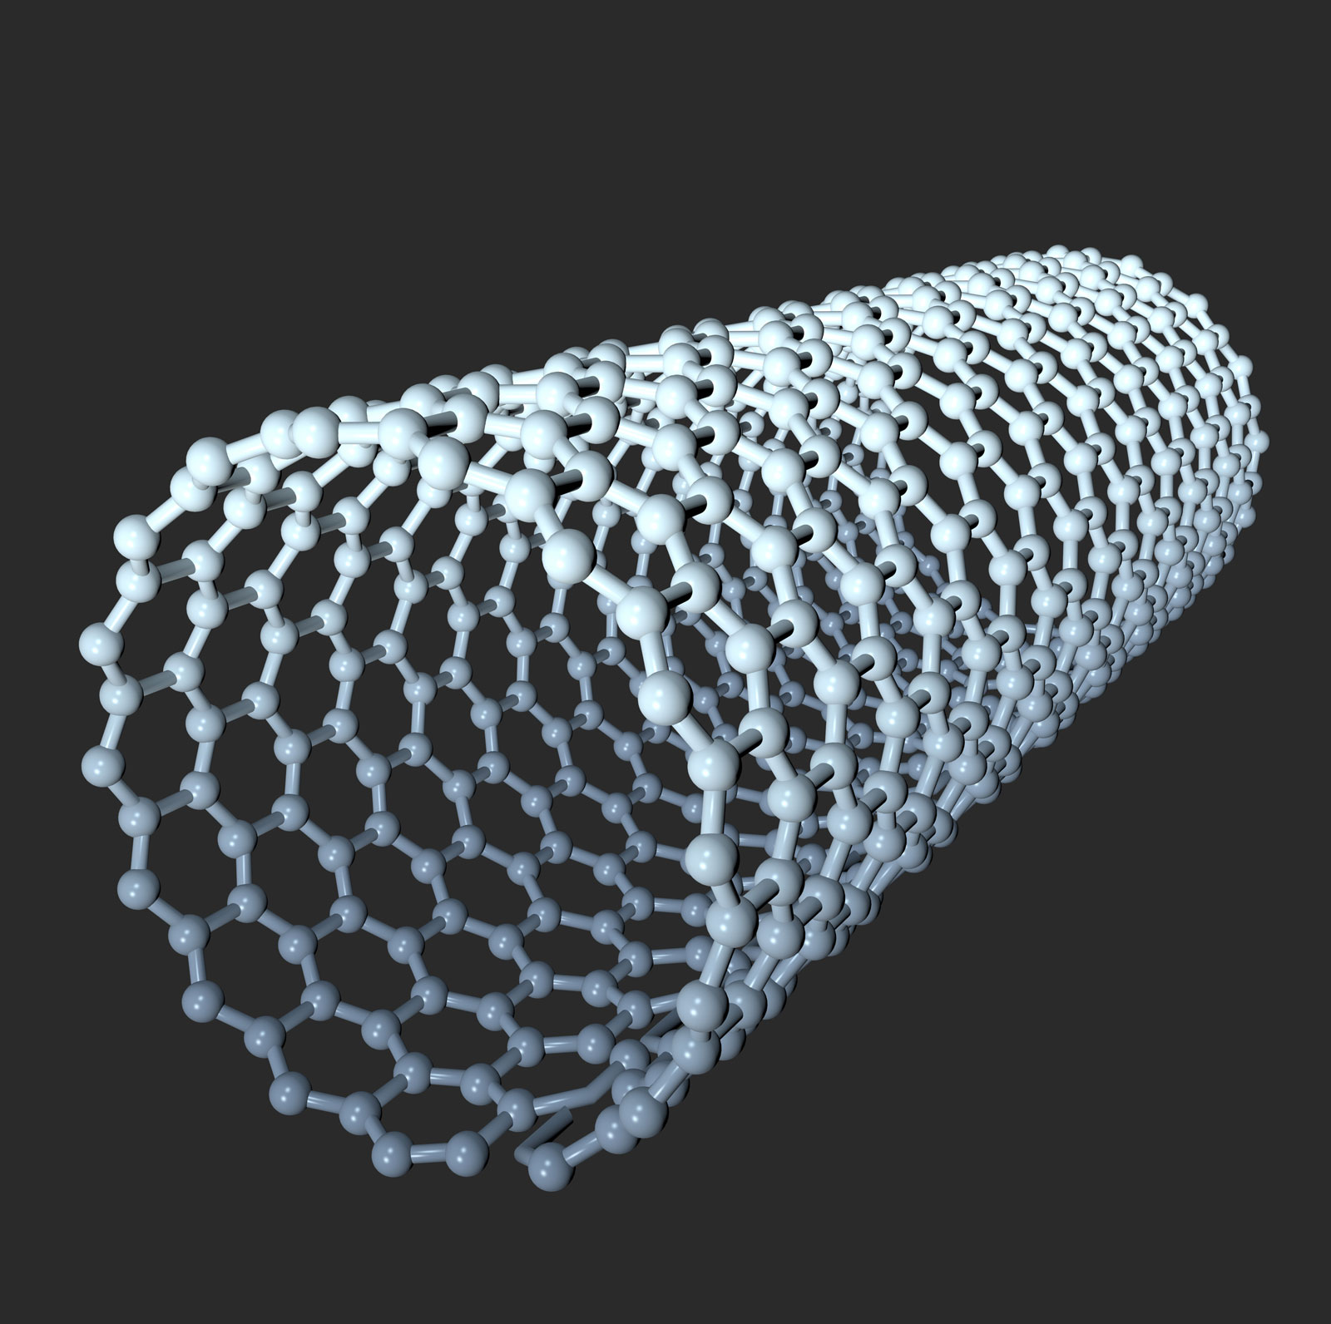

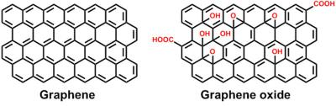
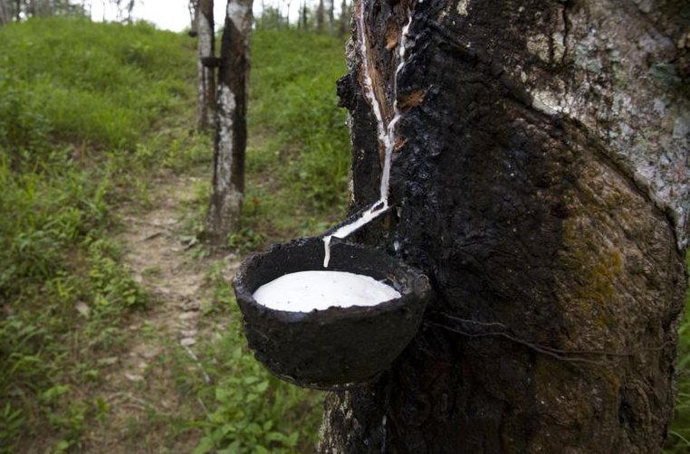
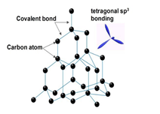
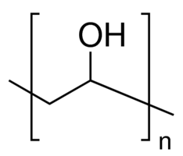
A Comparison of Agents:
The Development of Novel Biocompatible Materials for Strength, Durability, Conductivity, Elasticity, and Visibility
Srinitya Allam, Rosa Bouchery, Eirian Crocker, Ria Hosuru, Richard Kim, Valerie Lau,Terrance Luangrath, Rohebot Mengesha, Elena Novak, Skylar Ondrejko, Hannah Park, Wamia Said, Meron Tadesse, Irene Torosyan, Jessica Truong, Riley Turbak, Jack Cantarella, Elizabeth Romano, P.I.
The Governor’s School at Innovation Park - Prince William County Schools & George Mason University
Methods- Expression & Function:
Select natural agent comparison for strength, durability, flexibility, conductivity, visibility and conductivity
Is there a gene/protein/polymer sequence known?
What are the agent’s current uses that can be enhanced?
Alginate, Collagen, Lignin, Chitin, Limpet teeth, Agarose, Silica, Gelatin, Cellulose, Spider Silk
An overview of the products that may be secreted through synthetic biology approaches and/or chemically synthesized ex vivo.
Spider silk, Lignin, Chitin, Cellulose, Limpet Teeth, Polyvinyl Alcohol, Ceramic Fibers
Choice of products that be generated and used in conjunction for novel materials that retain one or more the following themes:
  Strength, Durability, Conductivity, Elasticity, and Visibility
A Comparison of Agents:
Polylactic acid
Hyaluronic acid
Polyglycotic acid
Ceramic fibers
Carbon nanotubes
A Comparison of Agents:
Organic material derived from fermentation of corn by Lactobacillus bacteria (Ali, Zulfiqar & Anjum, Faqir & Zahoor, Tahir. 2010)
High strength, a high level of durability, and is extremely biocompatibility.
Ldh gene, contains the genetic code for the lactate dehydrogenase (Ldh—L-lactate dehydrogenase—Lactobacillus delbrueckii subsp. Bulgaricus (Strain 2038)—Ldh gene & protein. (n.d.)).
Polylactic acid is currently used as a 3D Printer filament, used in drug delivery, tissue engineer, plastic bags, alternate source of paper, and plastic cups . (Jamshidian, M. et al, (2010).)
Polysaccharide component of the extracellular matrix (ECM) (Ström, Larsson, & Okay, 2015)
Synthesized by hyaluronan synthases (HAS) at the plasma membrane (MilliporeSigma, n.d.)
Biocompatible without tissue specificity (da Costa et al., 2017)
Fibrous meshes for tissue engineering applications via electrospinning and are chemically stable and able to withstand degradation (Beringer, 2012)
Water retention abilities (Papakonstantinou, Roth, & Karakiulakis, 2012)
Rapid biodegradable polymer. (Dardik, Dardik, & Laufman, 2004)
Force-elongation, resilience, elastic recovery (Dardik, Dardik & Laufman, 2004)
Its high tensile strength and high absorbant with miminal way of infecting it makes it a great item for medical usages. (Gokturk & Erdal, 2017)
High biocompatibility rates with other polymer and makes it usage for many different medical usage. (Gokturk & Erdal, 2017)
Poly(ethylenetere-phthalate) ( PET ) chain molecule (Clau ß, 2015)
alumina-based fibers and mullite matrix for polymer matrix composites” (Clau ß, 2015)
blankets, felts, bulk fibers, vacuum-formed or cast shapes, paper, … textiles … aircraft engine components (turbine combustors, compressors, and exhaust nozzles), automotive and gas turbine elements, aerospace missiles, heat exchangers, hot gas filters, rocket nozzles, gasket, and wrapping insulations” (Yalamaç, 2017)
Carbon Nanotubes (CNTs) are cylindrical molecules that are composed of single-layered carbon atoms
Most common use today is for structural reinforcement due to their high aspect ratio (Reidel, 3017)
Honeycomb lattice structure of the carbon atoms provide for their high strength properties
CNTs do not cause significant inflammation when exposed to it for a prolonged time
Single walled CNTs demonstrate superconductivity below 20 Kelvin (Cheaptubes, 3030)
Select natural agent comparison for strength, durability, flexibility, conductivity, visibility and conductivity
Is there a gene/protein/polymer sequence known?
What are the agent’s current uses that can be enhanced?
PLA, HLA, PGA, Ceramic, CNT, PA, PC, Diamond, GO, R-L, PV
Optimization:
Match each theme with a secretable product, and choose whether this needs to be embedded into a matrix for support
Generate multiple polymers using pre-made plasmids rather than generating a completely new vector backbone
Combine polymers to create a new biocompatible materials combine 1+ of the desired output through evaluation using control:
  Strength
  Durability
  Conductivity
  Elasticity
  Visibility (Color, Iridescence, Light Dispersion)
Assess financial feasibility for commercial growth
Minimize waste products to streamline secreted product harvesting,
Assess biocompatibility and eco-friendliness of product generate and waste generated.
Test secreted output for ideal performance
  Protein Isolation and Purification
Methods- Vector & Model Species:
Initial comparison for the vectors for synthetic biology approaches and model species for expression
  Spider silk
  Lignin
  Chitin
  Cellulose
Su, S., 2019
Structural formula of Hyaluronan courtesy of uniport.org
Crystal strucutral form of Polycotic acid
https://www.researchgate.net/
Clau ß, B. (2015)
Ren, G. 2018
Polyaramid
Polycarbonate
Diamond
Graphene oxide
Rubber-latex
Polyvinyl alcohol
Inorganic, man made fibers with very high specific strength. (Cripps, David; 2019)
Its structure of long linked CO-NH chains make the fibers low in density, strong and resistant to heat.
The fibers do have weaknesses to strong acids and ultraviolet light which reduce their effectiveness in certain environments.
The fibers can be combined with composites and used in waterproofing and other construction applications. The high heat resistance is used for firefighting suits and Kevlar is made from aramid fibers to make bulletproof vests.
Used for making lightweight, heat resistant eyewear, and shatter-proof windows, Polycarbonate is named for its carbonate groups in its backbone chain
UV-Ray Protection, Bullet Resistance, Higher quality substitute for windows.
Solid, but can also be bought in a liquid resin form that can molded into a shape desired by the user.
Impact strength of 600-850 J/m and is a lot more durable when it comes to regular, clear glass and plastics.
290ºF heat deflection Polycarbonates also absorb little moisture and is resistant to acid solutions.
Composed of carbon atoms surrounded by four other carbon atoms connected by strong covalent bonds
Form at high temperatures and pressures that occur in the Earth’s mantle during volcanic eruption.
At room temperature and pressure, another solid form of carbon known as graphite is chemically stable (King, 2020).
Biocompatible
When embedded within polymer-based microfilm devices, nano-diamonds find far-reaching biomedical applications (Gupta C., Prakash, & Gupta S., 2017).
Created when Graphite Oxide is oxygenated.
Found deep within earth, requires mining to access
Easily dissolves in water, can be used to mix with other materials (ex. Ceramic) to make them stronger/ more insulated (LA Fuente, n.d).
Organic; "Isoprene units in cis-configuration (Lau et al., 2016)"
Most produced by: Hevea brasiliensis (Distler, 2001)
High elasticity, resilience, compressive strength, and biocompatibility
Uses: surgical gloves, medical tools, shoes, balloons, tires, etc.
Cloudy white mixture
Polyvinyl alcohol is a synthetic polymer that is soluble in water.
It is effective in film forming, emulsifying, and has an adhesive quality.
It has no odor and is nontoxic, and it is highly resistant to grease, oils, and solvents.
PVA is made by dissolving another polymer, polyvinyl acetate, in an alcohol such as methanol.
It can form fibers and hydrogels.
(2016, Britannica).
Sigma Aldrich, 2020
Methods- Vector & Model Species
Initial comparison for the vectors for synthetic biology approaches and model species for expression
  Limpet Teeth
  Polyvinyl alcohol
  Ceramic Fibers
References:
Mertens, R.,2019
Media and content resources listed alphabetically
De Luyck, F., 2019)
Mohsin Raza (2012)
Click Section Headings to View Additional Content

Slide 3
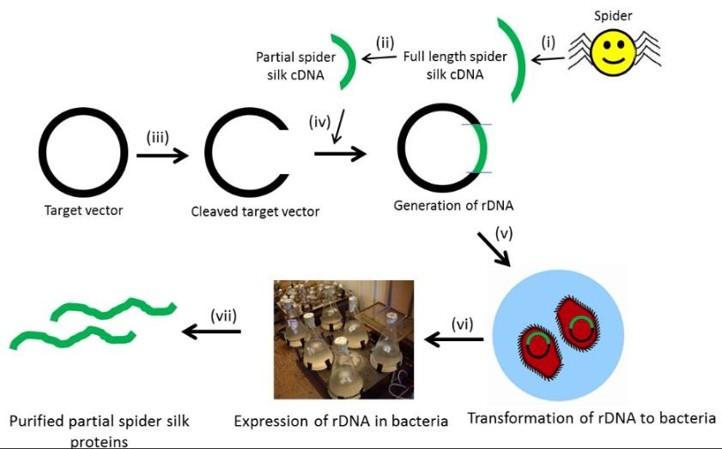
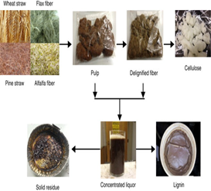
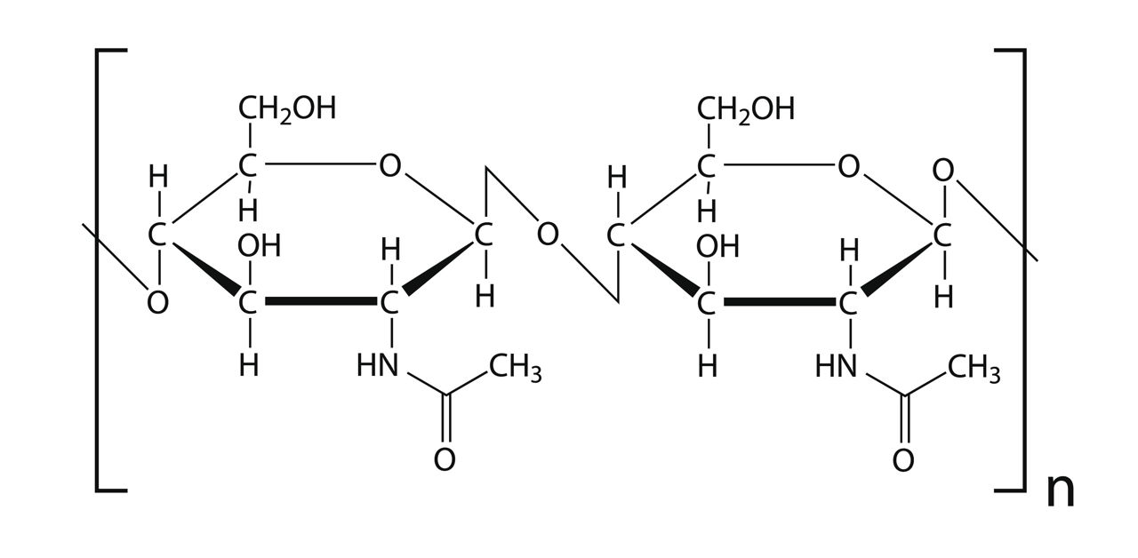
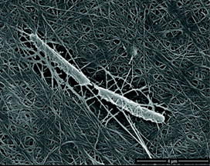
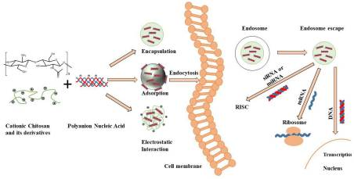
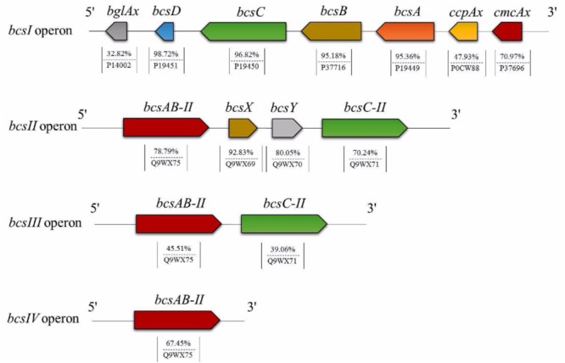
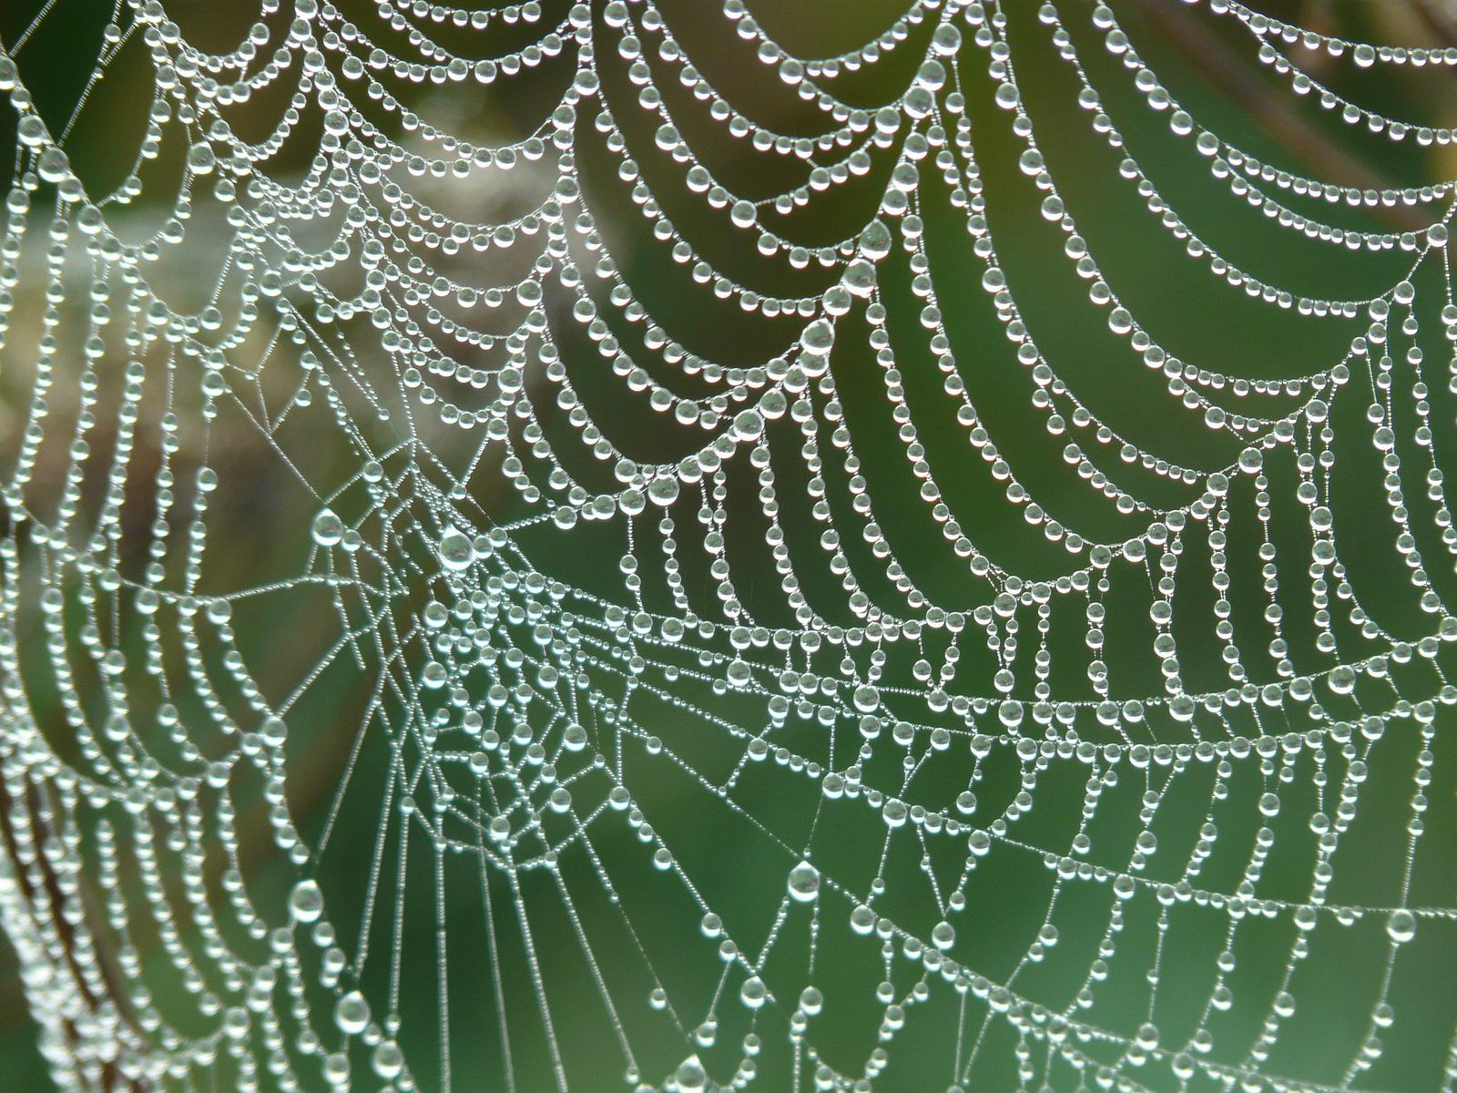
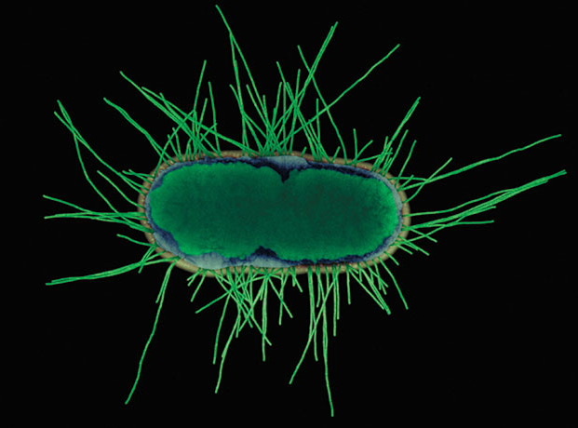
A Comparison of Agents:
The Development of Novel Biocompatible Materials for Strength, Durability, Conductivity, Elasticity, and Visibility
Srinitya Allam, Rosa Bouchery, Eirian Crocker, Ria Hosuru, Richard Kim, Valerie Lau,Terrance Luangrath, Rohebot Mengesha, Elena Novak, Skylar Ondrejko, Hannah Park, Wamia Said, Meron Tadesse, Irene Torosyan, Jessica Truong, Riley Turbak, Jack Cantarella, Elizabeth Romano, P.I.
The Governor’s School at Innovation Park - Prince William County Schools & George Mason University
Methods- Expression & Function:
Select natural agent comparison for strength, durability, flexibility, conductivity, visibility and conductivity
Is there a gene/protein/polymer sequence known?
What are the agent’s current uses that can be enhanced?
Alginate, Collagen, Lignin, Chitin, Limpet teeth, Agarose, Silica, Gelatin, Cellulose, Spider Silk
An overview of the products that may be secreted through synthetic biology approaches and/or chemically synthesized ex vivo.
Spider silk, Lignin, Chitin, Cellulose, Limpet Teeth, Polyvinyl Alcohol, Ceramic Fibers
Choice of products that be generated and used in conjunction for novel materials that retain one or more the following themes:
  Strength, Durability, Conductivity, Elasticity, and Visibility
Methods – Vector & Model Species
Spider Silk
Lignin
Chitin
Cellulose
A Comparison of Agents:
Dragline silk is the strongest
Spidroin proteins of the major ampullate gland (MaSp proteins): MaSp1 (MaSp1A and MaSp1B) and MaSp2 are long and repetitive because they code for long and repetitive proteins.
MaSp1 gene is a single exon of 9390 base pairs (bp) and MaSp2 is a single exon with 11,340 bp. The genes have C-terminals (300bp) and N-terminals (450 bp) (Ayoub et al., 2007).
Ideal vectors could be a pET30L vector or a pET19b vector. Both require a isopropyl-β-D-1-thiogalactopyranoside additive for protein expression (Ayoub et al., 2007).
A one-step head-to-tail ligation can be completed to modify pBluescriptII SK(+) vector into a pET19b vector (Ayoub et al., 2007).
Step-by-step directional ligation can be employed where a pET30a(+) vector is modified into the pET30L vector (Ayoub et al., 2007).
The vectors have been used with relative success in E. coli modification to produce silk
Using a plasmid, bacteria like E.coli , such as E.coli K12 can serve as the model species for expression. (Bowen et al,2018)
Lignin has roles in cell wall rigidity, mineral transport, and defense against pathogen invasion
Lignin is the second-most abundant biopolymer on earth (Dixon & Barros, 2019)
Arabidopsis thaliana is a frequent model species for lignin biosynthesis and expression (Koornneef & Meinke, 2010)
Lignin regulation is also observed in flowering plants, legumes, or grass species (Liu, Luo, & Zheng, 2018)
Lignin is too structurally complex to be expressed in microbes, but bacterial-based systems have been used for lignin degradation and valorization (Xu, Lei, Zhai, Wen, & Jin, 2019)
Harvesting possible through acid hydrolysis to extract any and all cellulose and hemicellulose from the cell wall, leaving behind the excess lignin
Chitosan extracted from the exoskeleton of shellfish or insects (crabs, shrimps, beetles etc.), offers the advantage of being biodegradable and biocompatible (Cao et al., 2019).
After deacetylation of chitin, each subunit of chitosan will contain a primary amine group and two hydroxyl groups, which can be easily modified depending on the desired end product.
Two chitin synthase (CHS), TcCHS1 and TcCHS2 in the red flour beetle, Tribolium Castaneum, revealed unique and complementary properties that could potentially be used to synthesize chitin/chitosan (Arakane et al., 2005).
Class A chitin synthase genes have two alternate exons in a region encoding a transmembrane portion of the enzyme., which need further study (Arakane et al., 2005).
Need to assess secretion
Bacterial cellulose genes encoding the cellulose synthase enzymes are taken from Komagataeibacter xylinus (K2G30).
K2G30 has several bcs operons (genes that produce cellulose), but only bcsI contains all of the genes to create all of the enzymes needed to synthesize cellulose (Gullo et al., 2019).
BcsI is 13795 base pairs long, which would fit in a plasmid (Gullo et al., 2019).
Plasmids would be the optimal vector for the bcsI gene due to the gene’s small size (less than 14 kb)
By culturing in 3% w/v glucose solution Komagataeibacter rhaeticus produced the highest yield of cellulose (Thorat & Dastager, 2018)
Dried cellulose fibers from K. rhaeticus withstood pressures of 48MPa (Costa et al., 2017)
Gluconacetobacter sp. RV28. The strain produced 4.7 g/L of cellulose at optimum growth conditions of temperature (30°C), pH (6.0), sucrose (2%), peptone (0.5%), and inoculum density (B. E. Rangaswamy, K. P. Vanitha, and Basavaraj S. Hungund, 2015)
Select natural agent comparison for strength, durability, flexibility, conductivity, visibility and conductivity
Is there a gene/protein/polymer sequence known?
What are the agent’s current uses that can be enhanced?
PLA, HLA, PGA, Ceramic, CNT, PA, PC, Diamond, GO, R-L, PV
Optimization:
Match each theme with a secretable product, and choose whether this needs to be embedded into a matrix for support
Generate multiple polymers using pre-made plasmids rather than generating a completely new vector backbone
Combine polymers to create a new biocompatible materials combine 1+ of the desired output through evaluation using control:
  Strength
  Durability
  Conductivity
  Elasticity
  Visibility (Color, Iridescence, Light Dispersion)
Assess financial feasibility for commercial growth
Minimize waste products to streamline secreted product harvesting,
Assess biocompatibility and eco-friendliness of product generate and waste generated.
Test secreted output for ideal performance
  Protein Isolation and Purification
Methods- Vector & Model Species:
Initial comparison for the vectors for synthetic biology approaches and model species for expression
  Spider silk
  Lignin
  Chitin
  Cellulose
Methods- Vector & Model Species
Initial comparison for the vectors for synthetic biology approaches and model species for expression
  Limpet Teeth
  Polyvinyl alcohol
  Ceramic Fibers
References:
Media and content resources listed alphabetically
Matchar, E. (2017)
Science News. (2015)
Watkins, 2014
Click Section Headings to View Additional Content
(Gullo et al., 2019
Thorat, M. 2018

Slide 4
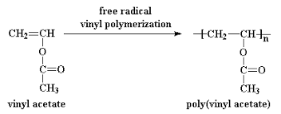
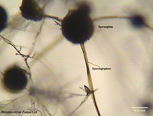
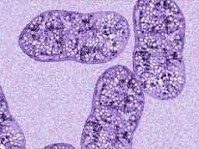
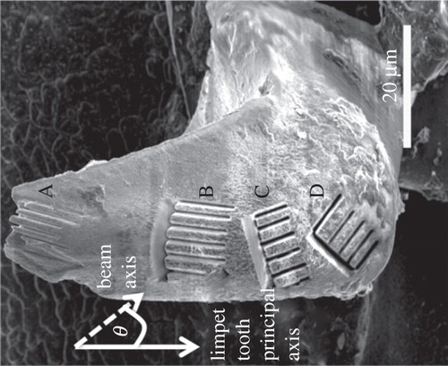
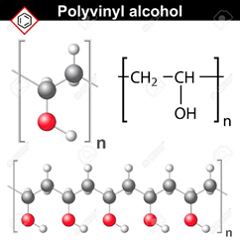
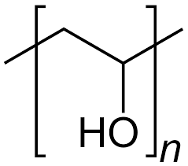
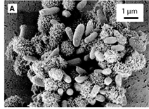
A Comparison of Agents:
The Development of Novel Biocompatible Materials for Strength, Durability, Conductivity, Elasticity, and Visibility
Srinitya Allam, Rosa Bouchery, Eirian Crocker, Ria Hosuru, Richard Kim, Valerie Lau,Terrance Luangrath, Rohebot Mengesha, Elena Novak, Skylar Ondrejko, Hannah Park, Wamia Said, Meron Tadesse, Irene Torosyan, Jessica Truong, Riley Turbak, Jack Cantarella, Elizabeth Romano, P.I.
The Governor’s School at Innovation Park - Prince William County Schools & George Mason University
Methods- Expression & Function:
Select natural agent comparison for strength, durability, flexibility, conductivity, visibility and conductivity
Is there a gene/protein/polymer sequence known?
What are the agent’s current uses that can be enhanced?
Alginate, Collagen, Lignin, Chitin, Limpet teeth, Agarose, Silica, Gelatin, Cellulose, Spider Silk
An overview of the products that may be secreted through synthetic biology approaches and/or chemically synthesized ex vivo.
Spider silk, Lignin, Chitin, Cellulose, Limpet Teeth, Polyvinyl Alcohol, Ceramic Fibers
Choice of products that be generated and used in conjunction for novel materials that retain one or more the following themes:
  Strength, Durability, Conductivity, Elasticity, and Visibility
Methods – Vector & Model Species
Limpet Teeth
Polyvinyl Alcohol
Ceramic Fibers
A Comparison of Agents:
Exon gene sizes – 9,473 nucleotides within the gene , codes for Chitinase critical to the formation of soft chitin microstructures (https://www.uniprot.org/citations/23254933)
Bacillus subtilis already has genes that code for four different chitinases, a potential vector.
Vectors for expression - Myoviridae family and one phage of the Siphoviridae family (Krasowska, et al. 2015)
Transferring the gene to a species of chitin involved Bacillus bacteria via a phage vector could potentially allow the bacterium to produce the chitin matrix found in limpet teeth.
Highly understudied genome sequence, the only genetic source is still under review (Lottia gigantea, giant owl limpet)
Acidovorax sp. Strain BoFeN1 for goethite production:
Gram-negative, nitrate-reducing bacterium
Works at pH 7 without "complexing ligands"
Used to produce goethite in previous experiments
Not traditionally disease-causing in humans
(Larese-Casanova, Haderlein, and Kappler, 2010)
Rhizopus oryzae for chitin production:
Filamentous, generally non-toxic fungi
Cell wall contains more chitin than yeasts
Used in numerous studies for chitin extraction, providing a standard process
(Gachhi and Hungund, 2018)
Non-toxic, odorless, water soluble polymer.
Found in resin forms that can be molded
Both hydrophobic and hydrophilic components, with the hydrophobic component facing externally
Combination with fiber secretion needs to be assessed
PVA particles cannot be prepared by direct polymerization of vinyl alcohol.
Usually suspend and polymerize vinyl acetate monomers to produce polyvinyl acetate followed by the saponification of the PVAc particles and obtain spherical particles with a core-shell structure of PVAc with regular morphology.
Bacteria have been found to degrade polyvinyl alcohol.
Most PVA-degraders are Gram-negative bacteria belonging to the Pseudomonads and Sphingomonads, but Gram-positive bacteria also have PVA-degrading abilities.
Ceramic fibers can be made by melting varying ratios of pure aluminum (Al2O3) and silicon (SiO2) in an industrial furnace (Thermcraft inc., 2018).
Bacteria can be genetically modified to synthesize chemicals such as pure aluminum and silicon.
Purple sulfur bacteria are a group of bacteria that oxidizes hydrogen sulfide to produce granules of elemental sulfur.
Potential to modify their metabolic processes to produce either pure aluminum or silicon instead of sulfur (Gerardi & Lytle).
Organic material can be converted into ceramic fibers. Cellulose-based fibers can be converted through an indirect process where the fibers are soaked in pre-ceramic precursor material and pyrolyzed. This process is called the Relic Process and it saturates “absorbent organic fiber materials” with salt solutions that are later burned off through pyrolysis- converting the salt (also known as sol) to a ceramic material (Clau ß, 2015).
This could be synthesis by melting down kale and clay over 3400 degree Fahrenheit. Afterward, the melted ceramic fibers steam down with high pressure air. It creates a more solidity fiber. Another way to create ceramic clay is continuously spinning the clay, with added materials, till it solidifies. But in both methods after it solidifies, it’ll have continuous pressure placed on the clay to make it more durable. (Varsha RefactoriesPvt Ltd, 2014)
Select natural agent comparison for strength, durability, flexibility, conductivity, visibility and conductivity
Is there a gene/protein/polymer sequence known?
What are the agent’s current uses that can be enhanced?
PLA, HLA, PGA, Ceramic, CNT, PA, PC, Diamond, GO, R-L, PV
Optimization:
Match each theme with a secretable product, and choose whether this needs to be embedded into a matrix for support
Generate multiple polymers using pre-made plasmids rather than generating a completely new vector backbone
Combine polymers to create a new biocompatible materials combine 1+ of the desired output through evaluation using control:
  Strength
  Durability
  Conductivity
  Elasticity
  Visibility (Color, Iridescence, Light Dispersion)
Assess financial feasibility for commercial growth
Minimize waste products to streamline secreted product harvesting,
Assess biocompatibility and eco-friendliness of product generate and waste generated.
Test secreted output for ideal performance
  Protein Isolation and Purification
Methods- Vector & Model Species:
Initial comparison for the vectors for synthetic biology approaches and model species for expression
  Spider silk
  Lignin
  Chitin
  Cellulose
Methods- Vector & Model Species
Initial comparison for the vectors for synthetic biology approaches and model species for expression
  Limpet Teeth
  Polyvinyl alcohol
  Ceramic Fibers
Polymer Science Learning Center, 2020)
References:
Media and content resources listed alphabetically
Sulfur Bacteria. Retrieved from https://sites.google.com/site/botany317/session-2/bacteria/green-purple-bacteria
Polyvinyl Alcohol Monomer and Polymer
Lebedev, A. 2016
Polyvinyl Alcohol Chemical Structure (Monomer)
J. Strurturausschnitt 2015
Gauger, T. 2016
Khesali, H. 2015
Click Section Headings to View Additional Content

Slide 5
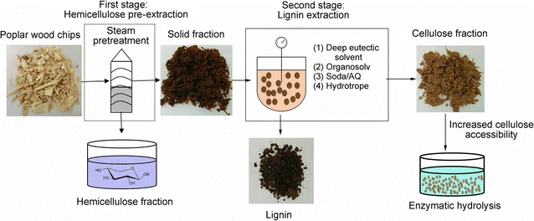
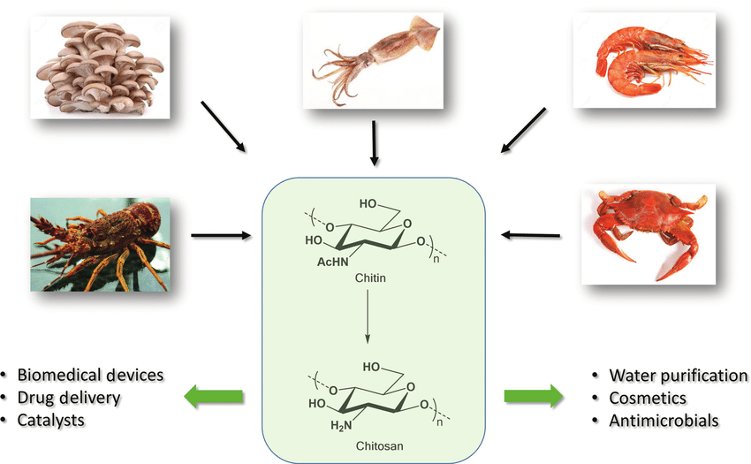
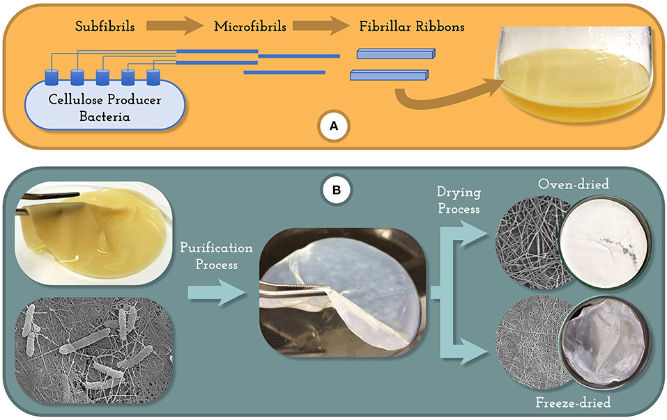
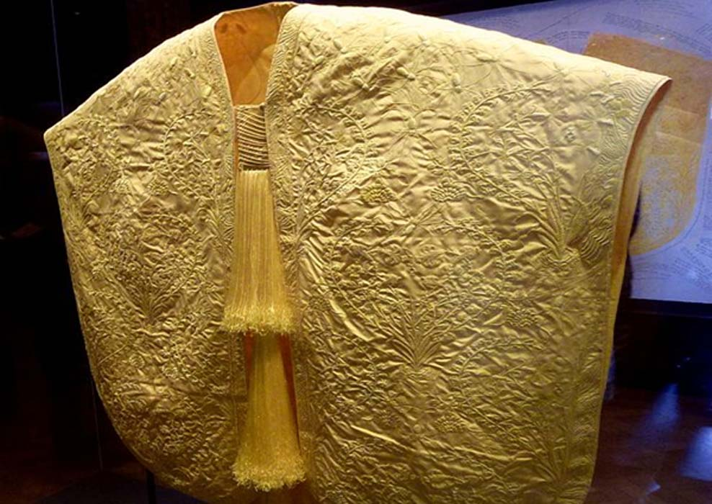
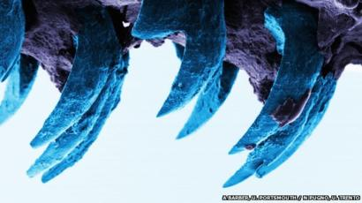
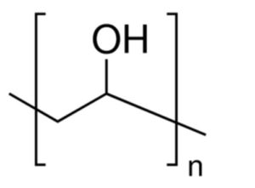
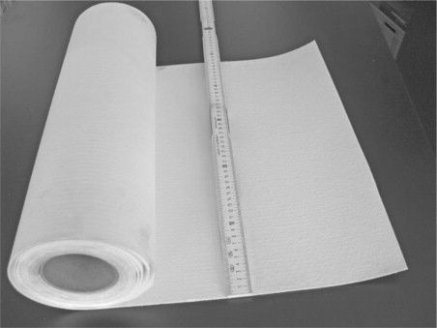
A Comparison of Agents:
The Development of Novel Biocompatible Materials for Strength, Durability, Conductivity, Elasticity, and Visibility
Srinitya Allam, Rosa Bouchery, Eirian Crocker, Ria Hosuru, Richard Kim, Valerie Lau,Terrance Luangrath, Rohebot Mengesha, Elena Novak, Skylar Ondrejko, Hannah Park, Wamia Said, Meron Tadesse, Irene Torosyan, Jessica Truong, Riley Turbak, Jack Cantarella, Elizabeth Romano, P.I.
The Governor’s School at Innovation Park - Prince William County Schools & George Mason University
Methods- Expression & Function:
Select natural agent comparison for strength, durability, flexibility, conductivity, visibility and conductivity
Is there a gene/protein/polymer sequence known?
What are the agent’s current uses that can be enhanced?
Alginate, Collagen, Lignin, Chitin, Limpet teeth, Agarose, Silica, Gelatin, Cellulose, Spider Silk
An overview of the products that may be secreted through synthetic biology approaches and/or chemically synthesized ex vivo.
Spider silk, Lignin, Chitin, Cellulose, Limpet Teeth, Polyvinyl Alcohol, Ceramic Fibers
Choice of products that be generated and used in conjunction for novel materials that retain one or more the following themes:
  Strength, Durability, Conductivity, Elasticity, and Visibility
Methods – Expression & Function
Spider Silk
Lignin
Chitin
Cellulose
A Comparison of Agents:
Composed of organic-inorganic compounds with the proteins,hydroxyapatite, and biominerals (Yu, Y., Mu, Z., Zhao, Y., Liu, Z., & Tang, R. 2019)
Potential synthesis through a process of yeast fermentation. (Mike, 2020)
Due to the tensile strength of spider silk, it can be used in conjunction with ceramic fibers in order to create a network frame for concrete in construction or in other products such as lined tape.
Express with a potential matrix material for fabric and construction
Contained within cell walls of woody plants (ex. Trees) (Horwath, 2014)
Not secreted, but can be harvested by dissolving outside cell.
Difficult to express in microorganisms due to size of polymer
Antimicrobial, anti-cholesterol, antitumor activity, wastewater treatment, drug delivery, and wound healing and as dietary fiber. (Swiontek, 2014)
Easy to process into textiles because it has a soft texture and dyes easily.
Resulting fabric is safe and hypoallergenic for people with sensitive skin.
To integrate chitin into clothing products, two major and general processing techniques can be used: plasma coating and surface restructuring/modification
Extraction of cellulose from plants can be a longer processes because there are multiple methods for different plants and the range can be varying
Bacterial Cellulose has a higher capacity to hold water
Potentially difficult to express due to size
Select natural agent comparison for strength, durability, flexibility, conductivity, visibility and conductivity
Is there a gene/protein/polymer sequence known?
What are the agent’s current uses that can be enhanced?
PLA, HLA, PGA, Ceramic, CNT, PA, PC, Diamond, GO, R-L, PV
Optimization:
Match each theme with a secretable product, and choose whether this needs to be embedded into a matrix for support
Generate multiple polymers using pre-made plasmids rather than generating a completely new vector backbone
Combine polymers to create a new biocompatible materials combine 1+ of the desired output through evaluation using control:
  Strength
  Durability
  Conductivity
  Elasticity
  Visibility (Color, Iridescence, Light Dispersion)
Assess financial feasibility for commercial growth
Minimize waste products to streamline secreted product harvesting,
Assess biocompatibility and eco-friendliness of product generate and waste generated.
Test secreted output for ideal performance
  Protein Isolation and Purification
Methods- Vector & Model Species:
Initial comparison for the vectors for synthetic biology approaches and model species for expression
  Spider silk
  Lignin
  Chitin
  Cellulose
Mike,2020
Tian, D, 2017
Azeredo, H, 2019
Limpet Teeth
Polyvinyl Alcohol
Ceramic Fibers
Methods- Vector & Model Species
Composed of the compound mineral goethite (iron bearing hydroxide mineral)
Not secreted by a cell, but can be incorporated into other composites
Stretchy chitin and goethite matrix can be mimicked to receive a high structural integrity
No biosynthesis
When E. coli is immobilized in PVA, the activation energies of certain degradation reactions were lowered significantly (Hong)
Use of PVA as a cryo-immobilizer could potentially result in a kinetically more efficient enzyme
We may be able to use PVA to enhance the pathway for producing whatever product we are targeting
Inorganic, so not secreted through a cell.
The fiber is very durable and has a high tensile strength, but it could be easily penetrated and cut with something small like scissors.
Used in furnace insulation, rope, blanket, and other relatively soft materials
Initial comparison for the vectors for synthetic biology approaches and model species for expression
  Limpet Teeth
  Polyvinyl alcohol
  Ceramic Fibers
References:
Media and content resources listed alphabetically
Webb, J., 2015
Click Section Headings to View Additional Content
Mehta, Vinit, 2018

Slide 6
A Comparison of Agents:
The Development of Novel Biocompatible Materials for Strength, Durability, Conductivity, Elasticity, and Visibility
Srinitya Allam, Rosa Bouchery, Eirian Crocker, Ria Hosuru, Richard Kim, Valerie Lau,Terrance Luangrath, Rohebot Mengesha, Elena Novak, Skylar Ondrejko, Hannah Park, Wamia Said, Meron Tadesse, Irene Torosyan, Jessica Truong, Riley Turbak, Jack Cantarella, Elizabeth Romano, P.I.
The Governor’s School at Innovation Park - Prince William County Schools & George Mason University
Methods- Expression & Function:
Select natural agent comparison for strength, durability, flexibility, conductivity, visibility and conductivity
Is there a gene/protein/polymer sequence known?
What are the agent’s current uses that can be enhanced?
Alginate, Collagen, Lignin, Chitin, Limpet teeth, Agarose, Silica, Gelatin, Cellulose, Spider Silk
An overview of the products that may be secreted through synthetic biology approaches and/or chemically synthesized ex vivo.
Spider silk, Lignin, Chitin, Cellulose, Limpet Teeth, Polyvinyl Alcohol, Ceramic Fibers
Choice of products that be generated and used in conjunction for novel materials that retain one or more the following themes:
  Strength, Durability, Conductivity, Elasticity, and Visibility
Optimization:
For continuation in wetlab aspects of this project beyond the information presented, the following items need to be addressed
Match each theme with a secretable product, and choose whether this needs to be embedded into a matrix for support
Generate multiple polymers using pre-made plasmids rather than generating a completely new vector backbone
One or more species can express these multiple products
Combine polymers to create a new biocompatible materials combine 1+ of the desired output through evaluation using control:
  Strength
  Durability
  Conductivity
  Elasticity
  Visibility (Color, Iridescence, Light Dispersion)
Assess financial feasibility for commercial growth
Minimize waste products to streamline secreted product harvesting,
Assess biocompatibility and eco-friendliness of product generate and waste generated.
Test secreted output for ideal performance
  Protein Isolation and Purification
A Comparison of Agents:
Select natural agent comparison for strength, durability, flexibility, conductivity, visibility and conductivity
Is there a gene/protein/polymer sequence known?
What are the agent’s current uses that can be enhanced?
PLA, HLA, PGA, Ceramic, CNT, PA, PC, Diamond, GO, R-L, PV
Optimization:
Match each theme with a secretable product, and choose whether this needs to be embedded into a matrix for support
Generate multiple polymers using pre-made plasmids rather than generating a completely new vector backbone
Combine polymers to create a new biocompatible materials combine 1+ of the desired output through evaluation using control:
  Strength
  Durability
  Conductivity
  Elasticity
  Visibility (Color, Iridescence, Light Dispersion)
Assess financial feasibility for commercial growth
Minimize waste products to streamline secreted product harvesting,
Assess biocompatibility and eco-friendliness of product generate and waste generated.
Test secreted output for ideal performance
  Protein Isolation and Purification
Methods- Vector & Model Species:
Initial comparison for the vectors for synthetic biology approaches and model species for expression
  Spider silk
  Lignin
  Chitin
  Cellulose
Methods- Vector & Model Species
Initial comparison for the vectors for synthetic biology approaches and model species for expression
  Limpet Teeth
  Polyvinyl alcohol
  Ceramic Fibers
References:
Media and content resources listed alphabetically
Click Section Headings to View Additional Content

Slide 7
A Comparison of Agents:
The Development of Novel Biocompatible Materials for Strength, Durability, Conductivity, Elasticity, and Visibility
Srinitya Allam, Rosa Bouchery, Eirian Crocker, Ria Hosuru, Richard Kim, Valerie Lau,Terrance Luangrath, Rohebot Mengesha, Elena Novak, Skylar Ondrejko, Hannah Park, Wamia Said, Meron Tadesse, Irene Torosyan, Jessica Truong, Riley Turbak, Jack Cantarella, Elizabeth Romano, P.I.
The Governor’s School at Innovation Park - Prince William County Schools & George Mason University
Methods- Expression & Function:
Select natural agent comparison for strength, durability, flexibility, conductivity, visibility and conductivity
Is there a gene/protein/polymer sequence known?
What are the agent’s current uses that can be enhanced?
Alginate, Collagen, Lignin, Chitin, Limpet teeth, Agarose, Silica, Gelatin, Cellulose, Spider Silk
An overview of the products that may be secreted through synthetic biology approaches and/or chemically synthesized ex vivo.
Spider silk, Lignin, Chitin, Cellulose, Limpet Teeth, Polyvinyl Alcohol, Ceramic Fibers
Choice of products that be generated and used in conjunction for novel materials that retain one or more the following themes:
  Strength, Durability, Conductivity, Elasticity, and Visibility
References
(Master’s thesis, Drexel University, Philadelphia, United States of America). Retrieved from https://www.researchgate.net/publication/258697369_Electrospun_Crosslinked_Hyaluronic_Acid_Fibers_for_Tissue_Engineering
acid-based cryogels. Journal of Applied Polymer Science, 132(29). DOI: 10.1002/app.42194
Agarose Product Information. (n.d.). Retrieved from https://www.sigmaaldrich.com/technical-documents/articles/biology/agarose.html
Ali, Zulfiqar & Anjum, Faqir & Zahoor, Tahir. (2010). Production of lactic acid from corn cobs hydrolysate through fermentation by Lactobaccillus delbrukii. 8
Andersen, T., Auk-Emblem, P., & Dornish, M. (2015). 3d cell culture in alginate hydrogels. Microarrays, 4(2), 133–161. https://doi.org/10.3390/microarrays4020133
Andersen, T., Auk-Emblem, P., & Dornish, M. (2015). Alginate cross-linkage with calcium chloride. Retrieved from, https://doi.org/10.3390/microarrays4020133
Arakane, Y., Hogenkamp, D.G., Zhu, Y.C., Kramer, K.J., Specht, C.A., Beeman, R.W., Kanost, M.R. and Muthukrishnan, S. (2004) Characterization of two chitin synthase genes of the red flour beetle, Tribolium castaneum, and alternate exon usage in one of the genes during development. Insect Biochem Mol Biol 34: 291–304.
Ayoub, N. A., Garb, J. E., Tinghitella, R. M., Collin, M. A., & Hayashi, C. Y. (2007, June 13). Blueprint for a High-Performance Biomaterial: Full-Length Spider Dragline Silk Genes. Retrieved February 26, 2020, from https://journals.plos.org/plosone/article?id=10.1371/journal.pone.0000514
Badwan, Adnan & Rashid, Iyad & Al Omari, Mahmoud & Darra, Fouad. (2015). Chitin and Chitosan as Direct Compression Excipients in Pharmaceutical Application. Marine Drugs. 13. 1519-1547. 10.3390/md13031519
Barber, A. H., Lu, D., and Pugno, N. M. (2015, April 6). Extreme strength observed in limpet teeth. Retrieved from https://royalsocietypublishing.org/doi/full/10.1098/rsif.2014.1326
Barber, A. H., Lu, D., Pugno, N. M., Nicola M. Pugno Laboratory of Bio-Inspired, Asa H. Barber Asa H. Barber School of Engineering, Asa H. Barber School of Engineering, & Dun Lu School of Engineering. (2015, April 6). Extreme strength observed in limpet teeth. Retrieved from https://royalsocietypublishing.org/doi/full/10.1098/rsif.2014.1326
Beringer, L.T. (2012). Electrospun Crosslinked Hyaluronic Acid Fibers for Tissue Engineering
Biocompatibility of carbon nanotubes. (n.d.). Retrieved from http://www.bionicsinstitute.org/biocompatibility-of-carbon-nanotubes/
Cao, Y., Tan, Y. F., Wong, Y. S., Liew, M., & Venkatraman, S. (2019). Recent Advances in Chitosan-Based Carriers for Gene Delivery. Marine drugs, 17(6), 381. https://doi.org/10.3390/md17060381
Caracciolo, N., Ahlgren, E., & Goetz, A. (2019, August 3). PRODUCTION OF ARTIFICIAL SPIDER SILK THROUGH YEAST ... Retrieved February 19, 2020, from https://www.engineering.pitt.edu/First-Year/First-Year-Conference/_Library/Goetz-Caracciolo-Ahlgren/
Carbon Nanotubes Properties and Applications. (n.d.). Retrieved from https://www.cheaptubes.com/carbon-nanotubes-properties-and-applications/#storage
Ceramic Fiber. (n.d.). Retrieved from https://www.sciencedirect.com/topics/materials-science/ceramic-fiber
Clau, B. (2015). Fibers for Ceramic Matrix Composites. Ceramic Matrix Composites, 1–20. doi: 10.1002/9783527622412.ch1
Correa-Garhwal, S. M., Chaw, R. C., Iii, T. H. C., Alaniz, L. G., Chan, F. S., Alfaro, R. E., & Hayashi, C. Y. (2018). Silk genes and silk gene expression in the spider Tengella perfuga (Zoropsidae), including a potential cribellar spidroin (Crsp). PLOS ONE, 13(9), e0203563. https://doi.org/10.1371/journal.pone.0203563
Costa, A. F. S., Almeida, F. C. G., Vinhas, G. M., & Sarubbo, L. A. (2017). Production of bacterial cellulose by gluconacetobacter hansenii using corn steep liquor as nutrient sources. Frontiers in Microbiology, 8. https://doi.org/10.3389/fmicb.2017.02027
Da Costa, A., et al. (2017). Durability of Three Different Types of Hyaluronic Acid Fillers in Skin: Are There Differences Among Biphasic, Monophasic Monodensified, and Monophasic Polydensified Products? Aesthetic Surgery Journal, 37(5), 573-581. DOI: 10.1093/asj/sjw161
Dardik, H., Dardik, I., & Laufman, H. (2004, March 20). Clinical use of polyglycolic acid polymer as a new absorbable synthetic suture. Retrieved from https://www.sciencedirect.com/science/article/abs/pii/0002961071900390 (
DeLuyck, F. (2019, August 11). Where does latex come from? Retrieved from https://www.thespruce.com/where-does-latex-come-from-3269790
Distler, D. (2001). Polymer dispersions. Retrieved from https://www.sciencedirect.com/topics/agricultural-and-biological-sciences/hevea-brasiliensis
Dixon, R. A. & Barros, J. (2019). Lignin biosynthesis: old roads revisited and new roads
Du, R., Zhao, F., Peng, Q., Zhou, Z., & Han, Y. (2018). Production and characterization of bacterial cellulose produced by Gluconacetobacter xylinus isolated from Chinese persimmon vinegar. Carbohydrate Polymers, 194, 200–207. doi: 10.1016/j.carbpol.2018.04.041
Dun, L., Asa, B., Lu, D., Barber, A. H., Dun Lu Dun Lu Google, Asa H. Barber Asa H. Barber Google, … Asa H. Barber Google. (2011, December 7). Optimized nanoscale composite behaviour in limpet teeth. Retrieved from https://royalsocietypublishing.org/doi/10.1098/rsif.2011.0688
Echave, M. C., Saenz del Burgo, L., Pedraz, J. L., & Orive, G. (2017). Gelatin as Biomaterial for Tissue Engineering. Retrieved from https://www.ncbi.nlm.nih.gov/pubmed/28494717
explored.Open Biology, 9. DOI: 10.1098/rsob.190215
Gachhi, D. B. and Hungund, B. S. (2018, November). Two-phase extraction, characterization, and biological evaluation of chitin and chitosan from Rhizopus oryzae. Retrieved from https://www.researchgate.net/publication/329414560_Two-phase_extraction_characterization_and_biological_evaluation_of_chitin_and_chitosan_from_Rhizopus_oryzae_ARTICLE_INFO
Gauger, T. Konhauser, K., and Kappler, A. (2016). Protection of nitrate-reducing Fe(II)-oxidizing bacteria from UV radiation by biogenic Fe(III) minerals. Retrieved from https://www.semanticscholar.org/paper/Protection-of-Nitrate-Reducing-Fe(II)-Oxidizing-UV-Gauger-Konhauser/69a6efe7e8df82f72260b3771b467fdc7cd6970a/figure/0
General purpose modified polycarbonate liquid acetoxy silicone free sealant cartridge msds for glass. (n.d.). Retrieved February 19, 2020, from https://www.alibaba.com/showroom/polycarbonate-liquid.html
Gerardi, M. H., Lytle, B., (2015, February 27). Purple and Green Sulfur Bacteria. Retrieved from https://onlinelibrary.wiley.com/doi/10.1002/9781118981771.ch9
Göktürk, E., & Erdal, H. (2017, March 1). Biomedical applications of polyglycolic acid (PGA). Retrieved from http://www.saujs.sakarya.edu.tr/en/download/article-file/313951 (
Gopakumar, D.A, Pai, A.R., Pasquini, D., Yuan S., Khalil, A., Thomas S. Chapter 1 - Nanomaterials — State of Art, New Challenges, and Opportunities. ScienceDirect, 1-24. https://doi.org/10.1016/B978-0-12 -813926-4.00001-X
Gullo, M., China, S. L., Petroni, G., Gregorio, S. D., & Giudici, P. (2019). Exploring K2G30 Genome: A High Bacterial Cellulose Producing Strain in Glucose and Mannitol Based Media. Frontiers in Microbiology, 10. doi: 10.3389/fmicb.2019.00058
Gupta, C., Prakash, D., & Gupta, S. (2017, January 1). Cancer treatment with nano-diamonds. Retrieved from https://www.ncbi.nlm.nih.gov/pubmed/27814575
Hannah. (2019, September 5). Ceramic Fiber Squares. Retrieved from https://www.carolina.com/lab-gloves/ceramic-fiber-squares/FAM_713326.pr
Hong, Marjorie & Rainina, Evguenia & Grimsley, Janet & Dale, Bruce & Wild, James. (1998). Neurotoxic Organophosphate Degradation with Polyvinyl Alcohol Gel-Immobilized Microbial Cells. Bioremediation Journal - BIOREMEDIAT J. 2. 145-157. 10.1080/10889869891214277.
Horwath, W. (2014, November 21). Carbon Cycling: The Dynamics and Formation of Organic Matter. Retrieved February 26, 2020, from https://www.sciencedirect.com/science/article/pii/B9780124159556000128
https://doi.org/10.1016/B978-1-78242-465-9.00005-7
https://www.ncbi.nlm.nih.gov/pmc/articles/PMC3282272/
International Journal of Molecular Sciences, 19(335). DOI: 10.3390/ijms19020335
Jamshidian, M., Tehrany, E. A., Imran, M., Jacquot, M., & Desobry, S. (2010). Poly-lactic acid: Production, applications, nanocomposites, and release studies. Comprehensive Reviews in Food Science and Food Safety, 9(5), 552–571. https://doi.org/10.1111/j.1541-4337.2010.00126.x
Jeannot, M. A. (2003). Polycarbonates. Retrieved February 19, 2020, from https://pslc.ws/macrog/pc.htm
Khan, R., & Khan, M. H. (2013, July). Use of collagen as a biomaterial: An update. Retrieved from https://www.ncbi.nlm.nih.gov/pmc/articles/PMC3800424/
Khesali, H. (2015, July). Rhizopus oryzae. Retrieved from https://www.researchgate.net/publication/280572840_Rhizopus_oryzae
King, H. M. (n.d.). Diamond. Retrieved from https://geology.com/minerals/diamond.shtml
Ko, F. K., & Wan, L. Y. (2018). Engineering properties of spider silk. Handbook of Properties of Textile and Technical Fibres, 185–220. doi: 10.1016/b978-0-08-101272-7.00006-7
Koornneef, M. & Meinke, D. (2010). The development of Arabidopsis as a model plant. The
Krieger, A. (2012, November 30). Ballistic Gel, a How-To. Retrieved from https://welikeshooting.com/tips-how-to/ballistic-gel-a-how-to/
Krieger, A. (2012, November 30). Ballistic Gel, a How-To. Retrieved from https://welikeshooting.com/tips-how-to/ballistic-gel-a-how-to/
La Fuente, J. de. (n.d.). Graphene Applications & Uses. Retrieved February 18, 2020, from https://www.graphenea.com/pages/graphene-uses-applications
Larese-Casanova, P., Haderlein, S. B., and Kappler, A. (2010, April 7). Biomineralization of lepidocrocite and goethite by nitrate-reducing Fe(II)-oxidizing bacteria: Effect of pH, bicarbonate, phosphate, and humic acids. Retrieved from https://www.sciencedirect.com/science/article/abs/pii/S0016703710001778?via%3Dihub
Lau, N. S., Makita, Y., Kawashima, M., Taylor, T. D., Kondo, S., Othman, A. S., Shu-Chien, A. C., & Matsui, M. (2016). The rubber tree genome shows expansion of gene family associated with rubber biosynthesis. Scientific reports, 6, 28594. Retrieved from https://doi.org/10.1038/srep28594
Ldh—L-lactate dehydrogenase—Lactobacillus delbrueckii subsp. Bulgaricus (Strain 2038)—Ldh gene & protein. (n.d.). Retrieved February 18, 2020, from https://www.uniprot.org/uniprot/F0JYK4
Lee, K. Y., & Mooney, D. J. (2012). Alginate: Properties and biomedical applications. Progress in Polymer Science, 37(1), 106–126. https://doi.org/10.1016/j.progpolymsci.2011.06.003
Lee, Pei & Costumbrado, John & Hsu, Chih-Yuan & Kim, Yong. (2012). Agarose Gel Electrophoresis for the Separation of DNA Fragments. Journal of visualized experiments : JoVE. 20. 10.3791/3923.
Lee, Pei & Costumbrado, John & Hsu, Chih-Yuan & Kim, Yong. (2012). Agarose Gel Electrophoresis for the Separation of DNA Fragments. Journal of visualized experiments : JoVE. 20. 10.3791/3923
Li, S., Bashline, L., Lei, L., & Gu, Y. (2014, January 13). Cellulose synthesis and its regulation. Retrieved from https://www.ncbi.nlm.nih.gov/pmc/articles/PMC3894906/
Little, A., Schwerdt, J. G., Shirley, N. J., Khor, S. F., Neumann, K., O’Donovan, L. A., … Burton, R. A. (2018, July 1). Revised Phylogeny of the Cellulose Synthase Gene Superfamily: Insights into Cell Wall Evolution. Retrieved February 26, 2020, from http://www.plantphysiol.org/content/177/3/1124
Liu, Q., Luo, L., & Zheng, L. (2018). Lignins: Biosynthesis and Biological Functions in Plants.
Lodish, H. (1970, January 1). Collagen: The Fibrous Proteins of the Matrix. Retrieved from https://www.ncbi.nlm.nih.gov/books/NBK21582/
Lu, L., Ouyang, D., & Xu, W. (2016, May 27). Mechanical Properties and Durability of Ultra High Strength Concrete Incorporating Multi-Walled Carbon Nanotubes. Retrieved from https://www.ncbi.nlm.nih.gov/pmc/articles/PMC5456816/
Mann, R. (2019, April 9). Ballistics-Gel Testing: What It Does and Doesn't Tell You. Retrieved from https://www.shootingillustrated.com/articles/2019/4/9/ballistics-gel-testing-what-it-does-and-doesnt-tell-you/
Manufacturing Ceramic Fiber Insulation. (2018, May 2). Retrieved from https://thermcraftinc.com/manufacturing-ceramic-fiber-insulation/
Marion, J., & Ferrentino, B. (2019, February 5). Uses for Diamonds Other Than Jewelry. Retrieved from https://www.ritani.com/blog/diamonds/uses-for-diamonds-outside-jewelry/
Martin.chaplin@btinternet.com, M. C. (2002). Gelatin. Retrieved from http://www1.lsbu.ac.uk/water/gelatin.html
Massengale, A. R., Quinn, F. J., Williams, A., Gallagher, S., & Aronoff, S. C. (2000). The effect of alginate on the invasion of cystic fibrosis respiratory epithelial cells by clinical isolates of Pseudomonas aeruginosa. Experimental Lung Research, 26(3), 163–178. https://doi.org/10.1080/019021400269853
Matchar, E. (2017)). New artificial spider silk: Stronger than steel and 98 percent water. Smithsonian Magazine. Retrieved March 4, 2020, from https://www.smithsonianmag.com/innovation/new-artificial-spider-silk-stronger-steel-and-98-percent-water-180964176
Mehta, Vinit. “Polyvinyl Alcohol: Properties, Uses, and Application.” Toppr Bytes, 22 Mar. 2018, www.toppr.com/bytes/polyvinyl-alcohol/.
Mertens, R. (2019, July 28). Info's introduction to reduced graphene oxide. Retrieved March 3, 2020, from https://www.graphene-info.com/graphene-infos-introduction-reduced-graphene-oxide
Method of Ceramic Fiber Manufacturing. (2014, March 11). Retrieved from https://www.youtube.com/watch?v=I8IBoXVh47w (
Mike. (2020, February 10). Microsilk™: Vegan Silk Inspired by Spider Silk. Retrieved from https://boltthreads.com/technology/microsilkFAQs. (2017). Retrieved from https://www.clearballistics.com/faq/
MiliporeSigma. (n.d.). What is Hyaluronan? Retrieved from https://www.sigmaaldrich.com/technical-document/articles/biology/what-is-hyaluronan.html
Molecules. 2015 Dec; 20(12): 22833–22847. Published online 2015 Dec 19. doi: 10.3390/molecules201219884
Molecules. 2015 Dec; 20(12): 22833–22847. Published online 2015 Dec 19. doi: 10.3390/molecules201219884
Nassa, M., Anand, P., Jain, A., Chhabra, A., Jaiswal, A., Malhotra, U., & Rani, V. (2012). Analysis of human collagen sequences. Retrieved from https://www.ncbi.nlm.nih.gov/pmc/articles/PMC3282272/
Nelson, D. M. Treguer, P. Brzezinski, M. A. Leynaert, A. & Queguiner, B. Production and dissolution of biogenic silica in the ocean: revised global estimates, comparison with regional data and relationship to biogenic sedimentation.. Global Biogeochem. Cycles 9, 359–372 (1995).
Ojima, T. (2013). 13—Polysaccharide-degrading enzymes from herbivorous marine invertebrates. In A. Trincone (Ed.), Marine Enzymes for Biocatalysis (pp. 333–371). Woodhead Publishing. https://doi.org/10.1533/9781908818355.3.333
Padoł, A. M., Draget, K. I., & Stokke, B. T. (2016). Effects of added oligoguluronate on mechanical properties of Ca – alginate – oligoguluronate hydrogels depend on chain length of the alginate. Carbohydrate Polymers, 147, 234–242. https://doi.org/10.1016/j.carbpol.2016.04.014
Papakonstantinou, E., Roth, M., & Karakiulakis, G. (2012). Hyaluronic acid: A key molecule in
Peixoto, L. S., Silva, F. M., Niemeyer, M. A., Espinosa, G., Melo, P. A., Nele, M., & Pinto, J. C. (n.d.). Synthesis of Poly(Vinyl Alcohol) and/or Poly(Vinyl Acetate) Particles with Spherical Morphology and Core-Shell Structure and its Use in Vascular Embolization. doi: 2/25/2020
Plant Journal, 61, 909-921. DOI: 10.1111/j.1365-313X.2009.04086.x
Poly(glycolic Acid). (n.d.). Retrieved from https://www.sciencedirect.com/topics/chemistry/poly-glycolic-acid
Radotić, K., & Mićić, M. (1970, January 1). Methods for Extraction and Purification of Lignin and Cellulose from Plant Tissues. Retrieved from https://link.springer.com/protocol/10.1007/978-1-4939-3185-9_26
Rajendran, S., Anand, S.C, Rigby, A.J. (2016) 5 - Textiles for healthcare and medical applications. ScienceDirect, 135-168.
Rangaswamy, & S., B. (2015, November 23). Microbial Cellulose Production from Bacteria Isolated from Rotten Fruit. Retrieved from https://www.hindawi.com/journals/ijps/2015/280784/
Reidel, H. (2019, October 3). Current and Potential Applications of Carbon Nanotubes - PreScouter - Custom Intelligence from a Global Network of Experts. Retrieved from https://www.prescouter.com/2017/03/applications-carbon-nanotubes/
Roberts, J. J., & Martens, P. J. (2016). Engineering biosynthetic cell encapsulation systems. In Biosynthetic Polymers for Medical Applications (pp. 205-239). Woodhead Publishing
Sakairi, N., Asano, H., Ogawa, M., Nishi, N., & Tokura, S. (1999, March 5). A method for direct harvest of bacterial cellulose filaments during continuous cultivation of Acetobacter xylinum. Retrieved from https://www.sciencedirect.com/science/article/abs/pii/S0144861797001355
Sayed.S, (2017, January 1st). Valorisation of chitinous biomass for antimicrobial applications. Retrieved from https://www.researchgate.net/publication/320845033 _Valorisation_of_chitinous_biomass_for_antimicrobial_applications
Sayed.S, (2017, January 1st). Valorisation of chitinous biomass for antimicrobial applications. Retrieved from https://www.researchgate.net/publication/320845033_Valorisation_of_chitinous_biomass_for_antimicrobial_applications
Science News. (2015, November 24). Gut microbes signal when dinner is done. Science News. https://www.sciencenews.org/article/gut-microbes-signal-when-dinner-done
Silva, Dana & Kaduri, Maya & Poley, Maria & Adir, Omer & Krinsky, Nitzan & Shainsky-Roitman, Janna & Schroeder, Avi. (2018). Biocompatibility, biodegradation and excretion of polylactic acid (PLA) in medical implants and theranostic systems. Chemical Engineering Journal. 340. 10.1016/j.cej.2018.01.010
Singhvi, M. S., Zinjarde, S. S., & Gokhale, D. V. (2019). Polylactic acid: Synthesis and biomedical applications. Journal of Applied Microbiology, 127(6), 1612–1626. https://doi.org/10.1111/jam.14290
skin aging. Dermato-Endocrinology, 4(3), 253-258. DOI: 10.4161/derm.21923
Spider silk properties graph (Ko & Wan, 2018) Retreived from: https://ars.els-cdn.com/content/image/3-s2.0-B9780081012727000067-f06-05-9780081012727.sml
Stasko, J., Kalniņš, M., Dzene, A., & Tupureina , V. (2008, September 19). Poly(vinyl alcohol) hydrogels . Retrieved February 2, 2020, from http://www.kirj.ee/public/proceedings_pdf/2009/issue_1/proc-2009-1-63-66.pdf Skyla
Ström, A., Larsson, A., & Okay, O. (2015). Preparation and physical properties of hyaluronic
Su, S., Kopitzky, R., Tolga, S., & Kabasci, S. (2019). Polylactide (Pla) and its blends with poly(Butylene succinate) (Pbs): A brief review. Polymers, 11(7), 1193. https://doi.org/10.3390/polym11071193
Su, S., Kopitzky, R., Tolga, S., & Kabasci, S. (2019). Polylactide (Pla) and its blends with poly(Butylene succinate) (Pbs): A brief review. Polymers, 11(7), 1193. https://doi.org/10.3390/polym11071193
Swiontek Brzezinska, M., Jankiewicz, U., Burkowska, A., & Walczak, M. (2014, January). Chitinolytic microorganisms and their possible application in environmental protection. Retrieved from https://www.ncbi.nlm.nih.gov/pmc/articles/PMC3889922/
Technology of Tosoh Silica Corporation - Manufacturing Process. (n.d.). Retrieved from http://www.n-silica.co.jp/english/technology/manufact.html
Thatikonda, N., & Hogskolan, K. T. (2018, October). Functionalization of spider silk with affinity and bioactive domains via genetic engineering for in vitro disease diagnosis and tissue engineering. Retrieved March 3, 2020, from https://www.researchgate.net/publication/328792425
Thorat, M. N., & Dastager, S. G. (2018). High yield production of cellulose by a Komagataeibacter rhaeticus PG2 strain isolated from pomegranate as a new host. RSC Advances, 8(52), 29797–29805. https://doi.org/10.1039/C8RA05295F
Tian, D., Chandra, R., Lee, J.-S., Lu, C., & Saddler, J. (2017, June 19). A comparison of various lignin-extraction methods to enhance the accessibility and ease of enzymatic hydrolysis of the cellulosic component of steam-pretreated poplar. Retrieved February 26, 2020, from https://biotechnologyforbiofuels.biomedcentral.com/articles/10.1186/s13068-017-0846-5
Tokareva, O., Michalczechen-Lacerda, V. A., Rech, E. L., & Kaplan, D. L. (2013, November). Recombinant DNA production of spider silk proteins. Retrieved February 26, 2020, from https://www.ncbi.nlm.nih.gov/pmc/articles/PMC3815454/
UniProt ConsortiumEuropean Bioinformatics InstituteProtein Information ResourceSIB Swiss Institute of Bioinformatics, S. (n.d.). Insights into bilaterian evolution from three spiralian genomes. Retrieved from https://www.uniprot.org/citations/23254933
Veliz, Esteban A, et al. “Chitinase-Producing Bacteria and Their Role in Biocontrol.” AIMS Microbiology, AIMS Press, 4 Aug. 2017, www.ncbi.nlm.nih.gov/pmc/articles/PMC6604996/.
Wang, Y., Liu, C., Jinzhe, D., Huang, J., Zhang, S. And Zhang, R. (2018, August). The microstructure, proteomics and crytallization of the limpet teeth. Retrieved from https://www.researchgate.net/publication/327207270_The_Microstructure_Proteomics_and_Crystallization_of_the_Limpet_Teeth
Weiner, Steve; Addadi, Lia (4 August 2011). "Crystallization Pathways in Biomineralization". Annual Review of Materials Research. https://www.annualreviews.org/doi/10.1146/annurev-matsci-062910-095803
Weiner, Steve; Addadi, Lia (4 August 2011). "Crystallization Pathways in Biomineralization". Annual Review of Materials Research. https://www.annualreviews.org/doi/10.1146/annurev-matsci-062910-095803
What is gelatin made of? (Peta, 2010). Retrieved from https://www.peta.org/about-peta/faq/what-is-gelatin-made-of/
What is gelatin made of? (Peta, 2010). Retrieved from https://www.peta.org/about-peta/faq/what-is-gelatin-made-of/
Wood-Black, F. (2018, July 30). The Steel Strength of Featherweight Spider Silk. Retrieved February 19, 2020, from https://inchemistry.acs.org/content/inchemistry/en/atomic-news/spider-webs.html
Xia, X.-X., Qian, Z.-G., Ki, C. S., Park, Y. H., Kaplan, D. L., & Lee, S. Y. (2010). Native-sized recombinant spider silk protein produced in metabolically engineered Escherichia coli results in a strong fiber. Proceedings of the National Academy of Sciences, 107(32), 14059–14063. https://doi.org/10.1073/pnas.10033
Xu, Z., Lei, P., Zhai, R., Wen, Z., & Jin, M. (2019). Recent advances in lignin valorization with bacterial cultures: microorganisms, metabolic pathways, and bio-products. Biotechnology for Biofuels, 12(32). DOI: 10.1186/s13068-019-1376-0
Yoshihiro Shigemasa & Saburo Minami (1996). Applications of Chitin and Chitosan for Biomaterials, Biotechnology and Genetic Engineering Reviews, 13:1, 383-420, DOI: 10.1080/02648725.1996.10647935
Yu, Y., Mu, Z., Zhao, Y., Liu, Z., & Tang, R. (2019, November 27). Biomimetic Mineralized Organic–Inorganic Hybrid Macrofiber with Spider Silk‐Like Supertoughness. Retrieved from https://onlinelibrary.wiley.com/doi/pdf/10.1002/adfm.201908556
Webb, J. (2015, February 18). Limpet teeth set new strength record. Retrieved from https://www.bbc.com/news/science-environment-31500883
Ren, G. (2018, November 16). Carbon nanotube. Retrieved from https://www.britannica.com/science/carbon-nanotube
A Comparison of Agents:
Select natural agent comparison for strength, durability, flexibility, conductivity, visibility and conductivity
Is there a gene/protein/polymer sequence known?
What are the agent’s current uses that can be enhanced?
PLA, HLA, PGA, Ceramic, CNT, PA, PC, Diamond, GO, R-L, PV
Optimization:
Match each theme with a secretable product, and choose whether this needs to be embedded into a matrix for support
Generate multiple polymers using pre-made plasmids rather than generating a completely new vector backbone
Combine polymers to create a new biocompatible materials combine 1+ of the desired output through evaluation using control:
  Strength
  Durability
  Conductivity
  Elasticity
  Visibility (Color, Iridescence, Light Dispersion)
Assess financial feasibility for commercial growth
Minimize waste products to streamline secreted product harvesting,
Assess biocompatibility and eco-friendliness of product generate and waste generated.
Test secreted output for ideal performance
  Protein Isolation and Purification
Methods- Vector & Model Species:
Initial comparison for the vectors for synthetic biology approaches and model species for expression
  Spider silk
  Lignin
  Chitin
  Cellulose
Methods- Vector & Model Species
Initial comparison for the vectors for synthetic biology approaches and model species for expression
  Limpet Teeth
  Polyvinyl alcohol
  Ceramic Fibers
References:
Media and content resources listed alphabetically
Click Section Headings to View Additional Content

