Slide 1


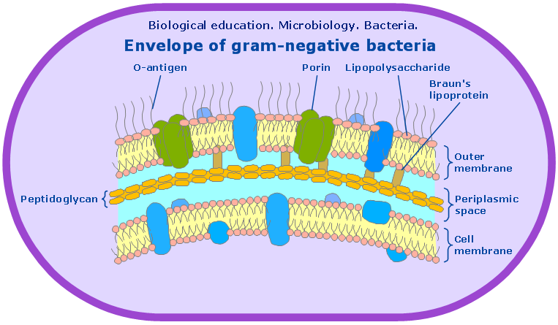
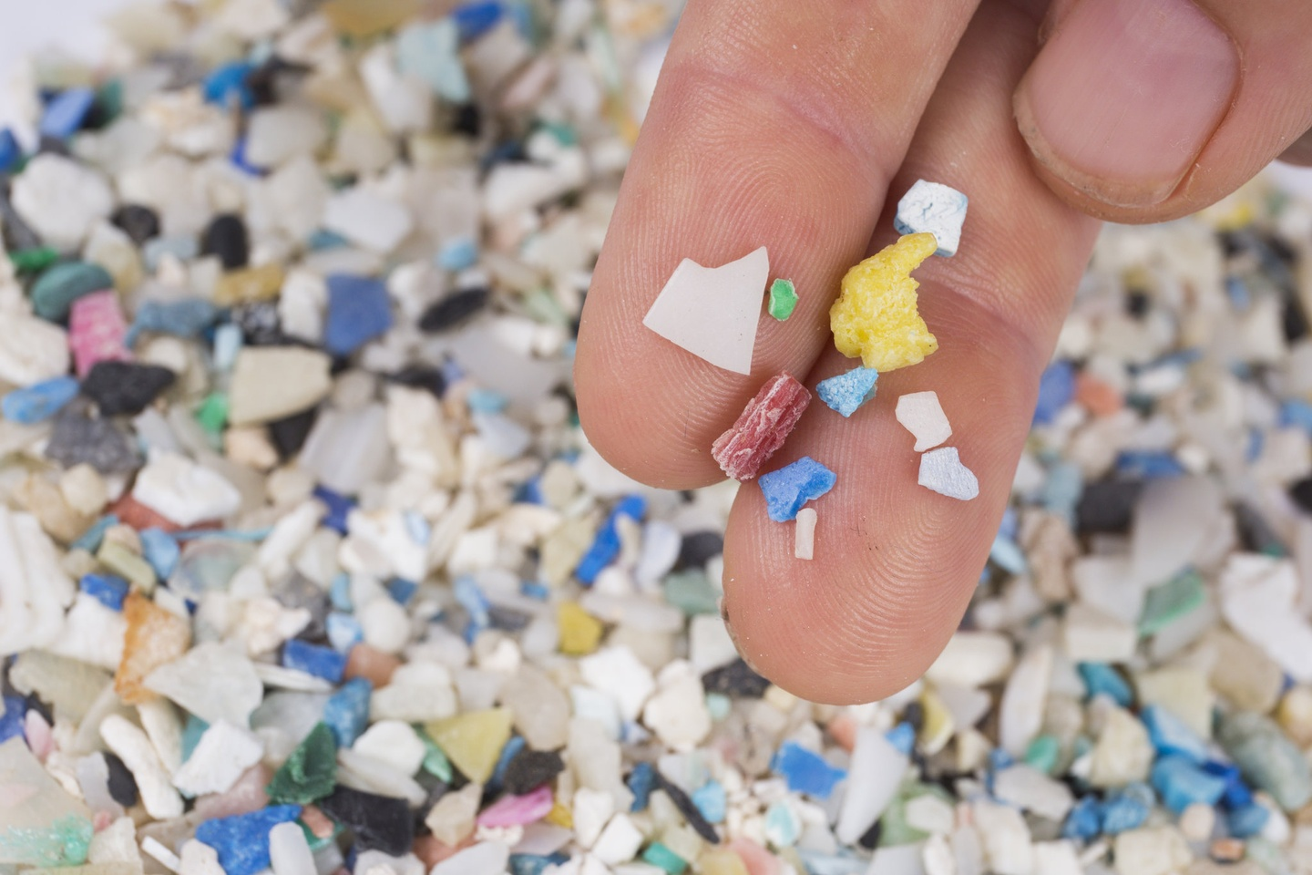
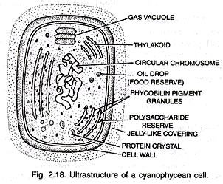
Polyethylene Terephthalate Breakdown with Cyanobacteria
SWA Bio2M Club: Kyra Husen
Hyun Seo Park, Christopher Hayden, Erney Marrogi, David Lips,
Ezira Wolle, Rania Wanandi, Ishan Chaurasia, Ye Eun Kim, Gisela Kasena, Hannah Basuki
Abstract
The little known aspect of plastic pollution are microplastics; pieces of plastics that are less than 5 mm in length. These microplastics are consumed by organisms, threatening their health and possibly killing them. Through a plasmid design, cyanobacteria can be given the ability to break down PET microplastics.
About Cyanobacteria
Cyanobacteria are photosynthetic bacteria that live in water.
Importance of Cyanobacteria
Cyanobacteria plays an important role in providing the Earth’s atmosphere and oceans with oxygen. In addition, it is a nitrogen-fixing
bacteria, meaning it converts nitrogen gas into nitrate and ammonia. Without cyanobacteria, marine plants would not have nitrogen to absorb for protein synthesis.
Gram-negative
Cyanobacteria are gram-negative as they have a thin peptidoglycan layer and an outer lipid membrane.
Thylakoids
Thylakoids, the membrane-bound structure inside a chloroplast, are found in the cytoplasm of the bacteria. Attached to these thylakoids are phycobilisomes, which has photosynthetic pigments called phycobilins of three types: phycocyanin, allophycocyanin and phycoeryth­rin. Different phycobilins are produced to maximise the absorption of sunlight. For this reason, cyanobacteria doesn’t always appear blue-green.
Introduction
Why are microplastics harmful?
Organisms consume microplastics, which can adsorb chemical pollutants on its surface. These microplastics clog the digestive system of the organism, causing starvation and a change in feeding behaviors. The blockage may also lead to internal bleeding as the plastic can puncture through the internal organs. Microplastics reduce the oxygen levels in cells as well. This makes it difficult for the organism to respire, hence reducing its energy, a factor crucial to growth and respiration.
What is PETase and MHETase?
PETase is an enzyme that breaks down polyethylene terephthalate (PET), the material used in single use bottles, into MHET. Once the PET has been broken down into mono-2-hydroxyethyl terephthalate (MHET), the intermediary polymer, MHETase can break it down into ethylene glycol (EG) and terephthalic acid (TPA).

Slide 2
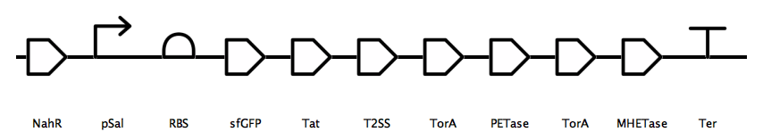
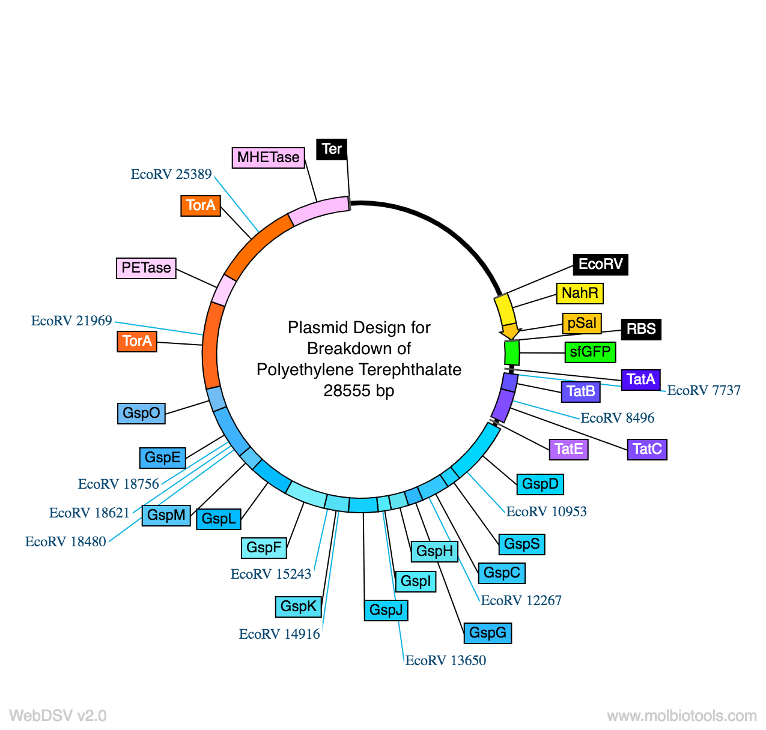

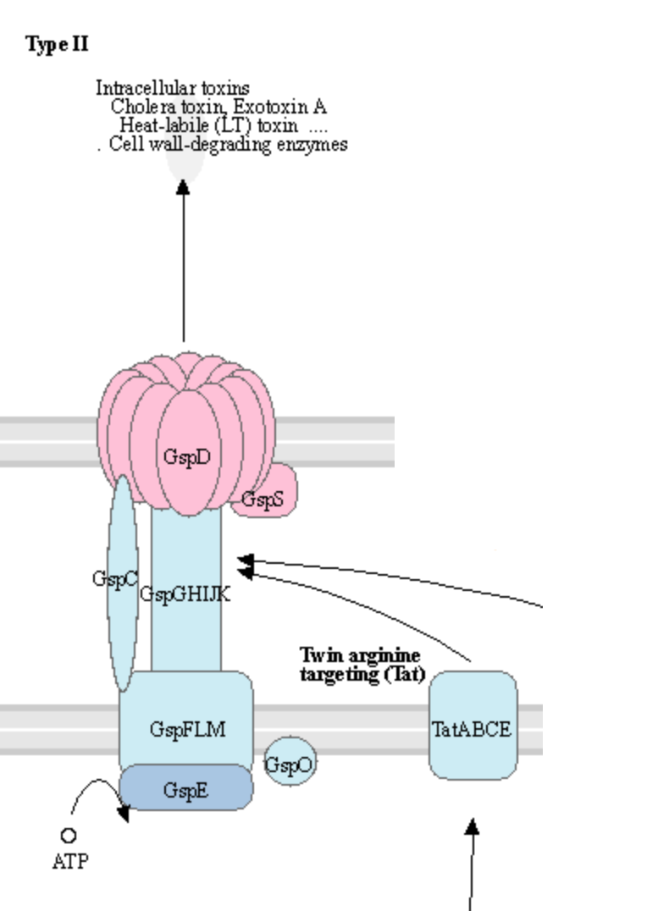
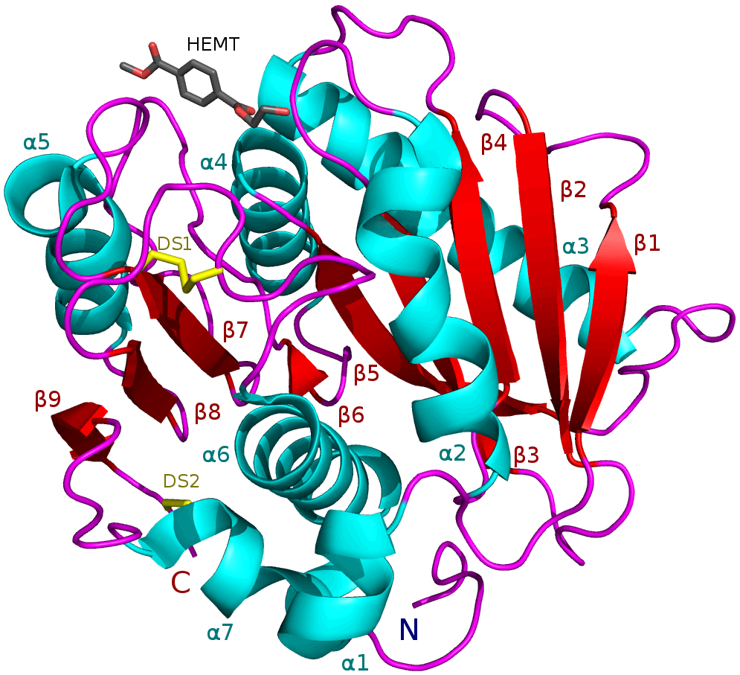
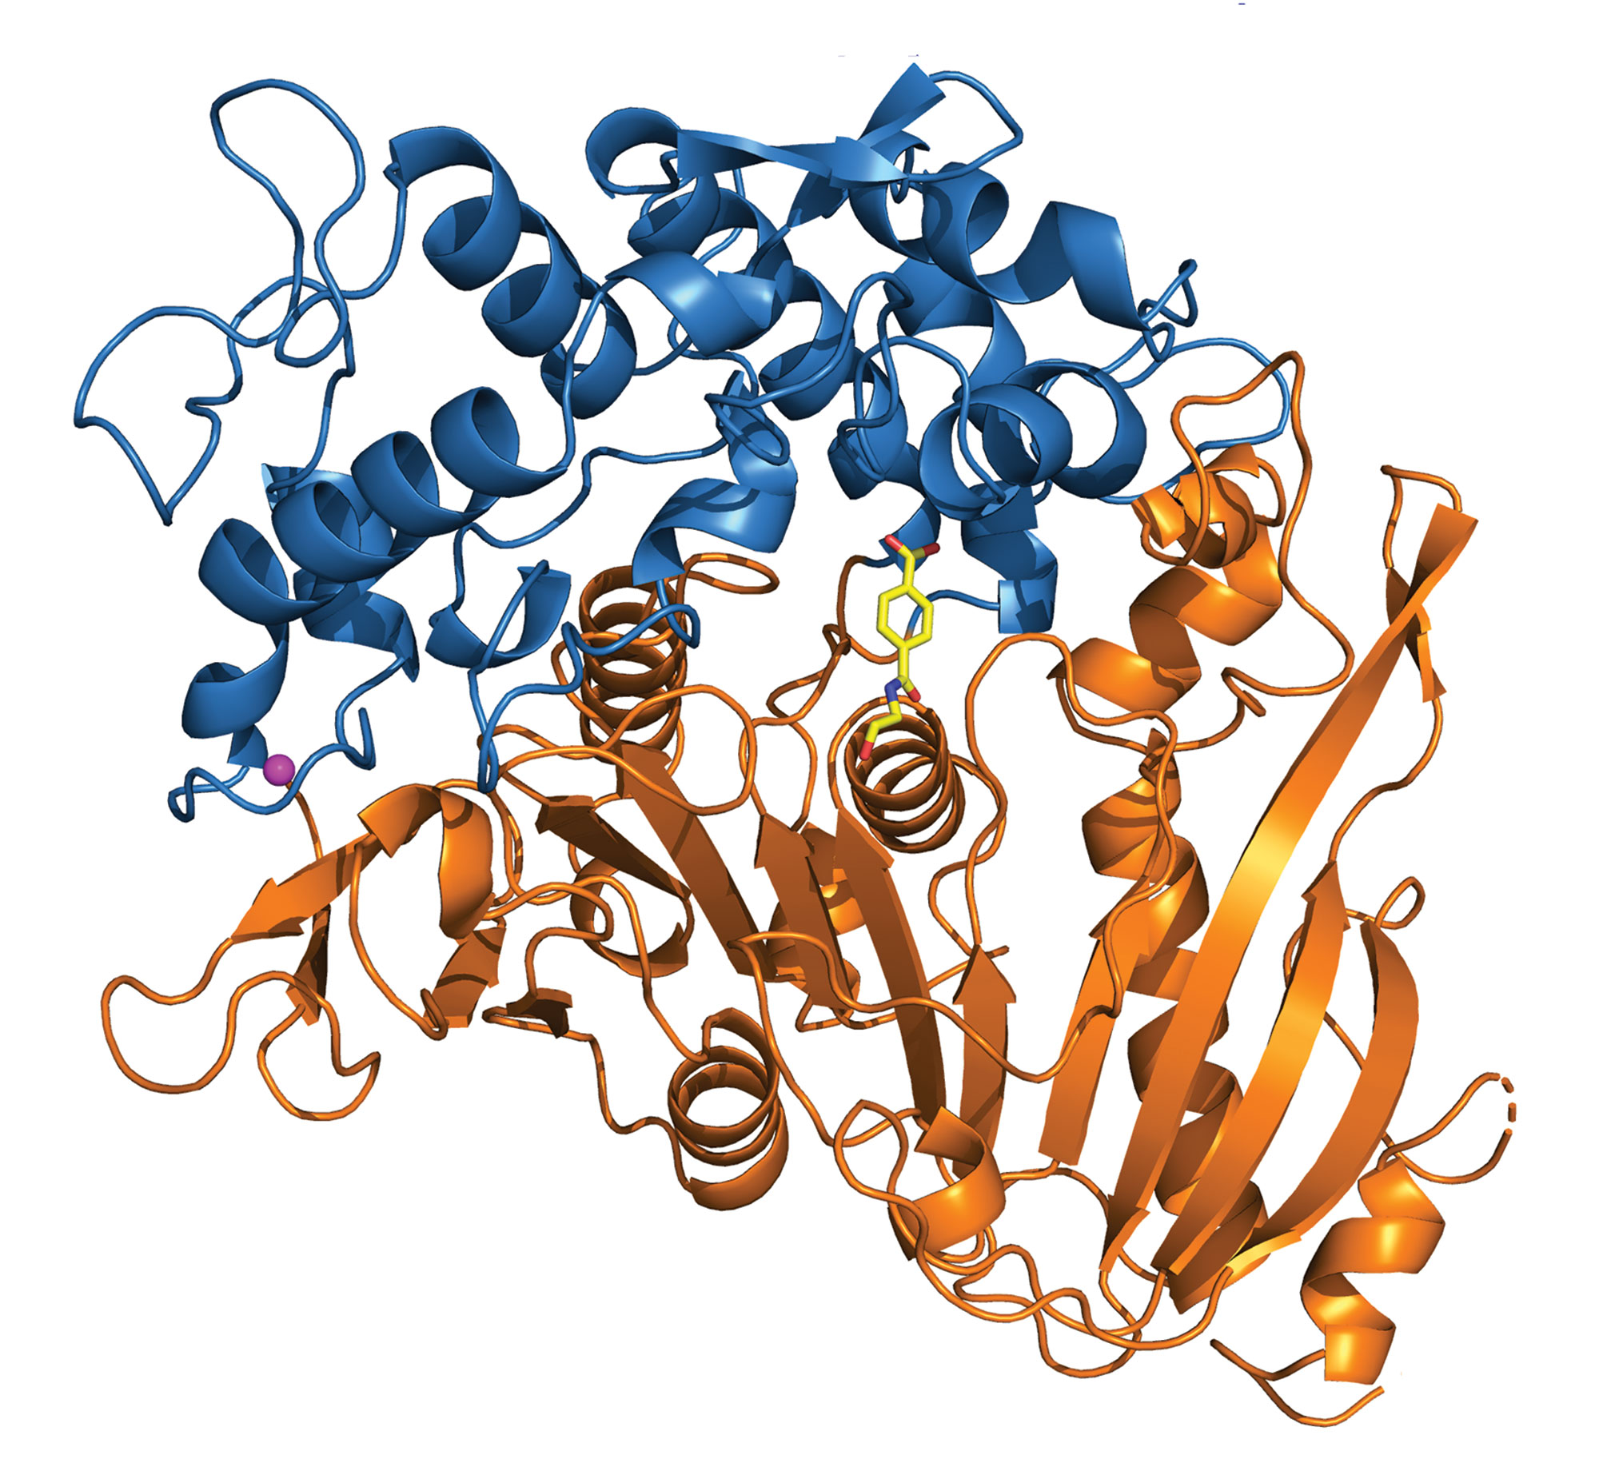
Polyethylene Terephthalate Breakdown with Cyanobacteria
SWA Bio2M Club: Kyra Husen
Hyun Seo Park, Christopher Hayden, Erney Marrogi, David Lips,
Ezira Wolle, Rania Wanandi, Ishan Chaurasia, Ye Eun Kim, Gisela Kasena, Hannah Basuki
Gene Sequence Design
Blunt End Cloning
To insert the gene sequence into the plasmid design, blunt end cloning with the restriction enzyme EcoRV would be used. The pBAD LIC cloning vector (8A) empty plasmid backbone has been chosen as it is often used in bacterial expression.
Regulation of Enzyme Production
In order to regulate enzyme production, the design includes the use of the NahR inducer and pSal inducer. The pSal gene detects the presence of salicylate acid, which is released by PET plastic during degradation. When salicylate acid is detected, the NahR gene will induce the pSal promoter, hence beginning the translation of the gene sequence.
Indicator of Modified Bacteria
The use of the superfolder green fluorescent protein (sfGFP) will allow the determination of whether the cyanobacteria has taken up the transformed plasmid, making it modified.
Secretion of Enzymes
The twin arginine translocation pathway (Tat), will allow the PETase and MHETase enzyme to travel from the inner membrane of the cell into the periplasm. From the periplasm, the enzyme will utilise the type 2 secretion system (T2SS) to travel through the outer membrane and exit the cell.
Along with the Tat and T2SS, a signal protein is needed to determine which proteins should be secreted out of the cell. The chosen protein for this design is TorA, which will bind the the PETase and MHETase, giving it the ‘ticket’ to exit the cell.
EcoRV cut site
Plasmid Design
Type 2 Secretion System
PETase
MHETase

Slide 3
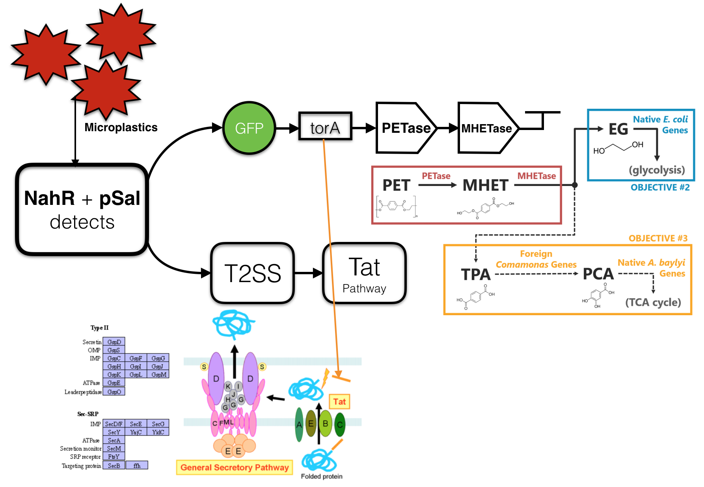
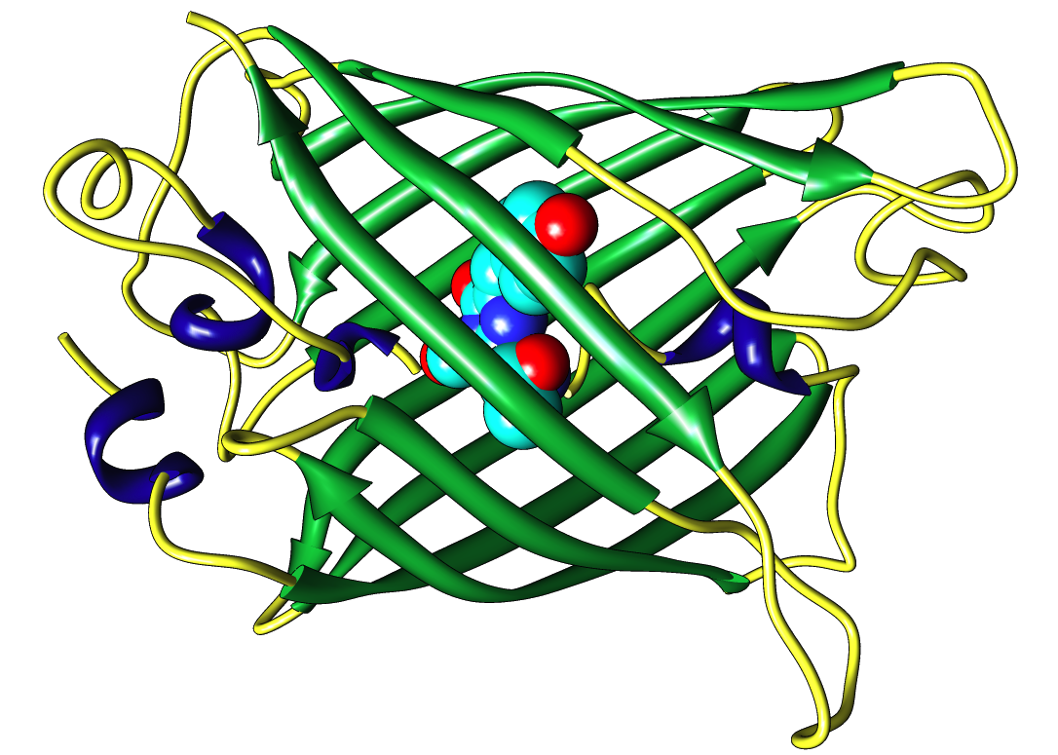
Polyethylene Terephthalate Breakdown with Cyanobacteria
SWA Bio2M Club: Kyra Husen
Hyun Seo Park, Christopher Hayden, Erney Marrogi, David Lips,
Ezira Wolle, Rania Wanandi, Ishan Chaurasia, Ye Eun Kim, Gisela Kasena, Hannah Basuki
Parts Description
sfGFP tag Part:BBa_K1321337
Only the cyanobacteria that has taken up the plasmid would be able to produce the green fluorescent proteins. Therefore, by adding this gene, it will allow us to determine whether the cyanobacteria has the taken up the plasmid and expressed the gene sequence.
PETase
The PETase gene is used to produce PETase, an enzyme discovered in Ideonella sakaiensis. It catalyses the hydrolysis of polyethylene terephthalate (PET) to mono-2-hydroxyethyl terephthalate (MHET).
MHETase
The MHETase will then hydrolyse the MHET molecule into ethylene glycol (EG) and terephthalic acid (TPA), which can undergo glycolysis and enter the tricarboxylic acid cycle respectively. However, in the case of the terephthalic acid, it has to go through one more modification which is made through the gene found in Comamonas sp. strain E6, which turns TPA into PCA which is used in citric acid cycle
This allows the PET to completely be broken down into organic compounds that can be used for metabolism of bacteria.
NahR + pSal Part:BBa_J61051
NahR responds to its inducer salicylate, which is an organic acid that forms when PET naturally degrades. It is used to activate the pSal promoter for transcription in the presence of salicylate acid. Thus, the gene expression will be expressed in the presence of a microplastic.
Superfolder
Green
Fluorescent
Protein

Slide 4
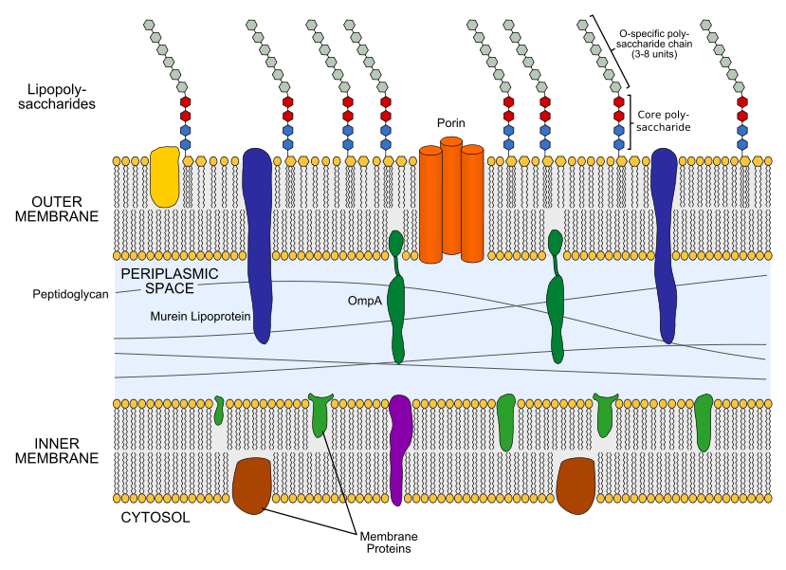
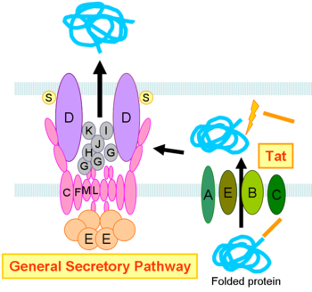
Polyethylene Terephthalate Breakdown with Cyanobacteria
SWA Bio2M Club: Kyra Husen
Hyun Seo Park, Christopher Hayden, Erney Marrogi, David Lips,
Ezira Wolle, Rania Wanandi, Ishan Chaurasia, Ye Eun Kim, Gisela Kasena, Hannah Basuki
Parts Description
Type 2 Secretion System (T2SS) & Twin Arginine Translocation Pathway (Tat pathway)
To secrete the PETase and MHETase out of the bacteria, T2SS was used in combination with the Tat pathway. It allows for transport of cytoplasmic proteins (PETase and MHETase) across the double membrane. The Twin-arginine translocation pathway (Tat pathway) was also used to allow the folded protein to be secreted.
When the enzyme is made, it will move out of the cytoplasm into the periplasm through the Tat pathway, it will then be secreted out of the bacteria through the T2SS. As both T2SS and Tat is made by smaller subunits 13 and 11 respectively. The T2SS gene and Tat pathway gene will contain the sequence for all these parts to ensure that the secretory system works.
Extracellular space
Periplasm
Cytoplasm
Enzyme Secretion Issue
Cyanobacteria are didermic meaning that they have a gram negative structure, it contains two membrane that separates the periplasm, cytoplasm and the extracellular space. Since, the PETase and METase is transcribed and translated in the cytosol the enzymes will be trapped within the inner membrane.
Signal Sequence: torA
TorA is used for the signal sequence to allow the enzymes to be transported through the Tat pathway. Once the the enzyme goes through the Tat pathway the signal will be removed.
Tat pathway was chosen as the PHET and MHET must be folded inside the cytoplasm before the secretion. As the Tat pathway was able to secrete matured proteins it was chosen instead of the Sec pathway.

Slide 5
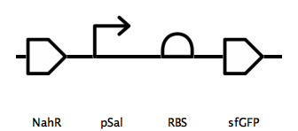
Polyethylene Terephthalate Breakdown with Cyanobacteria
SWA Bio2M Club: Kyra Husen
Hyun Seo Park, Christopher Hayden, Erney Marrogi, David Lips,
Ezira Wolle, Rania Wanandi, Ishan Chaurasia, Ye Eun Kim, Gisela Kasena, Hannah Basuki
Future Directions
Optimal conditions for PETase & MHETase
The optimal conditions for PETase to function is pH 9 and a temperature of 40 degrees celsius, while that of MHETase is pH 7 and 30 degrees celsius. The marine environment do not have these conditions, therefore the modified cyanobacteria would not be breaking down PET efficiently. Finding a biochemical to simulate these optimal conditions would increase the survival of the cyanobacteria, as less energy would be wasted.
Biofilm & Quorum Sensing
Biofilm is a glue-like, slimy substance that is secreted by microorganisms when they adhere to a surface during reproduction. The use of biofilm could potentially trap microplastics in it, collecting it in one location, hence making it easier for the enzymes to breakdown the plastics.
Quorum sensing refers to the regulation of gene expression in response to changes in the population density of cells. Quorum sensing bacteria release chemicals, which causes other bacteria to increase or decrease its cell density. Through using quorum sensing, the population of the modified cyanobacteria could be increased when there is a high concentration of PET plastics.
Limitations
The creation of the designs were made based on scientific research, however, the design itself has not been tested. Many assumptions were used during the development process, which makes the design unrealistic to a certain extent.
An identified limitation is the number of base pairs in the plasmid design. With 28555 base pairs, it would be more realistic to create two plasmid designs by splitting up the gene sequence design.
An assumption made is that the PETase and MHETase enzyme will not be denatured in marine environment conditions. Testing these enzymes in marine environment conditions would determine whether the cyanobacteria could potentially degrade PET plastic.
The regulation of enzyme production largely depends on the function of the NahR-pSal genes, yet these genes remain untested. In order their functionality, the gene sequence design below should be inserted into a plasmid and then used to modify E. coli. If the genes function correctly, it will produce green fluorescent proteins only in the presence of PET.
Citations
Abreu, et al. “Microplastics in the Oceans: the Solutions Lie on Land.” Field Actions Science Reports. The Journal of Field Actions, Institut Veolia, 1 Mar. 2019, journals.openedition.org/factsreports/5290.
“BBa_J61051.” Part, parts.igem.org/Part:BBa_J61051.
“Berkas:Gram Negative Cell Wall.svg.” Wikipedia, Wikimedia Foundation, id.wikipedia.org/wiki/Berkas:Gram_negative_cell_wall.svg.
“Biology.” ConceptDraw Samples | Science and Education - Biology, www.conceptdraw.com/samples/science-education-biology.
Christopher, J. “Registry of Standard Biological Parts .” Ribosome Binding Sites/Prokaryotic/Constitutive/Anderson, parts.igem.org/Ribosome_Binding_Sites/Prokaryotic/Constitutive/Anderson.
Embl-Ebi. “European Nucleotide Archive.” EBI, www.ebi.ac.uk/ena.
Gonçalves, Cátia F., et al. “Cyanobacterial Secretion Systems: Understanding Fundamental Mechanisms Toward Technological Applications.” Cyanobacteria, Academic Press, 5 Dec. 2018, www.sciencedirect.com/science/article/pii/B9780128146675000180.
“Green Fluorescent Protein: Shining New Light on Food QC.” Microbiologics Blog, 5 Aug. 2016, blog.microbiologics.com/green-fluorescent-proteins-shining-new-light-on-food-qc/.
Harvard IGEM Team. “Plastiback.” Team:Harvard BioDesign/Description, 2016.igem.org/Team:Harvard_BioDesign/Description.
“An Investigation into the Removal of Microplastics from Water Using Ferrofluids.” Google Science Fair, www.googlesciencefair.com/projects/2018/2c3f6207b15f46cb4bb66a56095bd6d901ccfa42e7e51600c766df7856590c4e.
ITB IGEM Team. “Composite Parts.” Team:ITB Indonesia/Composite Part, 2017.igem.org/Team:ITB_Indonesia/Composite_Part.
“KEGG Bacterial Secretion System.” KEGG PATHWAY: Bacterial Secretion System, www.genome.jp/kegg-bin/show_pathway?map=ko03070&show_description=show.
“Making Bacteria Eat Plastic.” Team:Yale, 2018.igem.org/Team:Yale.
“MHETase.” Wikipedia, Wikimedia Foundation, 9 June 2019, en.wikipedia.org/wiki/MHETase#/media/File:MHETase_ribbon_diagram.png.
“Overview: DNA Cloning.” Khan Academy, Khan Academy, www.khanacademy.org/science/biology/biotech-dna-technology/dna-cloning-tutorial/a/overview-dna-cloning.
PMC, Europe. “Characterization of the Terephthalate Degradation Genes of Comamonas Sp. Strain E6.” Europe PMC, 1 Mar. 2006, europepmc.org/article/PMC/1393238.
“Rosalind Franklin: A Crucial Contribution.” Nature News, Nature Publishing Group, www.nature.com/scitable/topicpage/rosalind-franklin-a-crucial-contribution-6538012/.
UniProt ConsortiumEuropean Bioinformatics InstituteProtein Information ResourceSIB Swiss Institute of Bioinformatics. “Poly(Ethylene Terephthalate) Hydrolase.” UniProt ConsortiumEuropean Bioinformatics InstituteProtein Information ResourceSIB Swiss Institute of Bioinformatics, 11 Dec. 2019, www.uniprot.org/uniprot/A0A0K8P6T7.
YouTube, YouTube, www.youtube.com/watch?v=00Qw36ooUp4.
YouTube, YouTube, www.youtube.com/watch?v=HcrSYbNqYdo.

