Slide 1



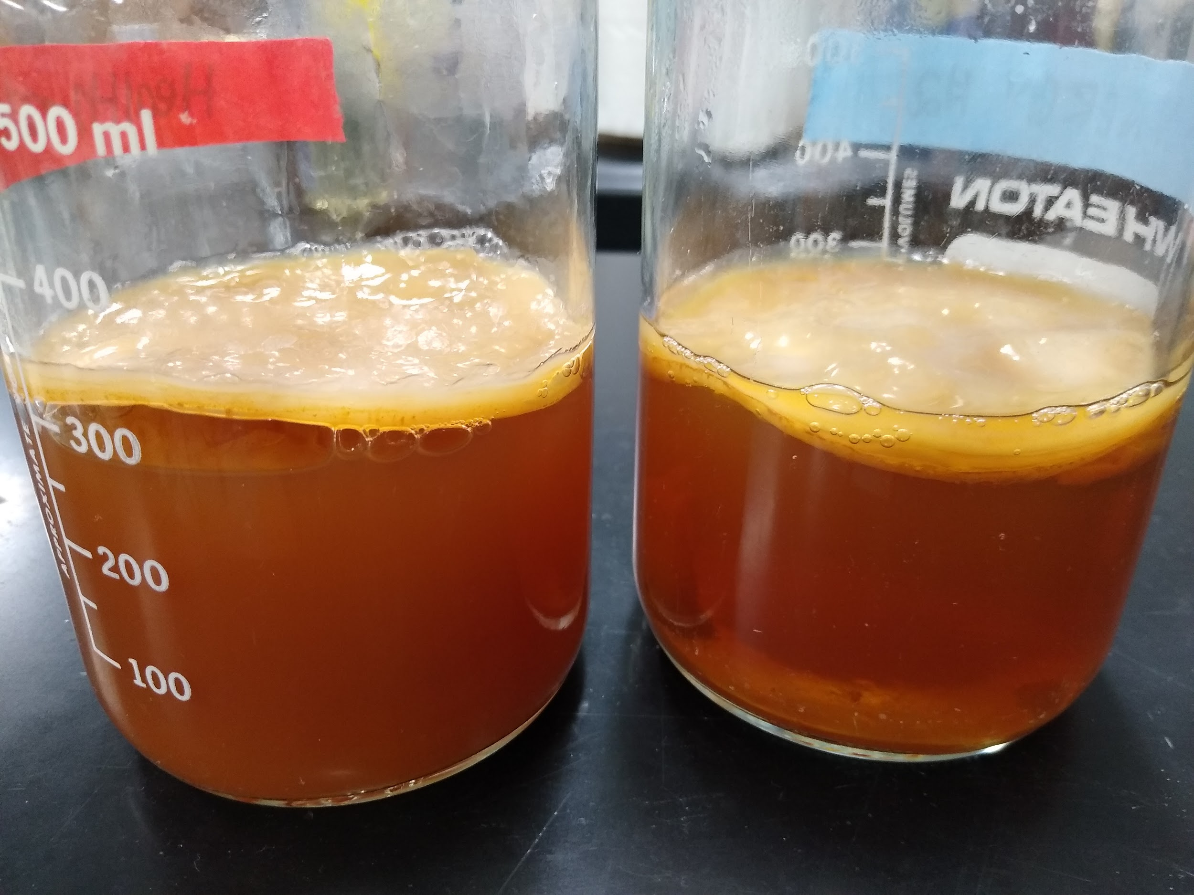
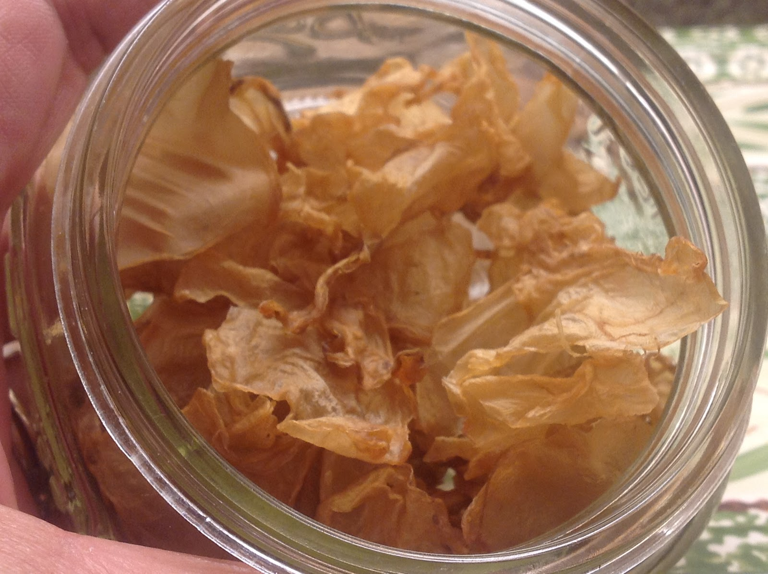

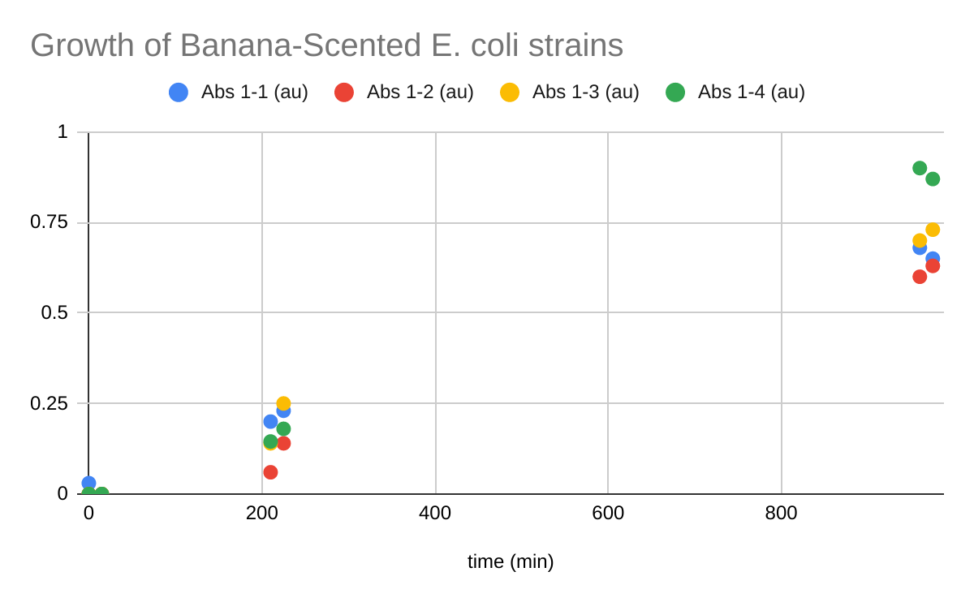
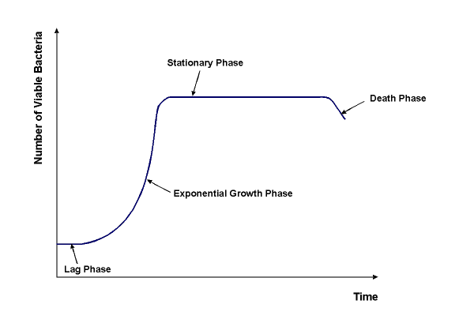
Synthesizing Scentless SCOBY
Holly Heinrich, Kristy Chan, Kristi Tu, Isabella Stuewe, Isabella Guevara-Longree, Molly Brennan, Anmol Gill
Mentor: Javin Oza Advisors: Laura O’Brien and Christopher Bing
Castro Valley High School
Objective
Methods: culturing kombucha
Results
Further Studies
The SCOBY (Symbiotic Culture of Bacteria and Yeast) produced when brewing kombucha can be dried and used as an environmentally friendly, biodegradable material.
One of the challenges is that the dried SCOBY has an unpleasant odor.
We made kombucha first by using store-bought kombucha as a starter, then by using a small piece of the resulting SCOBY to grow the following batches.
Culturing Kombucha
One of the three brands we used did not produce a solid SCOBY, but the other two generated a well-formed SCOBY.
Culturing Banana-Scented Bacteria
After allowing the test tube mixtures to rest for _ hours, we smell tested the mixtures. The banana odor was detectable in some, but was often overpowered by the smell of the E-coli, and did not improve the smell
Covering SCOBY scent:
Add banana-scented bacteria (from Eau That Smell) lab to kombucha cultures to see if adding an additional strain of bacteria still allows a SCOBY to form
If successful, explore other scents that can be added to the kombucha fermentation process via engineered bacteria
If additional bacterial species adversely affect SCOBY formation, experiment with engineering microbes already present in the SCOBY
Removing SCOBY scent:
Since vinegar is a major component of the SCOBY scent , we could add baking soda at some point during fermentation
We could engineer microbe(s) in the SCOBY to decompose acetic acid, removing the scent.
Further research could reveal additional molecules contributing to the foul odor of SCOBY
Figure 4:
Two of our kombucha cultures, with SCOBY that has formed on the surface (after 4 weeks of fermentation).
Photo by L. O’Brien
Figure 1: Dehydrated SCOBY
Image Source:
Http://4.bp.blogspot.com/-P7_sPakgHSY/T-a4nicsdwI/AAAAAAAABXc/AHE4kLV3fxk/s1600/IMG_0042.JPG
Figure 2: Representation of reaction to
SCOBY scent
Image Source:
https://www.habitatmag.com/Publication-Content/Building-Operations/2016/2016-February/Smelly-Neighbors
Design Plan
Methods: culturing banana-scented bacteria
We can approach the SCOBY scent in two ways:
mask the unpleasant smell of the bacteria and yeast by adding a more pleasant smell
remove the smell by breaking down the stinky compound(s)
We used the Eau That Smell kit, involving E.coli that has been engineered to produce a banana scent. We set up liquid cultures of four strains of bacteria, then used a spectrophotometer to measure the cell concentrations at three time periods: immediately upon innoculation (lag phase), after 3 ½ hours (exponential growth), and after 16 hours (stationary phase). The odors of the bacteria at the various stages of growth were compared with standard solutions made by diluting banana extract. We plan apply similar genetic engineering to mask the smell of our SCOBY.
Bacterial Strain | Growth Stage with Strongest Banana Scent
1-1 | stationary
1-2 | stationary
1-3 | exponential
1-4 | stationary
,
Pleasant-smelling compound, or enzyme that degrades foul-smelling compound
Indicator of growth stage during which stinky compound(s) produced.
Figure 5 (above): Absorbance readings (a measure of cell density) for 4 banana-scented cultures).
Table: growth stage of strongest banana scent for each E. coli strain
References & Acknowledgements
Figure 3: Our general design plan
iGEM, MIT 2006. MIT 2006 IGEM, 20 July 2007, 2006.igem.org/wiki/index.php/MIT_2006.
“Chapter 6: Eau That Smell.” BioBuilder: Synthetic Biology in the Lab, by Natalie Kuldell et al., O'Reilly, 2015, pp. 95–107.
Inducible promoter
Ribosome Binding site
gene
terminator
Figure 6: Bacterial growth curve
Image source: https://info.gbiosciences.com/blog/bacterial-growth-curves-turbidimetric-determination
Notes:
Single sided poster!

Slide 2
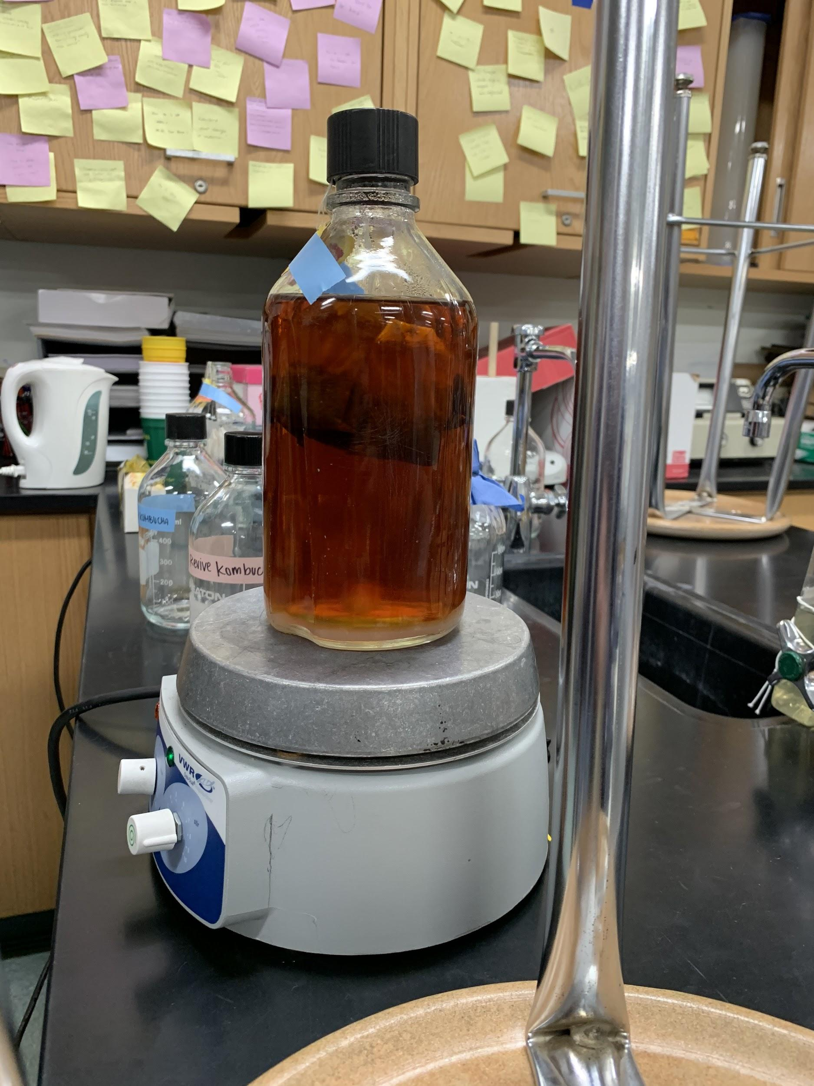
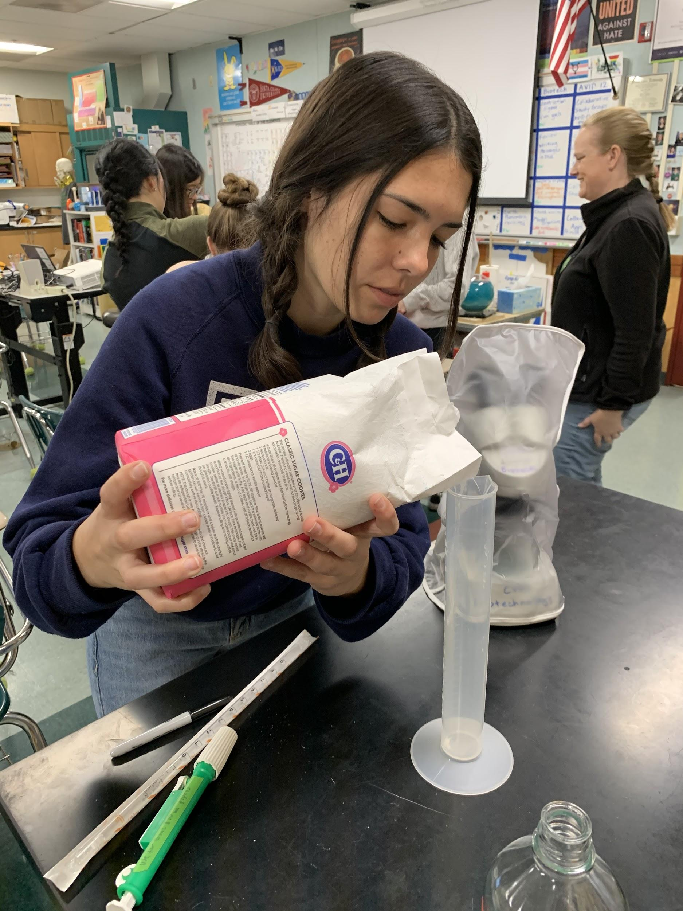
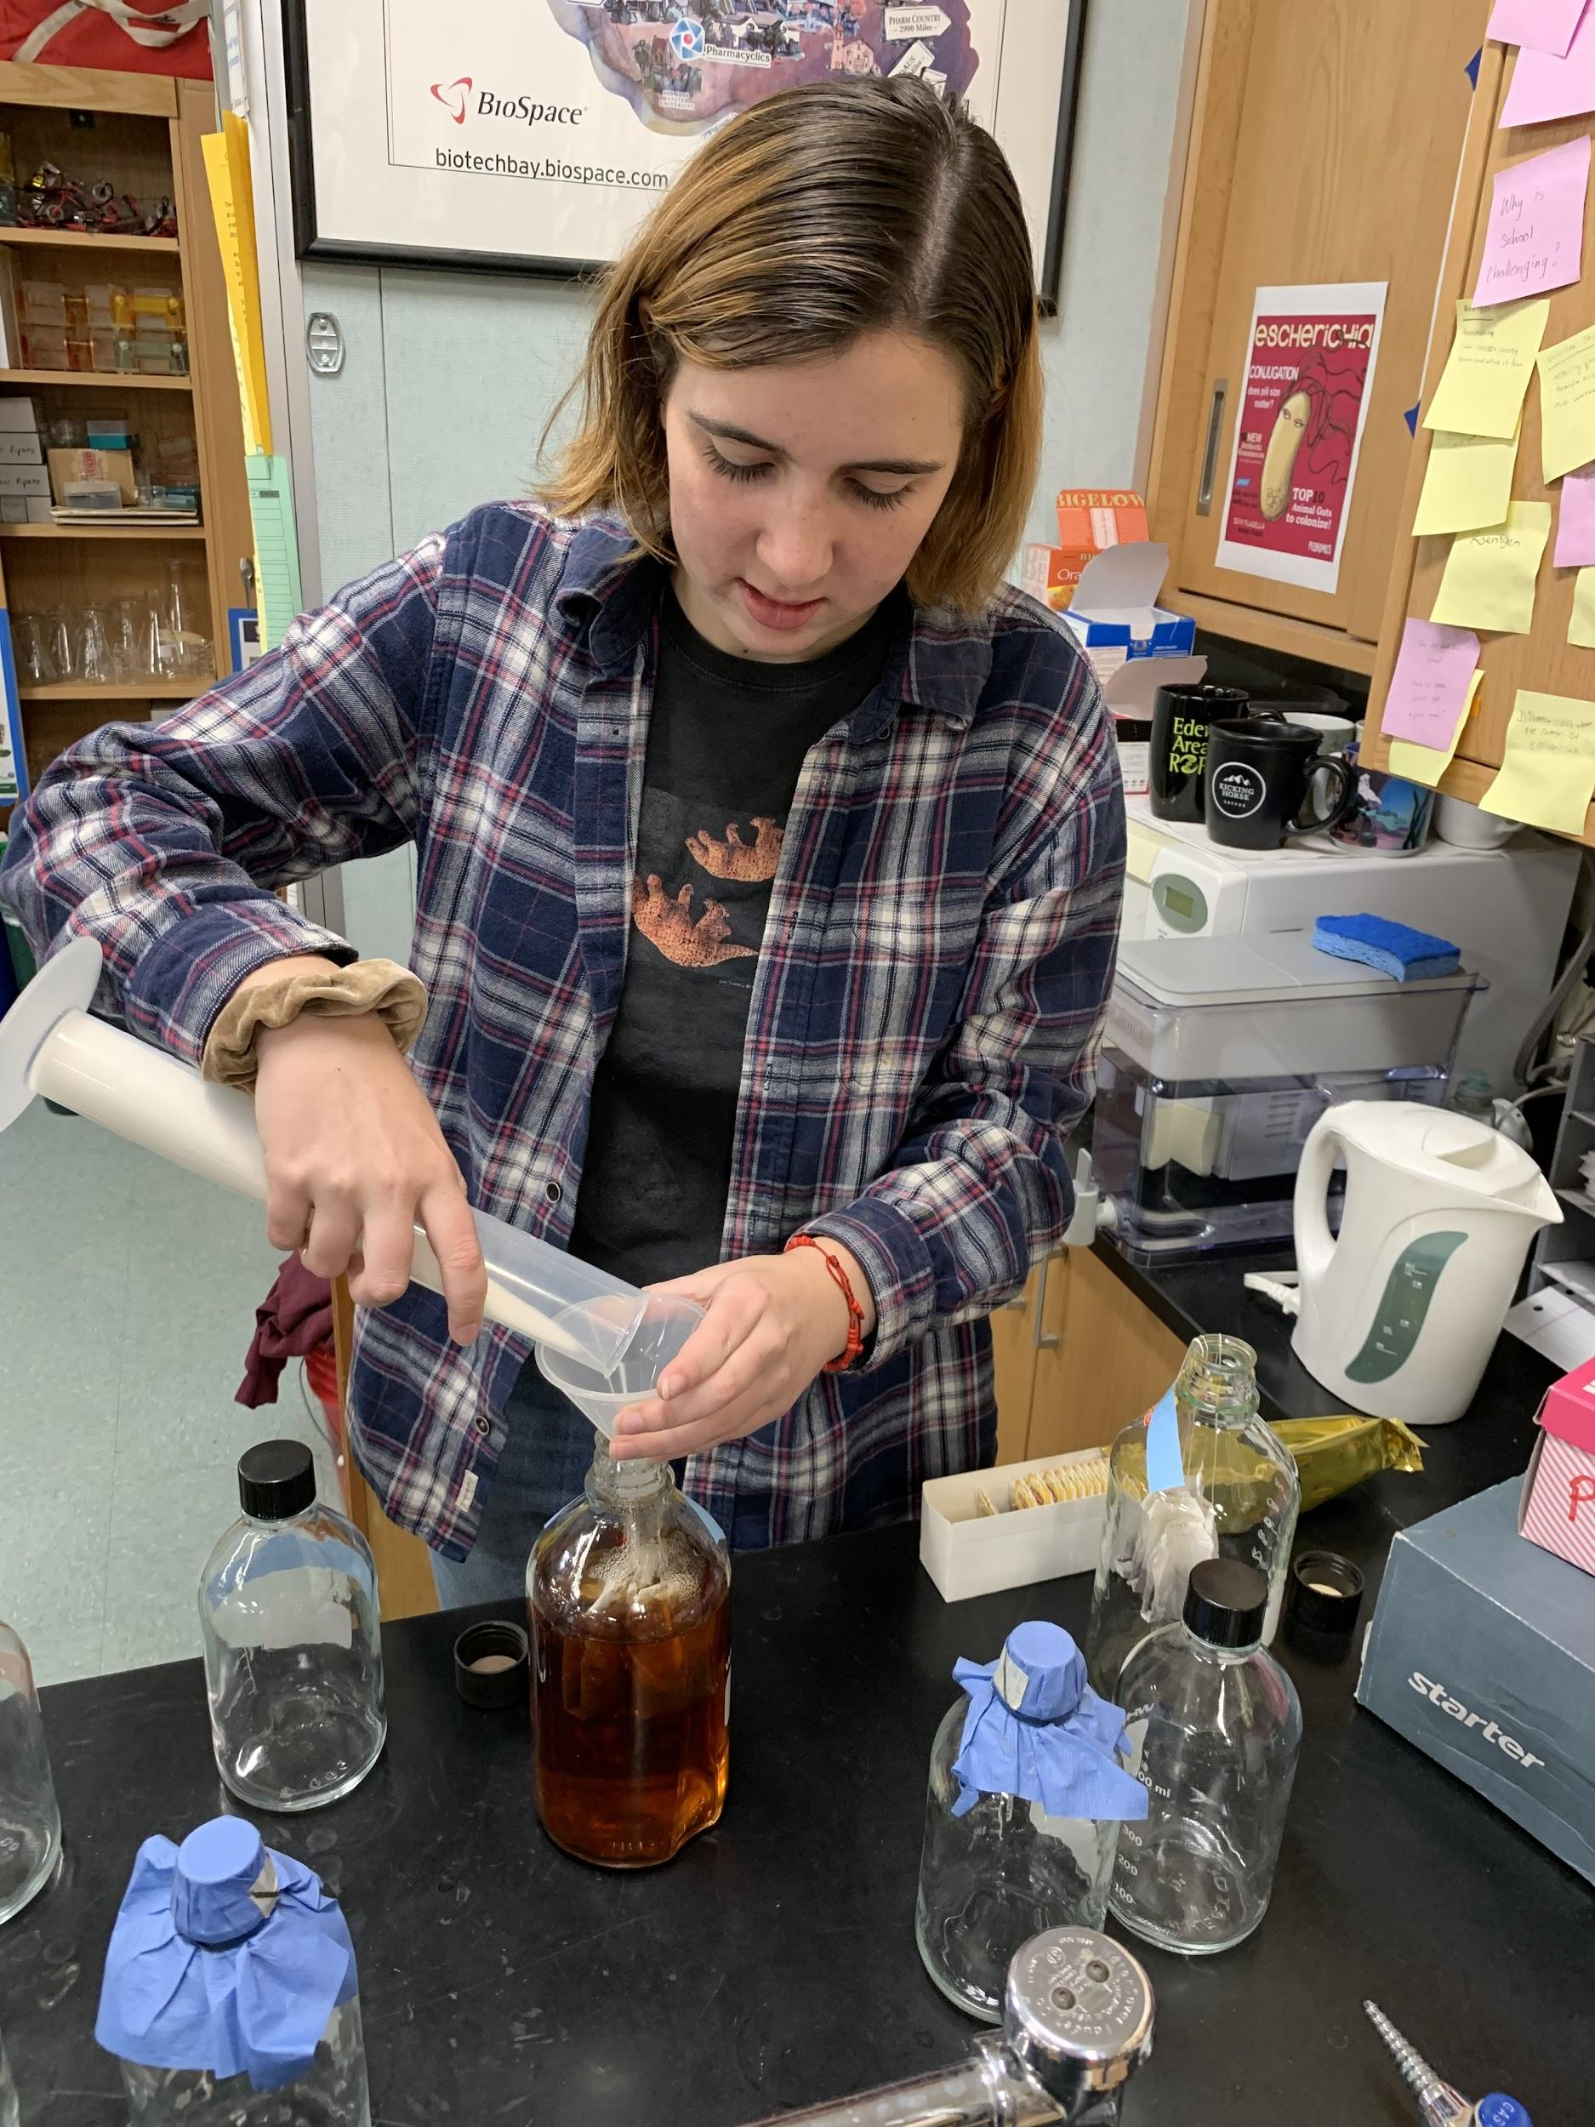
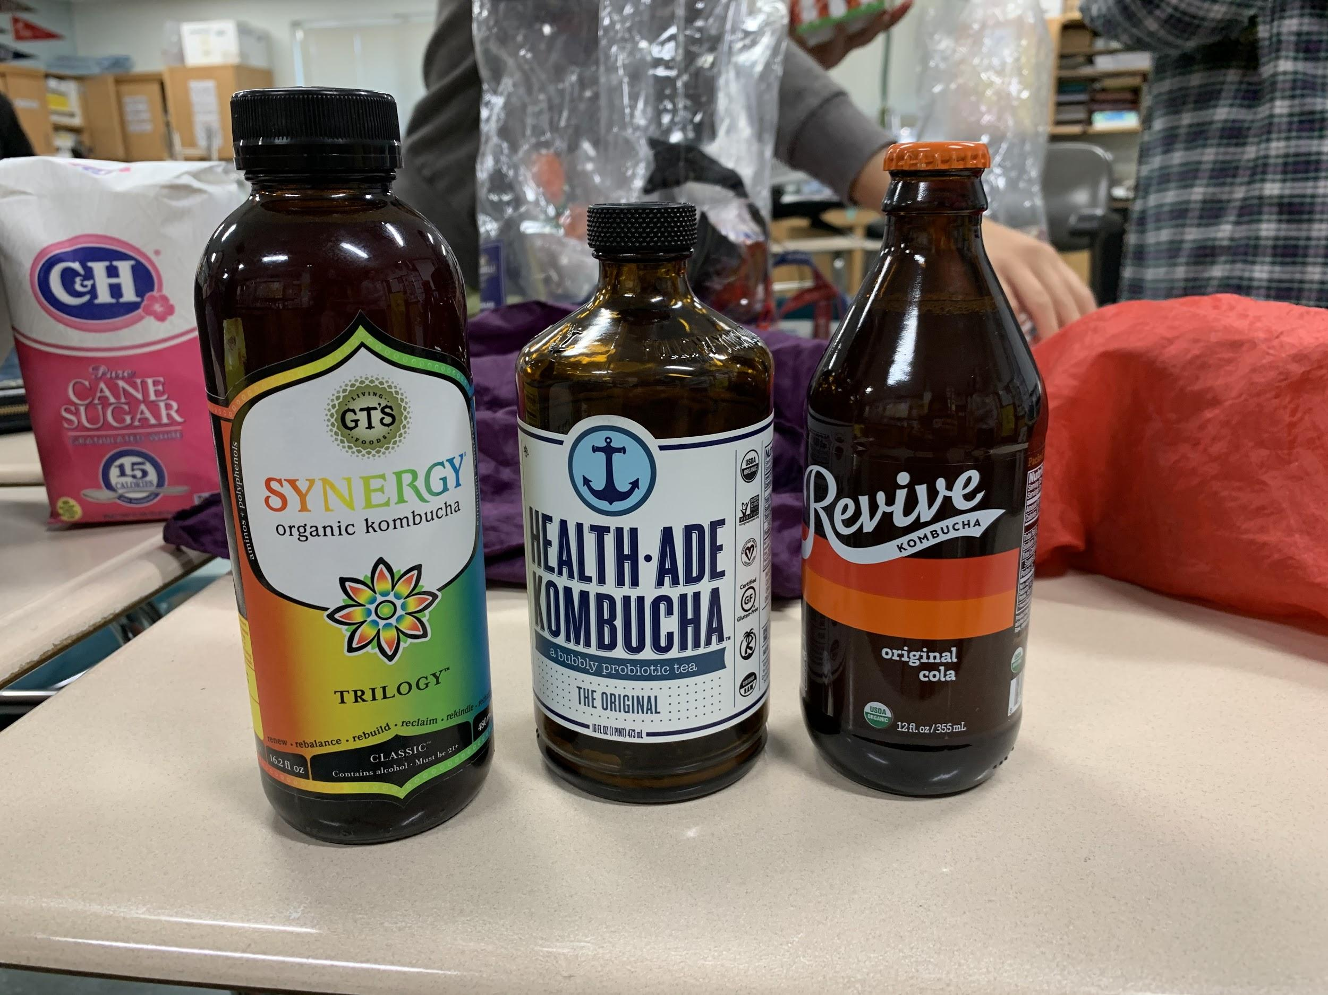
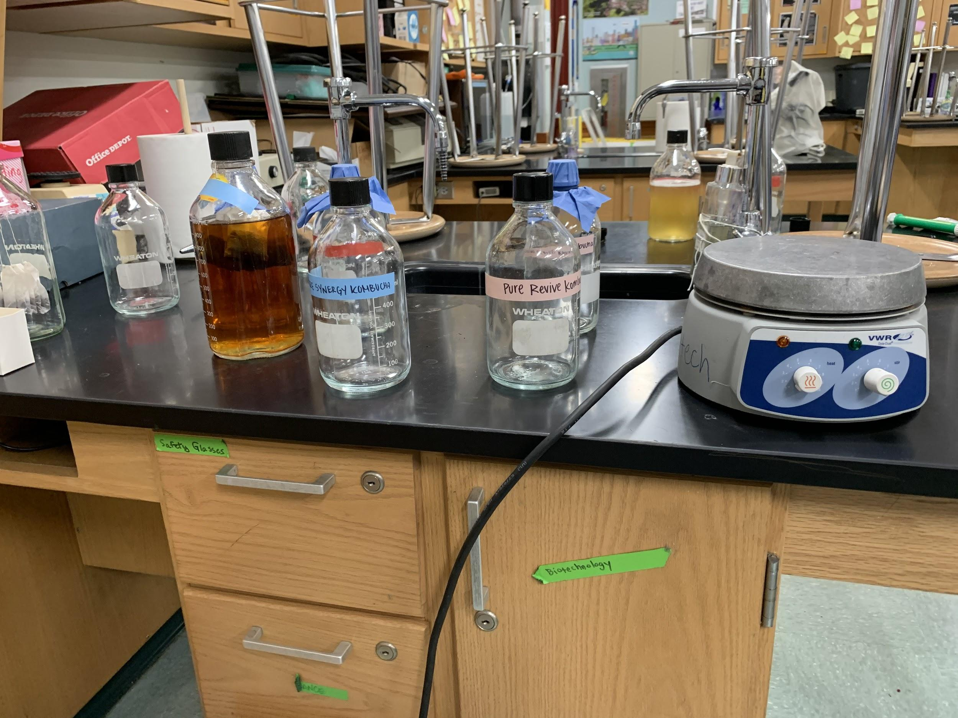
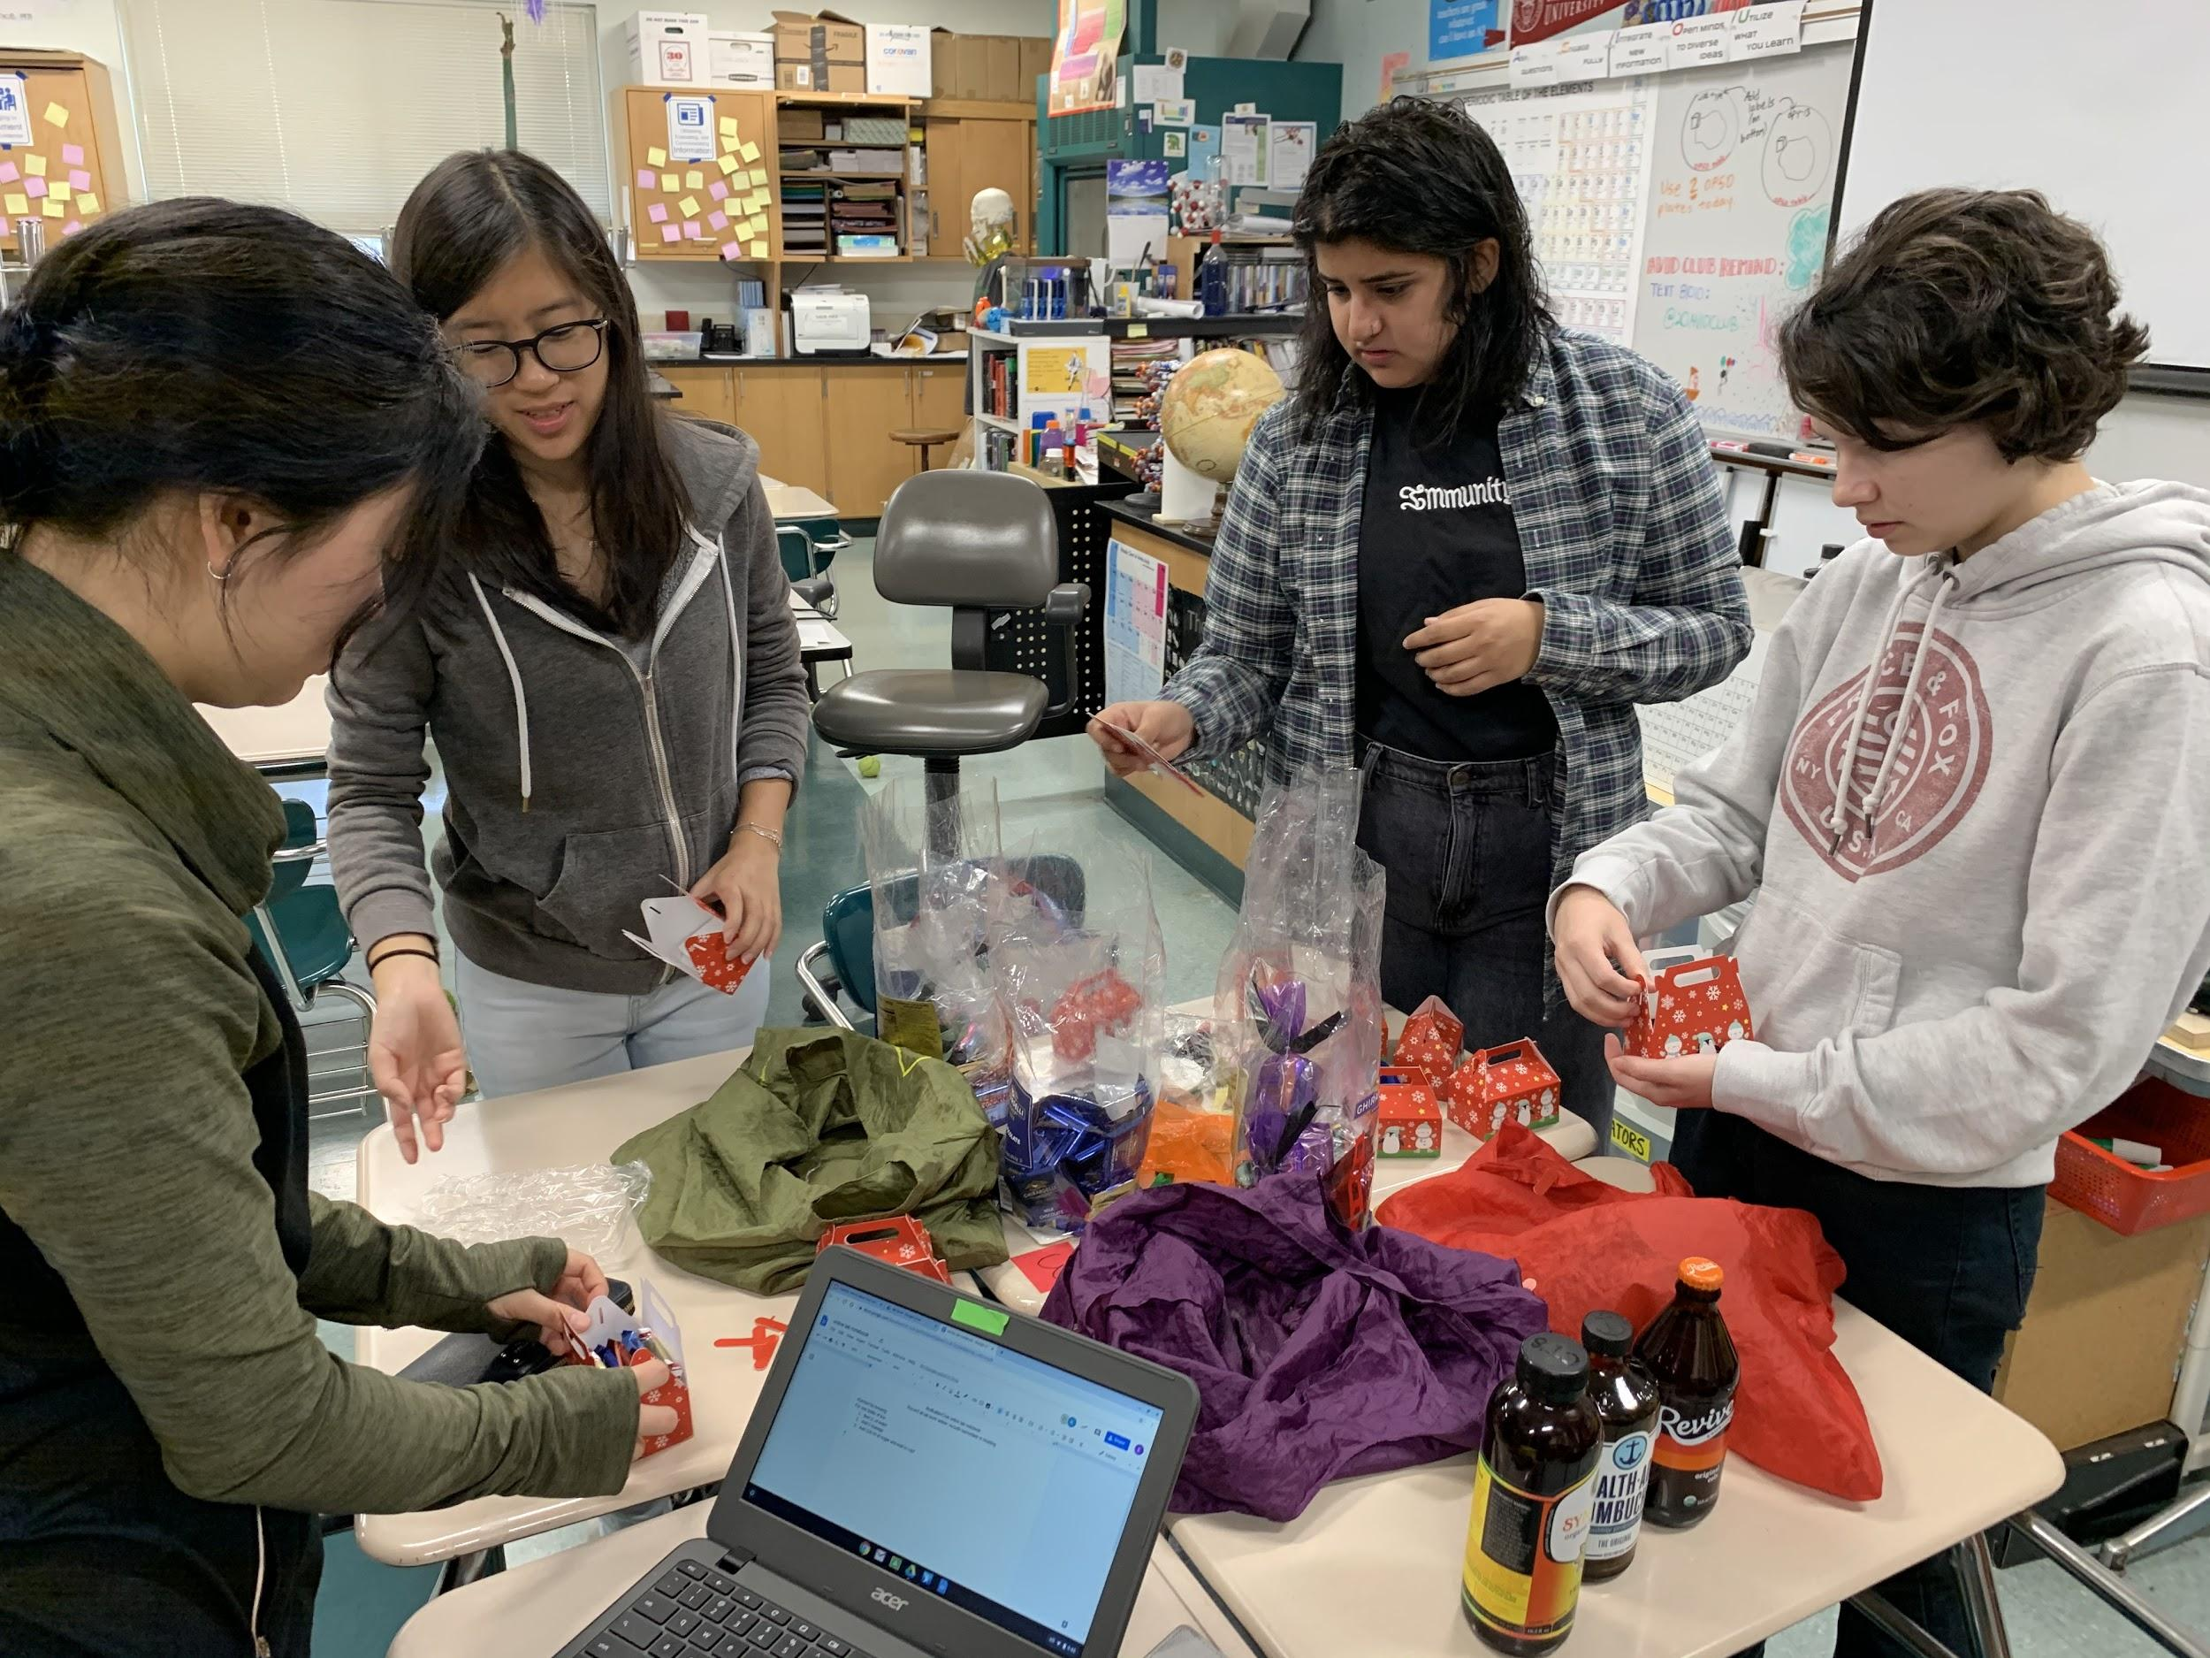
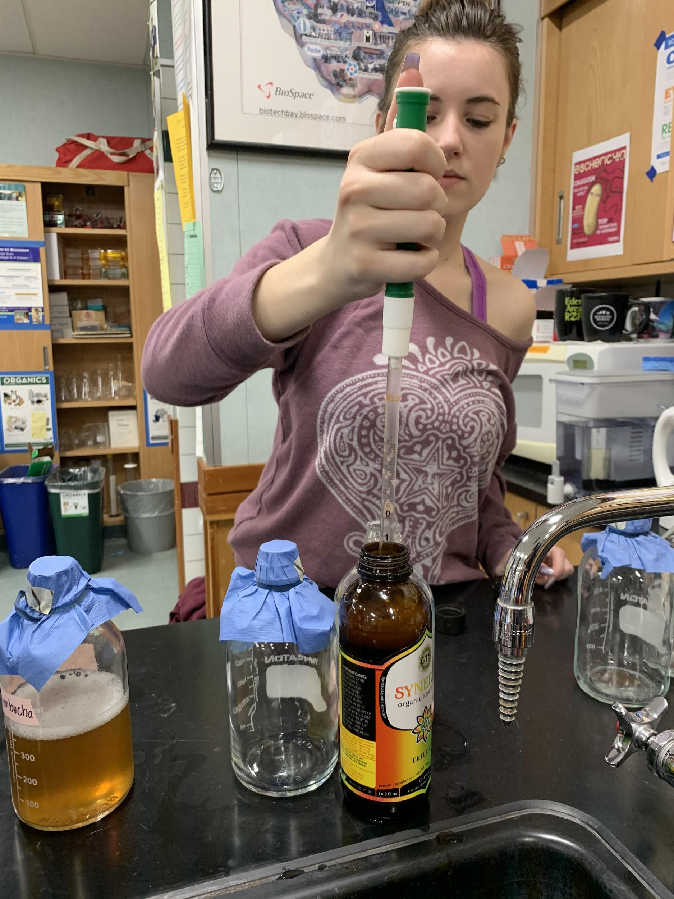
Images courtesy of Isabella Stuewe

