Slide 1

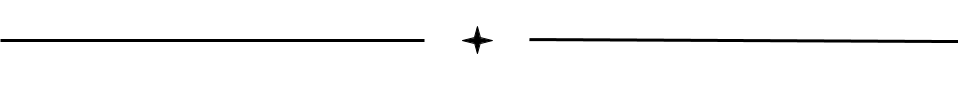
Osteoarthritis
How to Limit the Degradation of Cartilage
Eva McKone, Abhay Yajurvedi, Jeff Conners, Baishali Chaudhuri, and Nadia Shah.

Slide 2
What is Osteoarthritis?
Osteoarthritis is the degeneration of articular cartilage that covers the joints.
Very common; affects millions of people worldwide
Chronic: can last for years or be lifelong
Treatments can help, but there is no cure
Notes:
It occurs when the flexible tissue at the ends of the bone wears down.
Very common; affects millions of

Slide 3
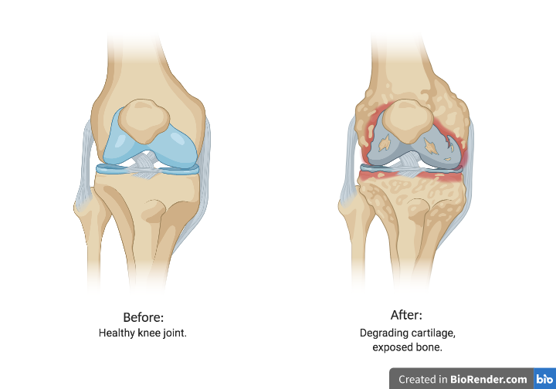

Slide 4
Challenges to Curing Osteoarthritis
Challenges in DMOAD (Disease Modifying Osteoarthritis Drugs) development
  Radiography cannot reveal full extent of multi-tissue involvement in joints
  Patients drop out during long-duration periods
  No single preclinical model reflects all components of human OA
  Some drugs fail to reduce symptoms and improve quality of life
Course of OA is highly variable

Slide 5
Existing Solutions
DMOADs
  Inhibits structural disease progression of OA
  No licensed DMOADs
Joint Replacement Surgery
  The arthritic joint surface is replaced with an orthopedic prosthesis.
Steroid Knee Injection
  temporarily relieve pain caused by an inflamed joint
Lifestyle Changes
  Weight loss, exercise, cold and hot compressions, and physical therapy

Slide 6
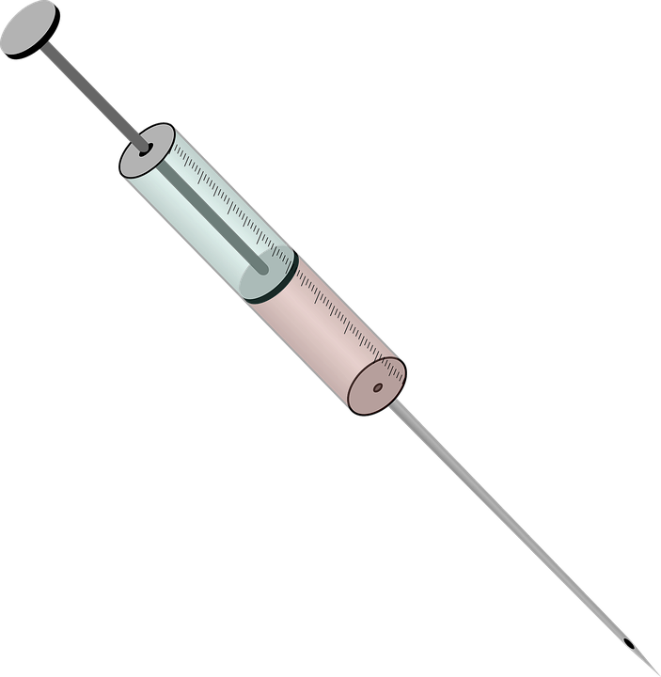

Design/Prototype
Chassis: Saccharomyces cerevisiae (yeast)
(People will take this in the form of an injection after the solution has been purified)
Promoter Ribosome Coding Sequence: Coding Sequence: Double Terminator
Binding Caspase 1 Resistance gene for Tmini Terminator
Site G418 in Yeast
RBS.1 (strong)
BBa_B0030 Caspase-1 BBa_K39400 BBa_K2314608
Yeast GAL1
http://parts.igem.org/Yeast
Notes:
A purified solution of yeast that can be injected to the affected area.
Interleukin 1 Beta -- Produces Matrix Metalloproteinases
Matrix Metalloproteinase (MMP) -- Causes cartilage degradation
Caspase 1 -- Interleukin 1 Beta Inhibitor
Caspase -- a subgroup of proteases that executes apoptosis and initiates inflammation

Slide 7
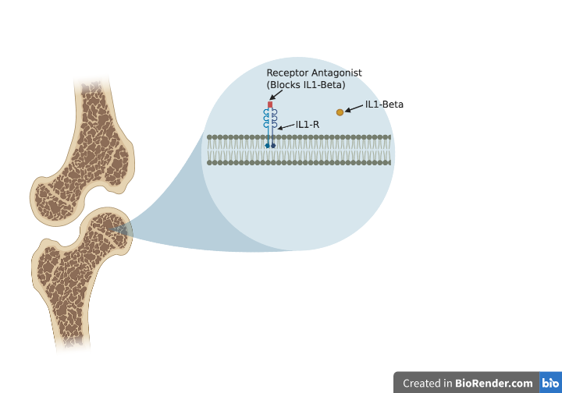
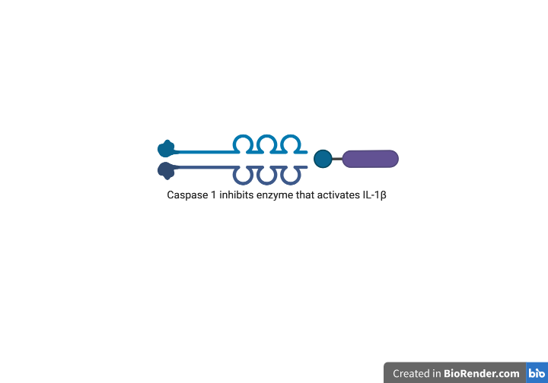
Caspase 1 inhibits the enzyme that activates IL-1𝛃

Slide 8
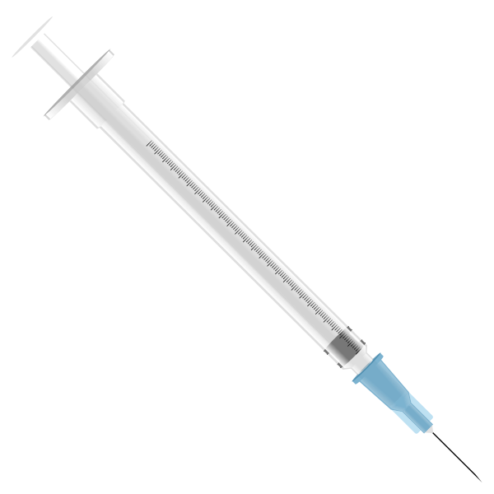

What is missing? What should be considered?
Blind Spots
  It is possible that the prototype could decrease the rate of degeneration, but not reduce the symptoms
  By eradicating IL1-𝛃, the solution could be harmful because the IL1-𝛃 could have other functions
Ethics
  Are people open to a new injection?
  Cannot guarantee that the patient’s quality of life will be fully restored
  Will people have an allergic reaction to the drug?
Notes:
We could be decreasing rate of degeneration but people may still experience symptoms
By eradicating the IL1-B we could be doing harm because the IL1-B could have other functions
Ethics: are people open to a new injection
We can't insure that people will return to a life like someone without Osteoarthritis
Will people have an allergic reaction to our drug

Slide 9
Key Points/Takeaways
Osteoarthritis is caused by MMPs produced by Interleukin 1.
Caspase-1 inhibits Interleukin 1-Beta from functioning by attaching to receptors.
By creating an injection of Caspase-1, the rate at which the disease progresses will decelerate.

Slide 10
Citations
https://docs.google.com/document/d/1mqjcsviz03Qvb-R6RjtjxHk7aUzX1fGZXBDwZlYAk1E/edit

