Slide 1

Alzheimer’s and the Tau Protein
Using a Synthetic Toggle Switch to Prevent Hyperphosphorylation in Alzheimer’s
Anna Chatterji, Ishaani Sharma
Notes:
“Using a Synthetic Toggle Switch to Prevent Hyperphosphorylation in Alzheimer's”

Slide 2

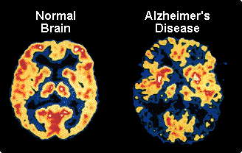
Need
Alzheimer’s Disease (AD) impacts 5.8 million people in the United States, 46.8 million worldwide¹
  Memory loss, confusion, loss of balance, etc.
How do we solve this?
  Tau hypothesis: tau protein supports microtubules in neurons, but tau clusters (caused by hyperphosphorylation) prevents this. Hyperphosphorylation could be caused by increased kinase activity and decreased phosphatase activity.
Footnotes
1 Krista Hillis. “Alzheimer’s Statistics - United States and Worldwide Stats.” BrainTest. Accessed 4 March 2020. https://braintest.com/alzheimers-statistics-throughout-the-united-states-and-worldwide/
A comparison of a normal brain to one affected by AD.

Slide 3
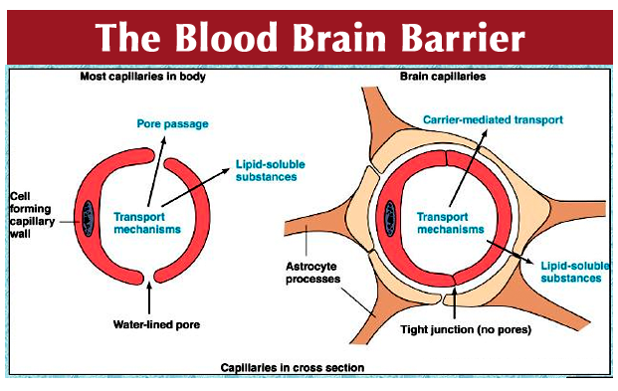
Challenges
Blood-Brain Barrier
  Regulates homeostasis
  Maintains proper neuronal function
  Protect central nervous system from toxins, pathogens, inflammation, injury, disease, etc.²
Ethical issues
  Injecting something directly into the brain
  Synthetic toggle switch may act differently in the brain environment
Footnotes
2 Richard Daneman and Alexandre Prat. “The Blood-Brain Barrier.” NCBI. January 2015. Accessed 4 March 2020. https://www.ncbi.nlm.nih.gov/pmc/articles/PMC4292164/
Notes:
2 https://www.ncbi.nlm.nih.gov/pmc/articles/PMC4292164/

Slide 4
Existing Methods
There is lots of ongoing research into treatment of alzheimer's
Currently there are several medications available³
  i.e. by breaking down pre-existing plaques in brain cells
Most treatments are focused on breaking down plaque in one way or another
But some focus on lowering the risk before a patient shows many symptoms
Footnotes
3 Gerardo Castillo and Alan D. Snow. “Specific saccharide compositions and methods for treating Alzheimer's disease and other amyloidosis.” 1998. Accessed 4 March 2020. https://patents.google.com/patent/US6037327A/en
Notes:
https://www.ncbi.nlm.nih.gov/pmc/articles/PMC4390027/
https://www.ncbi.nlm.nih.gov/pubmed/25651440
https://www.ncbi.nlm.nih.gov/pubmed/29653606

Slide 5
Synthetic Biology Based Solution
Start with a system-level description
A cell will be able to detect an increase in kinase levels and a decrease in phosphatase levels. A synthetic toggle switch will be used to regulate these levels.
Next ask, “What devices do we need?”
The synthetic toggle switch is the most complicated part of this design. Using coding sequences with promoters that trigger the copying of genes that break down kinase and build phosphatase, the levels will be regulated.
Then ask, “What parts can we use?”
We are currently looking into designing a synthetic toggle switch with CDS that cover the aforementioned steps.
Notes:
System-level: Alzheimer plaque goes in, broken down plaque comes out
Devices: Plaque breakdown device
Parts: Enzyme
http://parts.igem.org/Catalog

Slide 6
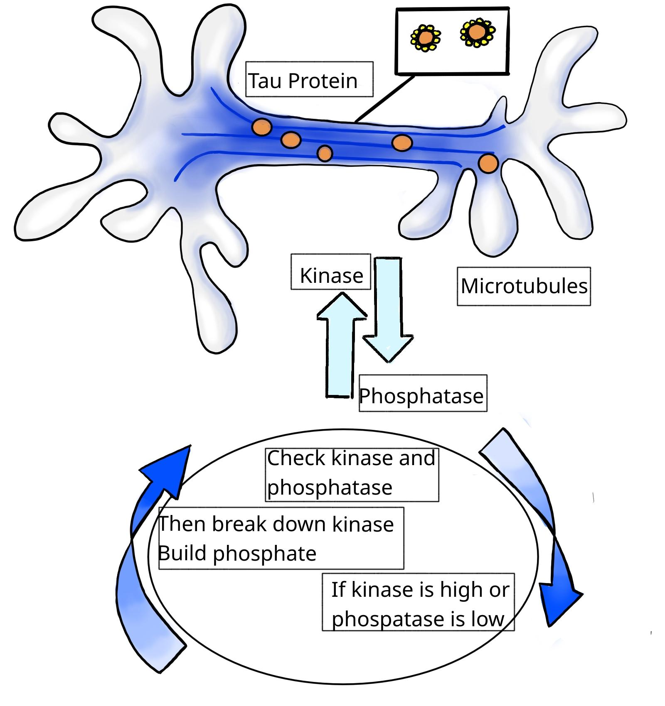

Slide 7
Ethical Considerations
Similar to “Challenges:”
  Limitations of injecting something into someone’s brain?
  Regulating synthetic toggle switch inside of a subject?
  Further degenerative issues caused by unknown substances in the brain?
  Multiple hypotheses for AD

Slide 8
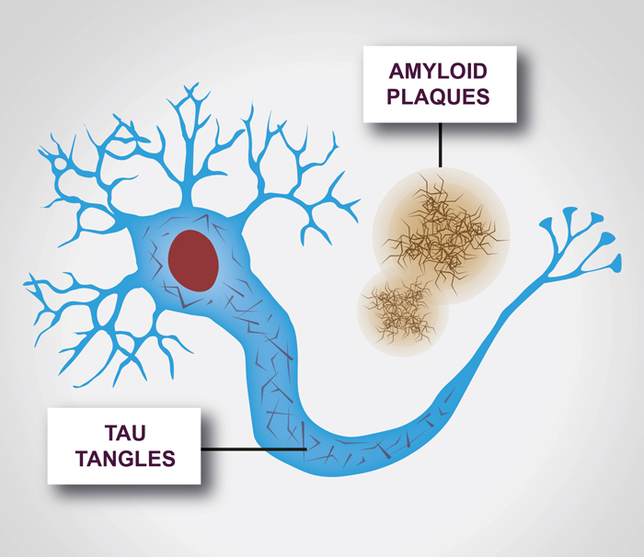
Blind spots
Effect of targeting kinase/phosphatase activity on other factors of the brain
  Amyloid deposits?
  Example of how exact cause of AD is not determined
Individual responses to the synthetic toggle switch may vary
The presence of both amyloid plaques and tau clusters can lead to AD.
Notes:
Are there different proteins that influence Alzheimer’s?
Are there similarly shaped proteins in the body?
Drug delivery → stomach? Brain injection? If so, BBB?

