Slide 1


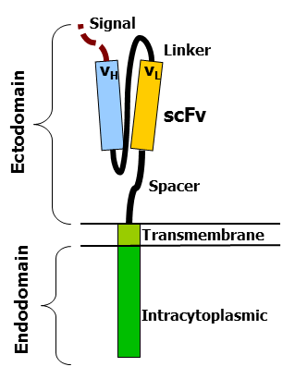
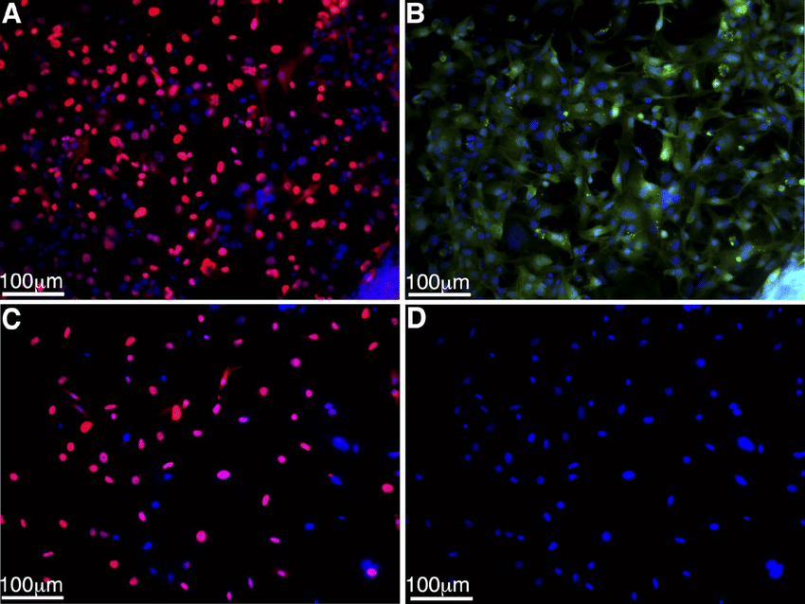
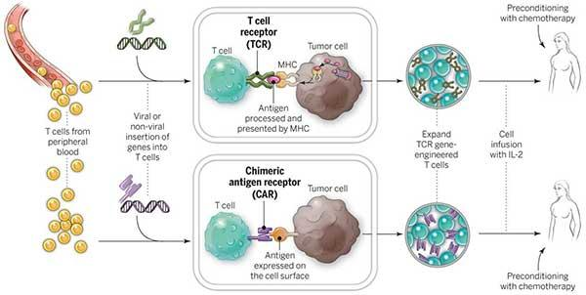
Potential of CAR T-Cells
Crystalia Liaw, Matthew Japati, Sinarmas World Academy, Indonesia
Patrick Holec, Massachusetts Institute of Technology
Introduction & Project Details
Our Idea
About your topic: Humanity is still far away from “curing” cancer but CAR T-cells therapy may just bring us a step closer. Unfortunately, CAR T-cells are mainly only used for leukemia & lymphoma since they target the CD19 antigen. Moreover, CD19 antigen is also present in B-cells which leads to the death of B-cells alongside tumors. Our team explores the full potential of using CAR T-cell in various ways such as brain tumors & immunology disorders.
CAR T-Cells & How they work: By using CAR T-Cells therapy, we use our own immune system to fight off the tumors. The process starts by isolating the leukocytes through leukocyte apheresis. T-cells collected are stimulated & treated with cytokine interleukin 2 (IL-2) & anti-CD3 antibodies. It will be then be purified & transduced with genetic material to encode for CAR (Chimeric Antigen Receptors) through CRISPR/ retroviral vector. These T-cells will be injected to your bloodstream where receptors will bind with specific antigens & destroys the cell through cell proliferation, toxins release & secretion of factors affecting other cells such as cytokines, interleukins & growth factors. The main parts of a CAR T-Cell are: extracellular antigen recognition domain, hinge region, transmembmbrane domain, and intracellular T-cell signaling domain
Our Idea: Applying CAR T-Cells therapy to target brain tumors and penetrates the blood-brain barrier ( as it will be easier for our own T-cell to penetrate the blood-brain barrier)
A potential antigen we can target for brain tumors are the SV40 antigen present in a variety of human neoplasms such as mesothelioma, osteosarcoma and brain tumors
Credit: National Cancer Institute
Structure of CAR T-cells
Credit: Mxpule
SV40 large T-antigen
Credit: Charles R Long

Slide 2
Potential of CAR T-Cells
Crystalia Liaw, Matthew Japati, Sinarmas World Academy, Indonesia
Patrick Holec, Massachusetts Institute of Technology
Challenge for Next Year’s Team
About This Year’s Team
Identify key needs for advancing the project or lessons learned from this experience
  Starting a project can be scary sometimes but keep in mind that your teachers, your mentor, your partners, your parents are all supporting you through it. Starting is the scariest part but that shouldn’t stop you from doing it!
  Explore the mysterious. Don’t be afraid to really explore topics that may be out of your comfort zone/knowledge area. I’ve learned that by being comfortable with the mysterious and always asking questions to your mentor will advance your project.
  Specify your focus! Don’t put your focus on such a broad topic, instead, choose something that is specific.
If your team doesn’t continue the project next year, but it was picked up by another school’s team, what experiment would you want them to do? (Be specific so they can actually try it!)
  Immunology disorders! I think immunology disorders are such interesting topic to really dive deep into. Disorders such as x-linked agammaglobulinemia occurs because of a genetic mutation that decreases the amount of antibodies in your body. Using CAR T-cell as a basis of understanding the immune system and genetic engineering, trying to find ways to code the genes will be an interesting area to experiment with.
We both are Grade 9 students curious about the workings of our human body, that’s what we started with. Last 1-2 years, we joined an extracurricular activity in our school that allows us to explore bioengineering and observe our seniors in participating the BioBuilder project development. We’ve learned so much when working with other people but we’ve never fully participate in BioBuilder and create a project ourselves so this was really exciting.
We got tremendous help from our teachers in school in terms of communication and mentors for directing us to the right way.
References & Acknowledgements
Thanks to whomever should be acknowledged in this research.
Huang H, Reis R, Yonekawa Y, Lopes JM, Kleihues P, Ohgaki H. Identification in human brain tumors of DNA sequences specific for SV40 large T antigen. Brain Pathol. 1999 Jan;9(1):33-42. doi: 10.1111/j.1750-3639.1999.tb00207.x. PMID: 9989448.
Singh AK, McGuirk JP. CAR T cells: continuation in a revolution of immunotherapy. Lancet Oncol. 2020 Mar;21(3):e168-e178. doi: 10.1016/S1470-2045(19)30823-X. PMID: 32135120.
And mentor guidance, Patrick Holec

