Slide 1


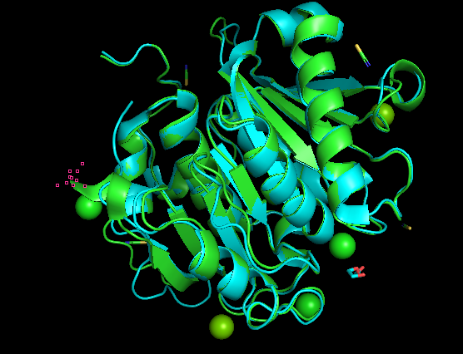

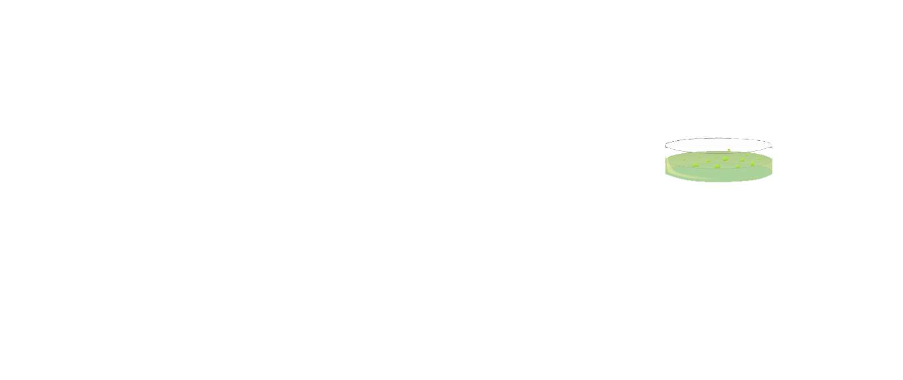


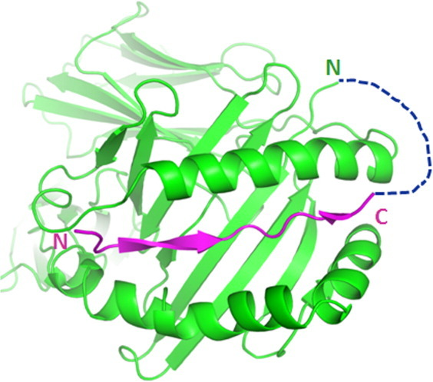


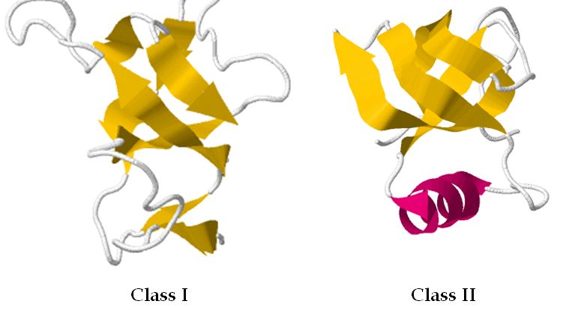


Hydrolysis of PET by Fusing Modified Hydrophobins to Cutinase
Jesus Espino, Sofia Hernandez, Isaac Rodarte, Michelle Palma, Edgar Ruiz, Anakaren Garcia, Carlos Araujo, Christopher Kuffner, Guadalupe Tapia
Silva Health Magnet, El Paso, TX
Introduction to the Enzymes
Inclusion Bodies
Experiment Procedure
PET hydrolases have been a major focus of study in enzymatic degradation of polyethylene terephthalate (PET), one of the most widely used plastics in the world. Various enzymes have been tested to degrade the highly crystallized PET, albeit at a severely limited efficiency. For this project, we chose to look into leaf-branch compost cutinase (LCC), an enzyme particularly suited toward these ends given its relatively high PET hydrolysis activity and thermostability.
One of the major downsides to this method is the formation of inclusion bodies as hydrophobins form disulfide bridges between cysteine residues amongst themselves when expressed. A potential solution could be to replace the unnecessary cysteine residues of a Class I hydrophobin.
1)
LCC +
HYD1
C- Terminus
2)
28°C
3)
Experiments Planned
A model alignment of LCC (Green) and Thc_Cut1 (Blue)
4)
Incubation
Protein Fusion to Hydrophobins
Preparation of a plasmid for the fusion protein of LCC and HYD1 hydrophobin.
E. coli is cultivated to be used for expression.
E. coli is transformed with the plasmid
E. Coli is incubated with various times, temperatures, and reagents
Bacteria is harvested, lysed, and centrifuged
Hydrolysis is performed by incubating PET films with the lysate in buffer
The films are washed and measured to determine the corresponding depolymerization rate.
Centrifuge
In addition, fusing the enzyme with another protein exhibiting hydrophobic properties can significantly increase the hydrolytic capabilities. In one paper, a similar cutinase (Thc_Cut1) was fused with a small selection of hydrophobins, improving hydrolysis 16-fold over the level with the free enzyme. Hydrophobins are small, cysteine-rich proteins mostly found in fungi that can naturally absorb to hydrophobic surfaces.
Also included is the bacterial hydrophobin BSIA
5)
Centrifuge
Example of two proteins fused by a protein linker
72°C
(12 Hours)
Class I:
Diverse range of amino acids
Has one, varied inter-cysteine spacing
      Ex. DewA and HYD1
Class II:
Conserved amino acid sequence
Have short, regular inter cysteine spacing
    Ex. HFB4 and HFB7
6)
PET Film
100 mL tube
7)
washed and measured
Structural differences of Class I and II hydrophobins

Slide 2
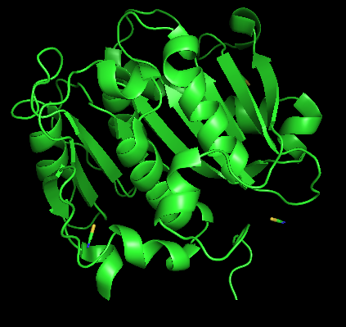
Hydrolysis of PET by Fusing Modified Hydrophobins to Cutinase
Jesus Espino, Sofia Hernandez, Isaac Rodarte, Michelle Palma, Edgar Ruiz, Anakaren Garcia, Carlos Araujo, Christopher Kuffner, Guadalupe Tapia
Silva Health Magnet, El Paso, TX
Challenge for Next Year’s Team
About This Year’s Team
To further advance with this project, we would really need to be able to get together in a lab and fully test our experiment. I believe we did the most we could with what we had but being able to get together would make this project easier.
If anyone were to pick up this project next year, we hope that they incorporate elements of circular permutation to further improve the protein
We are students from Silva Health Magnet in El Paso, TX, looking to make the world a cleaner place. With this BioBuilder project, we are targeting the environment to make it a safer and more sustainable place and enjoy working on an interesting project to help contribute to current efforts of doing just that.
References & Acknowledgements
1. Tournier, V., Topham, C.M., Gilles, A. et al. An engineered PET depolymerase to break down and recycle plastic bottles. Nature 580, 216–219 (2020).
2. D. Ribitsch et al., Enhanced cutinase-catalyzed hydrolysis of polyethylene terephthalate by covalent fusion to hydrophobins. Appl. Environ. Microbiol. 81, 3586–3592 (2015).
3. Cheng Y, Wang B, Wang Y, et al. Soluble hydrophobin mutants produced in Escherichia coli can self-assemble at various interfaces. Journal of Colloid and Interface Science. 2020;573:384-395. doi:10.1016/j.jcis.2020.04.012
4. Hobley, L., Ostrowski, A., Rao, F. V., Bromley, K. M., Porter, M., Prescott, A. R., ... & Stanley-Wall, N. R. (2013). BslA is a self-assembling bacterial hydrophobin that coats the Bacillus subtilis biofilm. Proceedings of the National Academy of Sciences, 110(33), 13600-13605.
5. Cheng Y, Wang B, Wang Y, Zhang H, Liu C, Yang L, Chen Z, Wang Y, Yang H, Wang Z. Soluble hydrophobin mutants produced in Escherichia coli can self-assemble at various interfaces. J Colloid Interface Sci. 2020 Aug 1;573:384-395. doi: 10.1016/j.jcis.2020.04.012. Epub 2020 Apr 6. PMID: 32298932.
For circular permutation on the LCC enzyme, these two terminals would be joined, and an opening would be inserted elsewhere to provide some structural improvement

