Slide 1
Eutrophication System
Acton-Boxborough Regional High School
Problem
Eutrophication: excess nutrients causes toxic algal blooms → less oxygen in air and water, dead organisms, poor air and water quality
Solutions
Insert a phosphorus- absorbing gene into E.coli
Contain E.coli in buoys and place the buoys in water bodies with eutrophication
Authors: Julia Wu, Yuying Fan, Annabella Chen, Song Leav, Amanda Zhang, Abigail Dillon
Advisor: Aaron Mathieu

Slide 2

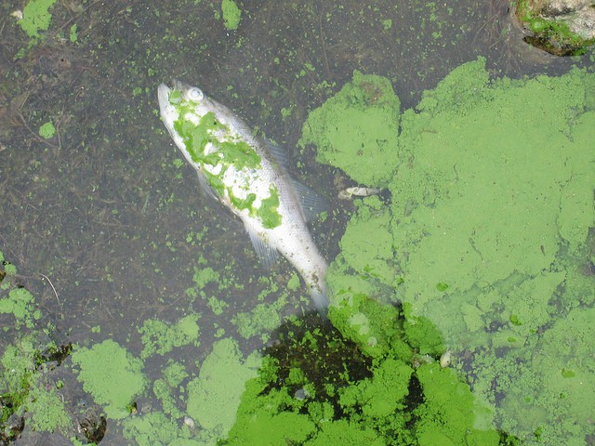
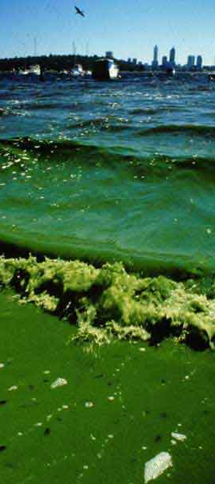

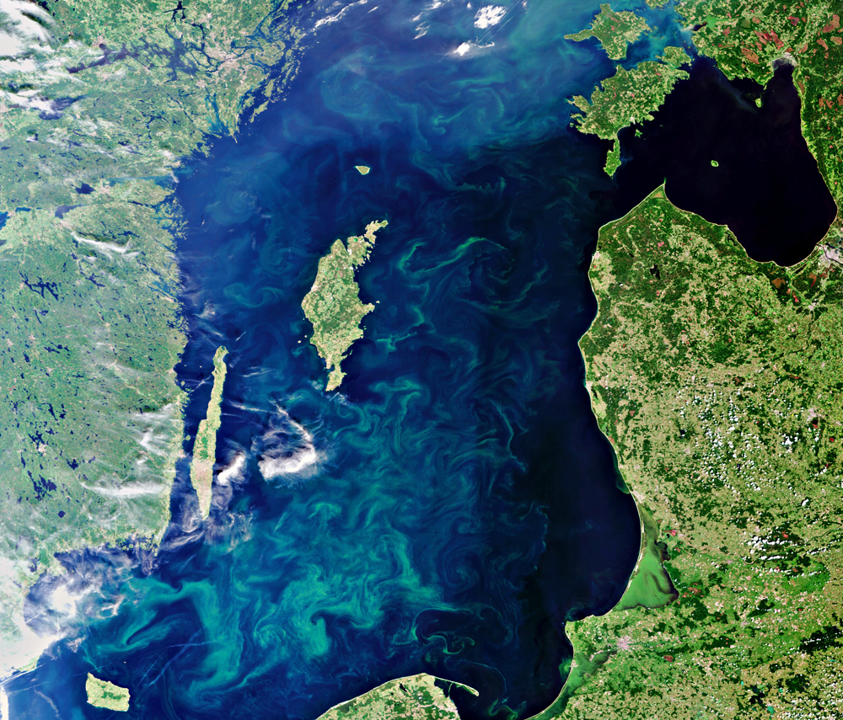

Slide 3
Eutrophication System Design
Acton-Boxborough Regional High School
ppk
ccdA
Terminator
BBa_J23100
ccdB
Repressible operator
PPHO89
Terminator
ccdB

Slide 4
Eutrophication System Testing
Acton-Boxborough Regional High School
Next Step: Testing ppk
  Current literature provides no definite claim supporting the efficacy of ppk
We plan to add E. coli containing the ppk gene into water tanks with different concentrations of phosphorus and track the change in phosphorus level in each daily.

Slide 5
Eutrophication System Testing
Acton-Boxborough Regional High School
Next Step: Testing ppk
  Control groups: water tanks with different levels of phosphorus; add normal E.coli
  Experimental groups: water tanks with different levels of phosphorus; add E.coli with the ppk gene
  Data Collection: use spectrophotometry to measure the level of phosphorus in each water tank daily
  Statistical Analysis: determine if there is a significant decrease in phosphorus level over time in the ppk tanks

Slide 6
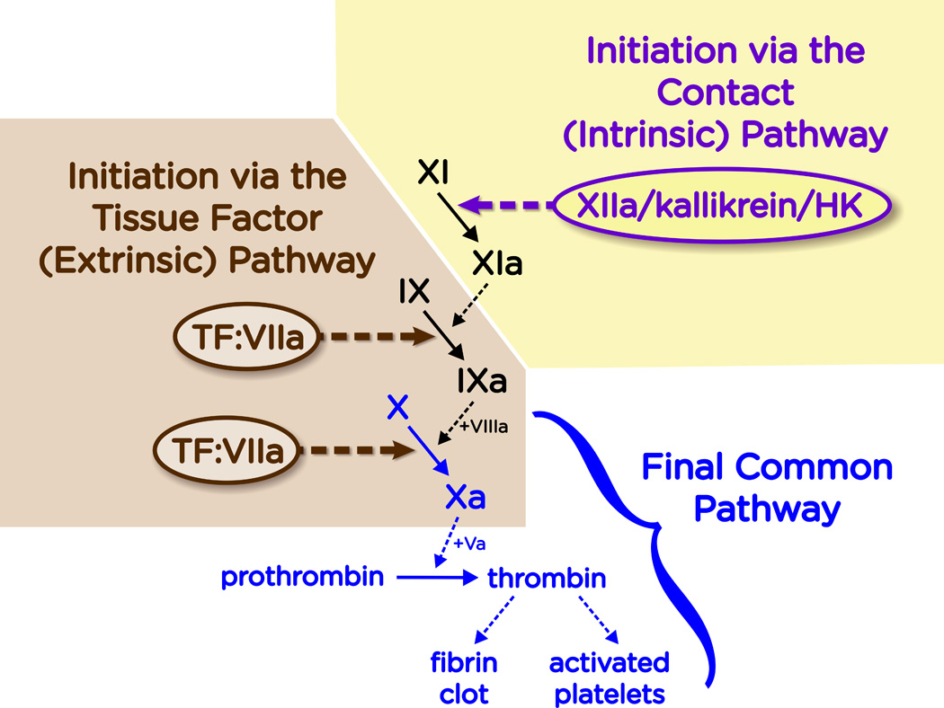
Closing Wounds System
Acton-Boxborough Regional High School
Problem:
Over bleeding is an issue for hemophiliacs, as their ability to blood clot is significantly reduced due to lack of clotting factors
Solution:
Create bacterial applicant using E. coli K12 that produces Factors VIII, IX, and X to speed up blood clotting
Authors: Nitya Aryasomayajula, Soumili Dey, Sam Dillon, Anne Fu, Apurva Joshi, Paul Kim, Rohit Kommuru, Alex Russell, Julia Wu Advisor: Mr. Mathieu

Slide 7
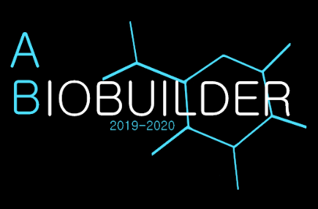
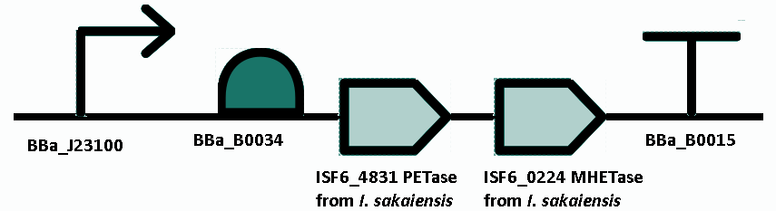
Closing Wounds System
Acton-Boxborough Regional High School
System Parts:
Further Investigation:
Type of applicant - how to get system into the body and through which microbiome
Potential kill switch and/or gene to prevent overproduction of factors
Potential side effects
2
8
3
4
5
6
7
1
1: potential kill switch
2: promoter
3: RBS
4: Factor 8 (F8) gene
5: Factor 9 (F9) gene
6: Factor 10 (F10) gene
7: GFP
8: terminator
Acknowledgements: We would like to thank Mr. Mathieu for guiding and advising us with our project. We would also like to thank our mentors Tatiana Netterfield and Chris Kuffner for helping us refine our ideas and providing suggestions to improve our project.

Slide 8
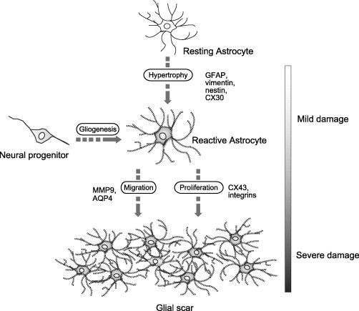
Glial Scars System
Acton-Boxborough Regional High School
Problem:
Gliosis in astrocytes prevents recovery from CNS injury and leads to permanent damage. Currently difficult to quicken recuperation from nerve damage
Solution:
Use siRNA to prevent GFAP, vimentin, CX30 and nestin from hyperactivating astrocytes.
Anya Mittal, Arjun Saulnier, Hannah Tandang, Grace Xu, Mariana Maranga, Srinidhi Thirumurugaram, William Klatte

Slide 9
Glial scars are temporarily blocked and are no longer formed past the threshold.
GFAP
AND gate is introduced to cause siRNA to temporarily interfere with the four proteins shown on the right, and keep them from activating an astrocyte
CX30
siRNA
?
Vimentin
Nestin
Further Investigation: Find out what causes the siRNA to latch onto the mRNA, and blocks it from entering the ribosome so the proteins are not being produced.
Acknowledgements: We would like to thank our mentors Tatiana Netterfield and Chris Kuffner for providing us with external resources as well as our advisor Mr.Mathieu for advising us.

