Slide 1
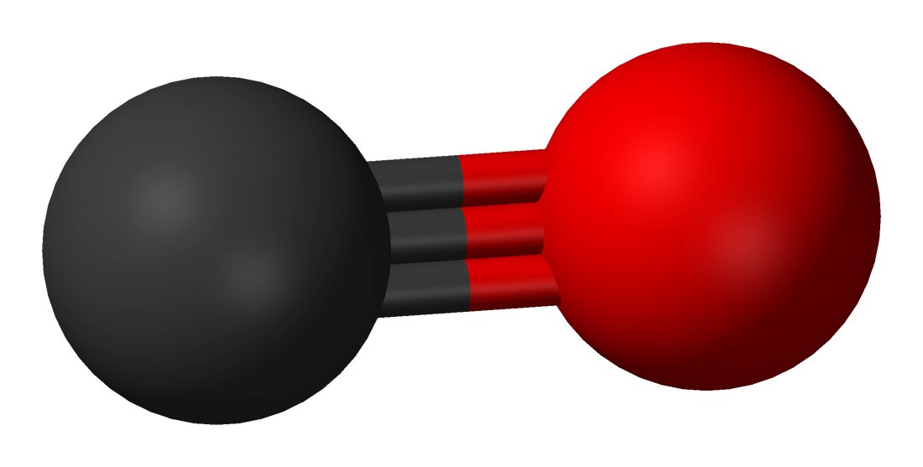
CO’ Later!
Pratheek Kuimanda, Jonathan Cheng, Iltikin Wayet, Avi Janarthanan, Sam Feng, Akshay Godhani

Slide 2

What is CO ’Later?
To create a clip-on that contains bacteria that binds to CO molecules and releases a smell. Our goal is to save countless lives from the silent killer, Carbon Monoxide and limit the amount of accidental lives lost, hence the name, “CO ‘Later”.
We came upon this idea when we heard about leaked carbon monoxide in homes after the first bomb cyclone hit New England in November and caused mass spread power outages

Slide 3
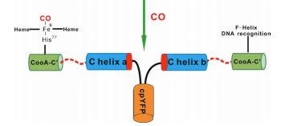
Our Design:
Input
(CO Molecules)
CO’ Later & CooA/ Rhodospirillum rubrum
Output
(Banana Odor)
CO’ Later
Constitutive
Promoter
Ribosome Binding Site
Terminator
CO’ Later
GFP (green fluorescent protein)
Notes:
Input -> gene-> output (talk about it)
Constitutive promoter- will always remain searching for CO molecules
After CooA there would be a green color
Rhodospirillum rubrum modified cooA with smell integrated into it (CO later)<-> (Banana smell (ATF1))
GFP- it tells us that the bacteria on the clip is still alive and will have a green flourescent color

Slide 4
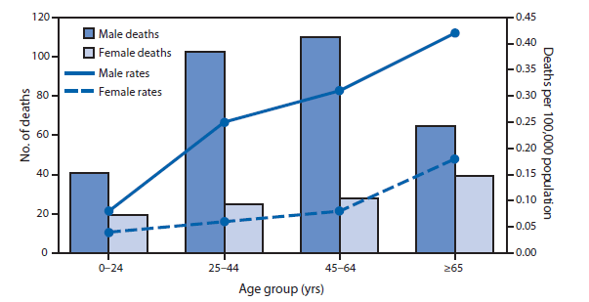
Stats on CO Poisoning
2,244 deaths in 2010-2015, unintentional deaths
People didn’t realize that CO was present this is a reason that CO is called the Silent Killer
393 deaths were reported in 2015
Of the deaths 36%, occurred during winter (December, January, and February
54% of deaths occured at home
From 1999-2012, it was second most non-medicinal poisoning deaths in the US

Slide 5
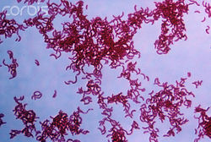
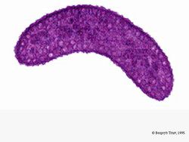
What is Rhodospirillum rubrum
Rhodospirillum rubrum, a photosynthetic bacterium, responds to Carbon Monoxide by activating CooA, a protein that is necessary to the CO-oxidation system.
This bacterium plays an important role in activating our odor, ATF1, which has a banana like smell.
  When the the bacteria senses the CO molecules it activates a sensor to stimulate a reporter and release the scent.

Slide 6
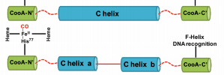
How did we solve this problem?
We used Rhodospirillum rubrum as our bacterium
It recognizes the Carbon Monoxide molecules, and triggers a mechanism that will release a scent detectable to the victim
This could drastically reduce the death toll in accidental CO poisoning
It ensures a more safe and reliable way to detect the effects of the silent killer
The smell activated by our “CO’ Later” coding sequence would release a banana like odor
We also used a GFP, in our case a green fluorescent color would be inserted into our modified genes to show that the bacteria are still alive when glowing green.

Slide 7
Works Cited
Shelver, Daniel. “CooA, a CO-Sensing Transcription Factor
from Rhodospirillum Rubrum, is a CO-Binding
Heme Protein.” Proceedings of the National Academy of Science, US National Library of Medicine, 14 Oct. 1997, www.ncbi.nlm.nih.gov/pmc/articles/PMC23420/.
http://web.mst.edu/~microbio/BIO221_2000/Rhodospirillum_rubrum.html
“QuickStats: Number of Deaths Resulting from Unintentional Carbon Monoxide Poisoning,* by Month and Year — National Vital Statistics System, United States, 2010–2015.” QuickStats: Number of Deaths Resulting from Unintentional Carbon Monoxide Poisoning,* by Month and Year — National Vital Statistics System, United States, 2010–2015, Government, 3 Mar. 2017, www.cdc.gov/mmwr/volumes/66/wr/mm6608a9.htm.
Wang, Jing, et al. “A Selective Fluorescent Probe for Carbon Monoxide Imaging in Living Cells.” Biosensors, 28 Aug. 2012, pp. 9652–9656., doi:10.1002/anie.201203684.
Puranik, Mrilalini, et al. “Dynamics of Carbon Monoxide Binding to CooA.” The Journal of Biological Chemistry, vol. 279, no. 20, 25 Feb. 2004, pp. 21096–21108., doi:10.1074/jbc.M400613200.
Yuan, Lin, et al. “Lighting up Carbon Monoxide: Fluorescent Probes for Monitoring CO in Living Cells.” Biosensors, 13 Dec. 2012, pp. 1628 – 1630., doi:10.1002/anie.201208346

