Slide 1


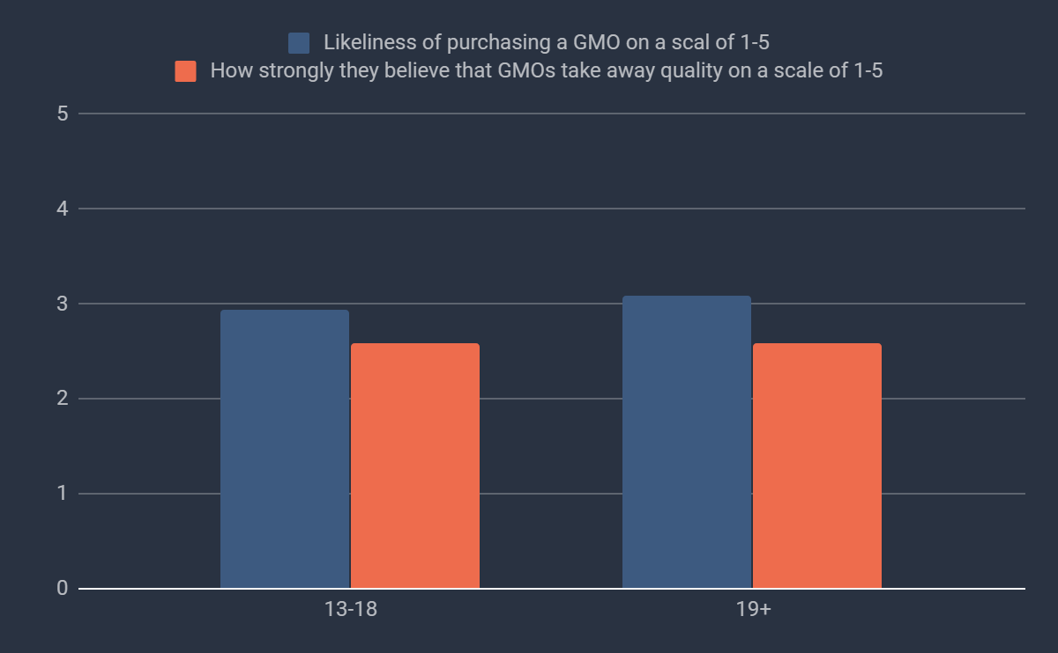
(—THIS SIDEBAR DOES NOT SHOW—)
DESIGN GUIDE
This PowerPoint 2011 template produces a 40.97”X23.04” presentation poster. You can use it to create your research poster and save valuable time placing titles, subtitles, text, and graphics.
We provide a series of YouTube tutorials that will guide you through the poster design process and answer your poster production questions. To view our template tutorials, go online to https://www.youtube.com/playlist?list=PLBz4JvE0AKmweXsMNGeyRXgWgN_lj_b5L
If you are uploading ahead of time, please go to our website:
http://www.eposterboards.com/eposterupload/
Need assistance? Call 617-588-3508 option 2
QUICK START
Title, Authors, and Affiliations
Start designing your poster by adding the title, the names of the authors, and the affiliated institutions. You can type or paste text into the provided boxes. The template will automatically adjust the size of your text to fit the title box. You can manually override this feature and change the size of your text.
TIP: The font size of your title should be bigger than your name(s) and institution name(s). The smallest font size should be 28 points.
Adding Logos / Seals
Most often, logos are added on each side of the title. You can insert a logo by dragging and dropping it from your desktop, copy and paste or by going to INSERT > PICTURES. Logos taken from web sites are likely to be low quality when printed. Zoom it at 100% to see what the logo will look like on the final poster and make any necessary adjustments.
TIP: If there is a conference website, you can pull logos from there. Please keep in my that we will be adding navigational buttons or a kiosk menu button on the right side of the slides. Please make the appropriate space for that.
Photographs / Graphics
You can add images by dragging and dropping from your desktop, copy and paste, or by going to INSERT > PICTURES. Resize images proportionally by holding down the SHIFT key and dragging one of the corner handles. For a professional-looking poster, do not distort your images by enlarging them disproportionally.
QUICK START (cont.)
How to change the template color theme
    You can easily change the color theme of your poster by going to the DESIGN menu, click on COLORS, and choose the color theme of your choice. You can also create your own color theme.
You can also manually change the color of your background by going to VIEW > SLIDE MASTER. After you finish working on the master be sure to go to VIEW > NORMAL to continue working on your poster.
How to add Text
    The template comes with a number of pre-formatted placeholders for headers and text blocks. You can add more blocks by copying and pasting the existing ones or by adding a text box from the HOME menu.
Text size
Adjust the size of your text based on how much content you have to present. The default template text offers a good starting point. The text should not be less than 28 points.
How to add Tables
  To add a table from scratch go to the INSERT menu and
  click on TABLE. A drop-down box will help you select rows and columns.
You can also copy and a paste a table from Word or another PowerPoint document. A pasted table may need to be re-formatted by RIGHT-CLICK > FORMAT SHAPE, TEXT BOX, Margins.
Graphs / Charts
You will have to convert your graphs/charts/formulas/equations into images (.jpg or .png and insert them into your presentation. This will help maintain the values as different operating systems can distort your work.
Save your work
Save your template as a lastname.firstname and as a .pptx file.
AliveLIGHT™: Engineering a natural light generating machine
Cate Barton, Anya Gemos, Meredith Hoole, Jackson Lundberg, Trey Marcantonio, Kenneth Moore, Amy Murrant-Johnson, Naama Perliger, and Ian Wood
Tyngsborough High School BioBuilderClub
Abstract
Introduction
Candles and light bulbs are commonly purchased forms of illumination, even though these lighting options pose potential health risks including the release of toxic heavy metals, susceptibility to contact burns, and an increased risk of fire. Our product seeks to replace these more hazardous and energy-consuming options with a self-sustaining biological desk lamp that lights up at night and recharges during the day, equipped with a gas release valve and enclosed in shatter-proof glass. This allows for a more sustainable and eco-friendly method for natural luminescence. By transforming the well-characterized bread yeast Saccharomyces cerevisiae with a copper inducible promoter that regulates the expression of firefly luciferase, the goal of engineering a sustainable, natural light source will be accomplished. This system will be constructed through plasmid design, assembly, and integration, followed by evaluation of luminescence, niche engineering, and system optimization. Here, work towards plasmid assembly is shown. This phase will require amplification of the copper inducible promoter and luciferase-containing vector, Gibson assembly of PCR products, and transformation of yeast. In preparation for this phase, a proof of concept transformation was conducted resulting in the successful expression of tryptophan in red, orange, yellow, and white color variants of yeast.
Batteries are one of the most underestimated threats to the prospect of a green world. When batteries undergo decomposition in landfills they release heavy metals such as mercury, lead, nickel, cadmium, and lithium into the environment. These metals can render surrounding soil infertile to life. When these metals make their way into the surrounding water, they result in the death of organisms and eventual collapse of ecosystems. In addition, candles and light bulbs pose a threat to a safe community. Fires caused by unattended candles resulted in an annual average of, 82 civilian deaths, 800 civilian fire injuries, and $295 million in direct property, from the years 2011-2015 (Ahrens, 2017). Luckily, these problems can be solved with bioengineering. By employing the eco-friendly luciferase enzyme produced by the firefly Photinus pyralis, AliveLIGHT™, a self-sustaining biological desktop lamp, will safely produce light without any harmful byproducts. Luciferase catalyzes the pathway described in Figure I below. Light is produced when dioxetane, an intermediate molecule (not shown), breaks apart supplying oxyluciferin with the energy required to release photons. When Saccharomyces cerevisiae is genetically modified to express luciferase from the Fluc reporter, a similar lighting effect can be seen. When grown with the protist Chlamydomonas reinhardtii, an artificially engineered niche forms in which the carbon dioxide produced by the yeast is consumed by the protist while the ammonia produced by the protist is consumed by the yeast. This mutualistic relationship can be sustained by the introduction of a Master Mix containing 2% glucose, 10mM KNO₂, and ATP to support the luciferase expression.
GMO Survey
A survey was administered to determine what the general opinion is on GMOs. Overall, people who live around this area where neutral. Though, there were more people believe that GMOs take away from quality than people who didn't. There was also a slight variance based on age, as shown in the graph. Adults are slightly more likely to buy a GMO from the store.
Likeliness of purchasing a GMO on a scale of 1-5
How strongly one believes that GMOs take away quality on a scale of 1-5
Figure 1.

Slide 2
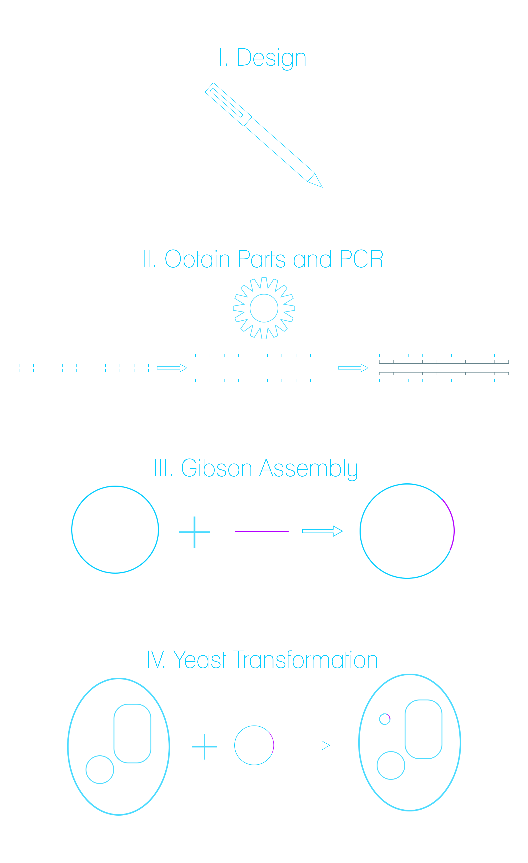
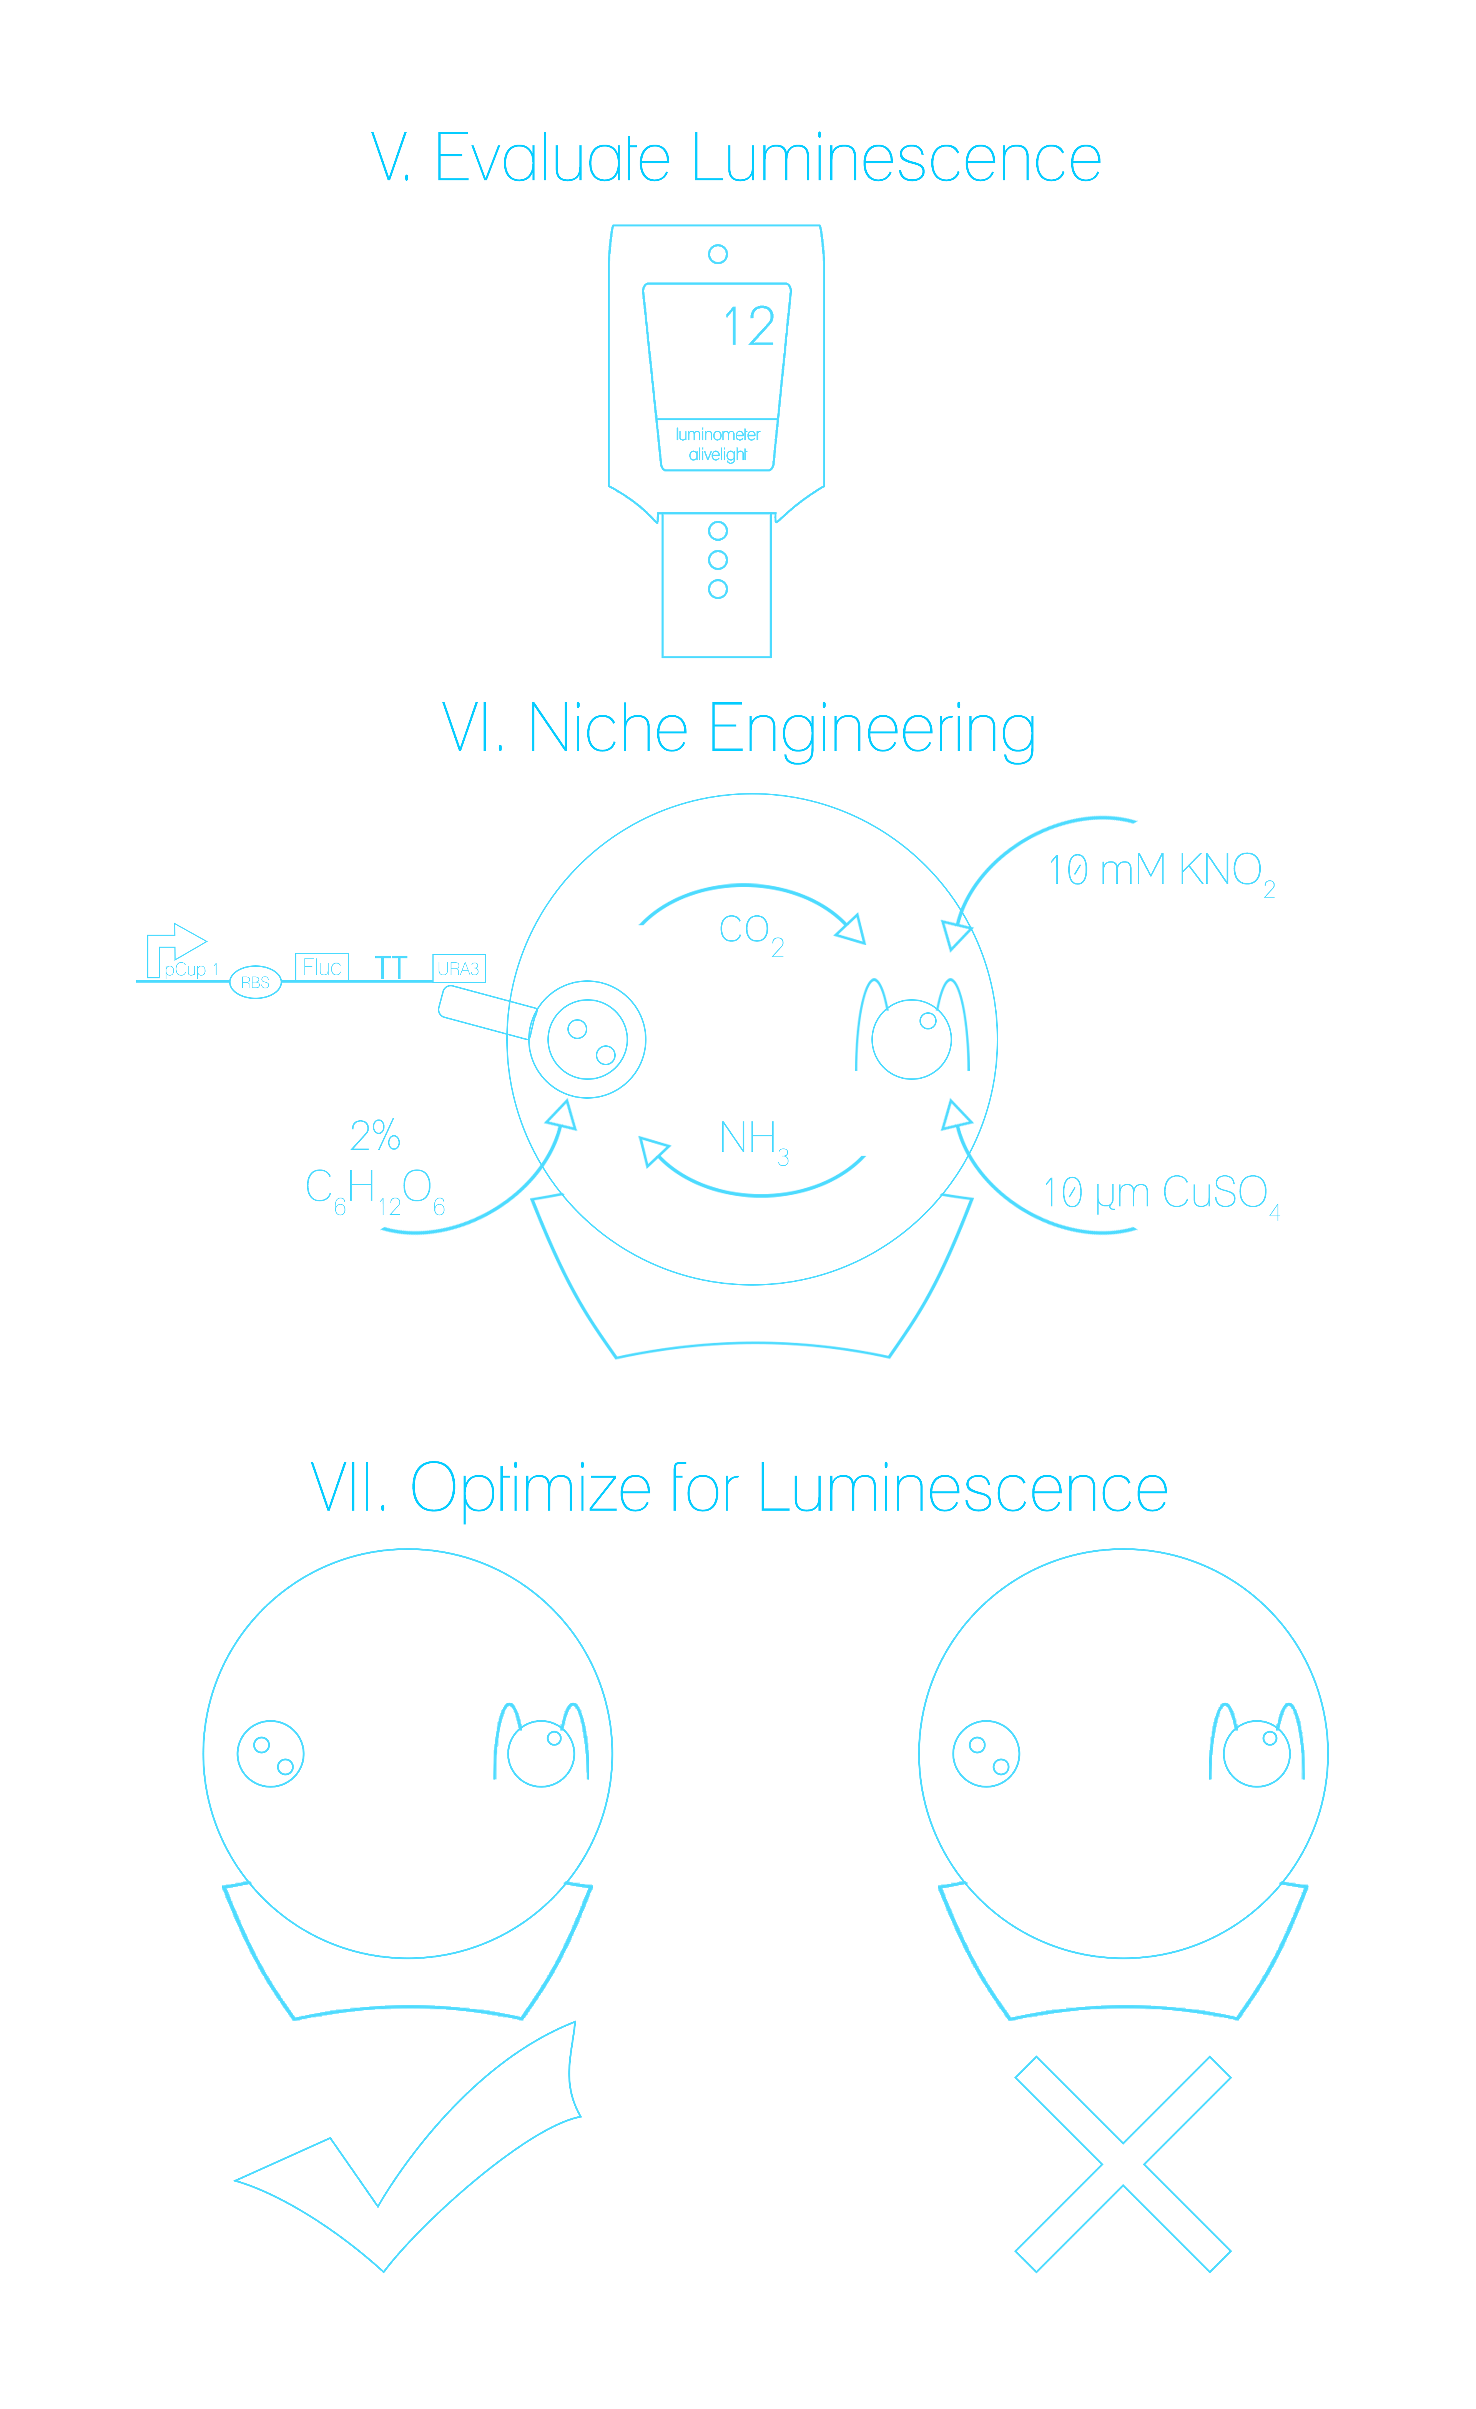
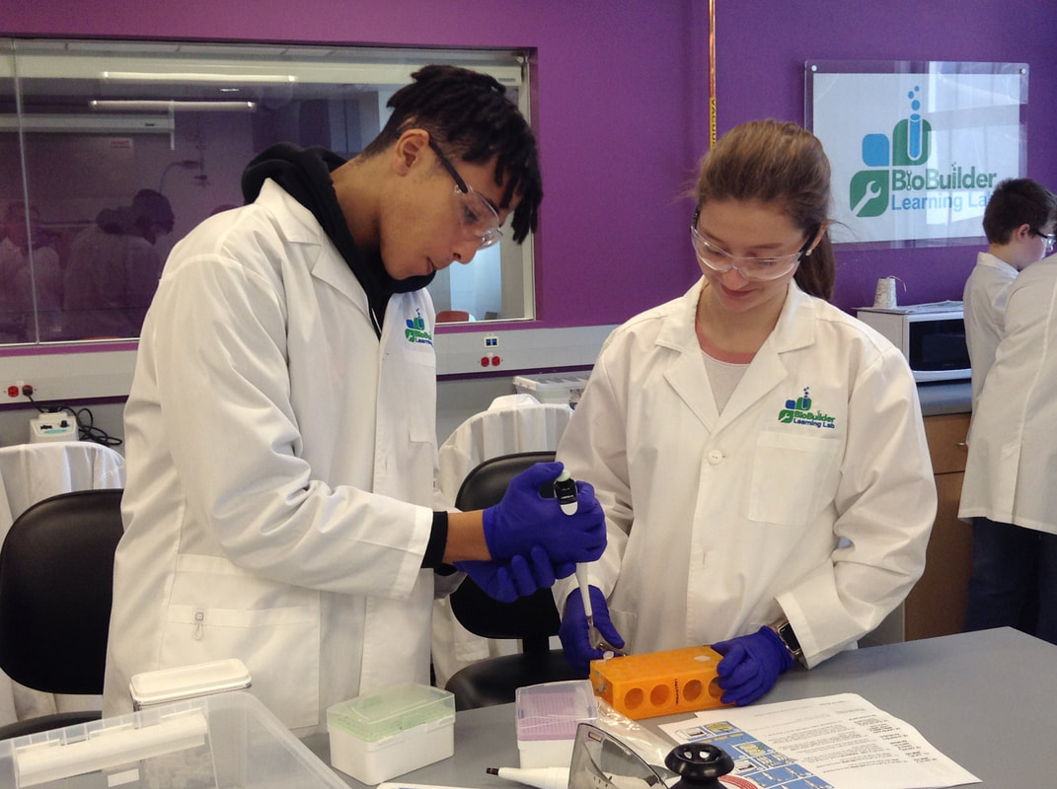
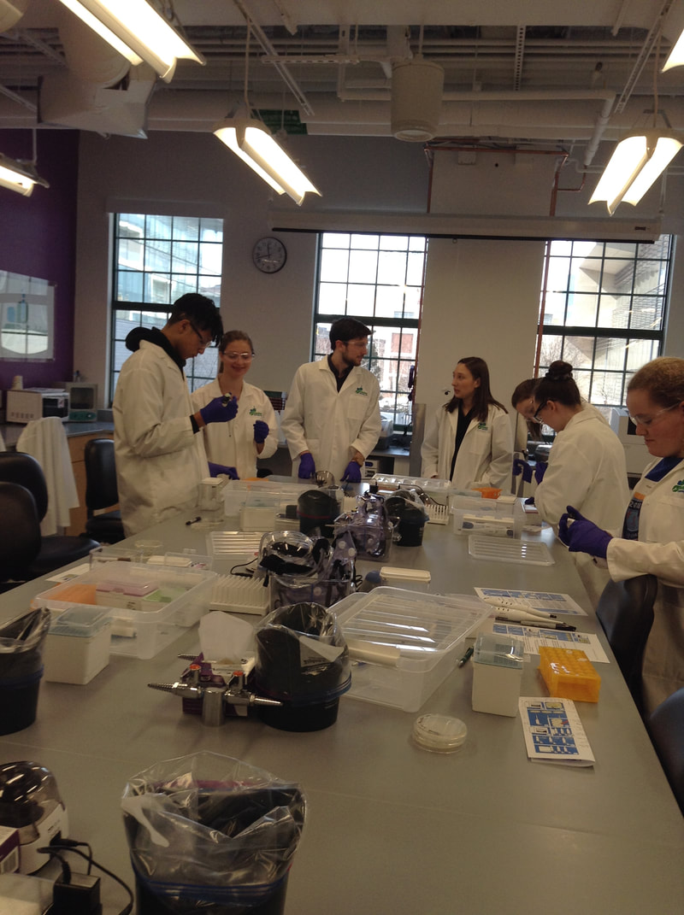
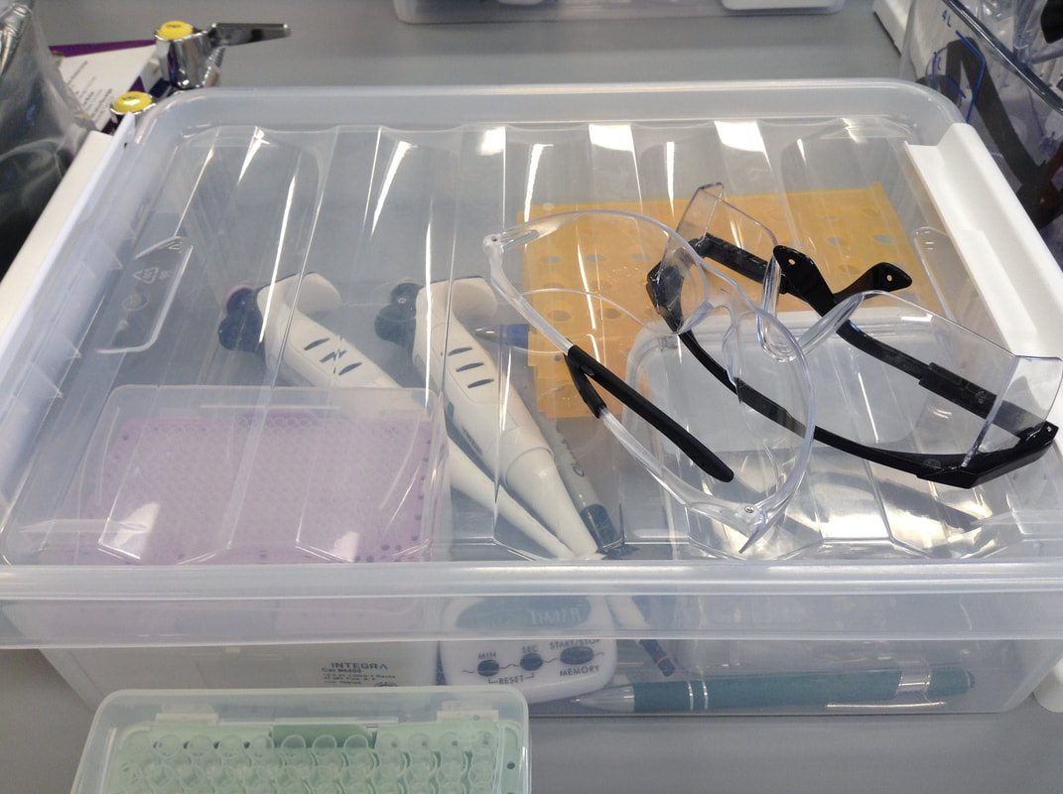
(—THIS SIDEBAR DOES NOT SHOW—)
DESIGN GUIDE
This PowerPoint 2011 template produces a 40.97”X23.04” presentation poster. You can use it to create your research poster and save valuable time placing titles, subtitles, text, and graphics.
We provide a series of YouTube tutorials that will guide you through the poster design process and answer your poster production questions. To view our template tutorials, go online to https://www.youtube.com/playlist?list=PLBz4JvE0AKmweXsMNGeyRXgWgN_lj_b5L
If you are uploading ahead of time, please go to our website:
http://www.eposterboards.com/eposterupload/
Need assistance? Call 617-588-3508 option 2
QUICK START
Title, Authors, and Affiliations
Start designing your poster by adding the title, the names of the authors, and the affiliated institutions. You can type or paste text into the provided boxes. The template will automatically adjust the size of your text to fit the title box. You can manually override this feature and change the size of your text.
TIP: The font size of your title should be bigger than your name(s) and institution name(s). The smallest font size should be 28 points.
Adding Logos / Seals
Most often, logos are added on each side of the title. You can insert a logo by dragging and dropping it from your desktop, copy and paste or by going to INSERT > PICTURES. Logos taken from web sites are likely to be low quality when printed. Zoom it at 100% to see what the logo will look like on the final poster and make any necessary adjustments.
TIP: If there is a conference website, you can pull logos from there. Please keep in my that we will be adding navigational buttons or a kiosk menu button on the right side of the slides. Please make the appropriate space for that.
Photographs / Graphics
You can add images by dragging and dropping from your desktop, copy and paste, or by going to INSERT > PICTURES. Resize images proportionally by holding down the SHIFT key and dragging one of the corner handles. For a professional-looking poster, do not distort your images by enlarging them disproportionally.
QUICK START (cont.)
How to change the template color theme
    You can easily change the color theme of your poster by going to the DESIGN menu, click on COLORS, and choose the color theme of your choice. You can also create your own color theme.
You can also manually change the color of your background by going to VIEW > SLIDE MASTER. After you finish working on the master be sure to go to VIEW > NORMAL to continue working on your poster.
How to add Text
    The template comes with a number of pre-formatted placeholders for headers and text blocks. You can add more blocks by copying and pasting the existing ones or by adding a text box from the HOME menu.
Text size
Adjust the size of your text based on how much content you have to present. The default template text offers a good starting point. The text should not be less than 28 points.
How to add Tables
  To add a table from scratch go to the INSERT menu and
  click on TABLE. A drop-down box will help you select rows and columns.
You can also copy and a paste a table from Word or another PowerPoint document. A pasted table may need to be re-formatted by RIGHT-CLICK > FORMAT SHAPE, TEXT BOX, Margins.
Graphs / Charts
You will have to convert your graphs/charts/formulas/equations into images (.jpg or .png and insert them into your presentation. This will help maintain the values as different operating systems can distort your work.
Save your work
Save your template as a lastname.firstname and as a .pptx file.
AliveLIGHT™: Engineering a natural light generating machine
Cate Barton, Anya Gemos, Meredith Hoole, Jackson Lundberg, Trey Marcantonio, Kenneth Moore, Amy Murrant-Johnson, Naama Perliger, and Ian Wood
Tyngsborough High School BioBuilderClub
Flow Chart
Methods
A microfuge tube was labeled “No DNA” and 500μL of EZ - Solution I was added to it. A sterile inoculating loop was then used to transfer an isolated white colony of yeast into the “No DNA” tube before the loop was discarded into a waste receptacle for decontamination. The “No DNA” tube was swirled in order to form a mixture of the EZ - Solution I and yeast and then placed into the microcentrifuge. A separate microfuge tube known as the “blank” tube was filled with 500μl of water and placed opposite of the “No DNA” tube on the microcentrifuge in order to balance out the apparatus. Once balanced properly, the microcentrifuge was run for 30 seconds on full speed in order to properly mix the contents of the “No DNA” tube. The microcentrifuge separated the contents of the “No DNA” tube after the 30 seconds, into white pellet of yeast and its associated supernatant. The majority of the supernatant was then removed using a pipet and disposed of in a waste receptacle. The white pellet of cells within the “No DNA” tube were resuspended with 100μL of EZ - Solution II to form a homogeneous solution. A sterile microfuge tube was then labeled “crtYB* DNA” and 5μL of DNA was added to it. 50μL of cells from the “No DNA” tube were added to the “crtYB* DNA,” resulting in each tube containing 50μL of suspended yeast cells. 500 μL of EZ - Solution III was added to both tubes using a pipet with sterile tips for each tube. The two tubes were then incubated at 30°C for an hour, periodically being flicked to prevent any of the contents from settling. Two Petri dishes were then labeled on the media side as NO DNA/ colony color, and crtYB* DNA/colony color along with our initials and the date. 200μL of each sample was then aliquoted onto the media of each appropriate Petri dish. The samples were then spread evenly across the petri dish using a sterile spreader. Both the spreader and microfuge tubes were then discarded, to be decontaminated. The two petri dishes then incubated, media side up, for 7 days at room temperature. The colonies of each color yeast were then counted and recorded after the 7 day incubation period.
Figure 2.
Figure 3. Lab work at the Learning Lab at Lab Central, hosted by BioBuilder (2.22.19)

Slide 3
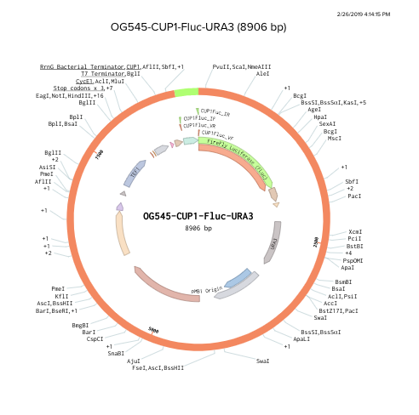
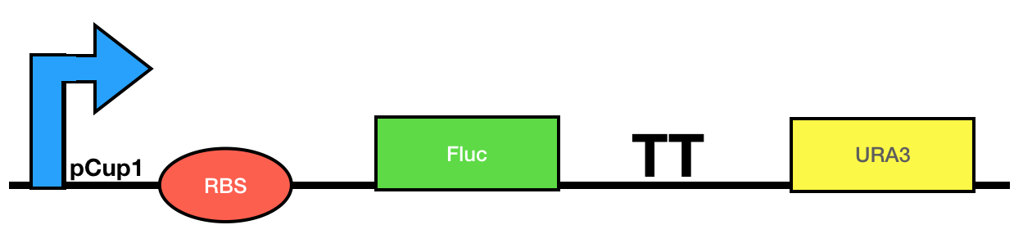
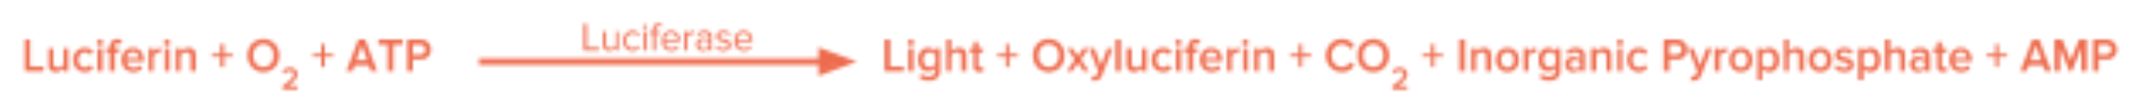
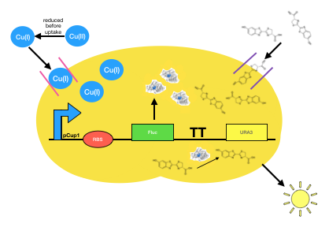
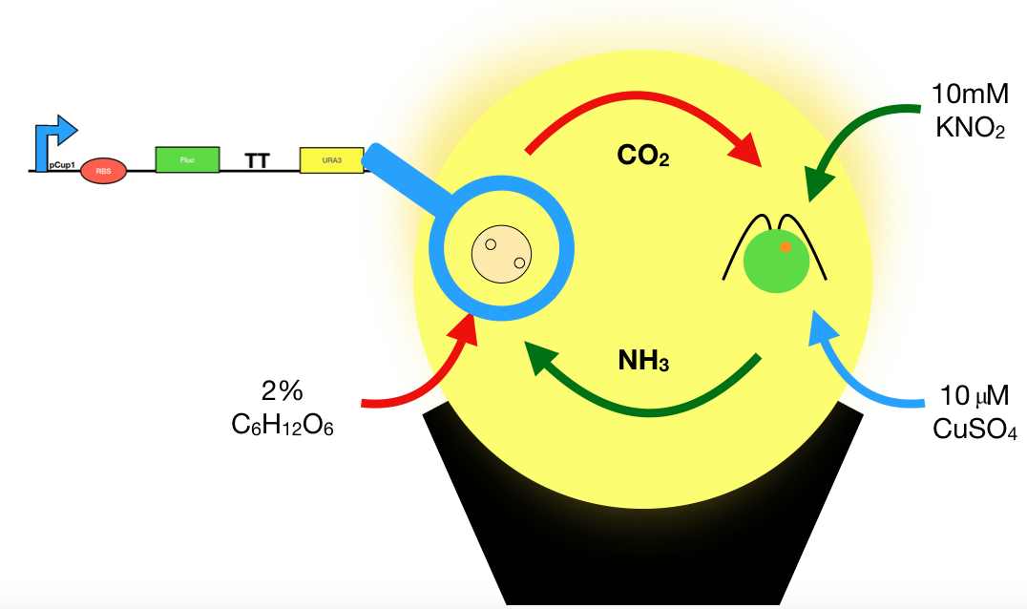
(—THIS SIDEBAR DOES NOT SHOW—)
DESIGN GUIDE
This PowerPoint 2011 template produces a 40.97”X23.04” presentation poster. You can use it to create your research poster and save valuable time placing titles, subtitles, text, and graphics.
We provide a series of YouTube tutorials that will guide you through the poster design process and answer your poster production questions. To view our template tutorials, go online to https://www.youtube.com/playlist?list=PLBz4JvE0AKmweXsMNGeyRXgWgN_lj_b5L
If you are uploading ahead of time, please go to our website:
http://www.eposterboards.com/eposterupload/
Need assistance? Call 617-588-3508 option 2
QUICK START
Title, Authors, and Affiliations
Start designing your poster by adding the title, the names of the authors, and the affiliated institutions. You can type or paste text into the provided boxes. The template will automatically adjust the size of your text to fit the title box. You can manually override this feature and change the size of your text.
TIP: The font size of your title should be bigger than your name(s) and institution name(s). The smallest font size should be 28 points.
Adding Logos / Seals
Most often, logos are added on each side of the title. You can insert a logo by dragging and dropping it from your desktop, copy and paste or by going to INSERT > PICTURES. Logos taken from web sites are likely to be low quality when printed. Zoom it at 100% to see what the logo will look like on the final poster and make any necessary adjustments.
TIP: If there is a conference website, you can pull logos from there. Please keep in my that we will be adding navigational buttons or a kiosk menu button on the right side of the slides. Please make the appropriate space for that.
Photographs / Graphics
You can add images by dragging and dropping from your desktop, copy and paste, or by going to INSERT > PICTURES. Resize images proportionally by holding down the SHIFT key and dragging one of the corner handles. For a professional-looking poster, do not distort your images by enlarging them disproportionally.
QUICK START (cont.)
How to change the template color theme
    You can easily change the color theme of your poster by going to the DESIGN menu, click on COLORS, and choose the color theme of your choice. You can also create your own color theme.
You can also manually change the color of your background by going to VIEW > SLIDE MASTER. After you finish working on the master be sure to go to VIEW > NORMAL to continue working on your poster.
How to add Text
    The template comes with a number of pre-formatted placeholders for headers and text blocks. You can add more blocks by copying and pasting the existing ones or by adding a text box from the HOME menu.
Text size
Adjust the size of your text based on how much content you have to present. The default template text offers a good starting point. The text should not be less than 28 points.
How to add Tables
  To add a table from scratch go to the INSERT menu and
  click on TABLE. A drop-down box will help you select rows and columns.
You can also copy and a paste a table from Word or another PowerPoint document. A pasted table may need to be re-formatted by RIGHT-CLICK > FORMAT SHAPE, TEXT BOX, Margins.
Graphs / Charts
You will have to convert your graphs/charts/formulas/equations into images (.jpg or .png and insert them into your presentation. This will help maintain the values as different operating systems can distort your work.
Save your work
Save your template as a lastname.firstname and as a .pptx file.
AliveLIGHT™: Engineering a natural light generating machine
Cate Barton, Anya Gemos, Meredith Hoole, Jackson Lundberg, Trey Marcantonio, Kenneth Moore, Amy Murrant-Johnson, Naama Perliger, and Ian Wood
Tyngsborough High School BioBuilderClub
Plasmid Design
Luciferin-Luciferase Chemistry
Figure 5.
Luciferase is an enzyme primarily found in species of Lampyridae, Elateridae, and Phengodidae, which are three of the Coleoptera families. Lampyridae, commonly known as fireflies, are a highly studied area which means information required to employ this luciferase is readily available. This luciferin used as a substrate by Lampyridae is commonly referred to as “firefly luciferin,” or D-firefly luciferin, which gets oxidized by luciferase causing it to emit a photon, which creates light. This reaction between luciferase and D-firefly luciferin is an aerobic process that can be represented by the equation:
Figure 4. Final plasmid assembly for genetic construct designed through Benchling.
Figure 5. Custom genetic circuit to create luciferase in the presence of copper.
Figure 6.
Figure 4.
AliveLIGHT © System Level Model
AliveLIGHT © Device Level Model
Before copper (II) enters the cell it is reduced to copper (I). By way of the Cup1 promoter, the copper promotes the transcription of luciferase encoded by the Fluc gene. The luciferase then complexes with the substrate D-luciferin in the presence of ATP and oxygen to generate oxyluciferin and release photons.
We plan to use Chlamydomonas reinhardtii to establish a mutualistic relationship with the genetically modified Saccharomyces cerevisiae. In this artificially engineered symbiosis, the yeast provides the protist with carbon dioxide while the protist provides the yeast with ammonia and oxygen to sustain luciferase output. The system just needs an input of glucose to support the nutritional needs of yeast, potassium nitrite to support the nutritional needs of the protist, and copper sulfate to induce transcription of Fluc.
Figure 7.
Figure 8.

Slide 4
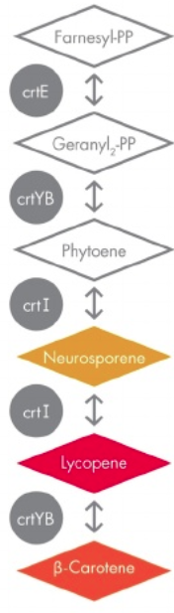

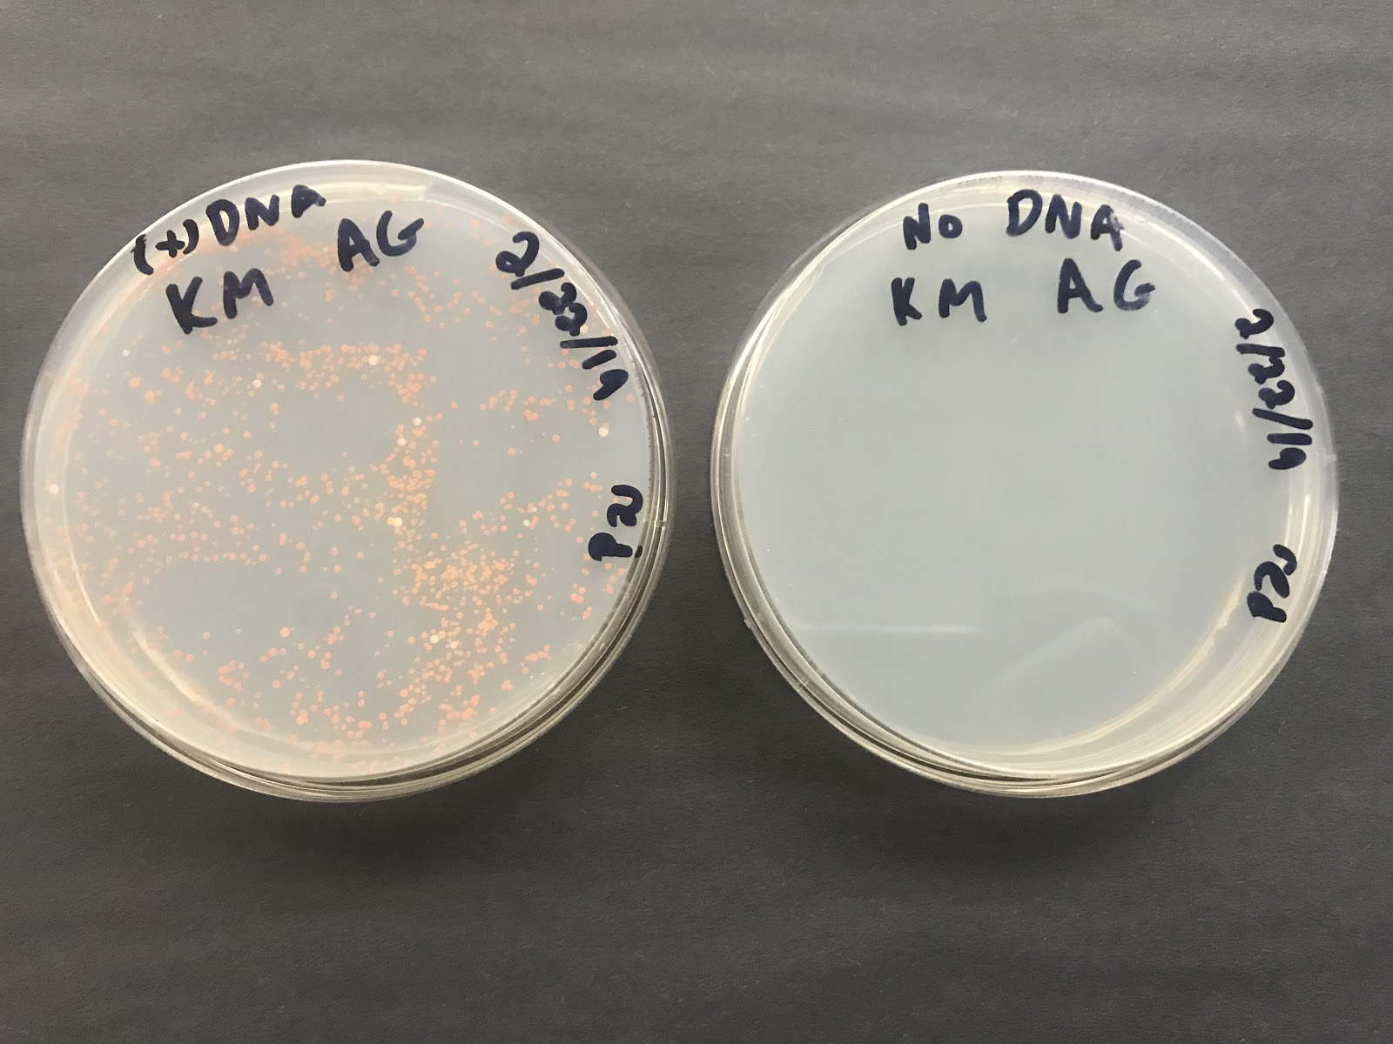
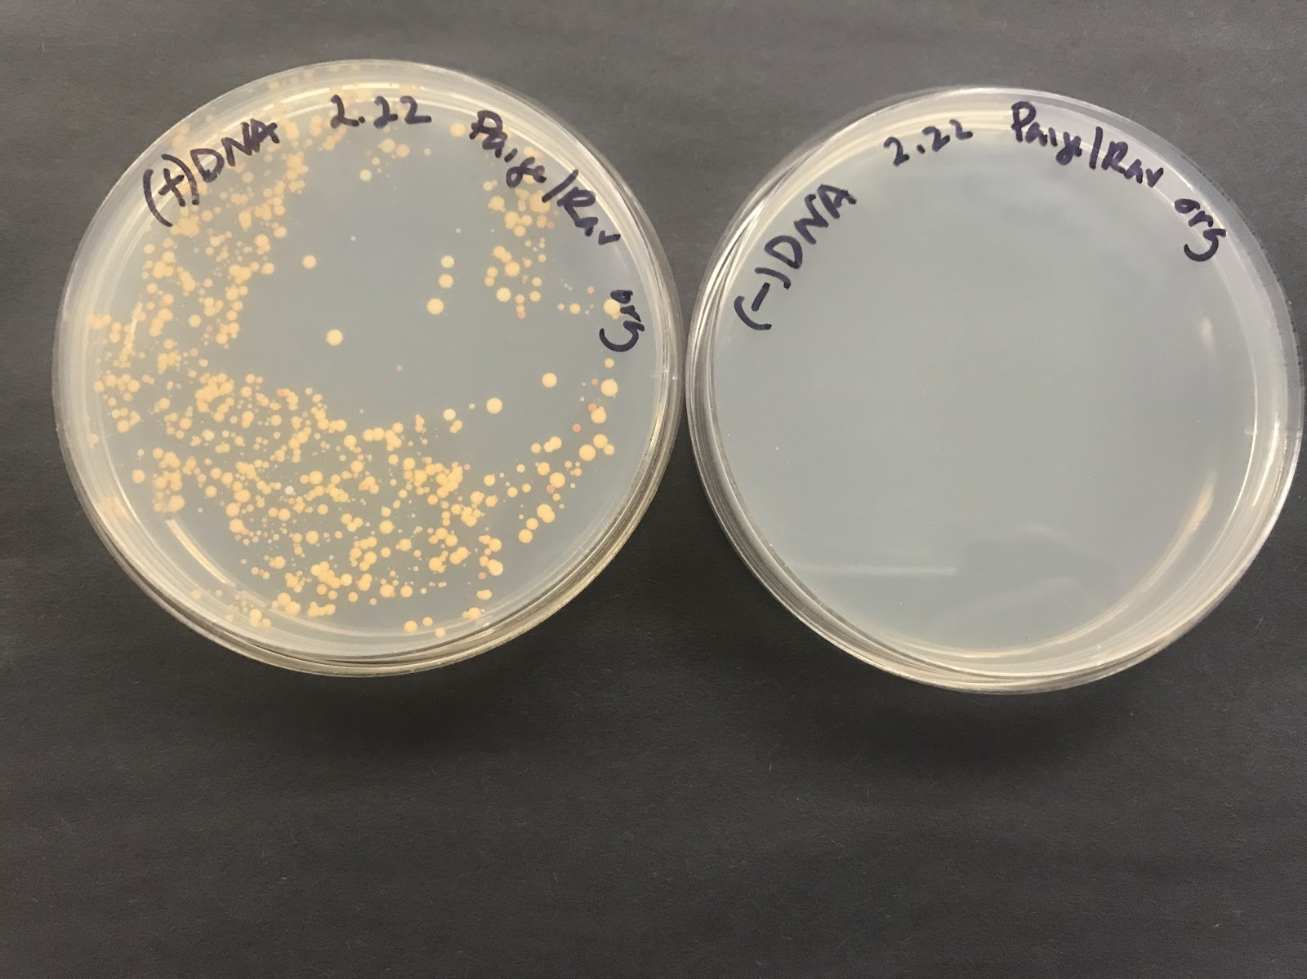
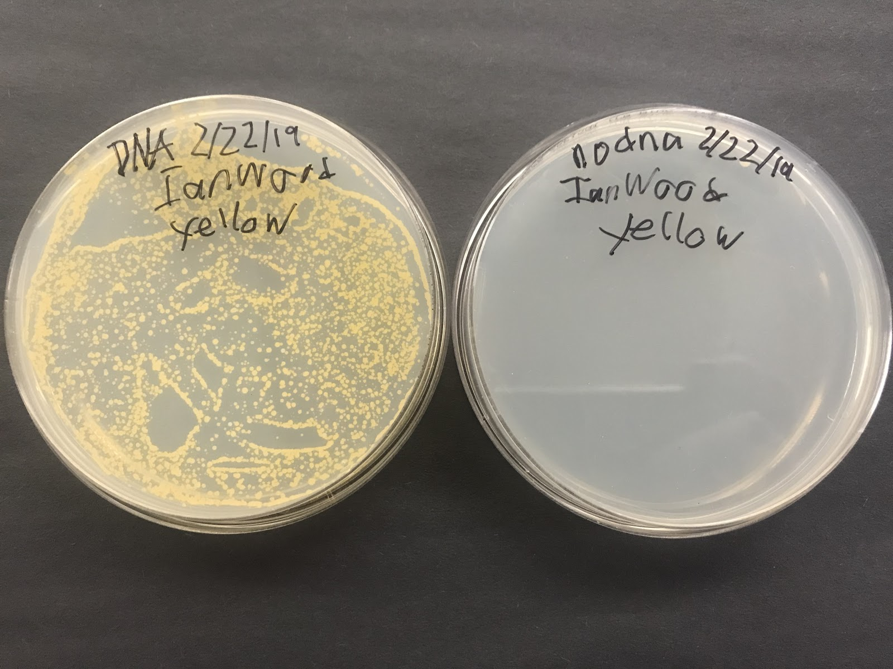
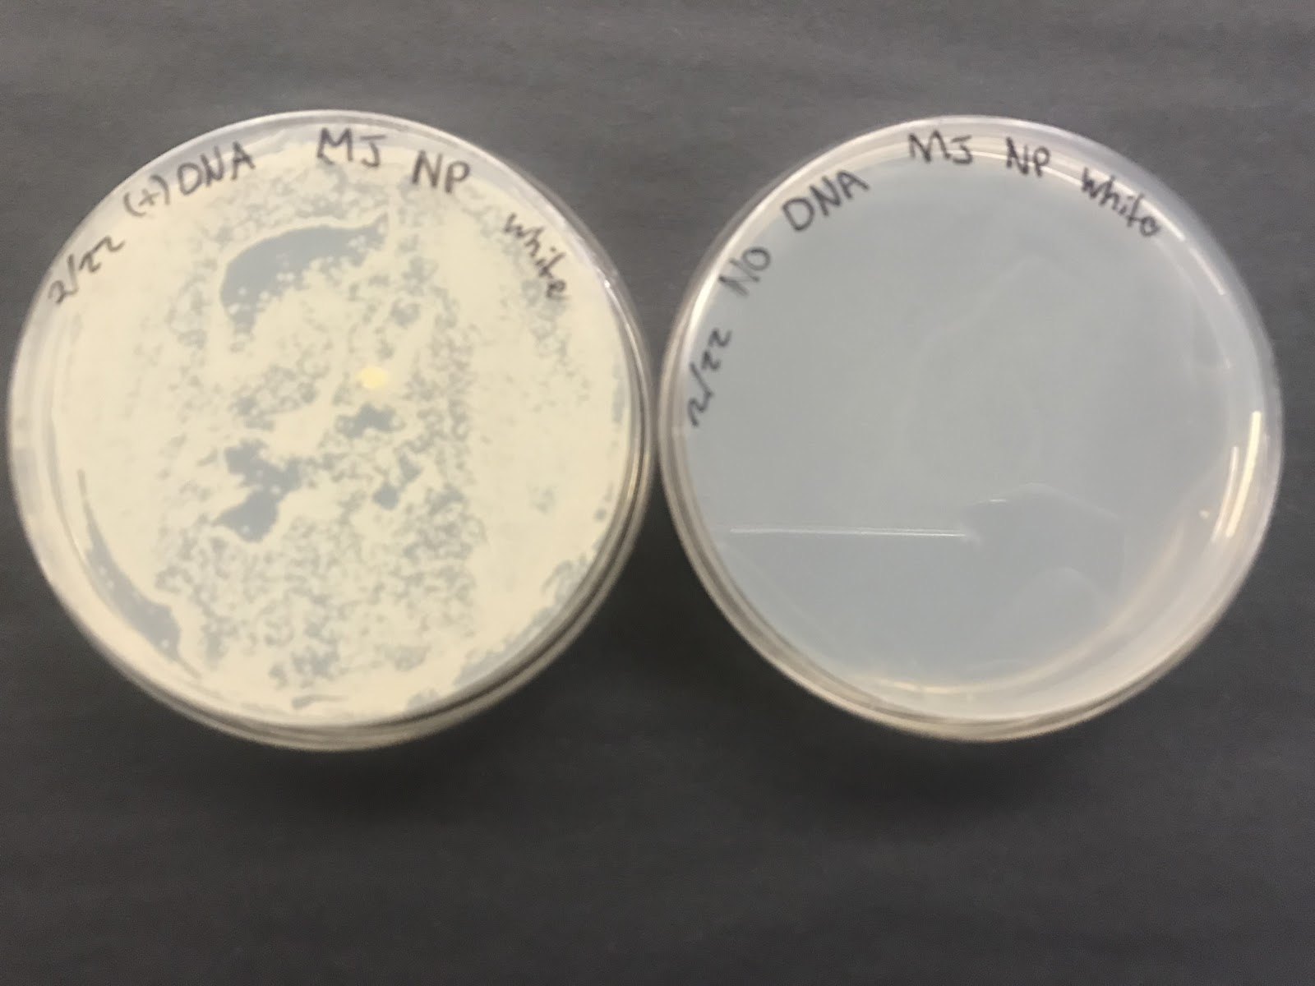
(—THIS SIDEBAR DOES NOT SHOW—)
DESIGN GUIDE
This PowerPoint 2011 template produces a 40.97”X23.04” presentation poster. You can use it to create your research poster and save valuable time placing titles, subtitles, text, and graphics.
We provide a series of YouTube tutorials that will guide you through the poster design process and answer your poster production questions. To view our template tutorials, go online to https://www.youtube.com/playlist?list=PLBz4JvE0AKmweXsMNGeyRXgWgN_lj_b5L
If you are uploading ahead of time, please go to our website:
http://www.eposterboards.com/eposterupload/
Need assistance? Call 617-588-3508 option 2
QUICK START
Title, Authors, and Affiliations
Start designing your poster by adding the title, the names of the authors, and the affiliated institutions. You can type or paste text into the provided boxes. The template will automatically adjust the size of your text to fit the title box. You can manually override this feature and change the size of your text.
TIP: The font size of your title should be bigger than your name(s) and institution name(s). The smallest font size should be 28 points.
Adding Logos / Seals
Most often, logos are added on each side of the title. You can insert a logo by dragging and dropping it from your desktop, copy and paste or by going to INSERT > PICTURES. Logos taken from web sites are likely to be low quality when printed. Zoom it at 100% to see what the logo will look like on the final poster and make any necessary adjustments.
TIP: If there is a conference website, you can pull logos from there. Please keep in my that we will be adding navigational buttons or a kiosk menu button on the right side of the slides. Please make the appropriate space for that.
Photographs / Graphics
You can add images by dragging and dropping from your desktop, copy and paste, or by going to INSERT > PICTURES. Resize images proportionally by holding down the SHIFT key and dragging one of the corner handles. For a professional-looking poster, do not distort your images by enlarging them disproportionally.
QUICK START (cont.)
How to change the template color theme
    You can easily change the color theme of your poster by going to the DESIGN menu, click on COLORS, and choose the color theme of your choice. You can also create your own color theme.
You can also manually change the color of your background by going to VIEW > SLIDE MASTER. After you finish working on the master be sure to go to VIEW > NORMAL to continue working on your poster.
How to add Text
    The template comes with a number of pre-formatted placeholders for headers and text blocks. You can add more blocks by copying and pasting the existing ones or by adding a text box from the HOME menu.
Text size
Adjust the size of your text based on how much content you have to present. The default template text offers a good starting point. The text should not be less than 28 points.
How to add Tables
  To add a table from scratch go to the INSERT menu and
  click on TABLE. A drop-down box will help you select rows and columns.
You can also copy and a paste a table from Word or another PowerPoint document. A pasted table may need to be re-formatted by RIGHT-CLICK > FORMAT SHAPE, TEXT BOX, Margins.
Graphs / Charts
You will have to convert your graphs/charts/formulas/equations into images (.jpg or .png and insert them into your presentation. This will help maintain the values as different operating systems can distort your work.
Save your work
Save your template as a lastname.firstname and as a .pptx file.
AliveLIGHT™: Engineering a natural light generating machine
Cate Barton, Anya Gemos, Meredith Hoole, Jackson Lundberg, Trey Marcantonio, Kenneth Moore, Amy Murrant-Johnson, Naama Perliger, and Ian Wood
Tyngsborough High School BioBuilderClub
Explanation of Results
Figure 9.
Discussion
Four different strains of Saccharomyces cerevisiae were used in this experiment, each expressing a different color. In order to achieve these 4 color variants, β-carotene needs to be expressed. When converting geranylgeranyl diphosphate into β-carotene it requires the use of 2 genes: crtYB and crtI. Xanthophyllomyces dendrorhous naturally expresses red pigmentation due to the metabolic pathway described in Figure 3 below. Since these genes do not occur naturally in Saccharomyces cerevisiae, they had to be introduced into common Baker’s yeast. Each enzyme in the metabolic pathway leading to the production of β-carotene plays a specific role. The gene, crtYB is involved in the early stage production of precursor compounds in this pathway. It converts geranylgeranyl diphosphate into phytoene. The gene, crtI, a catalytic enzyme, converts phytoene into neurosporene (yellow pigment) and then into lycopene (red pigment). During the last step in this pathway crtYB returns to convert lycopene in to β-carotene (orange).
The white color variants are non-biologically engineered yeast. The yellow color variants produce high concentrations of neurosporene, resulting in the yellow coloration. The orange yeast produces large quantities of β-carotene, resulting in the orange coloration. Lastly, the yeast culture manufacturing lycopene in large amounts produces red coloration. When colonies have more than one color present, it leads to the assumption that some of the steps of the pathway have malfunctioned and that the yeast sample is unstable. For the red and orange sample, different colors than originally hypothesized were produced. After a 7 day incubation period, the Petri dish inoculated with the orange variant produced several colonies of all colors, however, the majority were of the orange variety. After a 7 day incubation period, the Petri dish inoculated with the red variant produced several colonies of all colors. Alternatively, the yellow and white yeast cultures produced consistently yellow or white, respectively. However, at day 12, the yellow culture showed signs of contamination with satellite colonies of non-yellow variety on the perimeter of the dish. It can be concluded that the metabolic pathway leading to β-carotene production in Baker’s yeast is unstable for those samples observed to have colony pigment variation. In addition, since some of the engineered yeast have white colonies this means that some of the cells may have lost one or more crt genes.
The purpose of the AliveLIGHT™ system is to produce a safe, long-lasting light source using genetically modified yeast. The objectives for this season were to complete Phases 1 through 3 in the multi-step process described under Methods. Prior to construction of this final product, a consumer analysis survey was administered using a Google form. The total number of respondents participating in this survey was 107, ranging in age from 13 to over 55 years old. In response to the question, “Would you still be interested in this product if you knew that it contained genetically modified yeast?” 46.7% of respondents answered “yes,” 15.9% answered “no” while 37.4% answered “maybe.” This suggests that there is still some uncertainty about purchasing genetically modified products in the marketplace, but many are receptive to the idea. This further suggests that there will be a space, and possible demand, for a product of this nature in the existing market if one remains mindful of the implications related to knowledge about, and acceptance for, genetically modified products.
To move forward in the construction of AliveLIGHT™, the following phases will be executed: 1. Plasmid design, 2. Plasmid assembly, 3. Plasmid integration, 4. Evaluation of luminescence, 5. Niche engineering, and 6. System optimization. Currently, the project is entering the plasmid assembly Phase which will result in the assembly of the final genetic construct (see Figure 5.). This will be accomplished through DNA amplification by performing a polymerase chain reaction followed by Gibson Assembly, and culminating with the introduction of this final genetic assemblage into a Saccharomyces cerevisiae chassis by way of transformation. We will proceed with subsequent phases. Once this process goes as planned, the intention is to incorporate a kill switch into the final system to prevent possible exposure of our engineered system into the environment. Once the phases have been completed, a more sustainable and eco-friendly method for natural luminescence in the form of AliveLIGHT™ will be ready for market.
Figure 10.
Figure 11.
Figure 12.
Figure 13.
Yeast transformation (-trp to +trp) results with color variants (Fig. 10) red, (Fig. 11) orange, (Fig. 12) yellow, and (Fig. 13) white. Plates on right are control.

Slide 5
(—THIS SIDEBAR DOES NOT SHOW—)
DESIGN GUIDE
This PowerPoint 2011 template produces a 40.97”X23.04” presentation poster. You can use it to create your research poster and save valuable time placing titles, subtitles, text, and graphics.
We provide a series of YouTube tutorials that will guide you through the poster design process and answer your poster production questions. To view our template tutorials, go online to https://www.youtube.com/playlist?list=PLBz4JvE0AKmweXsMNGeyRXgWgN_lj_b5L
If you are uploading ahead of time, please go to our website:
http://www.eposterboards.com/eposterupload/
Need assistance? Call 617-588-3508 option 2
QUICK START
Title, Authors, and Affiliations
Start designing your poster by adding the title, the names of the authors, and the affiliated institutions. You can type or paste text into the provided boxes. The template will automatically adjust the size of your text to fit the title box. You can manually override this feature and change the size of your text.
TIP: The font size of your title should be bigger than your name(s) and institution name(s). The smallest font size should be 28 points.
Adding Logos / Seals
Most often, logos are added on each side of the title. You can insert a logo by dragging and dropping it from your desktop, copy and paste or by going to INSERT > PICTURES. Logos taken from web sites are likely to be low quality when printed. Zoom it at 100% to see what the logo will look like on the final poster and make any necessary adjustments.
TIP: If there is a conference website, you can pull logos from there. Please keep in my that we will be adding navigational buttons or a kiosk menu button on the right side of the slides. Please make the appropriate space for that.
Photographs / Graphics
You can add images by dragging and dropping from your desktop, copy and paste, or by going to INSERT > PICTURES. Resize images proportionally by holding down the SHIFT key and dragging one of the corner handles. For a professional-looking poster, do not distort your images by enlarging them disproportionally.
QUICK START (cont.)
How to change the template color theme
    You can easily change the color theme of your poster by going to the DESIGN menu, click on COLORS, and choose the color theme of your choice. You can also create your own color theme.
You can also manually change the color of your background by going to VIEW > SLIDE MASTER. After you finish working on the master be sure to go to VIEW > NORMAL to continue working on your poster.
How to add Text
    The template comes with a number of pre-formatted placeholders for headers and text blocks. You can add more blocks by copying and pasting the existing ones or by adding a text box from the HOME menu.
Text size
Adjust the size of your text based on how much content you have to present. The default template text offers a good starting point. The text should not be less than 28 points.
How to add Tables
  To add a table from scratch go to the INSERT menu and
  click on TABLE. A drop-down box will help you select rows and columns.
You can also copy and a paste a table from Word or another PowerPoint document. A pasted table may need to be re-formatted by RIGHT-CLICK > FORMAT SHAPE, TEXT BOX, Margins.
Graphs / Charts
You will have to convert your graphs/charts/formulas/equations into images (.jpg or .png and insert them into your presentation. This will help maintain the values as different operating systems can distort your work.
Save your work
Save your template as a lastname.firstname and as a .pptx file.
AliveLIGHT™: Engineering a natural light generating machine
Cate Barton, Anya Gemos, Meredith Hoole, Jackson Lundberg, Trey Marcantonio, Kenneth Moore, Amy Murrant-Johnson, Naama Perliger, and Ian Wood
Tyngsborough High School BioBuilderClub
References
Print Literature:
Gould, S.J., & Subramani, S. (1988). “Firefly luciferase as a tool in molecular and cell biology.” Anal. Biochem.175(5)-13.
Koller, A., Valesco, J., & Subramani, S. (2000). “The CUP1 promoter of Saccharomyces cerevisiae is inducible by copper in Pichia pastoris.” Yeast, 16, pp. 651-656.
Kuldell el al. (2015). “BioBuilder Synthetic Biology in the Lab.” O’Reilly. 1, pp. 187-204.
Lee, et al. (2015). “A highly characterized yeast toolkit for modular, multipart assembly.” ACS Synthetic Biology,4, pp. 975-986.
Marjorette et al. (2000). “Characterization of Saccharomyces cerevisiae High Affinity Copper Transporter Ctr3.” Journal of Biological Chemistry. 275, pp. 33244-33251.
Mazo-Vargas et al. (2014). “Measuring fast gene dynamics in single cells with time-lapse luminescence microscopy.” Molecular Biology of the Cell, 25, pp. 3699-3708.
Parsell et al. (1994). “Protein disaggregation mediated by heat-shock protein Hspl04”. Nature International Journal of Science, pp.475-478.
Richard, A., Dennis, J. (2012). “Copper at the Front Line of the Host-Pathogen Battle.” PLOS Pathogens. 8, pp.1-4.
Wu et al. (2009). “Copper Transport Activity of Yeast Ctr1 is Down-regulated via Its C Terminus in Response to Excess Copper.” Journal of Biology Chemistry. 284, pp. 4112-4122.
Electronic Literature:
Ahrens, M. (2017, December). “Home candle fires.” Retrieved March 7, 2019, from https://www.nfpa.org/News-and-Research/Data-research-and-tools/US-Fire-Problem/Candles.
Arnone, M., Gache, C. (2004). "Development of Sea Urchins, Ascidians, and Other Invertebrate Deuterostomes: Experimental Approaches." Science Direct. Retrieved from https://www.sciencedirect.com/topics/agricultural-and-biological-sciences/photinus-pyralis
Branchini, B. R. (2013, August 02). “CHEMISTRY OF FIREFLY BIOLUMINESCENCE.”. Retrieved from, http://photobiology.info/Branchini2.html
Editors of Encyclopedia of Britannica. (2018). "Bioluminescence CHEMICAL REACTION." Encyclopedia Britannica. Retrieved from https://www.britannica.com/animal/Photinus-pyralis
Leskinen, P., et al. “One‐Step Measurement of Firefly Luciferase Activity in Yeast.” The Canadian Journal of Chemical Engineering, Wiley-Blackwell, Retrieved from, onlinelibrary.wiley.com/doi/full/10.1002/yea.1024.
McKenzie, J. (n.d.). "Photinus pyralis."Animal Diversity Web. Retrieved from, https://animaldiversity.org/accounts/Photinus_pyralis/
Ratini, M. (Ed.). (2017, November 13). "What Is Yeast and What Can It Do?" WebMd. Retrieved from, https://www.webmd.com/diet/ss/slideshow-yeast-and-your-body
Zyga, L. (2010, January 07). “Scientists investigate how fireflies emit different colors of light.” Retrieved from https://phys.org/news/2010-01-scientists-fireflies-emit.html

